Slide 1
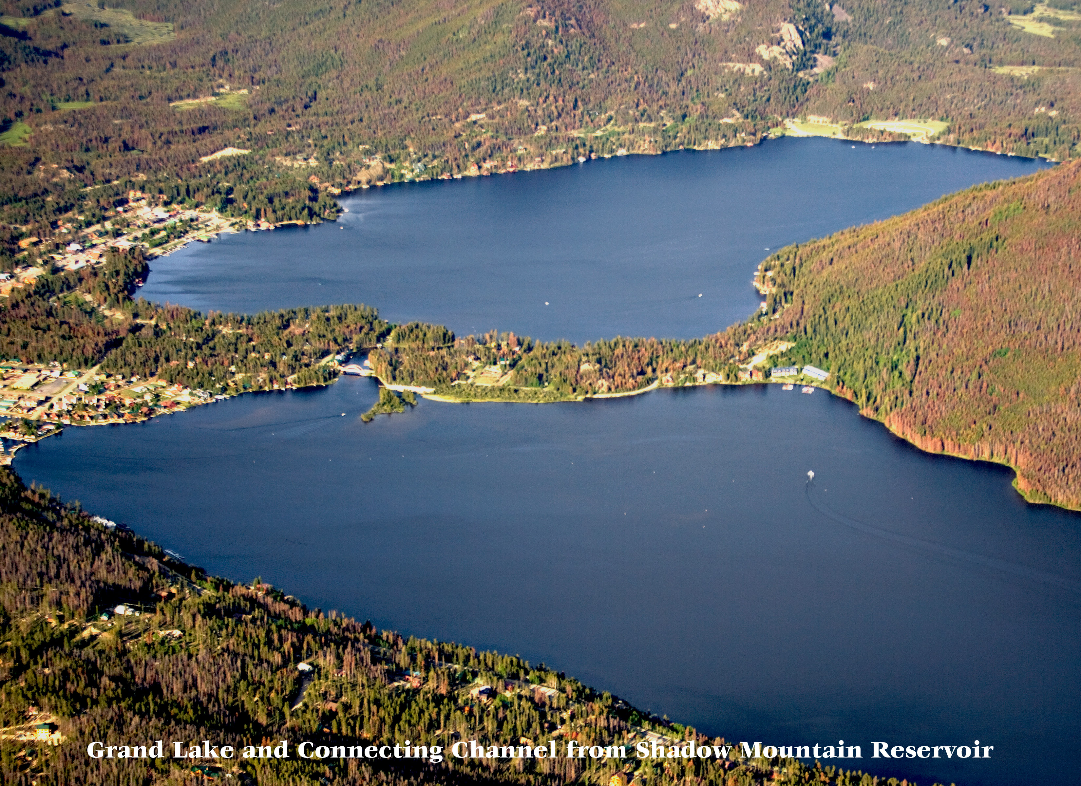
Northern Water
208 Plan Revisions - Grand Lake Outstanding Waters Designation Proposal
July 27, NWCCOG Hearing

Slide 2
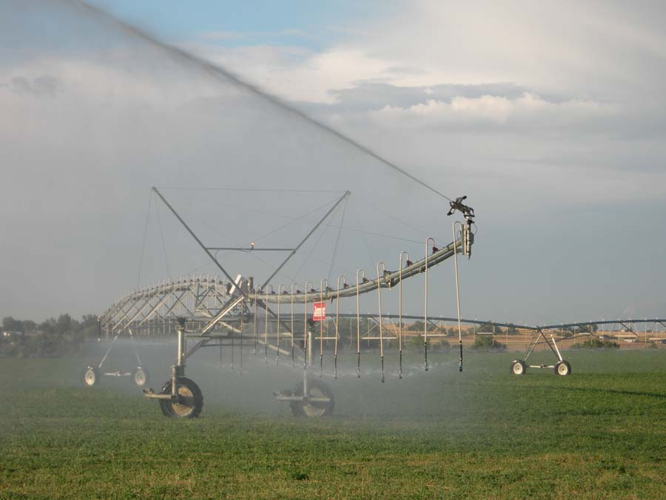
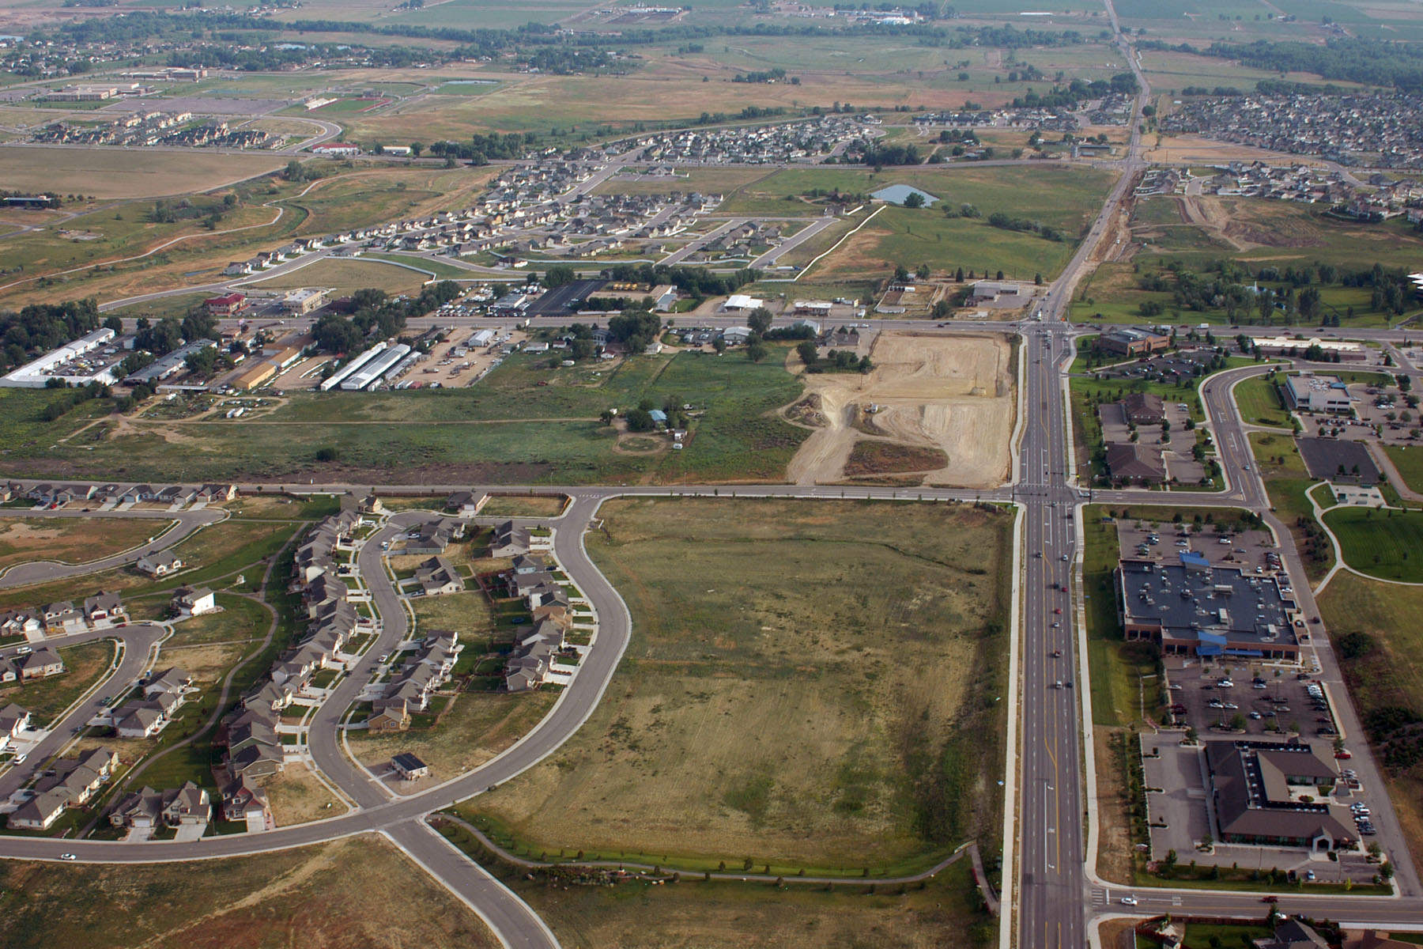
Who we are
Raw water provider for Northern Colorado’s Front Range since 1937
Serve 925,000+ people and provide irrigation water for 1.6 million acres
Reclamation owns most of the C-BT Facilities
Jointly operate and maintain C-BT Project with Reclamation

Slide 3
WATER COLLECTION AND DISTRIBUTION SYSTEMS

Slide 4
C-BT Operations
Overview

Slide 6
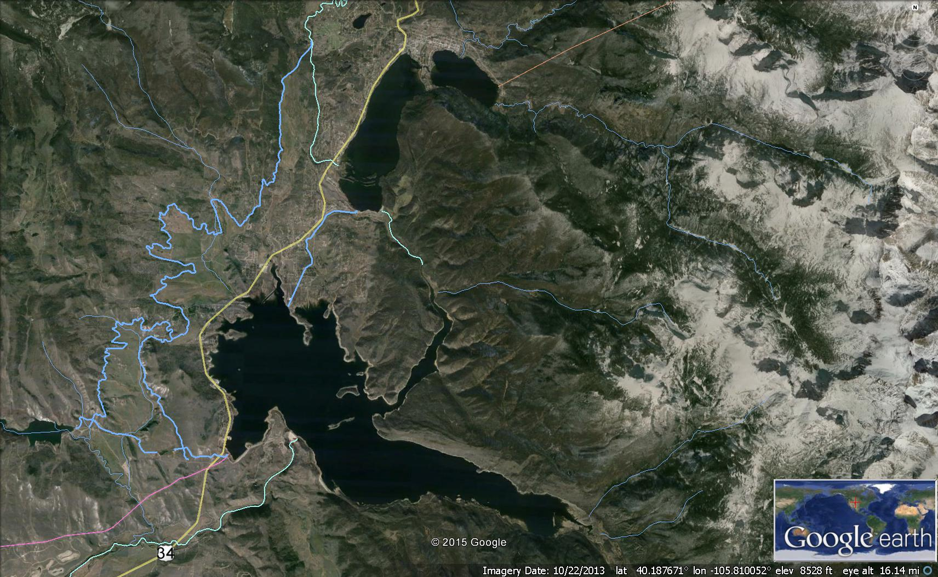
ADAMS TUNNEL
Grand Lake
Shadow Mountain Reservoir
Granby Reservoir
DURING RUNOFF

Slide 7
ADAMS TUNNEL
Grand Lake
Shadow Mountain Reservoir
Granby Reservoir
DIVERSION TO EAST SLOPE

Slide 8
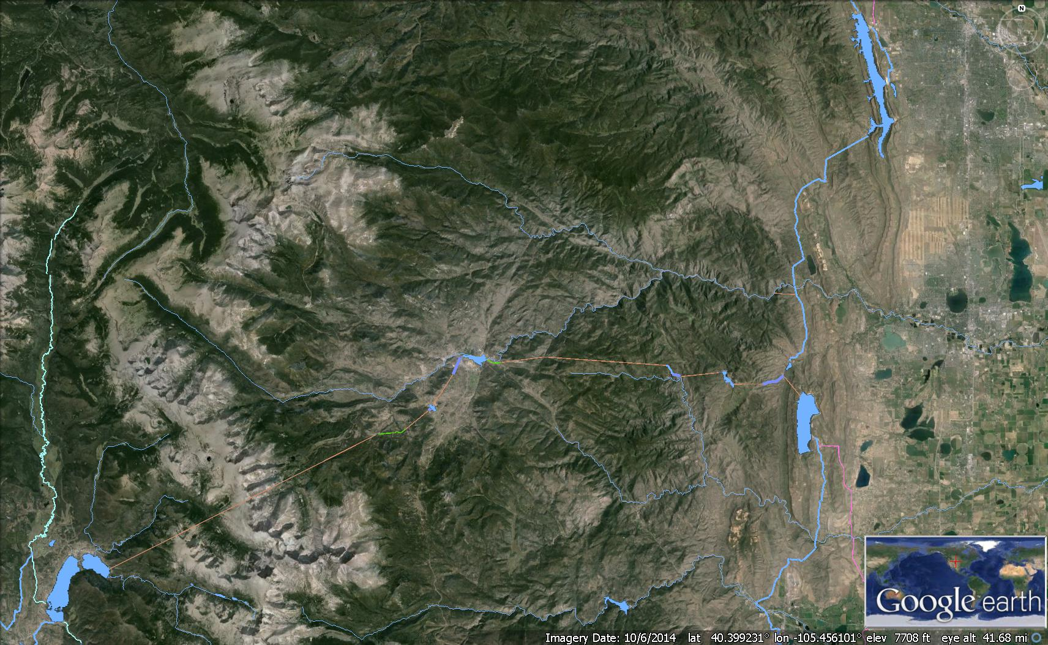
Horsetooth Reservoir
Lakes Estes
Big Thompson River
ADAMS TUNNEL
OLYMPUS TUNNEL
Carter Lake

Slide 9
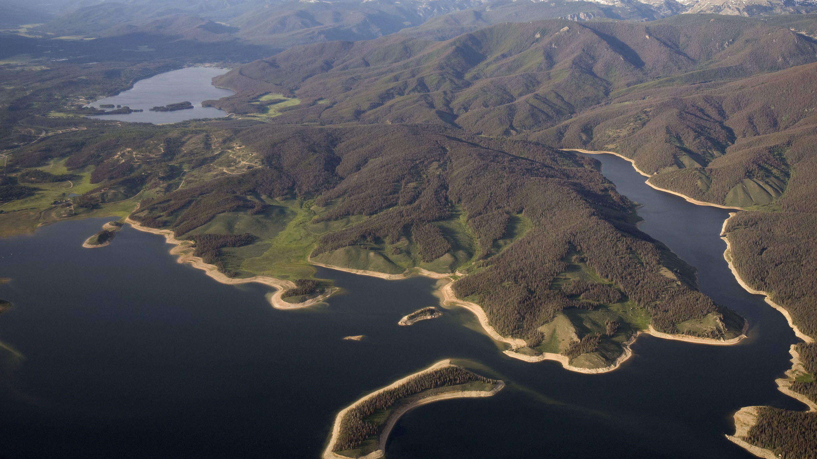
Grand Lake Clarity and C-BT

Slide 10
Senate Document 80 (Primary Purposes*)
To preserve the vested and future rights in irrigation.
To preserve the present surface elevations of the water in Grand Lake and to prevent a variation in these elevations greater than their normal fluctuation.
To so conserve and make use of these waters for irrigation, power, industrial development, and other purposes, as to create the greatest benefits.
To maintain conditions of river flow for the benefit of domestic and sanitary uses of this water.
To preserve the fishing and recreational facilities and the scenic attractions of Grand Lake, the Colorado River, and the Rocky Mountain National Park.
*listing order does not indicate ranking of importance

Slide 11
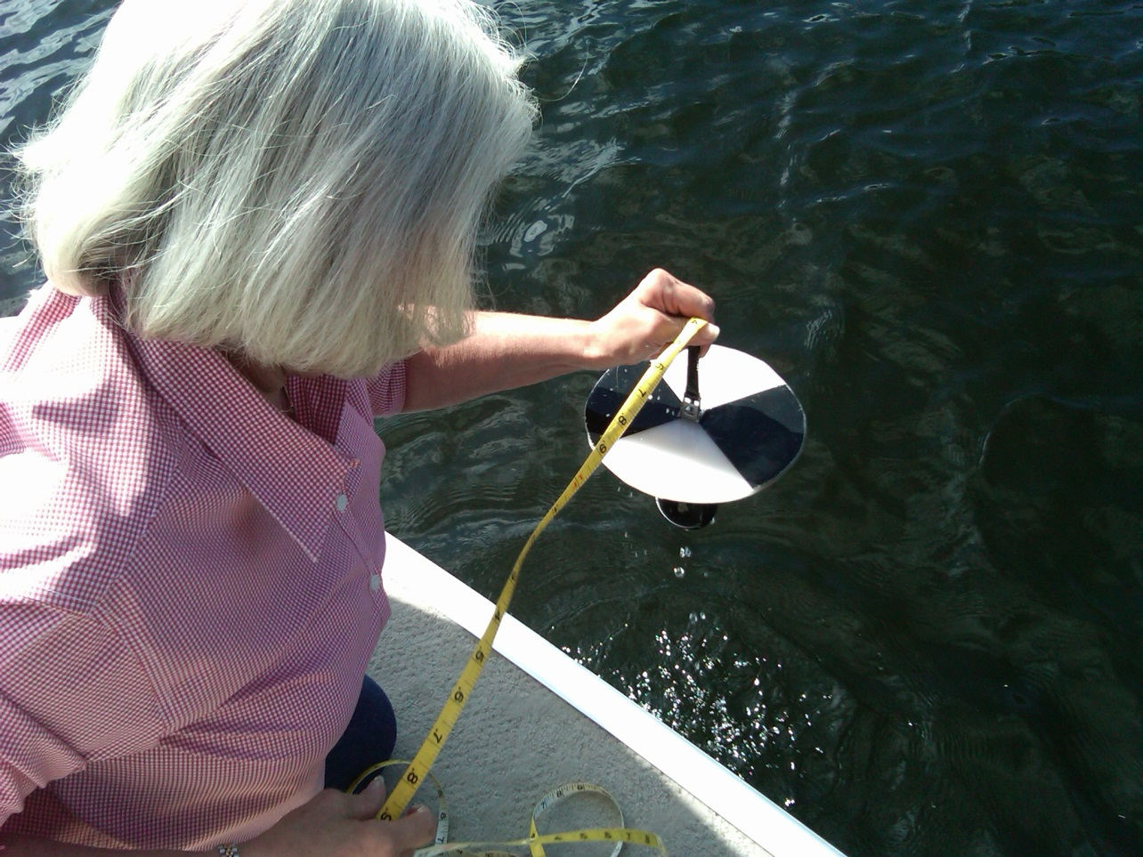
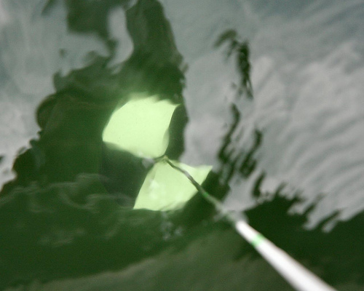
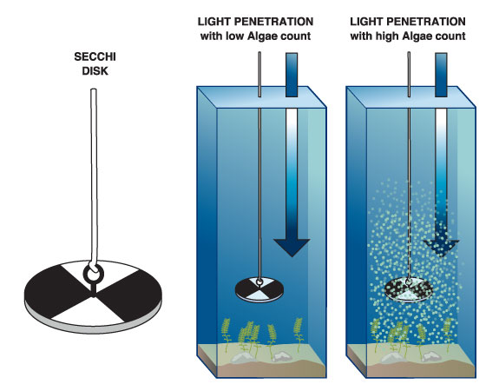
Clarity & Secchi
with low particles
with high particles

Slide 12
9.2 m Sep 1941
Pre-CBT

Slide 13
Grand lake Clarity Standard

Slide 14
2005
C-BT Nutrient Project Kick Off
2008
Hearing #1: Narrative criteria + Delayed numeric standard
2014
Hearing #2: Three Lakes water quality constraints added
2016
Hearing #3: Numeric Standard Repealed + Adaptive Management adopted
2016
First Year of Adaptive Management
2017
Clarity Alternatives NEPA Kick Off
13 YEARS

Slide 15
Cooperating Agencies (21)
USBR (Lead)
USACE
EPA
Federal Highways
RMNP
FWS
USFS
USGS
WAPA
WQCD
DNR
CDOT
River District
Grand County
Estes Valley Rec & Park
Larimer County
Middle Park Cons Dist
Northern Water
NWCCOG
PRPA
Estes Park
Grand Lake
8 Federal
3 State
10
Local Government

Slide 16
13 years to build trust, reach agreements and develop collaboration to start evaluating solutions

Slide 17
WATER QUALITY COMMITMENTS
C-BT Supplement 10 – Evaluate alternatives to improve clarity to meet the applicable clarity standard
Clarity Adaptive Management MOU
Extensive on-going water quality monitoring and reporting (WGFP)

Slide 18
Water quality in the Three Lakes is complex
…an interconnected system

Slide 19
Three Lakes Configuration
Shadow Mtn.
Reservoir
Grand Lake
SMR Release
Granby Reservoir
Adams Tunnel
Connecting Channel
Granby Pump Canal
River

Slide 20
GRAND LAKE
SHADOW MOUNTAIN RESERVOIR

Slide 21
Shadow Mountain Reservoir Delta
Sep 8, 2011

Slide 22
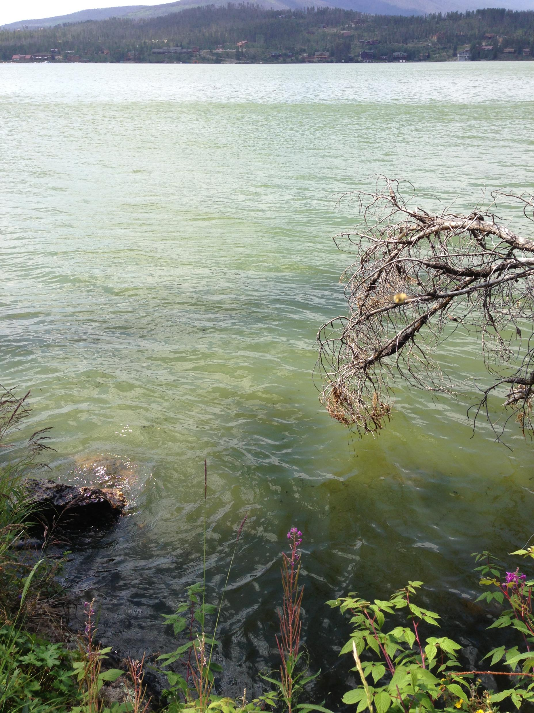
Algae

Slide 23
Aquatic Plants

Slide 24
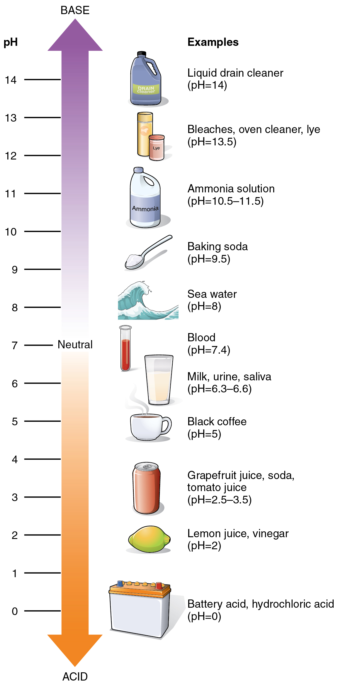
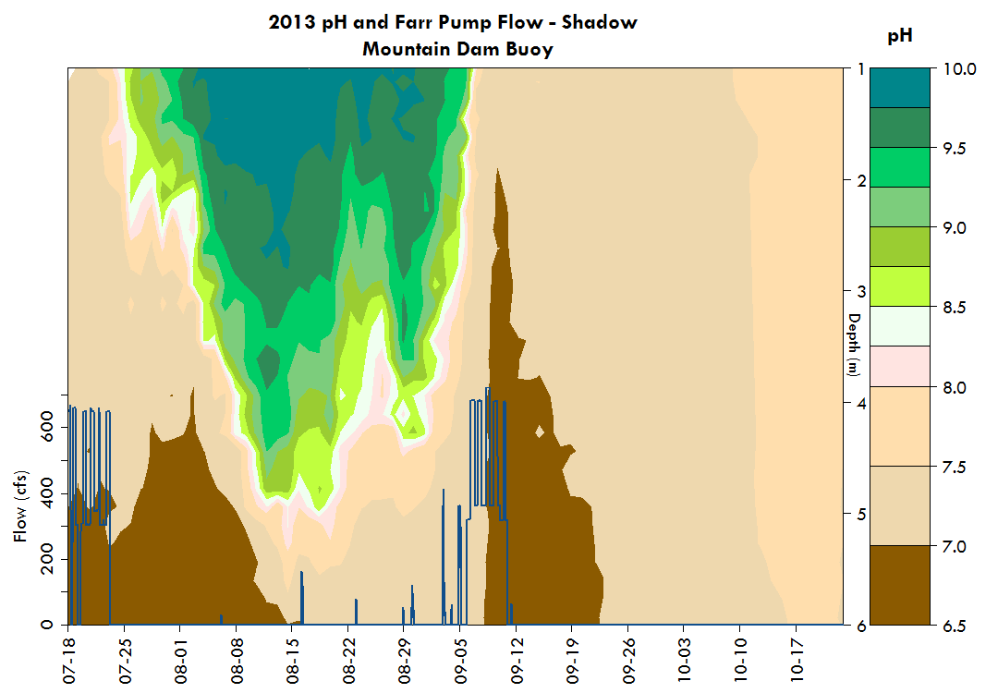
pH in Shadow Mountain Reservoir

Slide 25
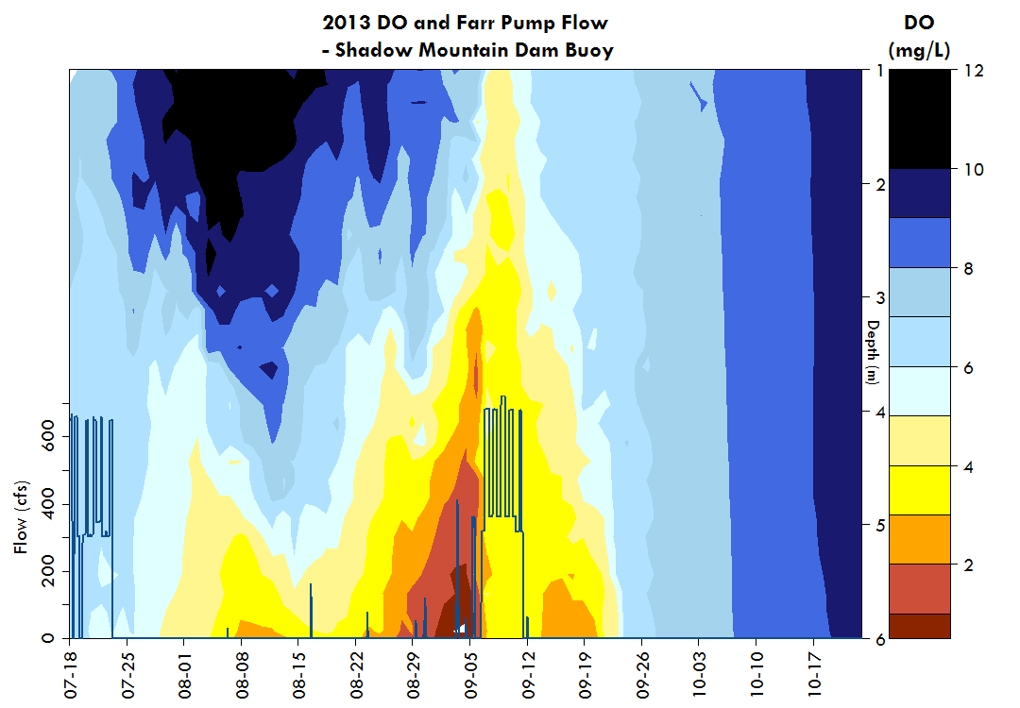
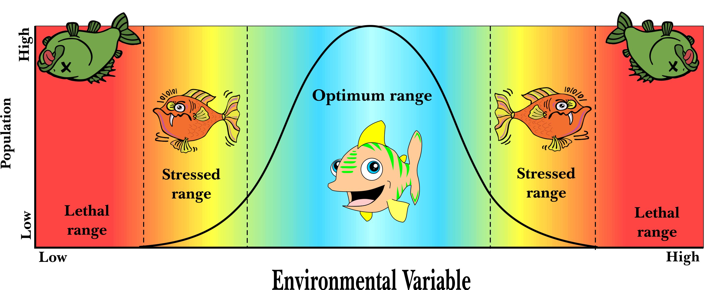
DO in Shadow Mountain Reservoir
6
Dissolved Oxygen

Slide 26
Grand Lake, Aug 28 2013
Shadow Mountain Reservoir, Aug 28 2013
WATER QUALITY TRADE OFFS

Slide 27
Water quality dynamics are very complex. Water quality objectives in Grand Lake and Shadow Mountain Reservoir are often at odds.

Slide 28
Conclusion
Outstanding water designation is a significant distraction from existing efforts that stretches limited resources to improve Grand Lake clarity
Proposal will likely complicate existing processes that work to improve Grand Lake clarity
Proposal threatens years of collaborative work and efforts to develop trust and cooperation
Designation is unnecessary to protect Grand Lake in light of existing agreements and commitments
Allow existing efforts to play out and move forward without unnecessary obstructions
Reclamation’s NEPA process will determine what alternatives are feasible
Notes:
….

Slide 29
Questions? Comments?
Esther Vincent, PE
Water Quality Manager
evincent@northernwater.org
970 622-2356
Data, reports and more detailed information available online:
http://www.northernwater.org/WaterQuality/WaterQuality.aspx

