Slide 1
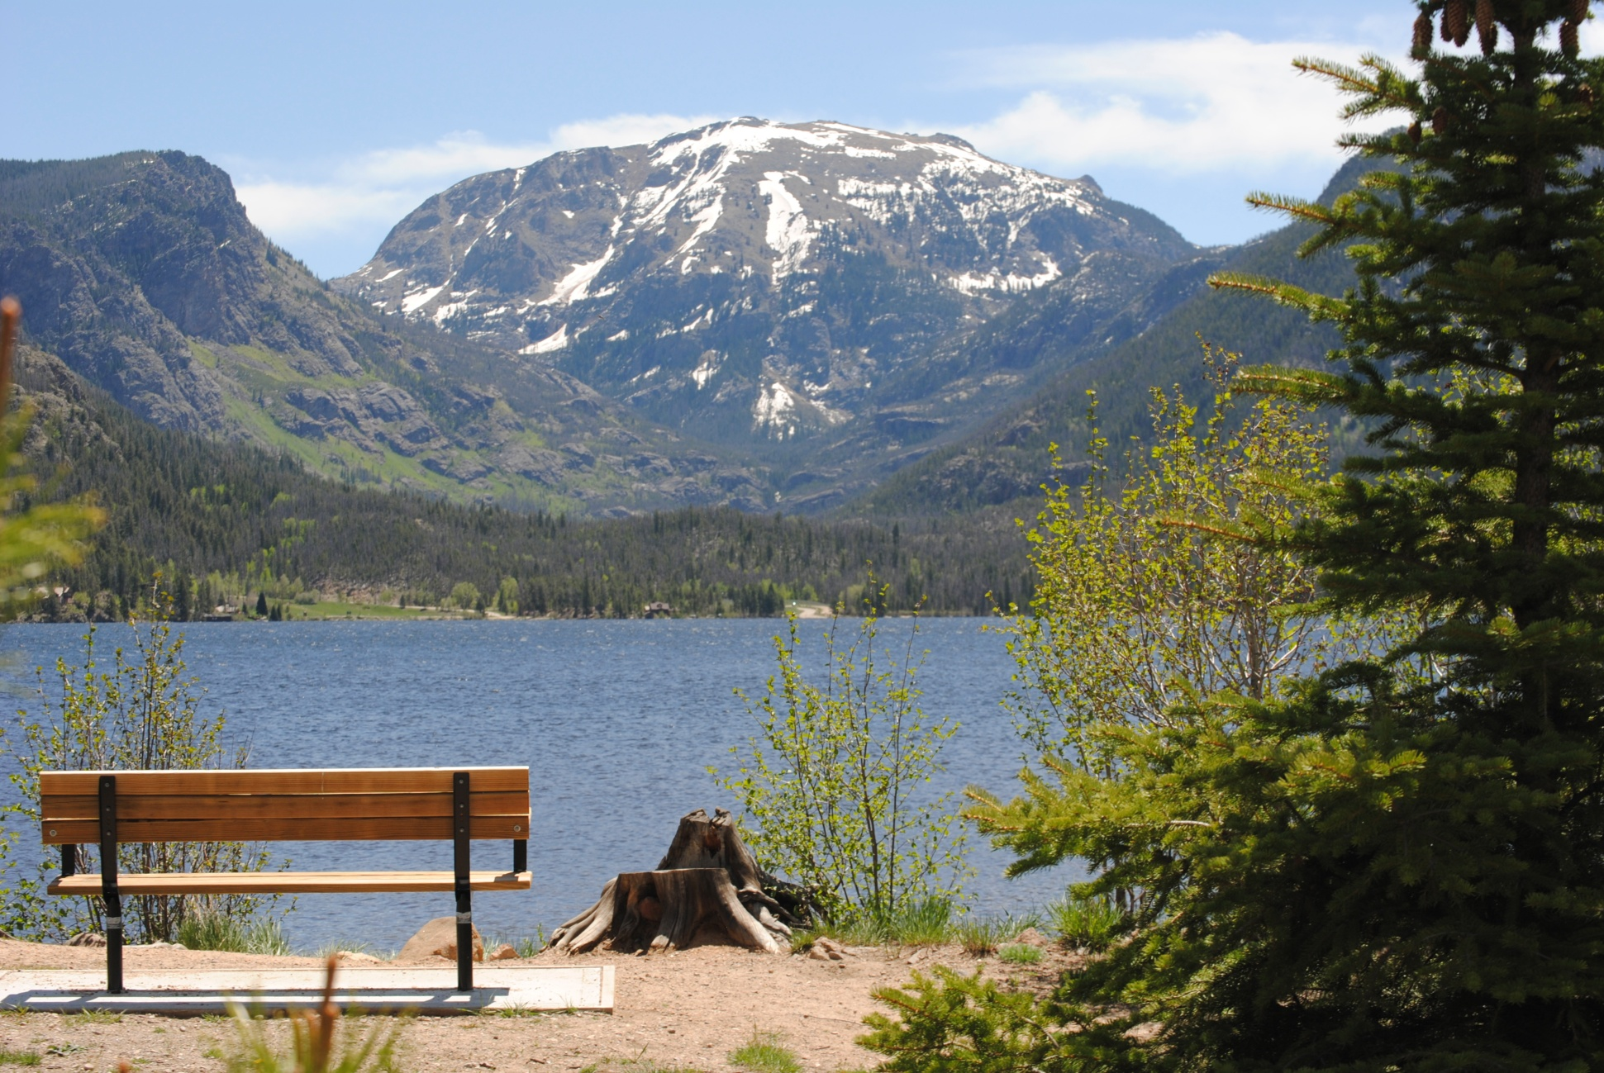
Outstanding Grand Lake

Slide 2
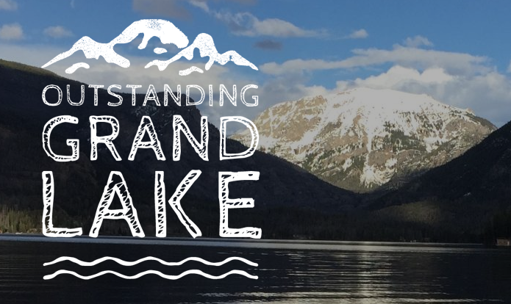
Mission: “Promote sustainable development through environmental education and eco-tourism, recognizing that a healthy lake and surrounding watershed are essential to our thriving business community.”

Slide 3
Outstanding Grand Lake Foundation*
Outstanding Grand Lake Foundation is the nonprofit arm of the Grand Lake Chamber of Commerce, with four areas of focus:
1. Increase watershed awareness in Three Lakes Area including the North Fork of the Colorado River, including Rocky Mountain National Park and the Arapaho National Recreation Area.
2. Promote eco-tourism and a sustainable, eco-friendly local economy. Watershed education programs in Visitor Center and in the field.
3. Secure Grand Lake designation as an “Outstanding Water” as part of branding and further protection of Grand Lake’s essential integrity.
4. Develop cadre of “water keepers” through an Adopt a Stream/Shore effort, school participation, and other community science programs.

Slide 4
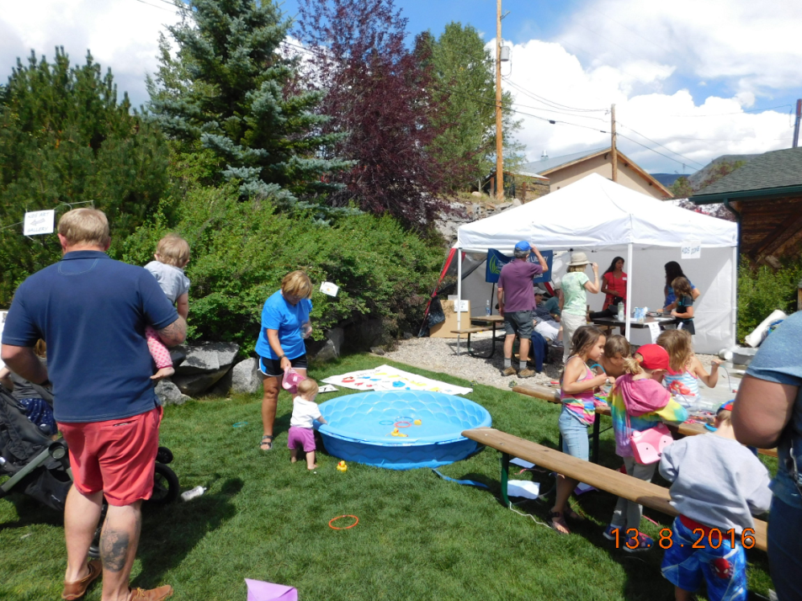
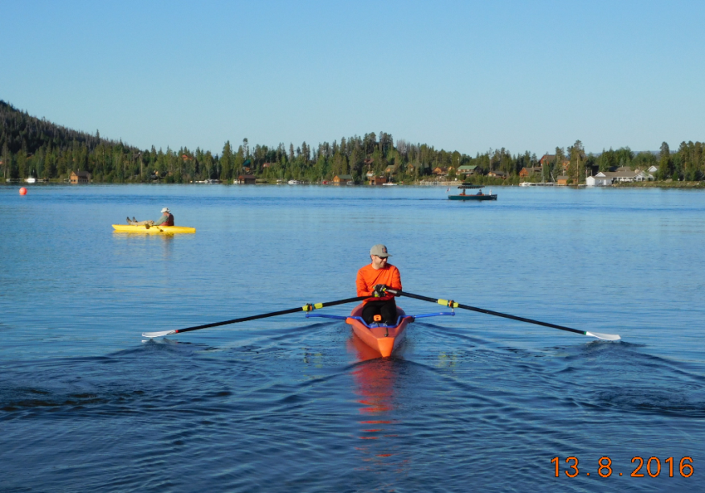
Support for Outstanding Grand Lake
501(c)(3) with a formal Board of Directors consisting of educators, scientists, business owners and lakefront homeowners.
OGLF represents the voices of nearly 2,000 supporters.

Slide 5
Signed Letters of Support From:
Town of Grand Lake
Columbine Lake HOA
KC Becker, House Majority Leader
Colorado Headwaters Land Trust
Infinite West
Shadowcliff
UCRWG
Grand Environmental Services

Slide 6
What are Outstanding Waters?
Outstanding Waters is a designation given to a water body by the state of Colorado through the Colorado Water Quality Control Commission; the state has primacy on this. It is not federal.
Criteria for designation are found in REGULATION NO. 31 - THE BASIC STANDARDS AND METHODOLOGIES FOR SURFACE WATER and specifically 5 CCR 1002-31.8(2)(a)
The designation as an Outstanding Water requires compliance with three provisions:
(1) meeting certain water quality parameters,
(2) having exceptional recreational or ecological significance, and has not been modified by human activities in a manner that substantially detracts from their value as a natural resource, and
(3) requiring protection in addition to that provided by the combination of water quality classifications and standards and the protection afforded reviewable water under section 31.8(3).

Slide 7
Outstanding Water: Criterion 1
The existing quality for each of the following parameters is equal to or better than that specified in Tables I, II, and III for the protection of aquatic life class 1, recreation class P and (for nitrate) domestic water supply uses:
Table I: dissolved oxygen, pH, E. coli
Table II: chronic ammonia, nitrate
Table III: chronic cadmium, chronic copper, chronic lead, chronic manganese, chronic selenium, chronic silver, and chronic zinc

Slide 8
“Existing Water Quality”
The determination of existing quality shall be based on adequate representative data
Data must be available for each of the 12 parameters listed; provided, that if E. coli samples from within the segment are infeasible due to its location, and a sanitary survey demonstrates that there are no human sources present that are likely to impact quality in the segment in question, E. coli data will not be required.
“Existing quality” shall be
the 85th percentile of the data for ammonia, nitrate, and dissolved metals,
the 50th percentile for total recoverable metals,
the 15th percentile for dissolved oxygen,
the geometric mean for E. coli, and
the range between the 15th and 85th percentiles for pH.

Slide 9
Table 1
Parameter | CLASS E (Existing Primary Contact) | CLASS P (Potential Primary Contact Use) | CLASS 1 COLD WATER BIOTA | Domestic Water Supply
D.O. (mg/l)(1)(9) | 3.0 | 3.0 | 6.0 7.0(spawning) | 3.0
pH (Std. Units)(3) | 6.5–9.0 | 6.5–9.0 | 6.5–9.0 | 5.0–9.0
E. coli per 100 ml | 126(7) | 205(7) |  | 630

Slide 10
Table 2: Inorganic Parameters
Parameter | CLASS 1 Cold Water Biota | Domestic Water Supply
Nitrate (mg/l as N) | - | 10(4) (1-day)
Ammonia | chronic = elsp Calculated: 3.4 mg/l
The highest nitrate value recorded between 2013 and 2016 at the surface
and bottom locations at GL-ATW and GL-MID was approximately two orders
of magnitude below the standard.
The highest ammonia value measured between 2013 and 2016 was 0.017
mg/l.

Slide 11
Table 3: Metals (ug/l)
Metal | Chronic Level | Standard
Cadmium | (1.101672-[ln(hardness) x(0.041838)] x e^{0.7998[ln(hardness)]}-4.4451 | 0.14
Copper | e ^{(0.8545[ln(hardness)] -}1.7428) | 2.5
Lead | (1.46203-[(ln(hardness)* (0.145712)])*e^{(1.273[ln(hardness)]-4.705)} | 0.49
Manganese | e^{(0.3331[ln(hardness)]+5.8743)} | 1008
Selenium | 4.6 | 4.6
Silver | (Trout) = e(1.72[ln(hardness)]-10.51) | 0.006
Zinc | 0.986*e^{(0.9094[ln(hardness)]+0.6235)} | 31.6

Slide 12
Metals

Slide 13
Metals

Slide 14
Dissolved Oxygen
In the lower portion of a lake
or reservoir, dissolved oxygen
may be less than the
applicable standard as long
as there is adequate refuge.

Slide 15
Criteria 2: Recreational or Ecological Significance
Ecologically significant as Colorado’s largest and deepest natural lake and a defining feature of Rocky Mountain National Park’s Kawuneeche Valley.
Home to the highest elevation yacht club in the world.
World class recreation is central to the economy and community of Grand Lake.
Tourism destination for over 100 years as the Western Gateway to Rocky Mountain National Park.
A headwater lake fed by the Outstanding Waters within Rocky Mountain National Park.
Federal Lands Livability Initiative stated that Grand Lake is of great recreational significance in their 2014 Gateway Community Livability Assessment & Recommendations Report.

Slide 16
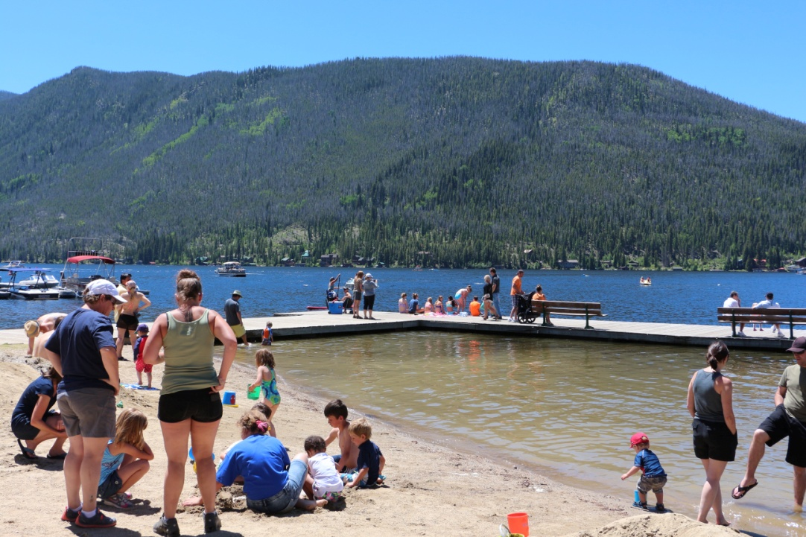
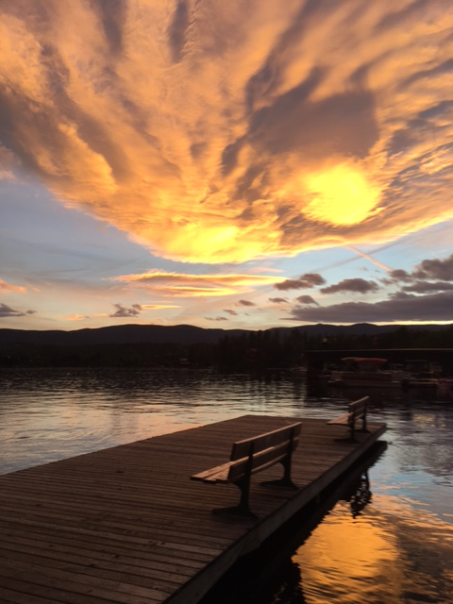
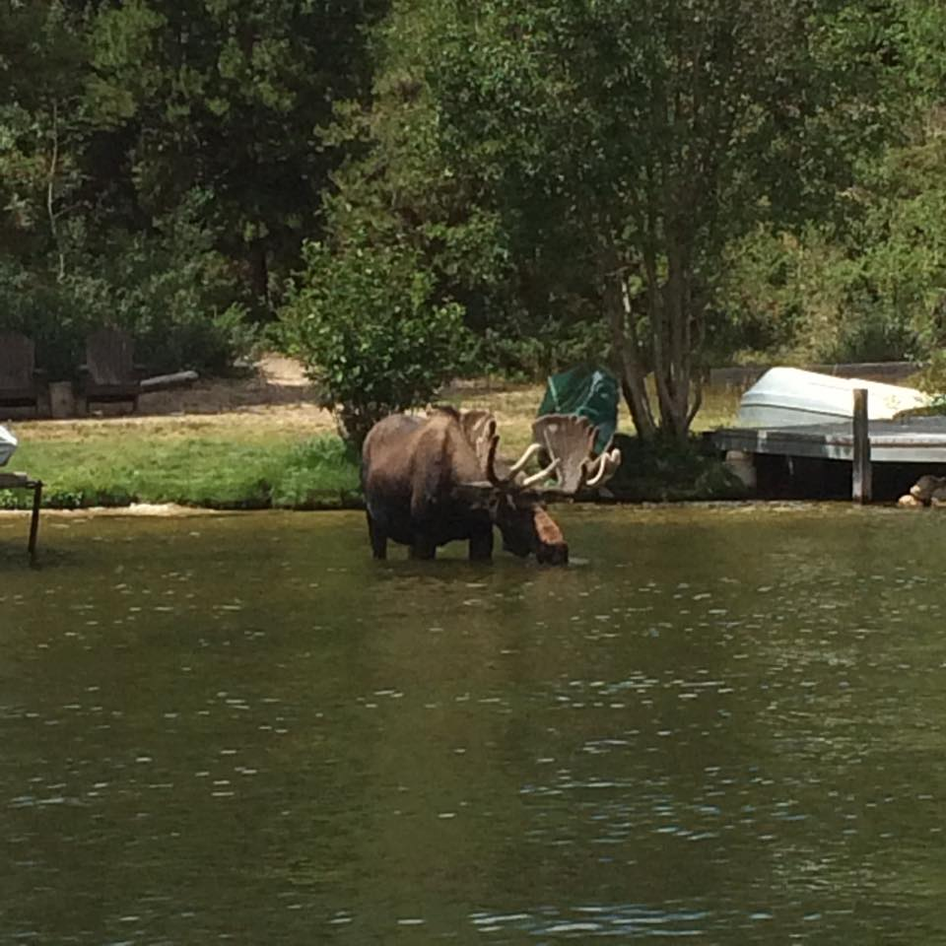

Slide 17
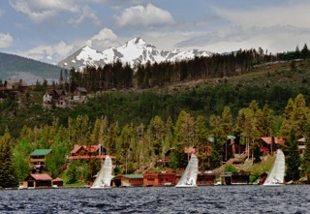
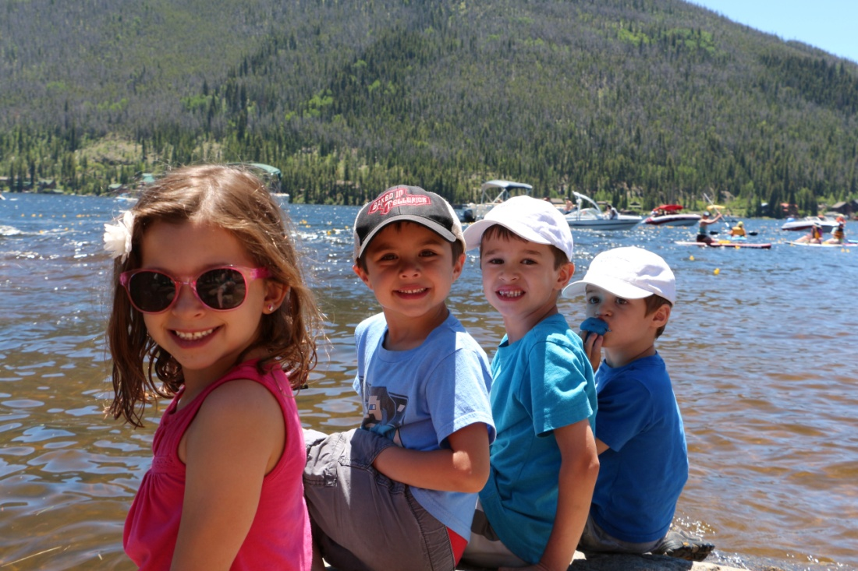
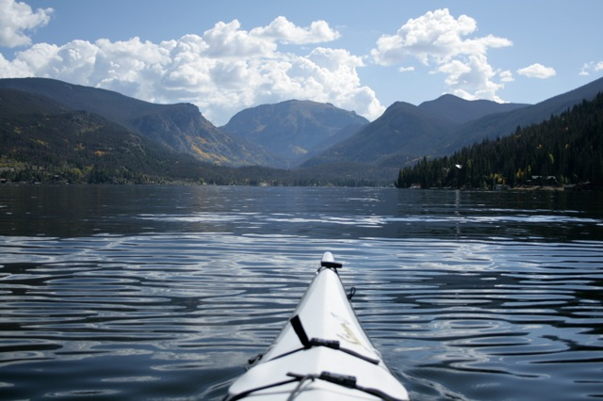

Slide 18
Criteria 3: Need for Additional Protection
TIMELINE
September 6, 1933: BOCC Resolution- “We the said board of county commissioners of Grand County Colorado do hereby place ourselves record as absolutely opposed to any further diversion of water from the Colorado River and its tributaries”
March 3, 1937: BOCC Resolution- “By the Board of County Commissioners of the County of Grand, state of Colorado that this board unequivocally opposes the diversion of the waters of Grand Lake and the evils incident thereto”
June 15, 1937: Senate Doc. 80- Article 2 states “To preserve the fishing and recreational facilities and the scenic attractions of Grand Lake, the Colorado River, and the Rocky Mountain National Park”
Feb. 8, 1954: D. Campbell Et Al. to area residents- “In Senate Document 80 it is very definitely stated that when the project was completed it would retain the natural beauty of Grand Lake and in fact improve it. This is a point on which we have a very definite complaint, and we are sure that you agree on this”
March 11, 1954: R. Coon to Bureau-"The businessmen in Grand Lake depend upon the tourists, vacationists from Denver and other Colorado towns and the summer residents for their livelihood. They will not be able to retain this business if Grand Lake loses its attraction, such as happened last summer when the lake was completely covered over with a dark green, slimy and odoriferous scum” and “therefore look to the Bureau of Reclamation to preserve the scenic beauty and natural attractions of Grand Lake as agreed and set forth in Senate Document No. 80 of the 75th Congress”
1954: Bureau responds- “We assure you that we are very much concerned with this problem, and there is no intention on the part of the Bureau of Reclamation to shirk its duties or responsibilities.” No plan is implemented.

Slide 19
Need for Additional Protection
Timeline Continued…
1968: Superintendent of Rocky Mountain National Park requests the assistance of the Federal Water Pollution Control Administration (now the USEPA) to determine the measures necessary to prevent the pollution of Grand Lake.
1976: 208 Plan adopted- pursuant to Section 208 of the Federal Clean Water Act as implemented through Colorado Water Quality Control Act "to protect, maintain, and improve where necessary and reasonable, water quality for public water supplies, for protection and propagation of wildlife and aquatic life, for domestic, agricultural, industrial, and recreational uses" (CRS 25-8-102).
2006: Algal bloom causes health alert on the lake.
2008: Clarity workgroup formed. NWCCOG proposed site specific clarity standard to WQCC: Numerical and Narrative Standard (the current standard)- “The highest level of clarity attainable, consistent with the exercise of established water rights and the protection of aquatic life”
2009: WQCC “Grand Lake adjoins and complements Rocky Mountain National Park in the headwaters of the Colorado River and its social and economic importance is worthy of protection.” CCR 1002-33.44(Q).
2014: Federal Lands Livability Initiative states Grand Lake is of great recreational significance in their livability assessment as the WQCC further delays a numerical standard for clarity.
2016: Clarity MOU established- “The clarity goals are a 3.8 meter average and a 2.5 meter minimum for the July through September 11 period” (NCWCD, p.3). These goals have not been achieved.

Slide 20
For Deliberation
As per NWCCOG staff:
Does the proposed designation satisfy the designation criteria?
Will this amendment further the regional water quality objectives of the 208 Plan?
As per the 208 Plan: "to protect, maintain, and improve where necessary and reasonable, water quality for public water supplies, for protection and propagation of wildlife and aquatic life, for domestic, agricultural, industrial, and recreational uses" (CRS 25-8-102).

