Slide 1
NWCCOG e-bike Survey - March 2018
Thursday, April 19, 2018

Slide 2
32
Total Responses
Date Created: Wednesday, March 07, 2018
Complete Responses: 26

Slide 3
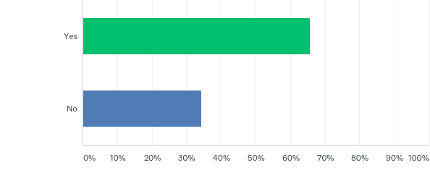
Q2: Does your jurisdiction currently regulate e-bikes, or is it actively considering doing so?
Answered: 32 Skipped: 0

Slide 4
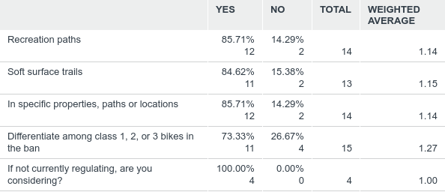
Q3: Does your jurisdiction regulate or ban use of e-bikes on:
Answered: 15 Skipped: 17

Slide 5
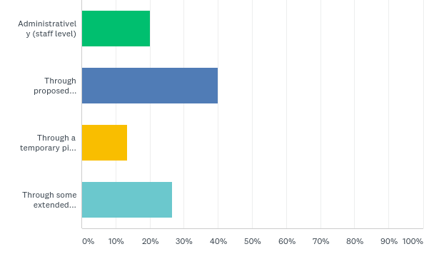
Q4: By what process or means did your jurisdiction regulate e-bikes?
Answered: 15 Skipped: 17

Slide 6
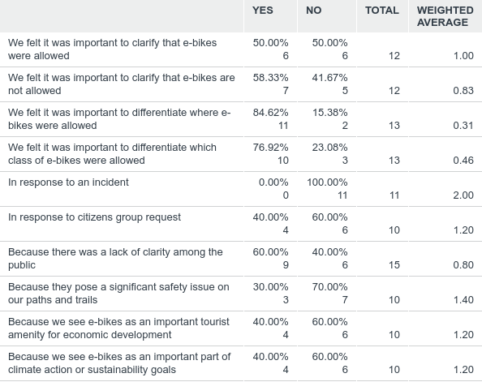
Q6: Which best describes why your jurisdiction chose to address e-bikes (check all that apply)
Answered: 16 Skipped: 16

Slide 7
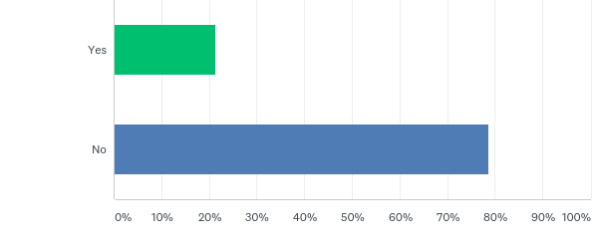
Q7: If your jurisdiction has allowed e-bikes are you fielding many negative reports about their use (speed, safety, e-bike rental fleets)?
Answered: 14 Skipped: 18

Slide 8
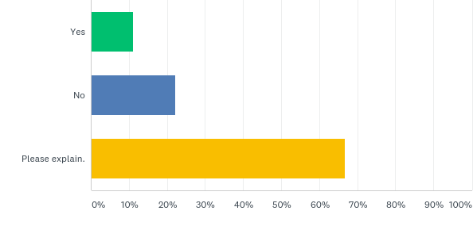
Q8: If fielding concerns about e-bikes, are you finding these concerns to be founded or unfounded? Explain.
Answered: 9 Skipped: 23

Slide 9
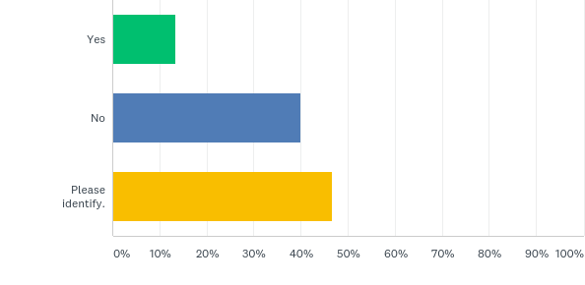
Q9: Is there a specific property or trail that prompted discussion around e-bikes? Explain
Answered: 15 Skipped: 17

Slide 10
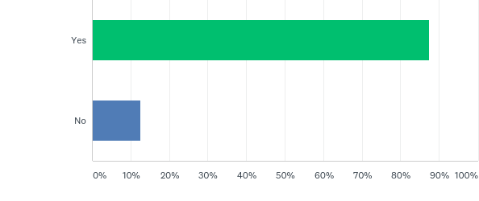
Q10: Do you have regional trails where e-bike regulation does or would involve multiple jurisdictions?
Answered: 16 Skipped: 16

Slide 11
Q11: Are differing regulations (or non-regulations) of e-bikes in neighboring jurisdictions, including federally managed public lands, a challenge for e-bike users which may enter a trail system in your jurisdiction?
Answered: 16 Skipped: 16

Slide 12
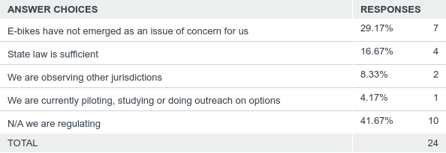
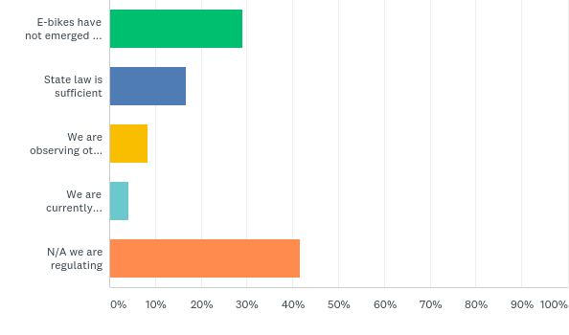
Q12: If your jurisdiction has chosen to not regulate e-bikes, which best describes why?
Answered: 24 Skipped: 8

Slide 13
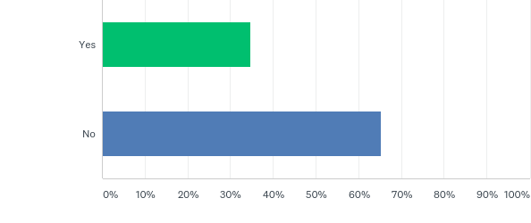
Q14: Does your jurisdiction allow ATVs on streets?
Answered: 23 Skipped: 9

