Slide 1
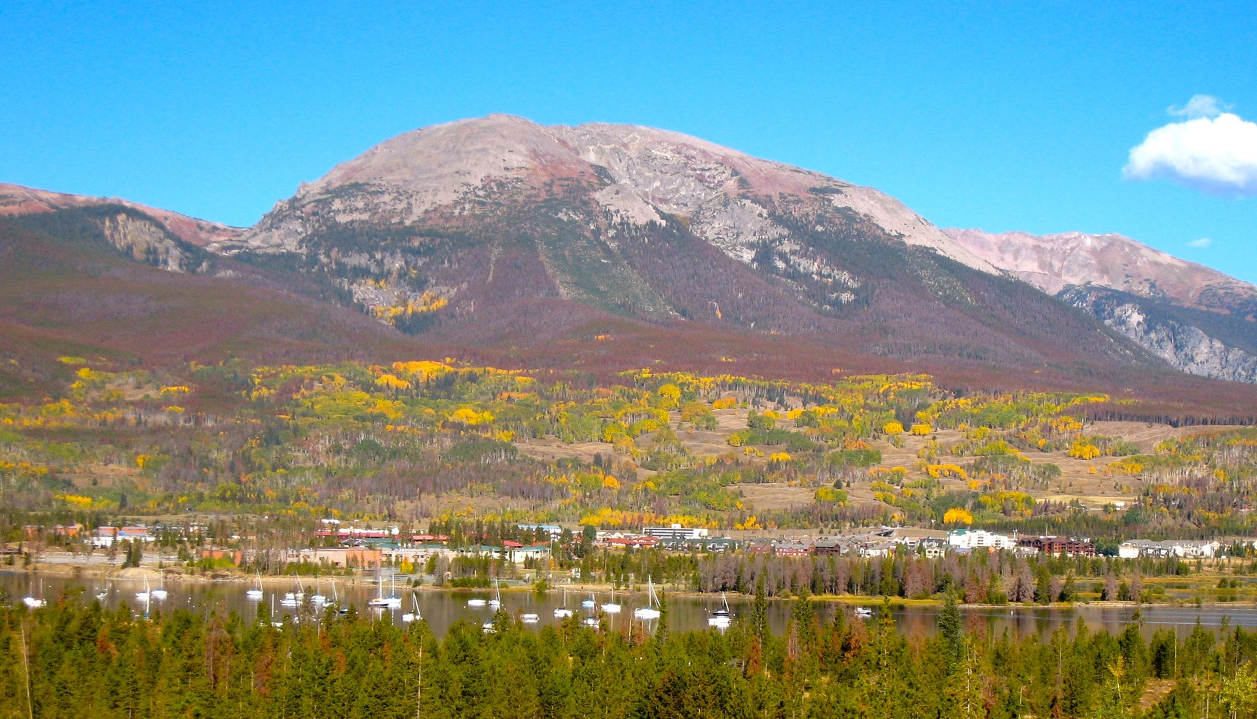
Dillon Reservoir
So the Beetle’s are gone now what?

Slide 2
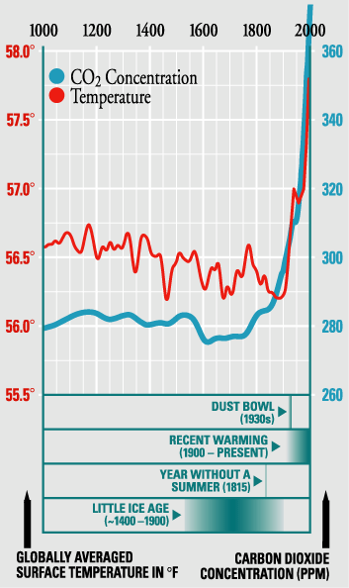
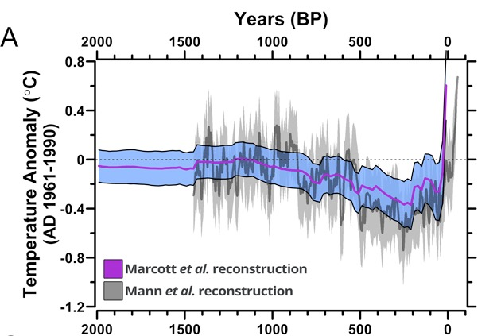

Slide 3
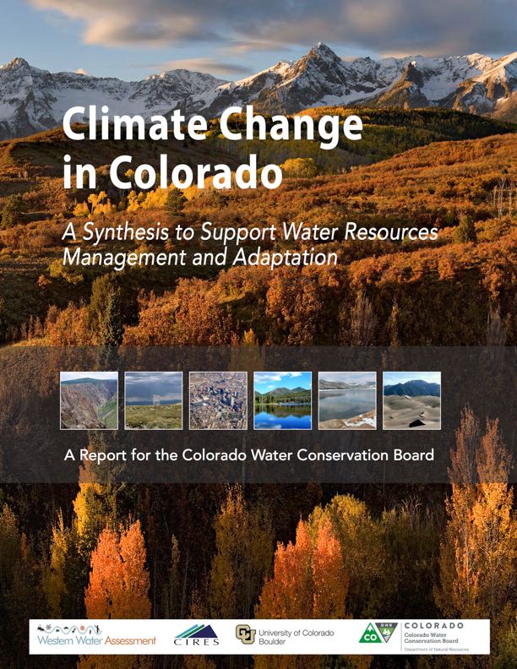
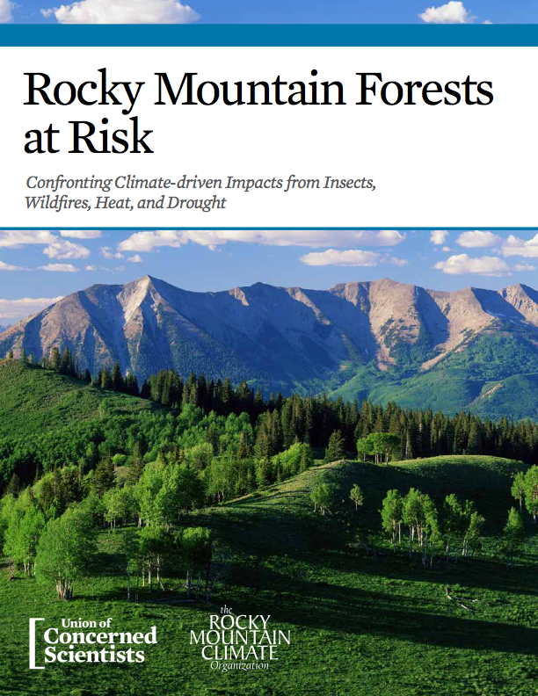

Slide 4
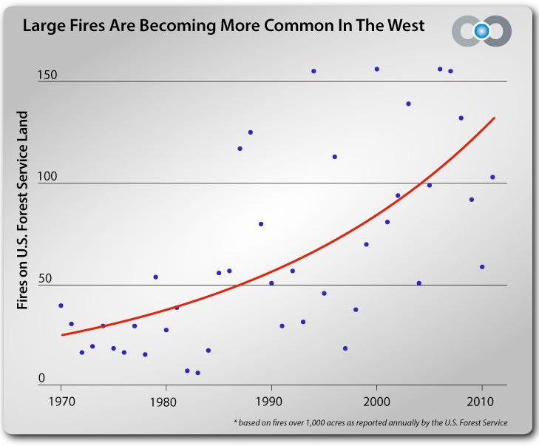
Number of Wildfires in Colorado up 150%

Slide 5
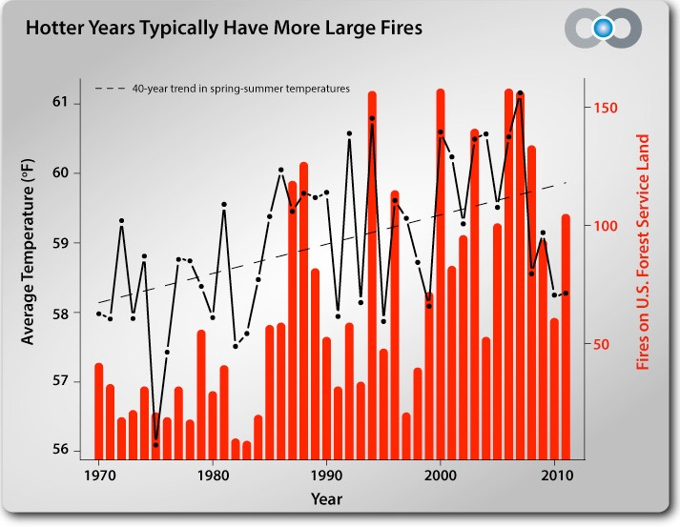
Fire Season is 65 days longer

Slide 6
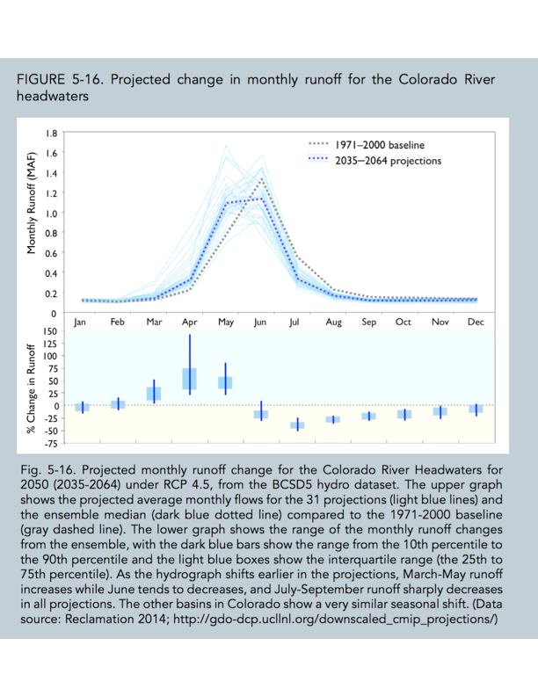

Slide 7
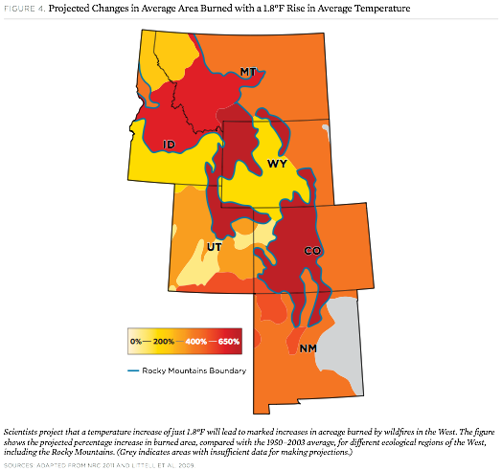

Slide 8
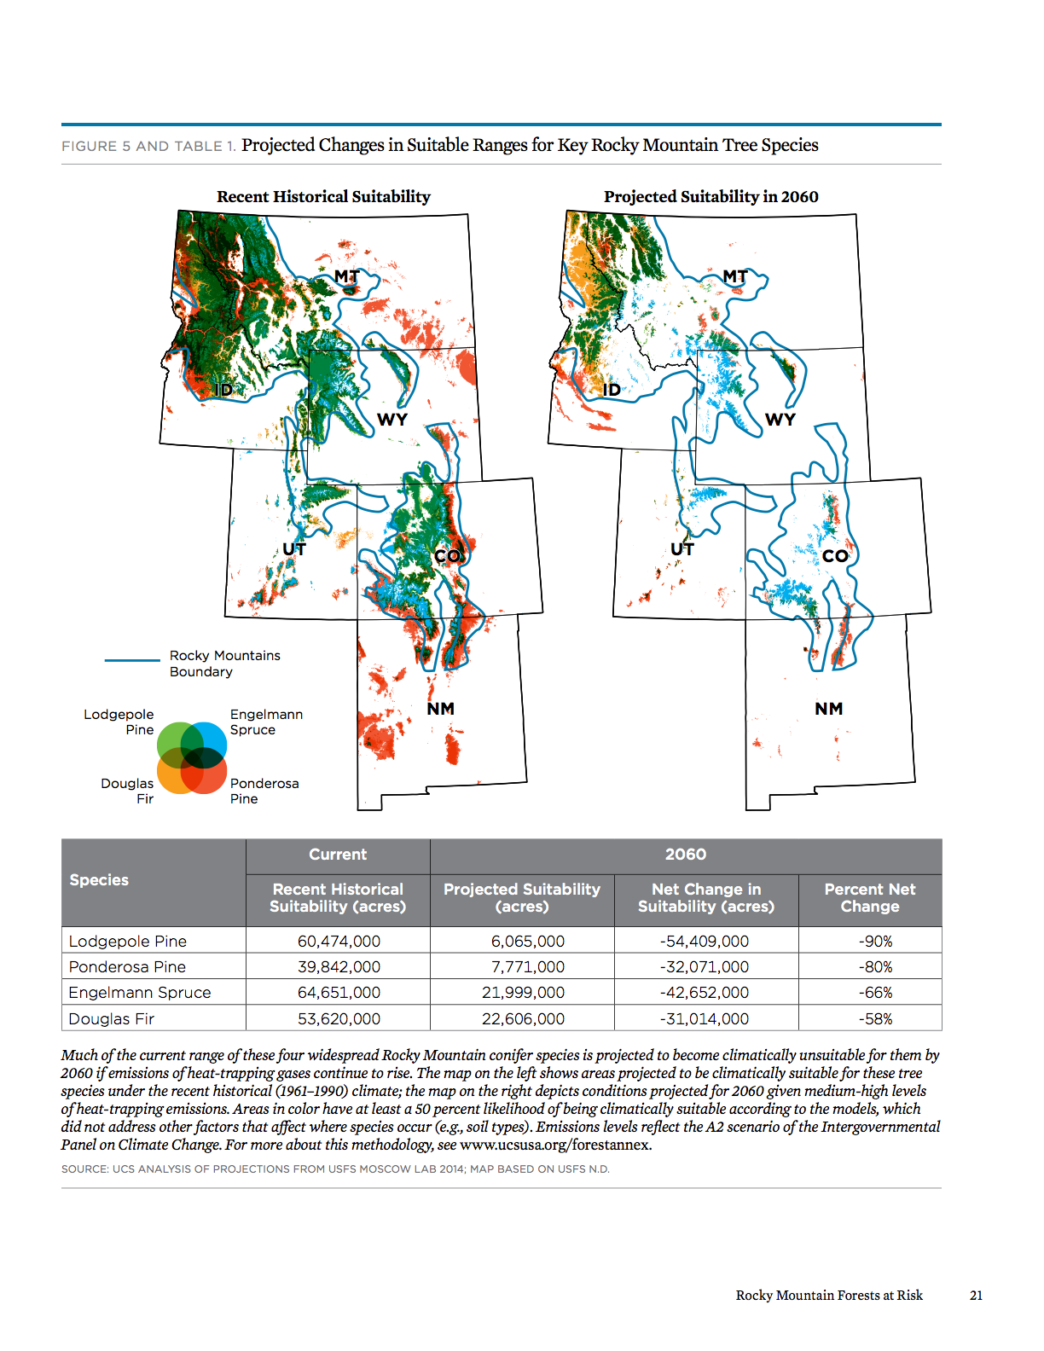

Slide 9
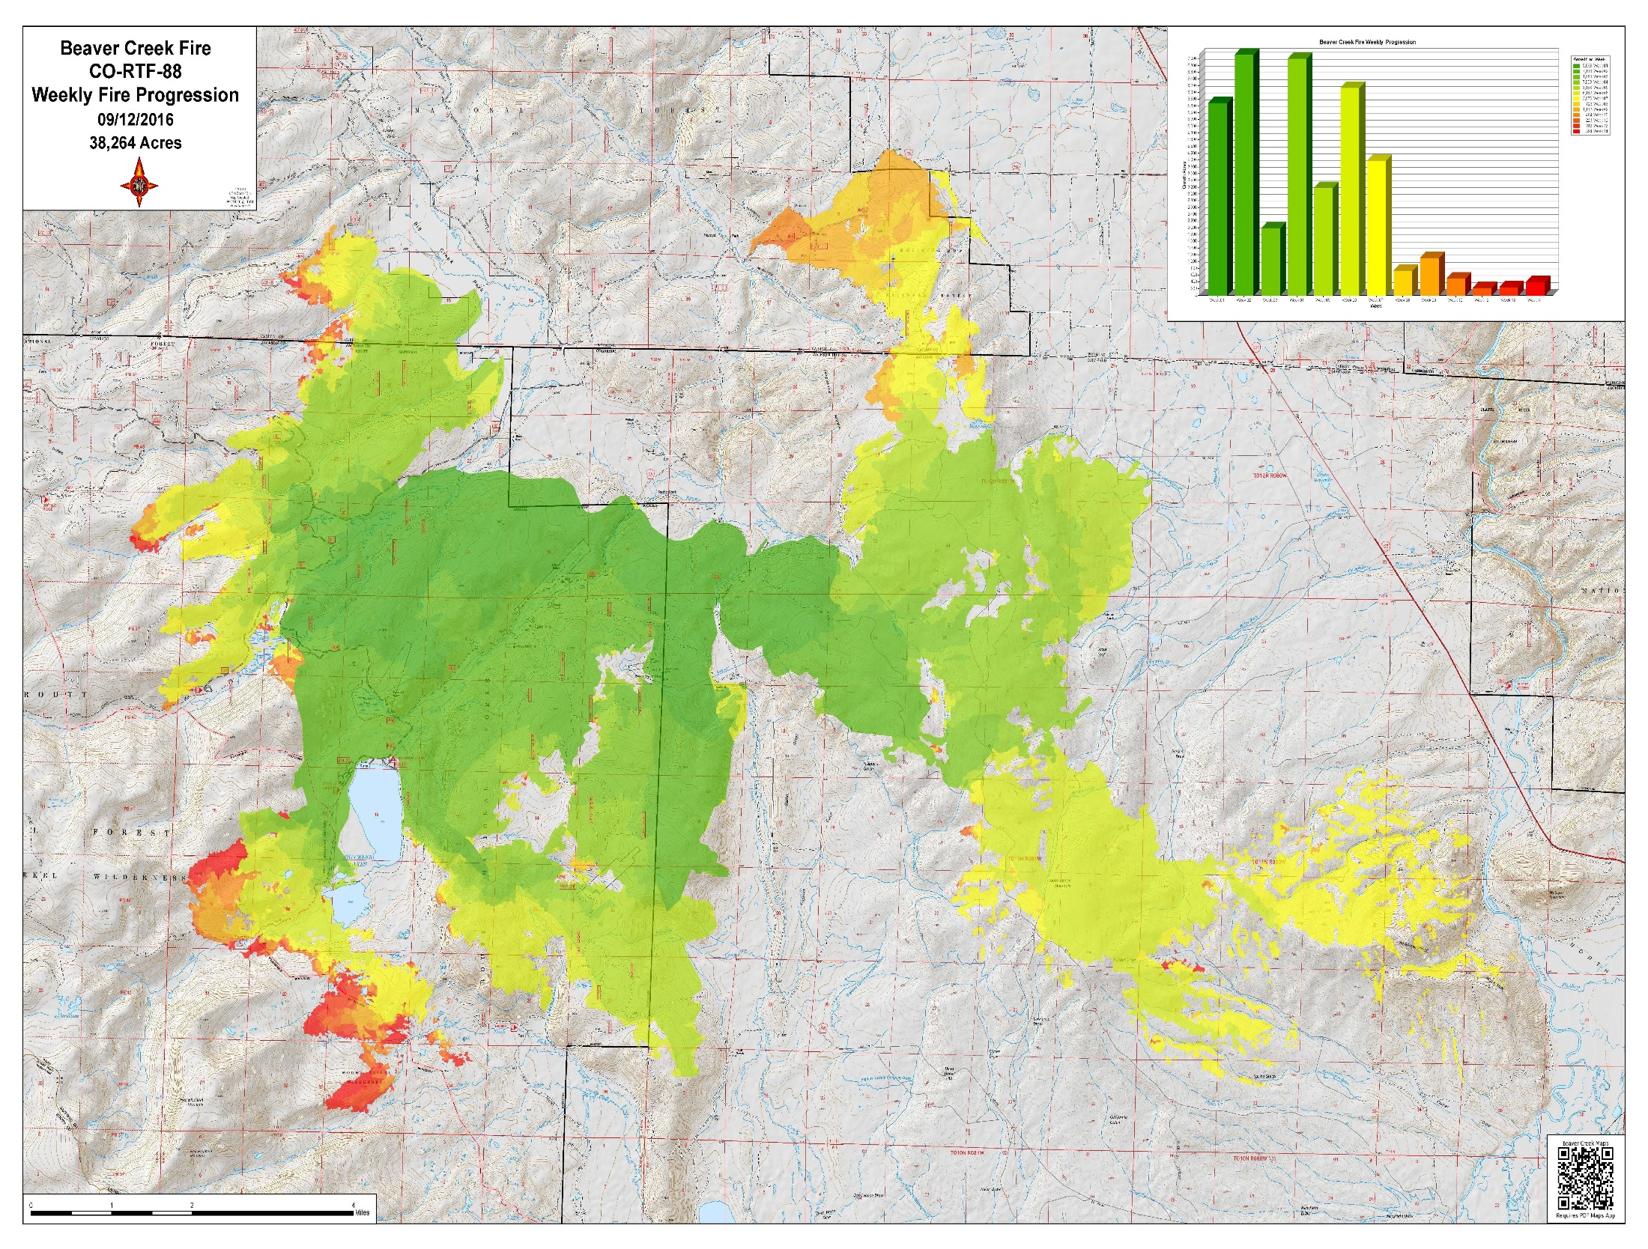
Notes:
Fire growth diminished after August 2nd because it had reached the down wind extent of the available fuel type.

Slide 10
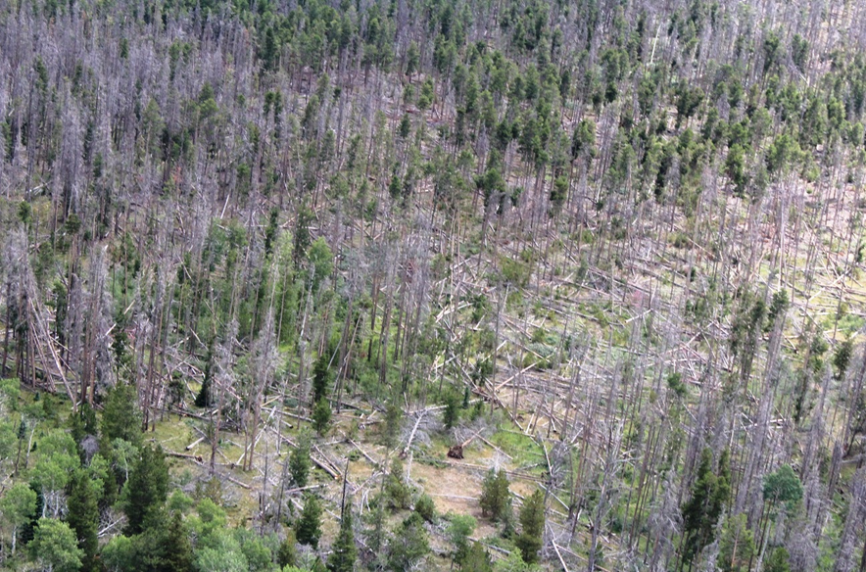
Notes:
Resulting MPB affected forests.

Slide 11
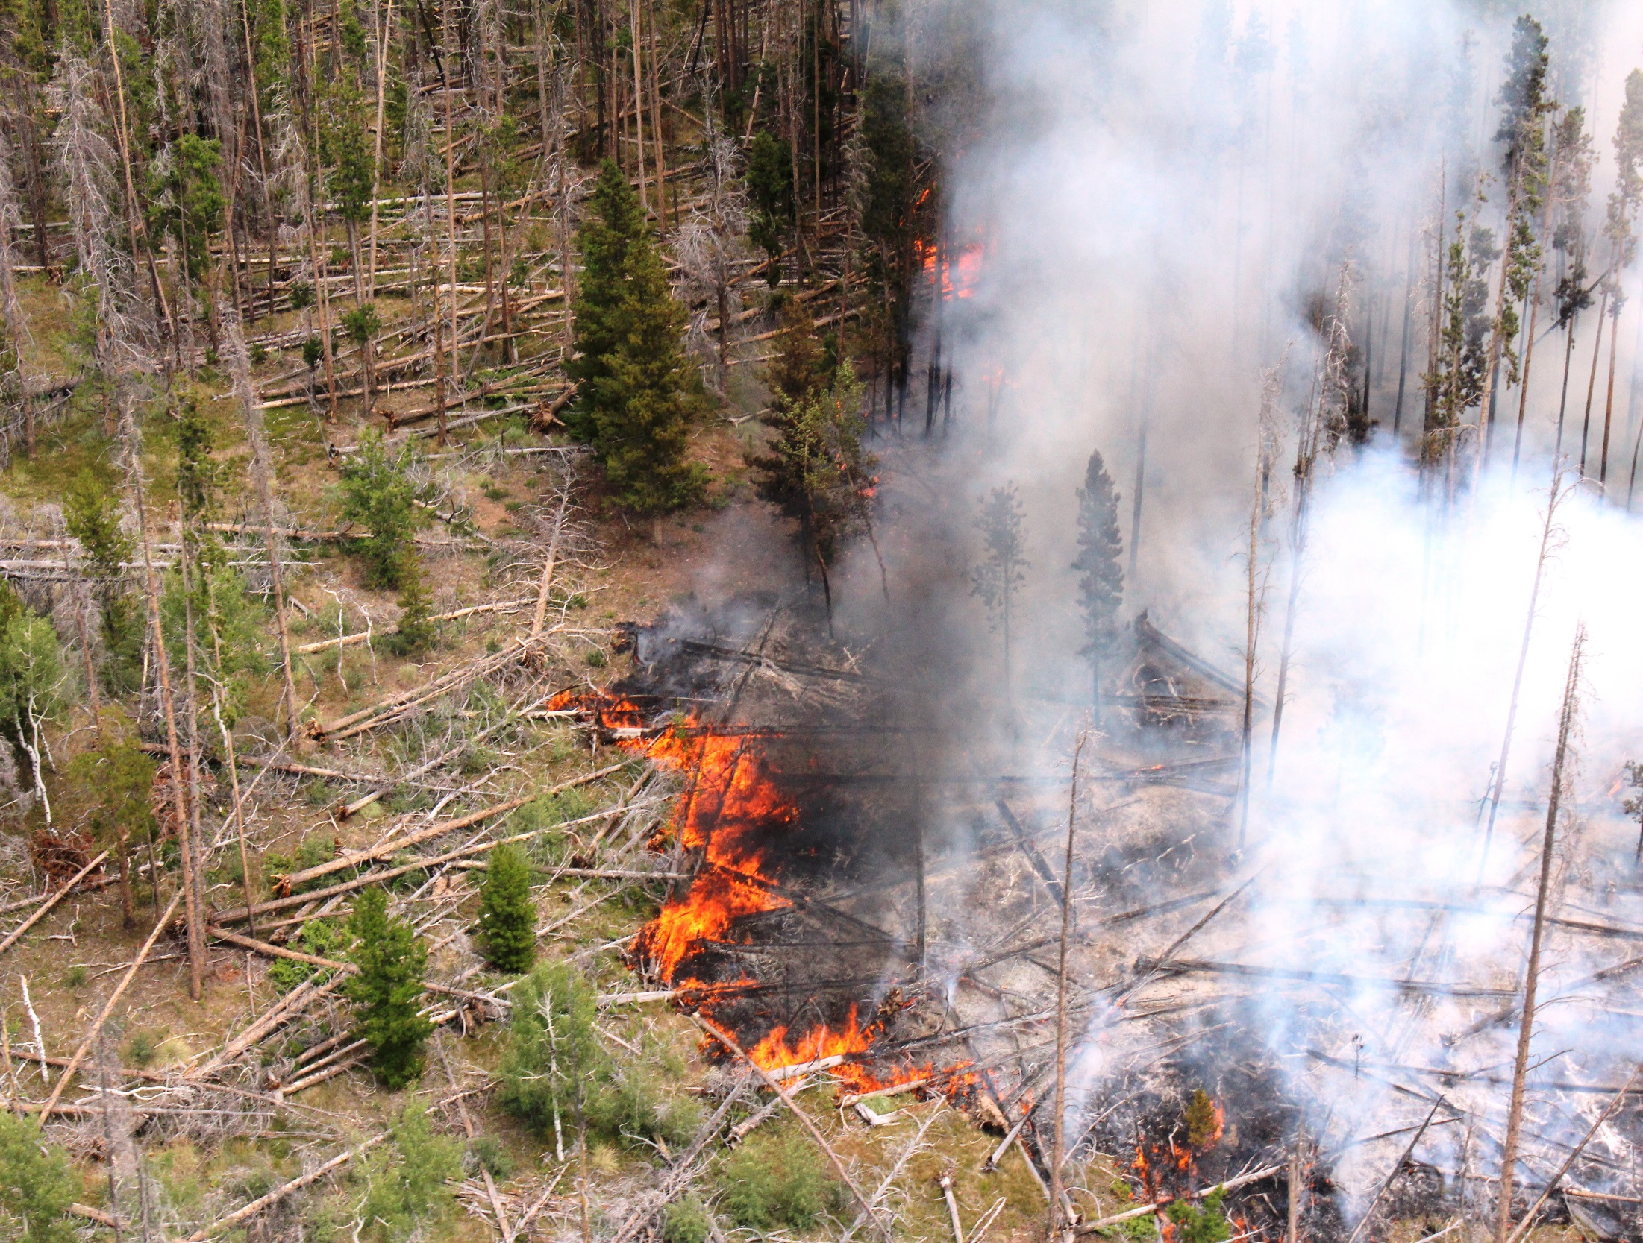
Notes:
Large down dead woody material as primary surface fuel.

Slide 12
Lodgepole Pine, Spruce-fire, Mesic Mixed Conifer
Mesic Ponderosa Pine, Xeric & Mesic Mixed Conifer
Xeric Ponderosa Pine, Pinyon-Juniper

Slide 13
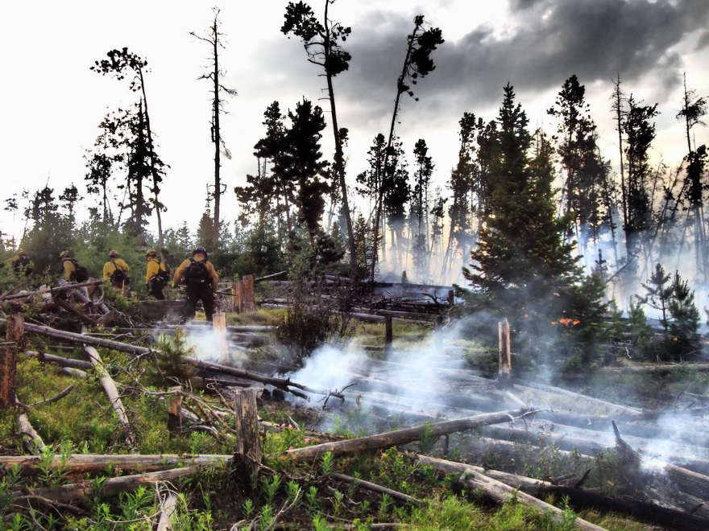
Notes:
Relatively few areas where firefighters could engage – were typically difficult places to establish control lines.

Slide 14
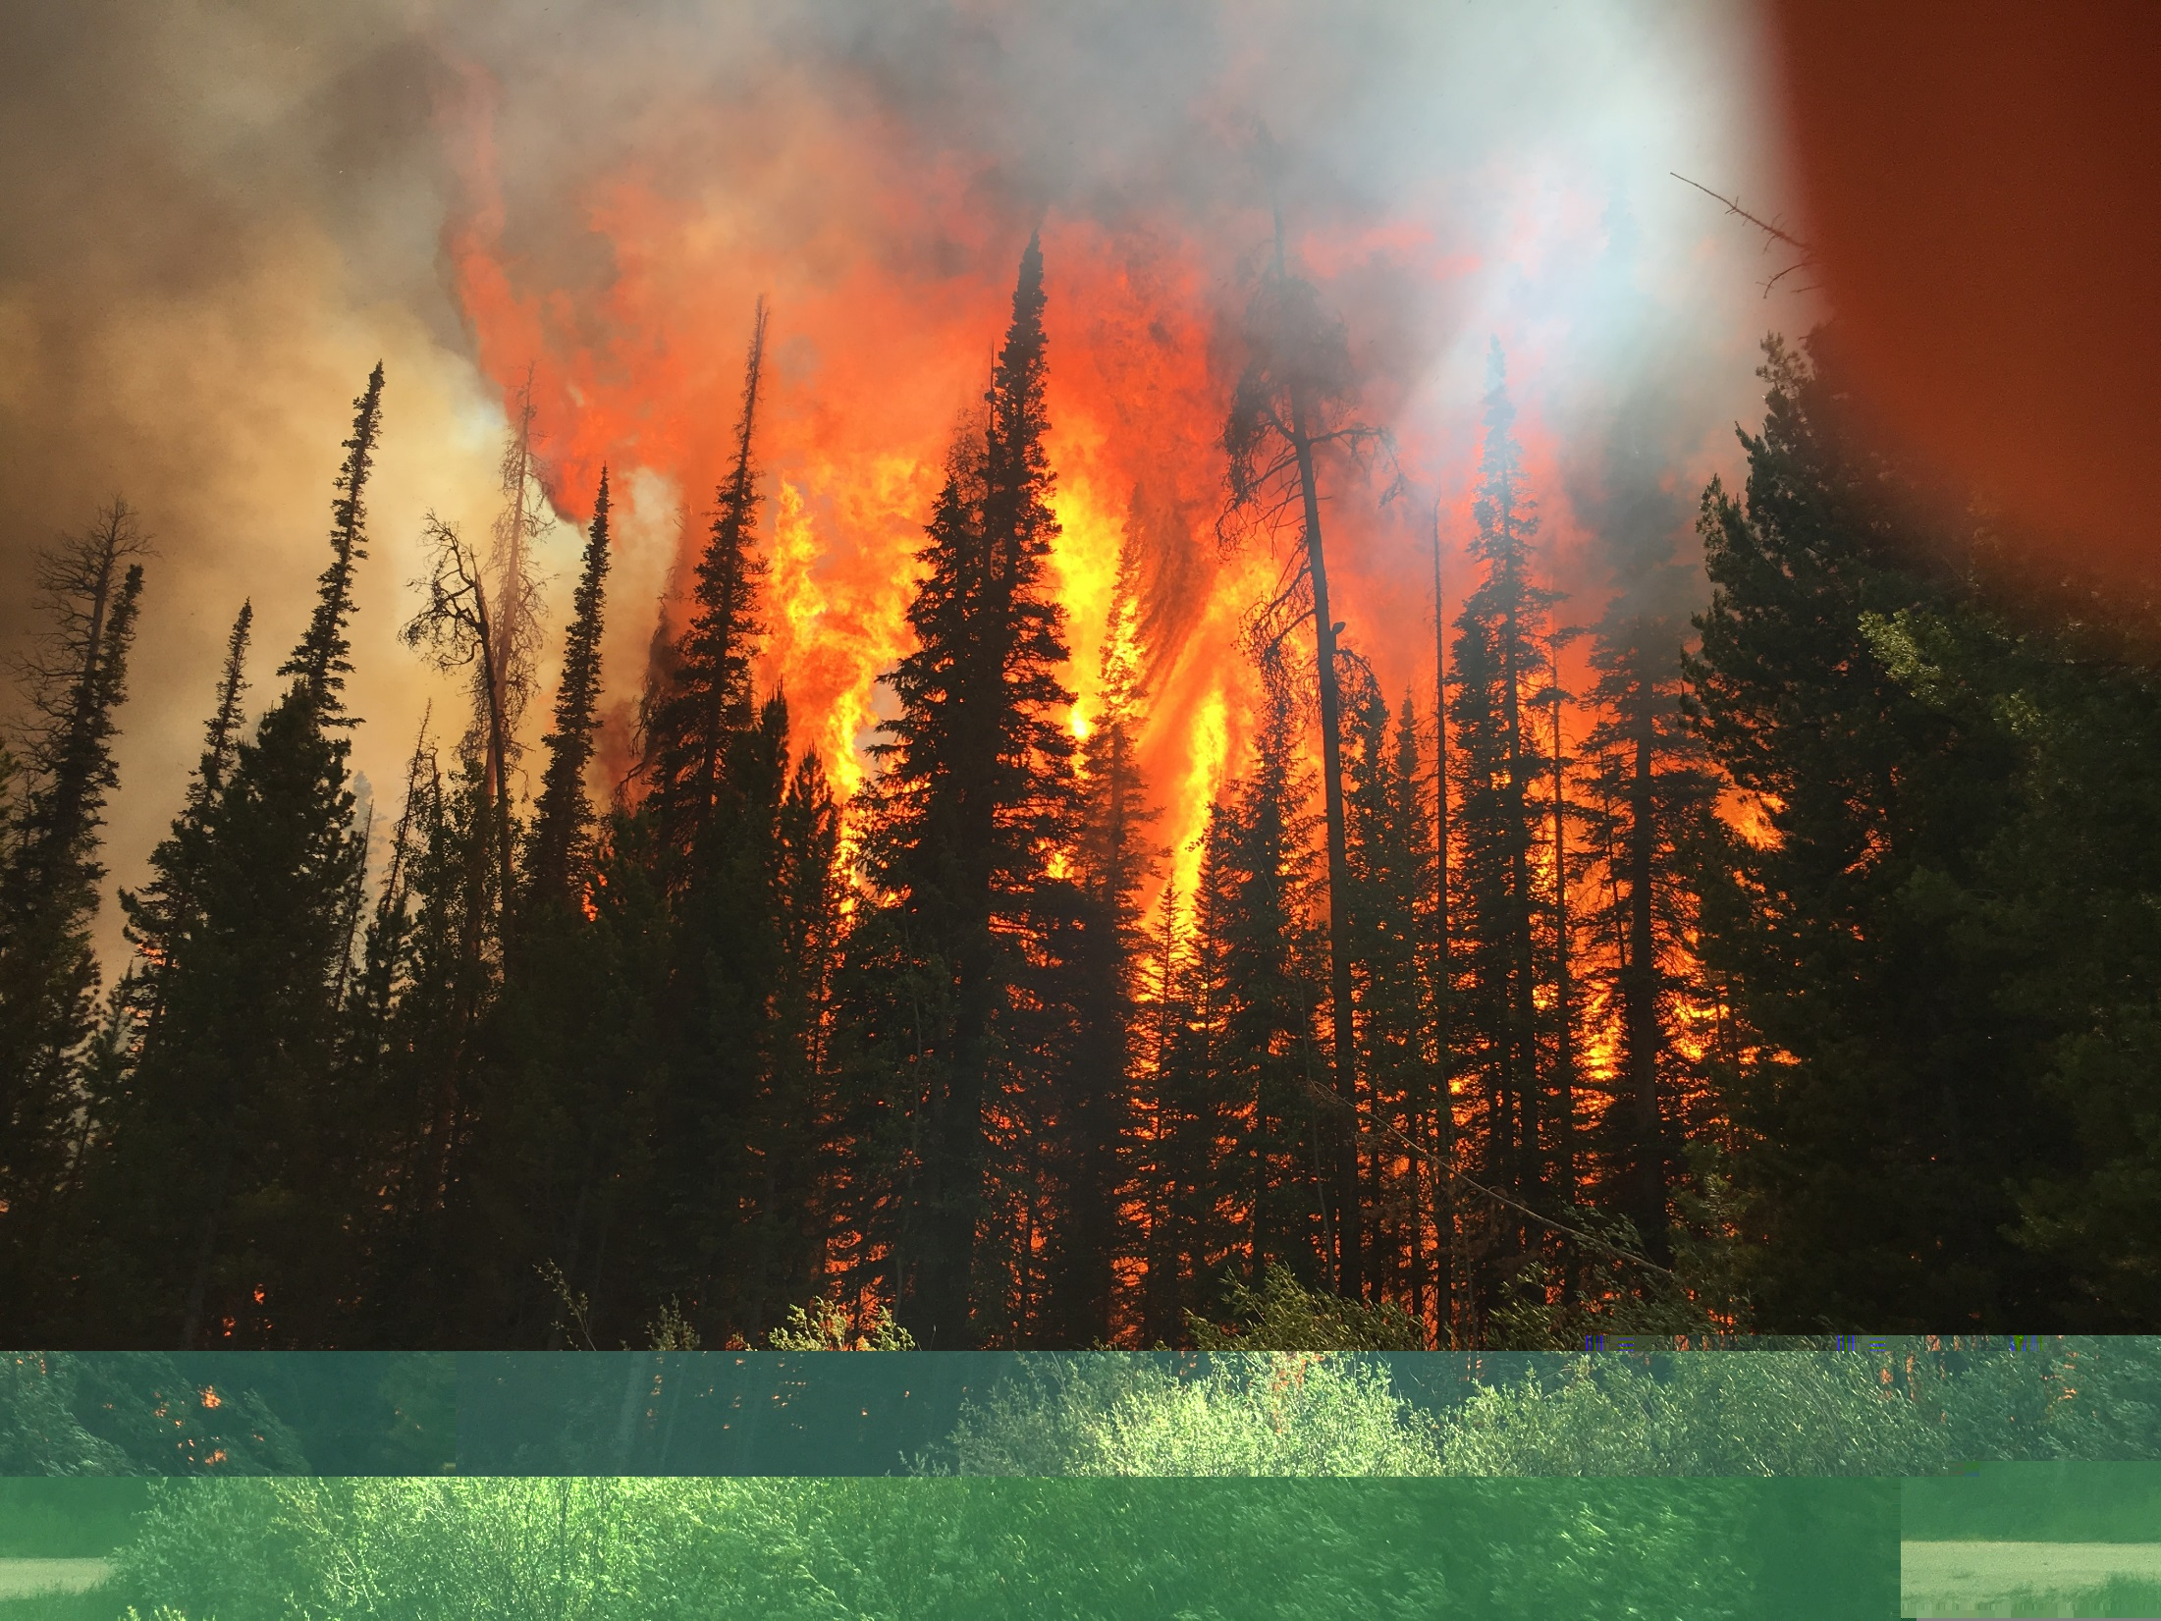
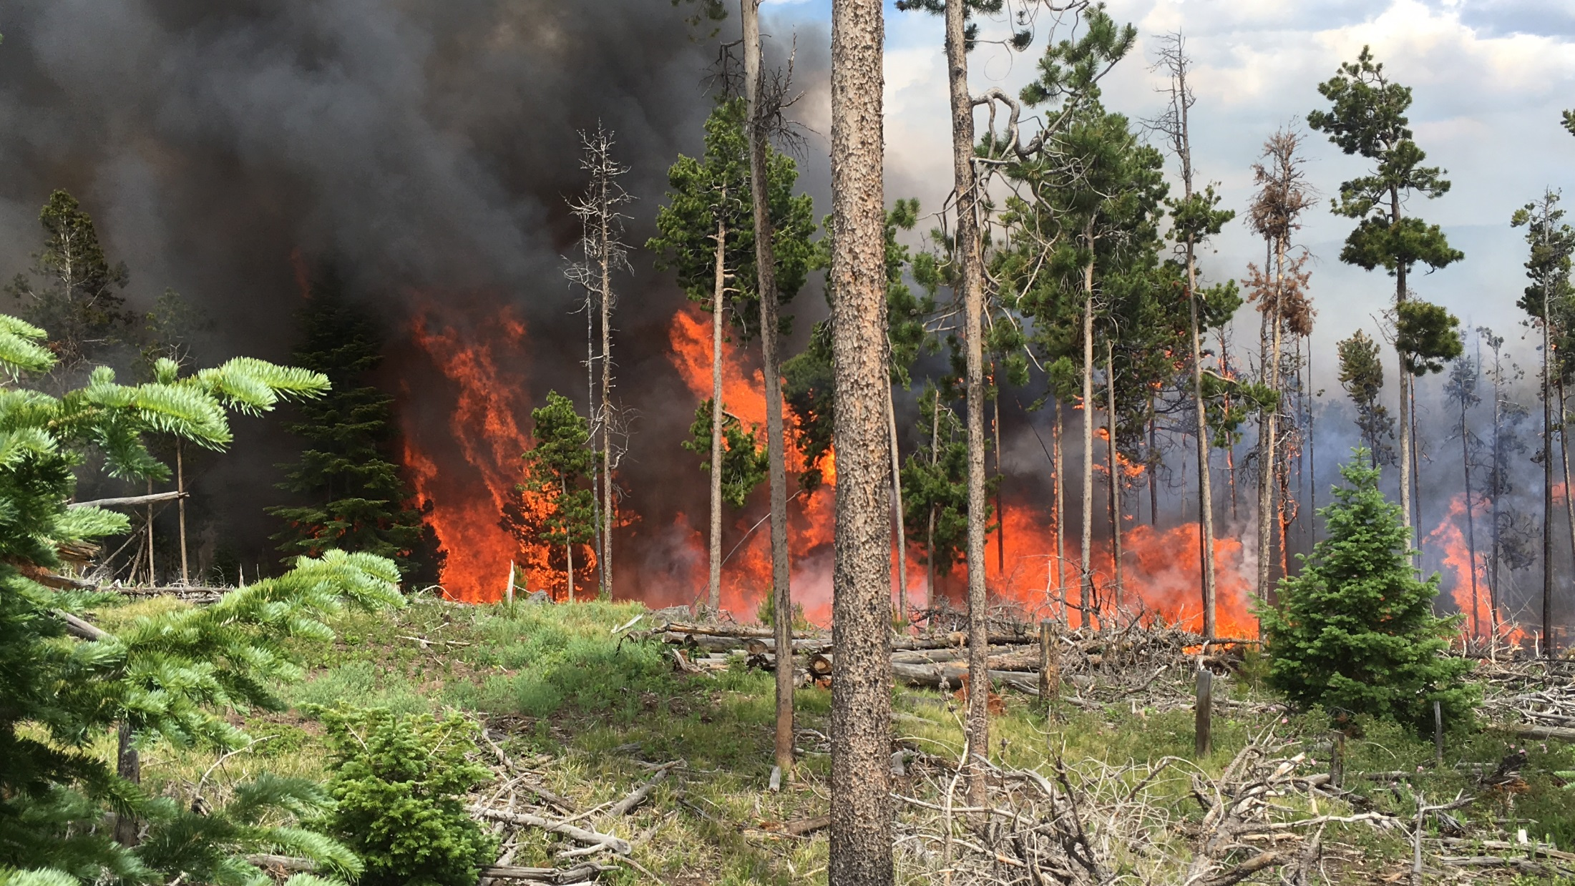
Notes:
Common occurrence on the fire. Torching and group torching with spotting was a primary method of movement.

Slide 15
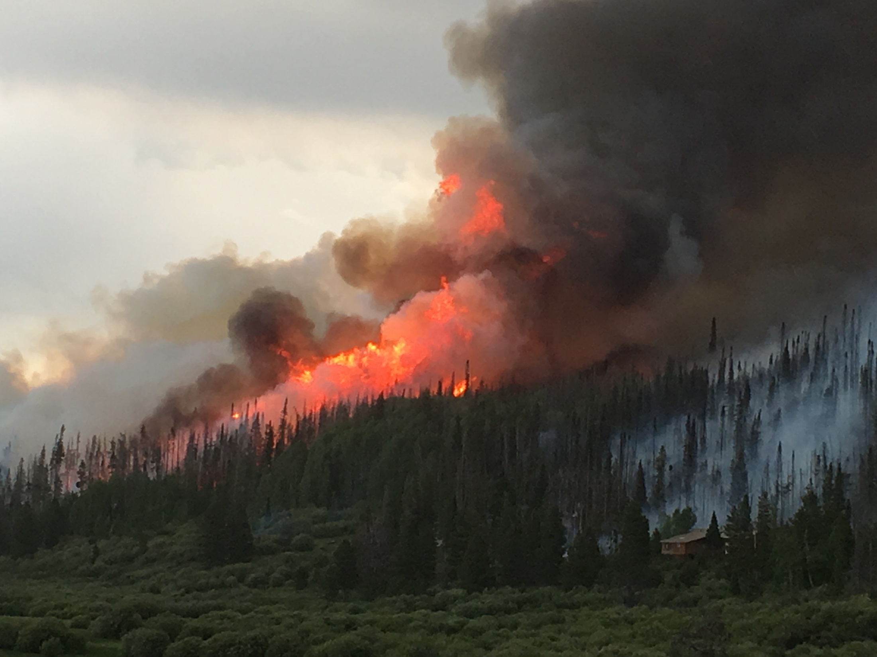
Notes:
Wind driven fires on high fire potential days

Slide 16
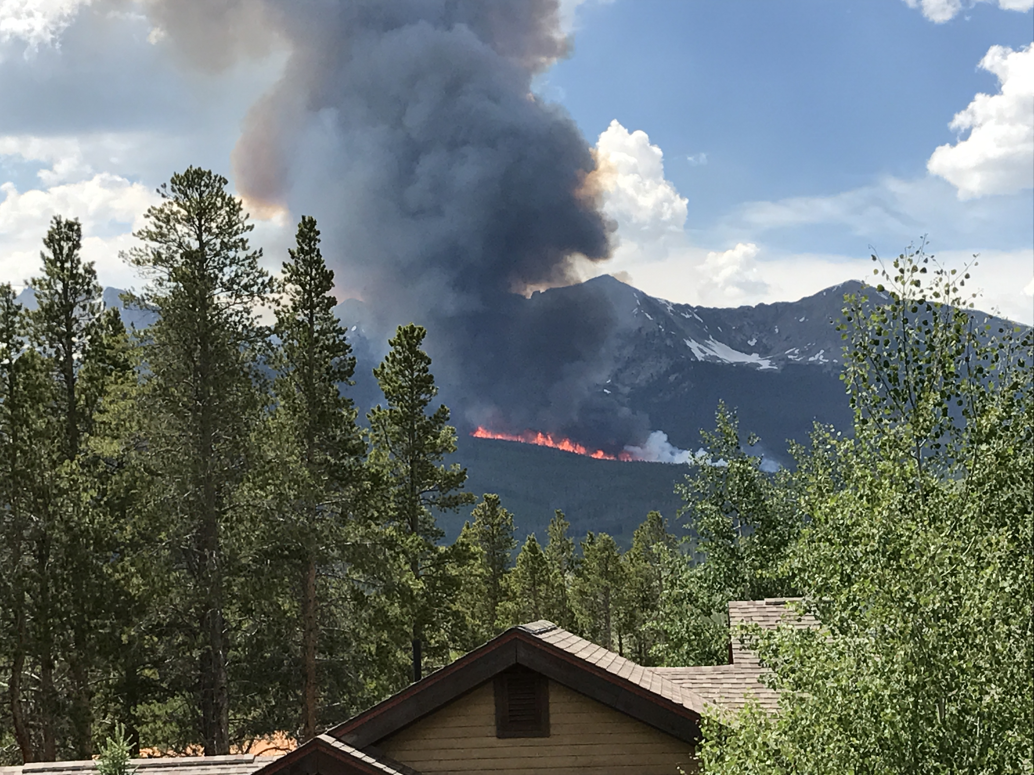

Slide 17
Resilience and Stability of Ecological Systems, Holling: 1973
the resilience of an ecosystem = the measure of its ability to absorb changes and still exist.

Slide 18
What are Resilient Forests?
Diversity (ages and species)
Openings, meadows, etc.
Functional riparian areas and floodplains

Slide 19
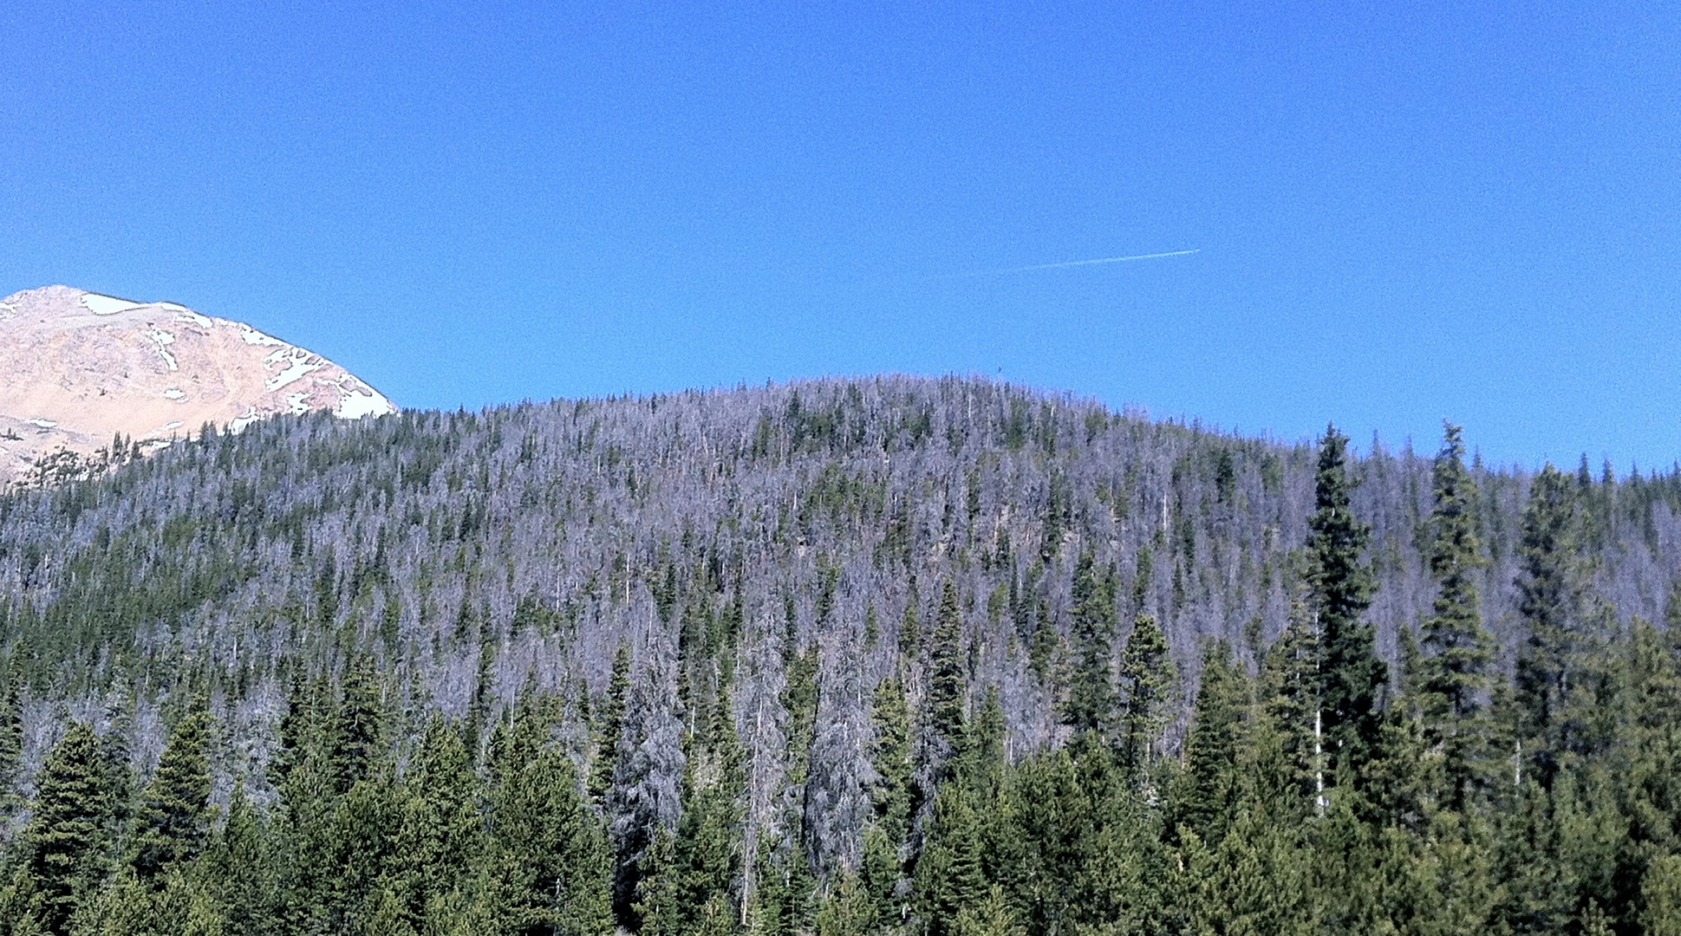

Slide 20
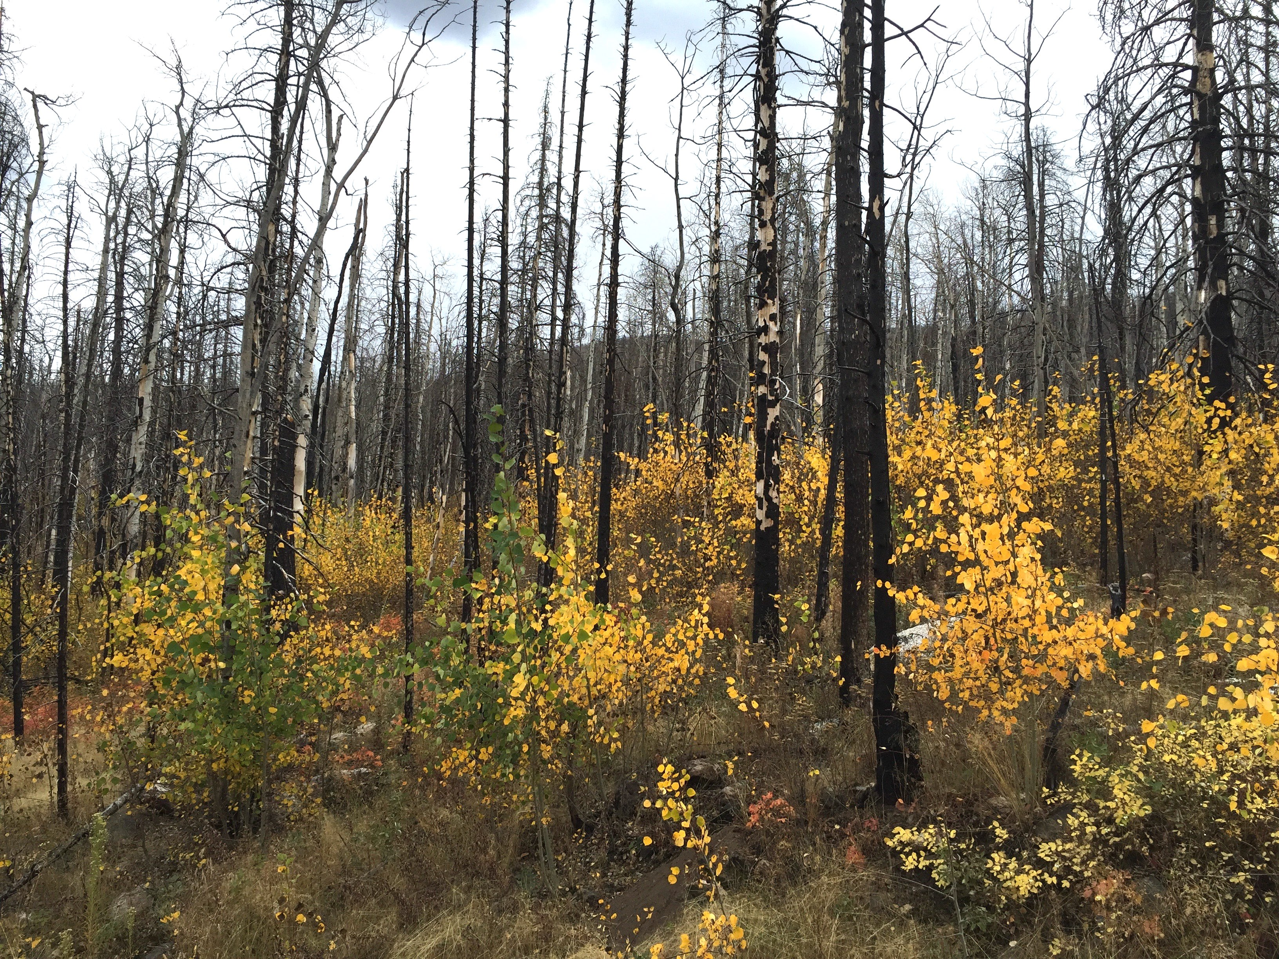

Slide 21
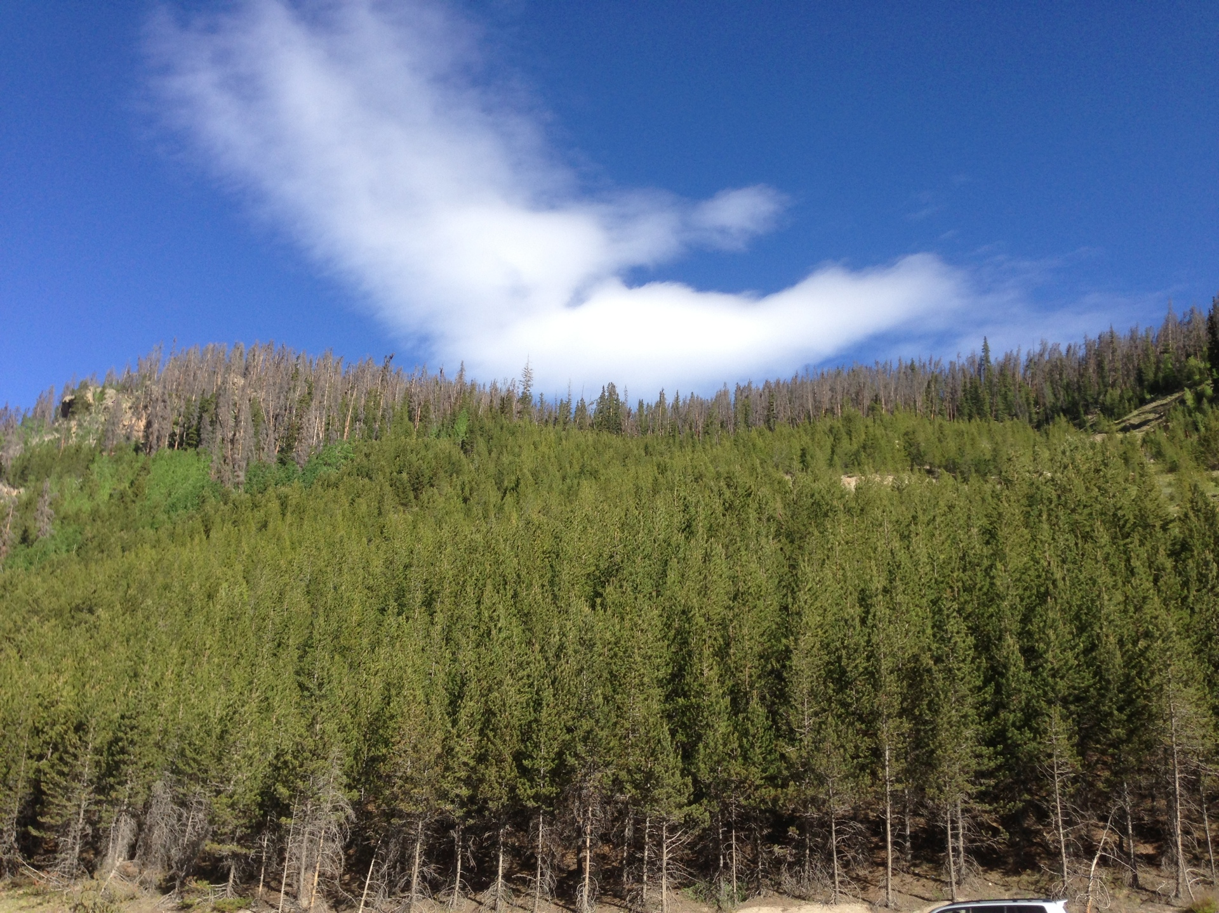

Slide 22
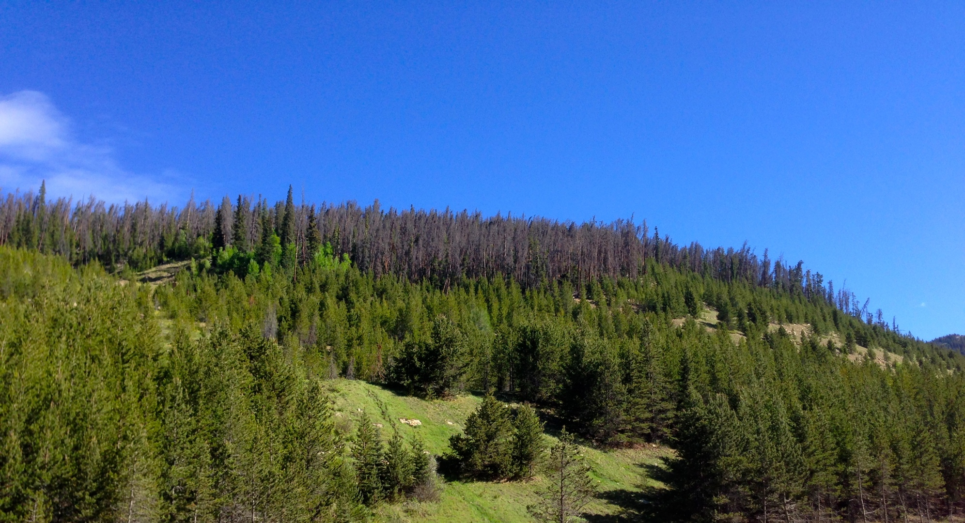

Slide 23
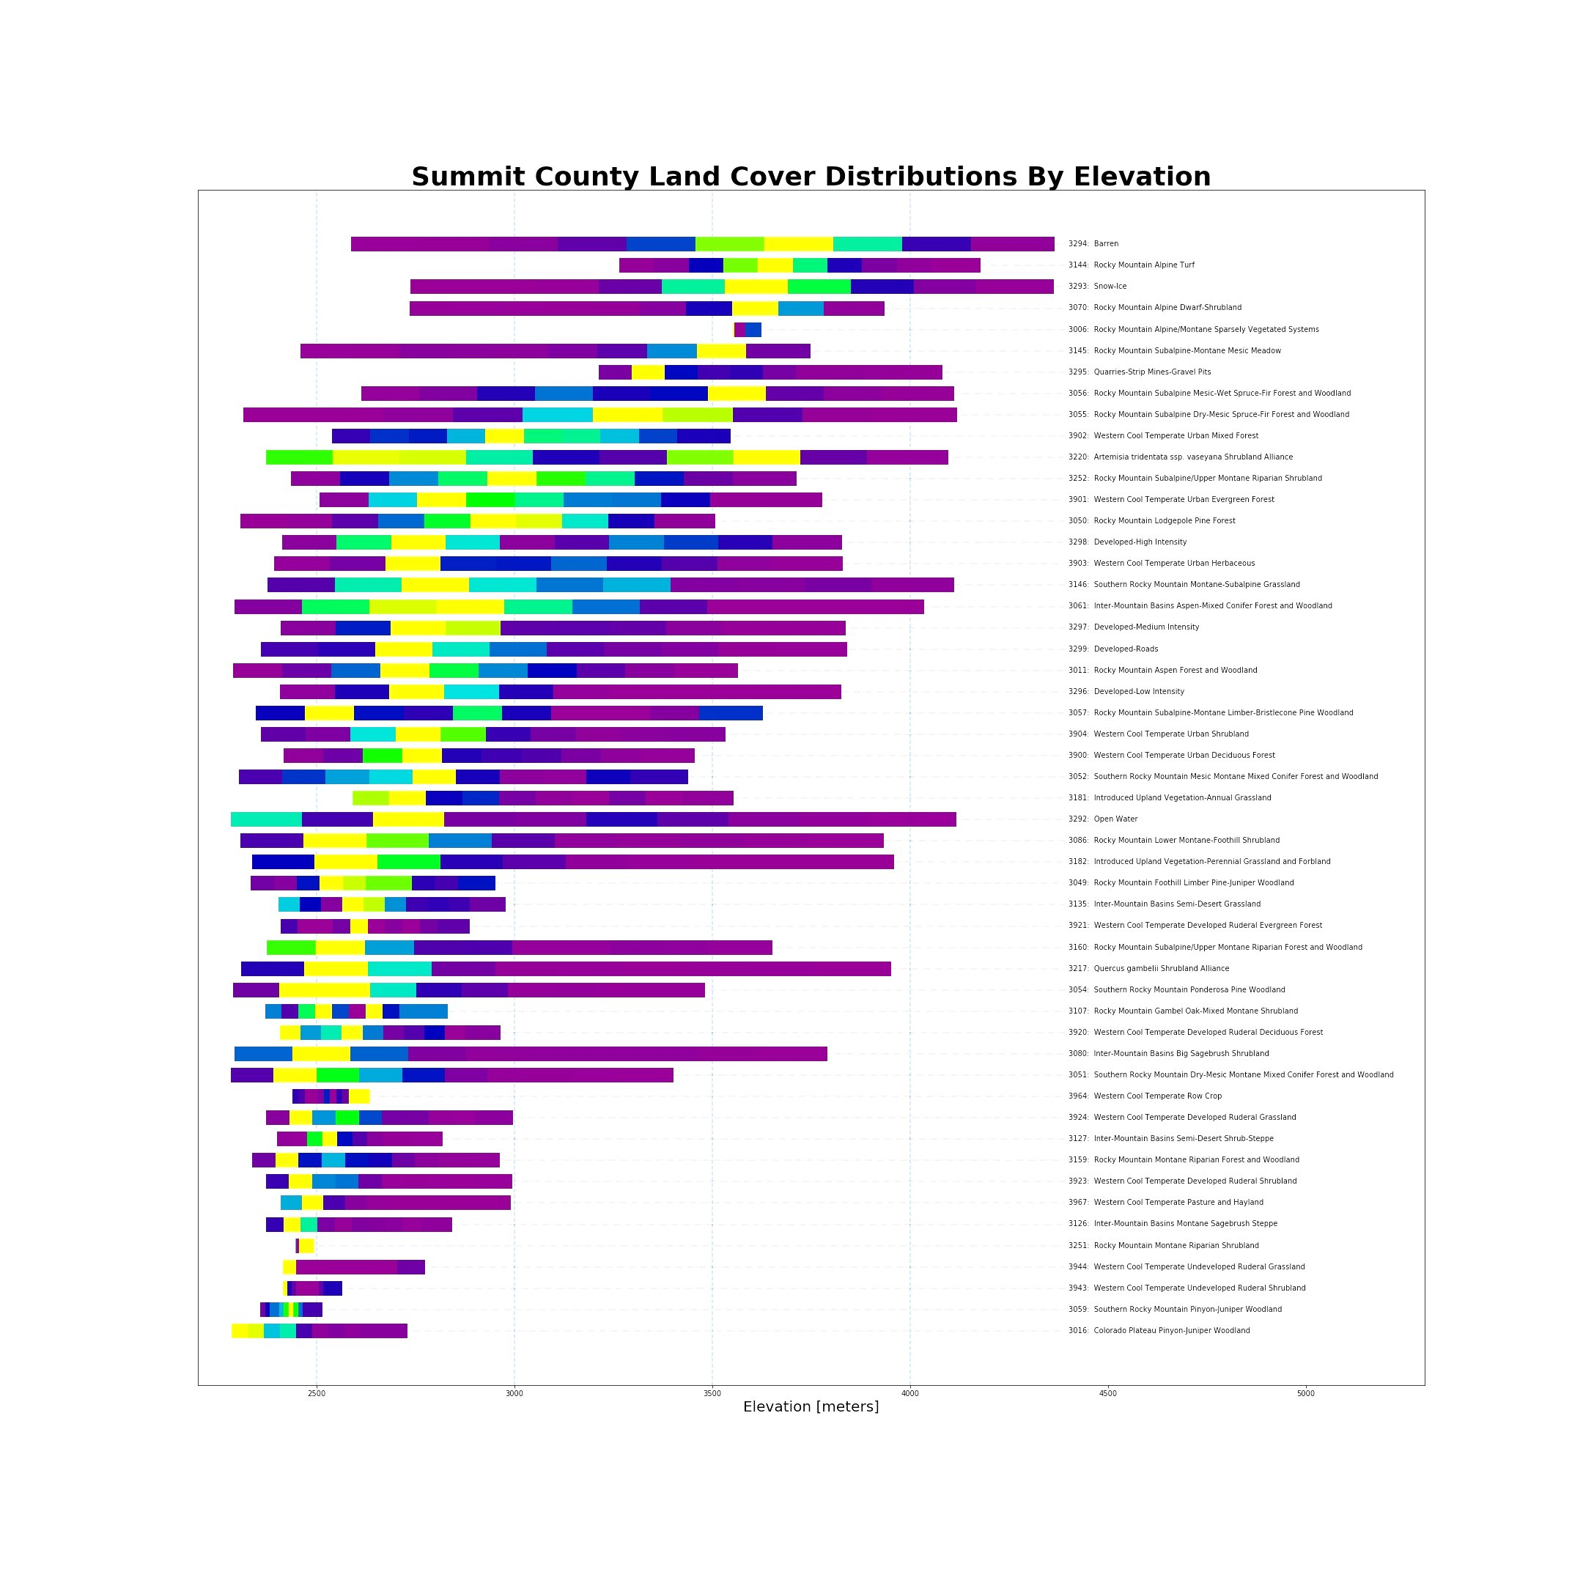

Slide 25
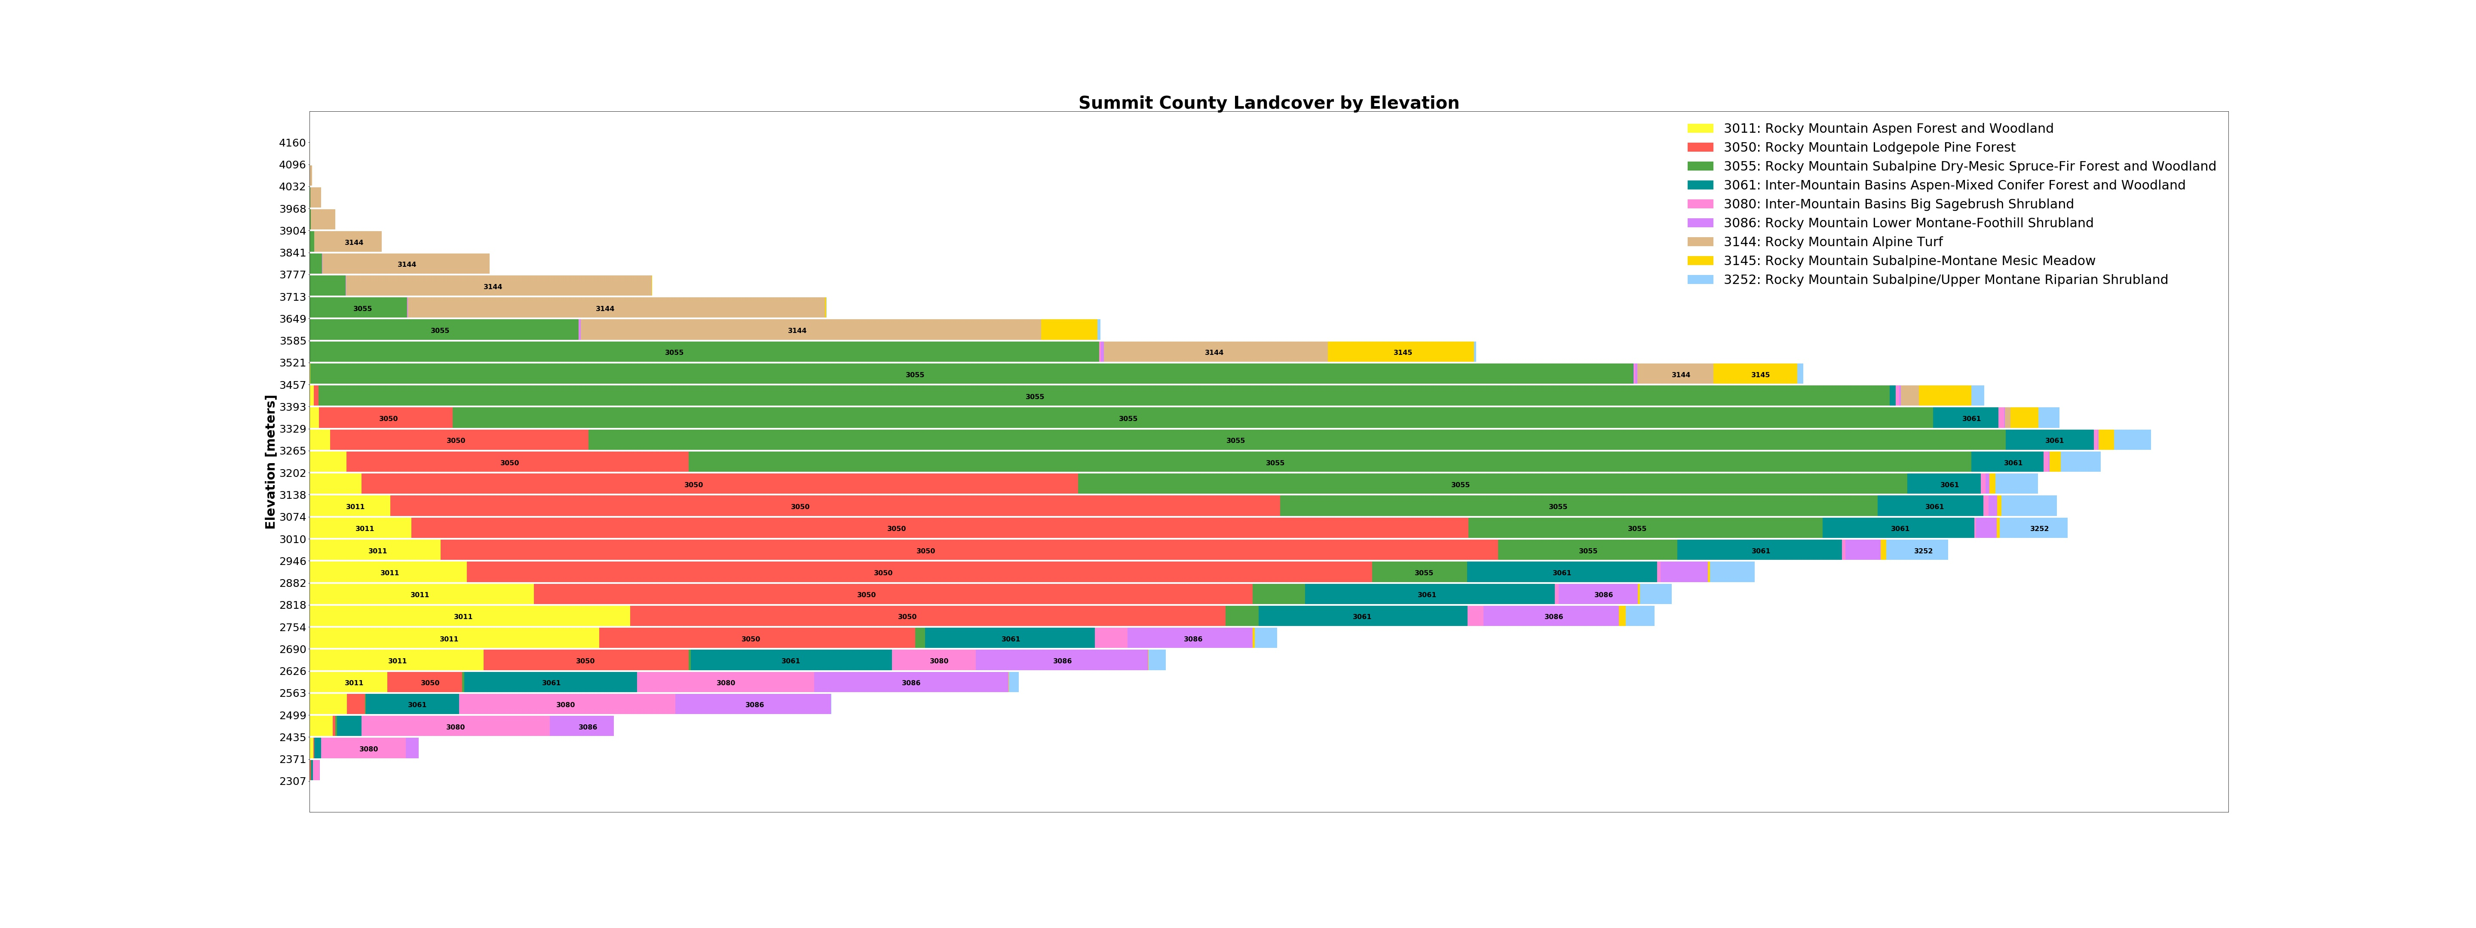

Slide 26
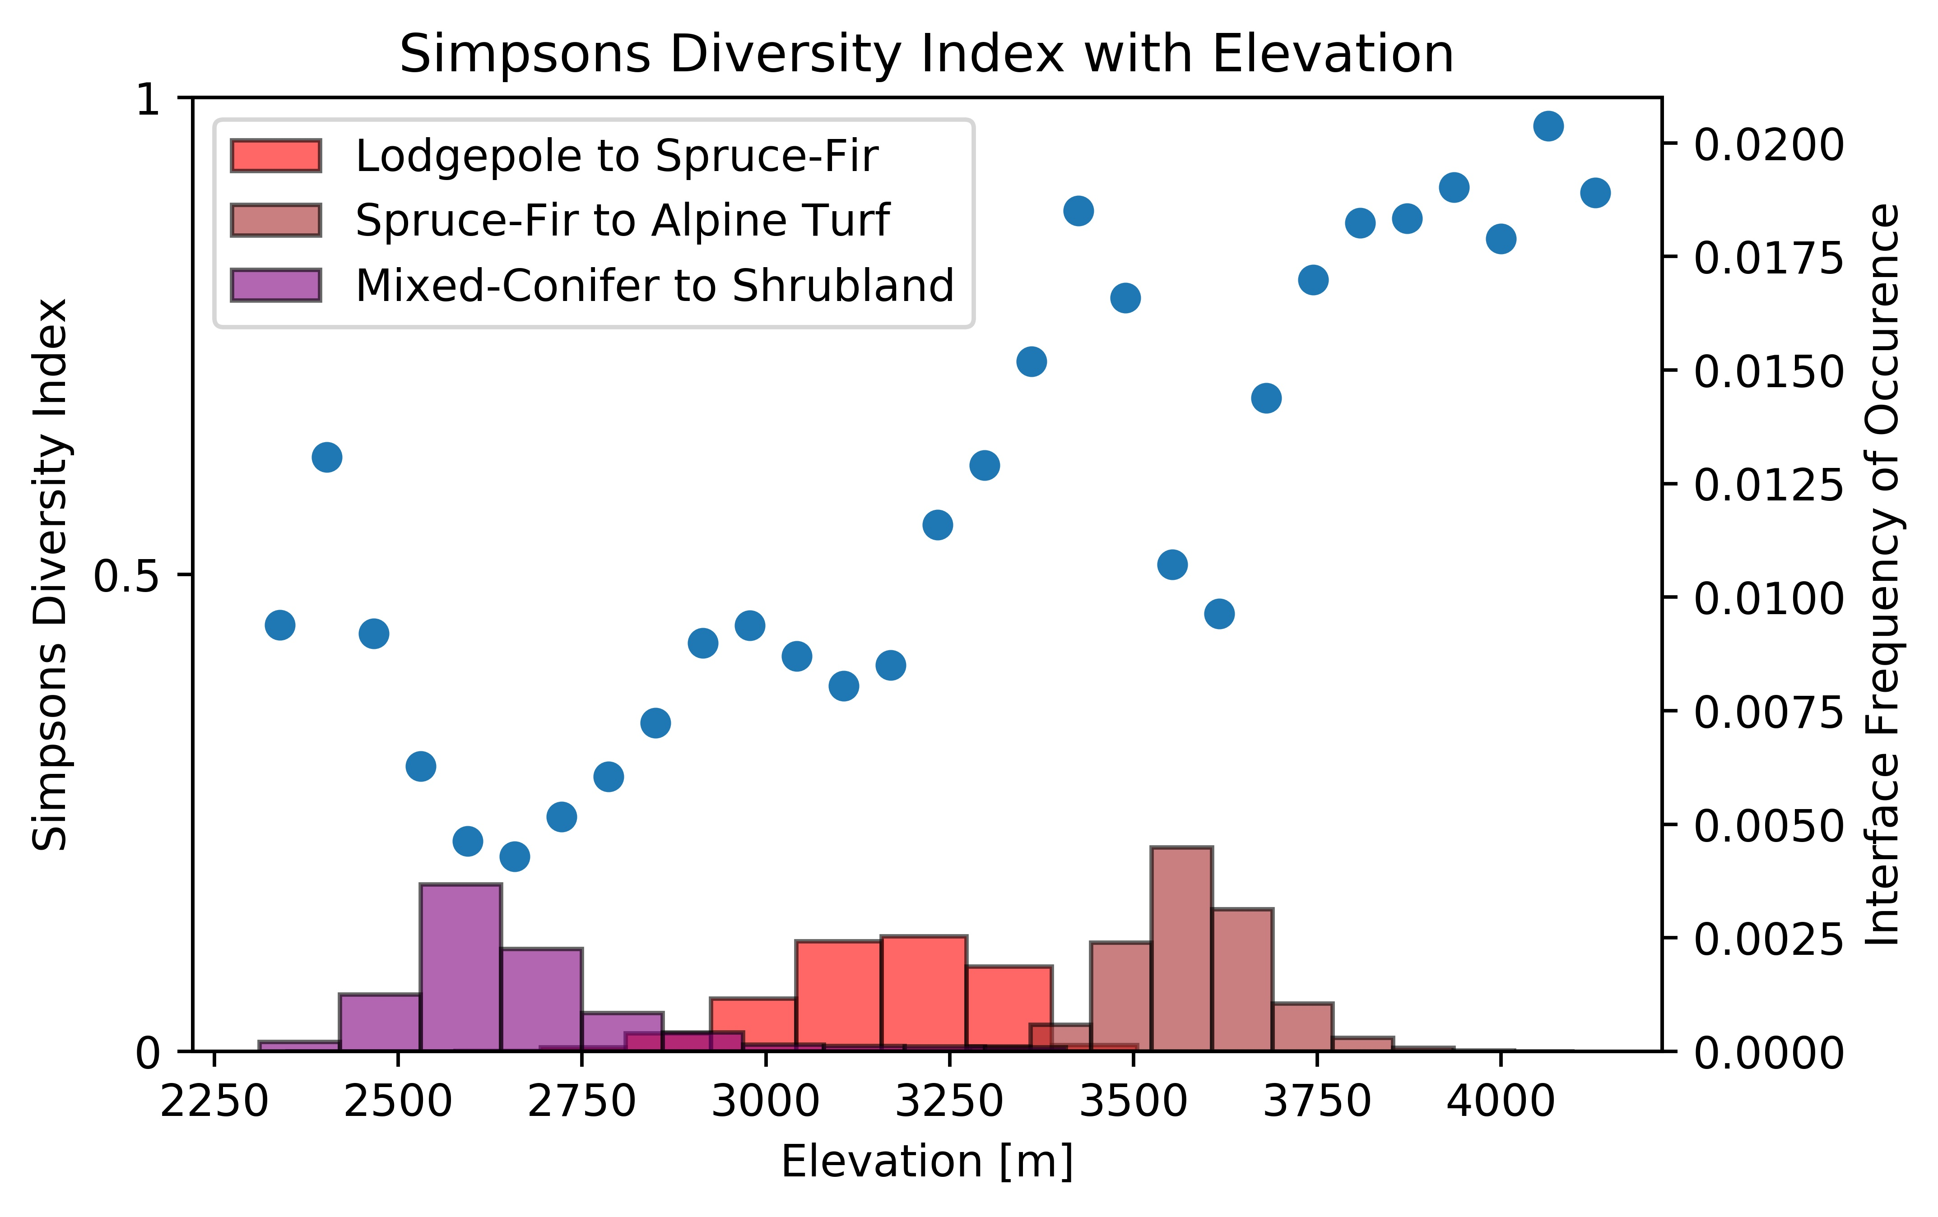

Slide 29
What are we doing?
Identifying hazards and values
Using collaborative groups to agree on actions
Advocating for funding, policies, and agency directions

Slide 30
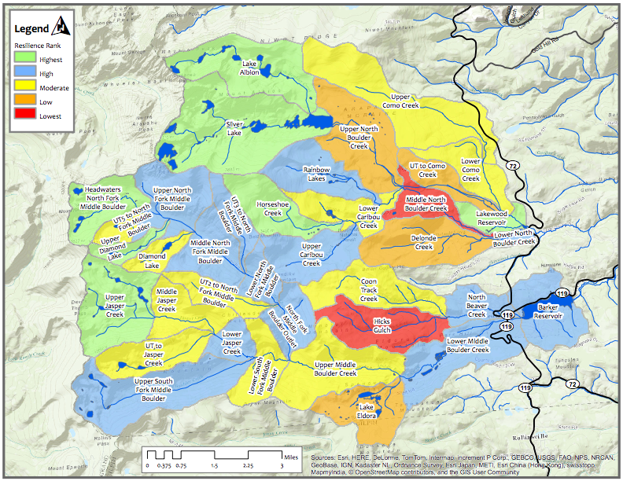

Slide 32
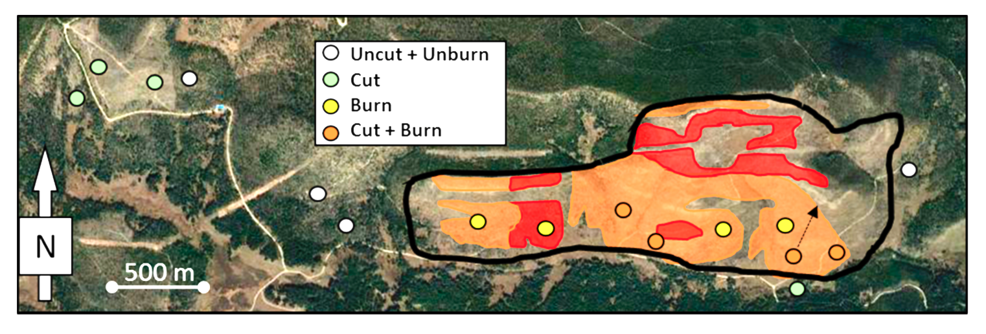

Slide 33
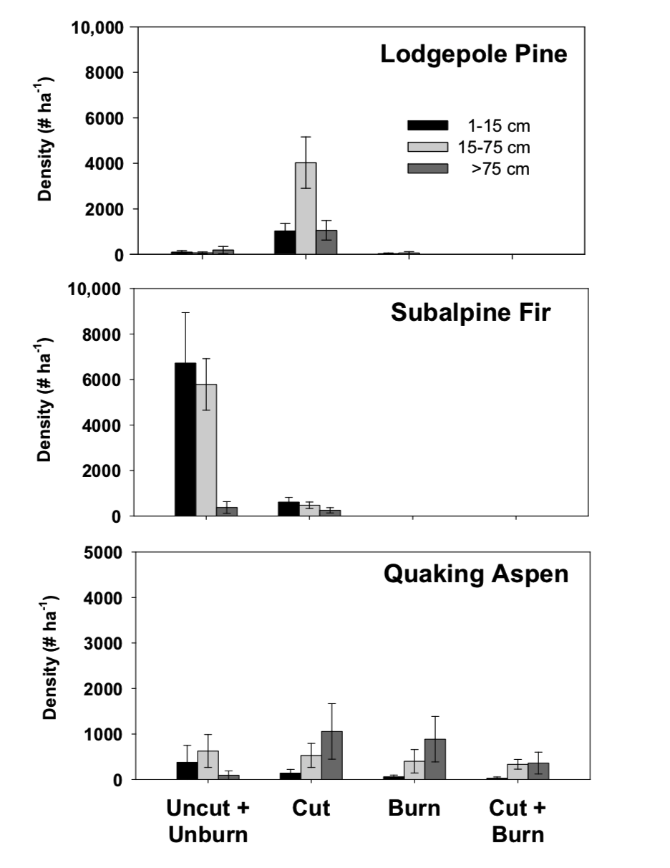

Slide 34
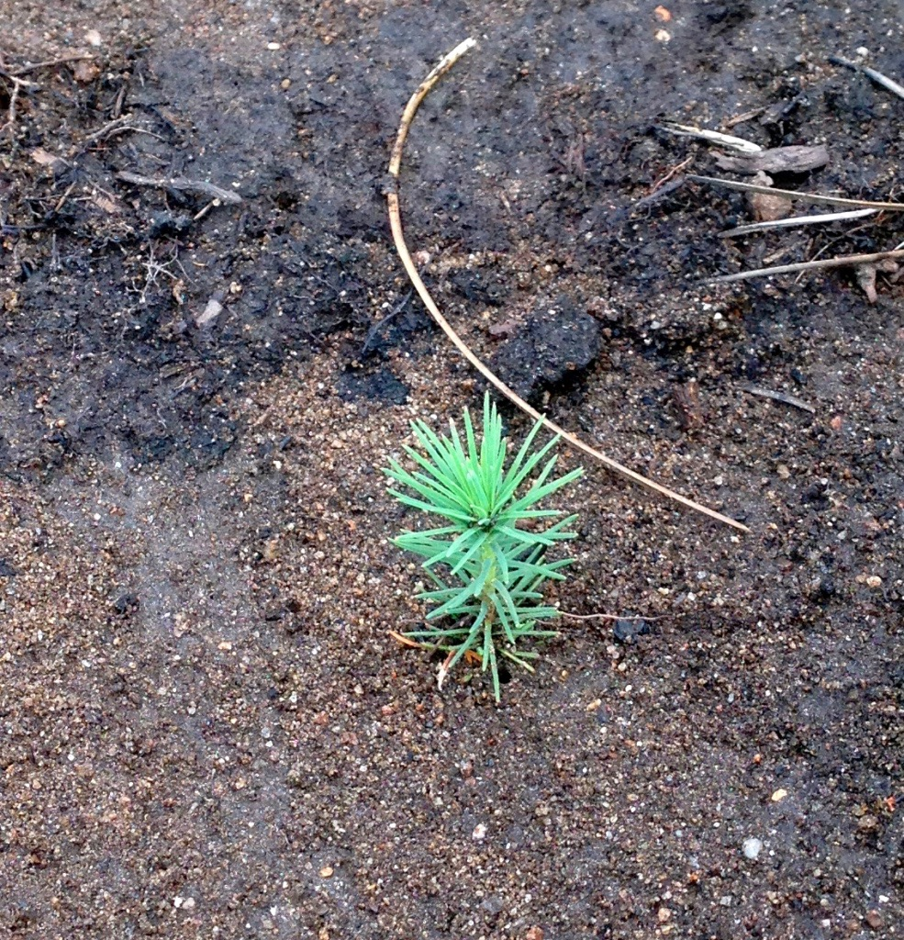
How to get involved
High Country Forest Collaborative highcountryforest.org
Watershed Wildfire Protection Group csfs.colostate.edu/forest-management/watershed-management
Forest Health Task Force summitpinebeetle.org
JW Associates jw-associates.org
Brad Piehl
970.406.0085
bpiehl@jw-associates.org

