Slide 1
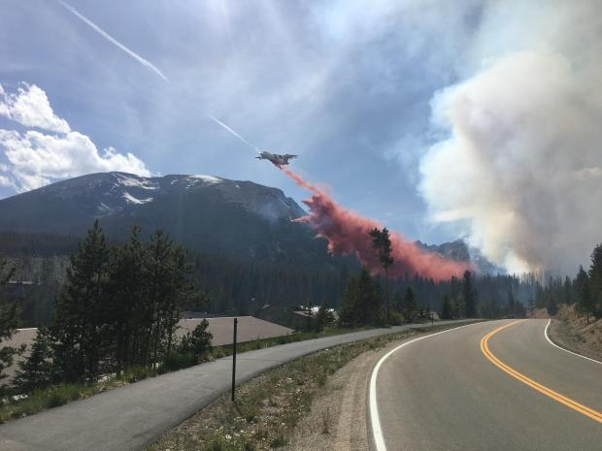
Buffalo Fire: June 2018
Aug. 16, 2018
NWCCOG
Notes:
Welcome

Slide 2
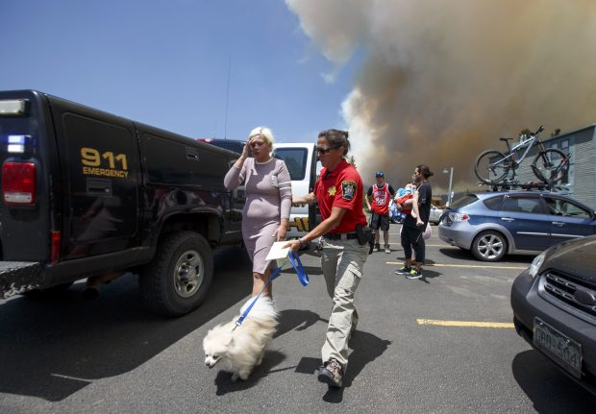
TIMELINE
June 12, 2018
10:46 am – Fire dispatched
10:54 am – Fire chief on scene
10:56 am – Evacuation ordered
11:01 am – SC Alert evacuation notice sent
11:11 am – 1st engine on scene

Slide 3
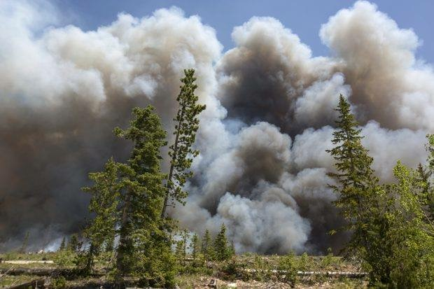
OVERVIEW
Mesa Cortina and Wildernest neighborhoods
91 acres
1,384 residential units evacuated
Large numbers of vacationers, pets, Spanish speakers
2,544 residential units threatened
Nearly $2 billion total values at risk

Slide 4
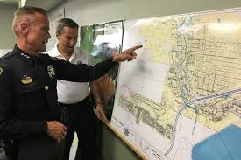
INTERAGENCY COORDINATION
Type III Delegation of Authority
June 12, 2018
EFF Funding and State Delegation
June 13, 2018
Type II Delegation of Authority
June 14-17, 2018

Slide 5
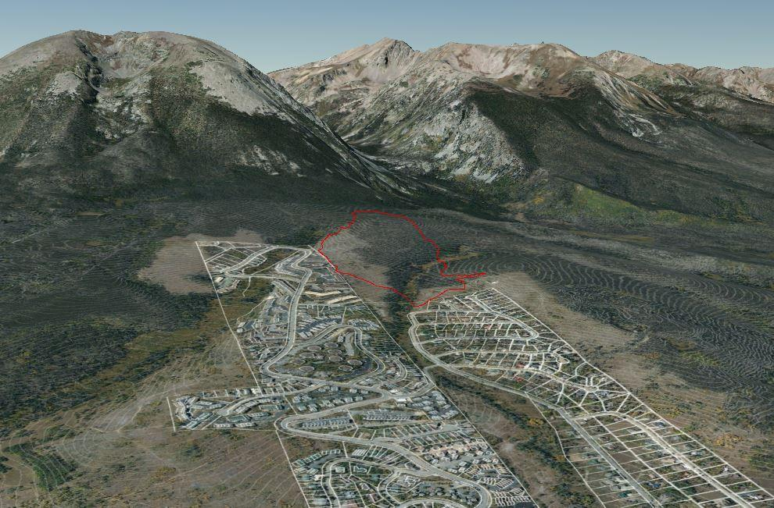
CRITICAL INFRASTRUCTURE
Gas & Electric
Public Safety Communications
Water Supply
Roadways

Slide 6
FIRE RESTRICTIONS
Summit County
Stage 1 Fire Restrictions: June 12, 2018
White River National Forest
Stage 1 Fire Restrictions: June 15, 2018

Slide 7
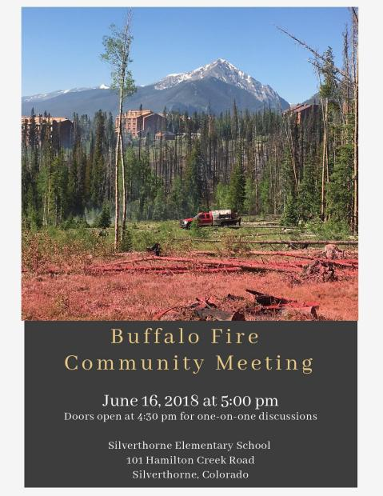
PUBLIC INFORMATION
Joint Information Center
Emergency Blog
Social Media
Media Hotline
Public Information Hotline
SC Alert
Day 1 Media Briefing
Media Tour
Community Meetings
Spanish Translation

Slide 8
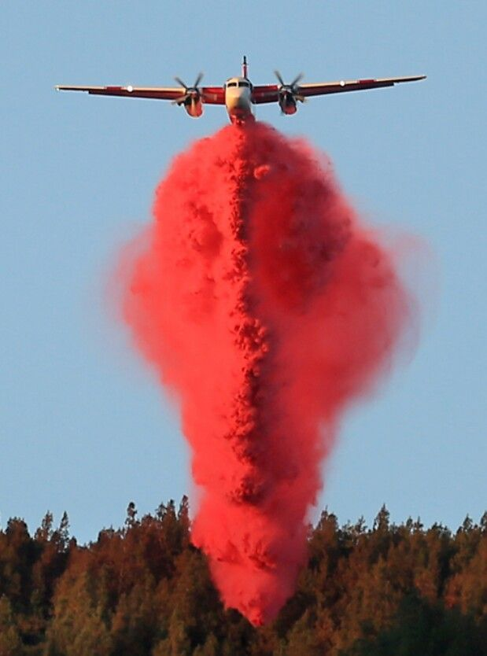
PUBLIC HEALTH
Air quality concerns
Food safety
Fire retardant considerations
Access and Functional Needs

Slide 9
MITIGATION EFFORTS

