Slide 1
NWCCOG Economic Development District COMPREHENSIVE ECONOMIC DEVELOPMENT STRATEGY 2017-2022 Mid-Year Progress Report – August 2018

Slide 2
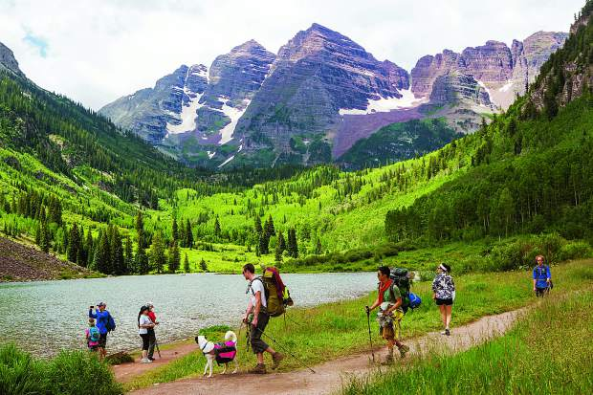
What Does the NWCCOG EDD “Do”?
NWCCOG Economic Development District exists to connect our communities with resources, build partnerships, and foster regional collaboration to enhance the economic prosperity of our region.

Slide 3
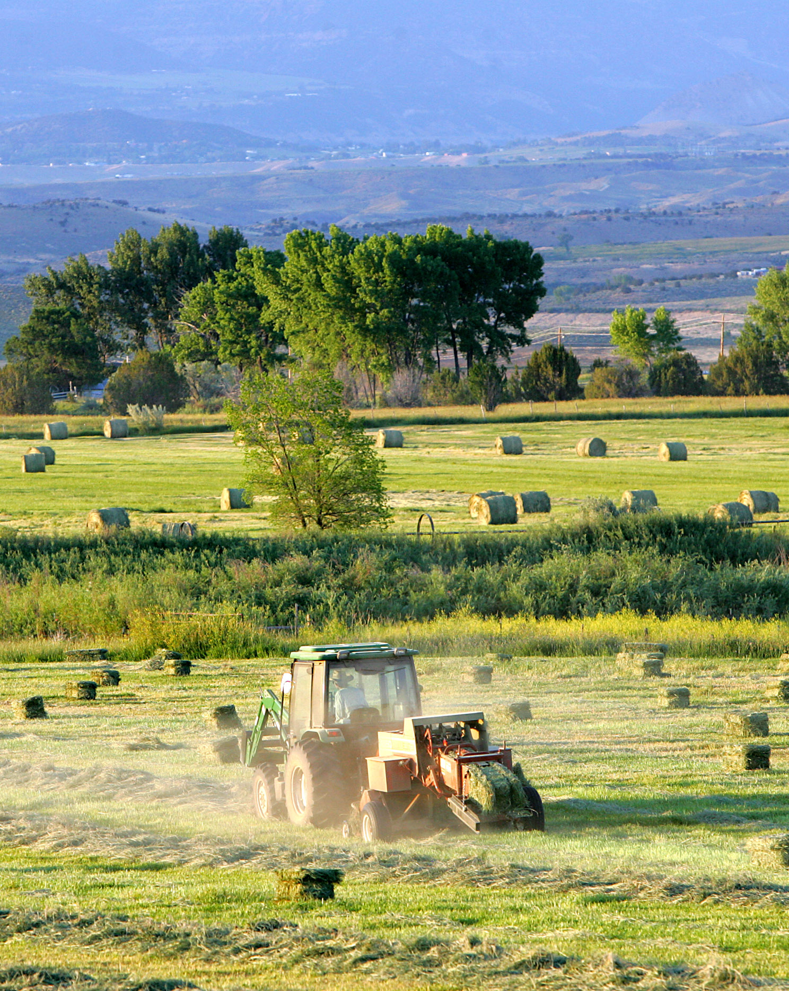
NWCCOG EDD
Since 2012
Funded by U.S. Dept. of Commerce / Economic Development Administration
Over 350 EDDs across the U.S.
6 In Colorado (soon to be 7)
$70,000 annual from EDA (+/-)
Matched 1:1 by Member Dues
Total Budget approx. $140,000

Slide 4
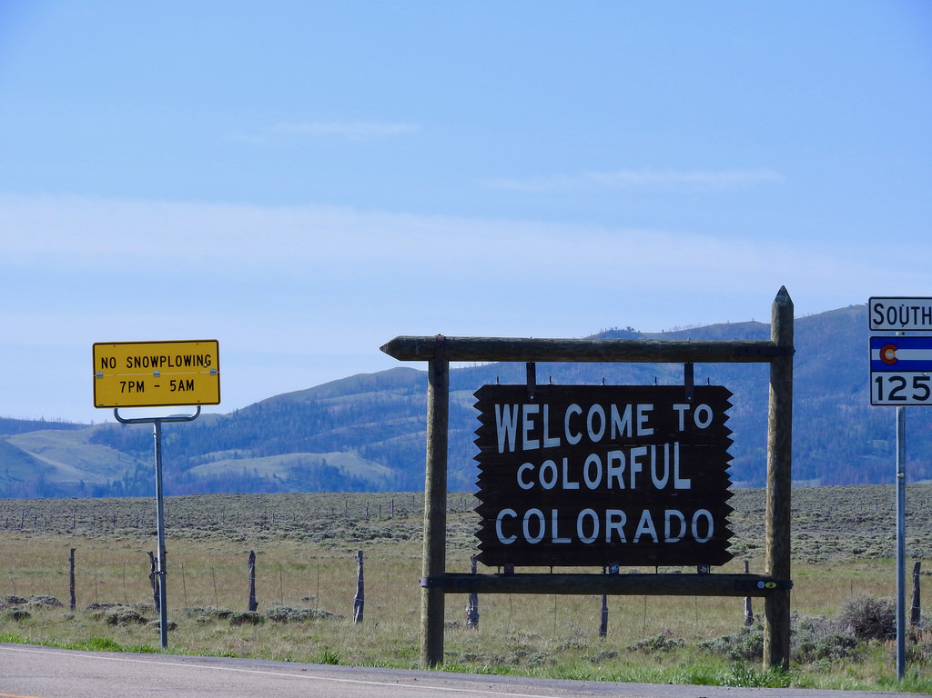
Data & Technical Assistance
Data
Population trends – provide insight into potential workforce pool, nature of the local market, need for local goods & services (i.e. schools, housing, healthcare, childcare, etc.)
Labor Force – indicates current and future tightness or slack in the regional labor force
Employment – indicates ability to create jobs
Unemployment – indicates ability to use human resources efficiently
Wages – indicate quality of jobs in the economy
Area Median Income – indicates money circulating in the economy
Personal Income – indicates wealth circulating in the economy to purchase local goods and services
Industry analysis – indicates the level of diversity in the economy
Technical Assistance
Small business owners & Entrepreneurs
Assist with access to capital
Help navigate how to start a business
Provide data
Answer questions on incentives, grant programs, re: specific communities

Slide 5
Connecting Resources & Building Partnerships
K-12
CMC
OEDIT
Workforce Centers
Chambers
Access to Capital
Non-Profits
DOLA
SDO
CLDE
NWCCOG
Businesses
Entrepreneurs
Private Foundations
Towns
Counties
Partners:
CML
CFI
CAST
CoWork Spaces
Accelerators
Incubators
SBDC
GEI
JEI
EDA
USDA
SBA

Slide 6
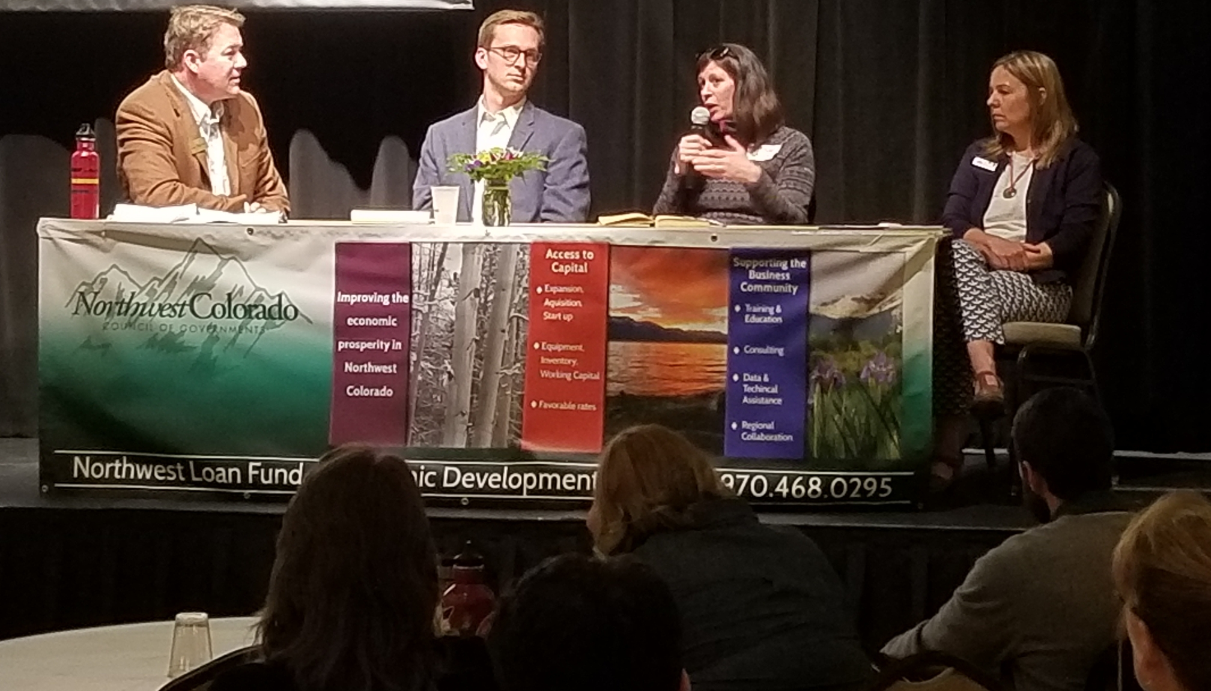
Forum for Regional Collaboration
NWCCOG Council / EDD Board meetings
Regional Economic Summit
Upon request from our partners
Topics of regional interest: STRs, recent fires, broadband, e-Bikes, workforce housing

Slide 7
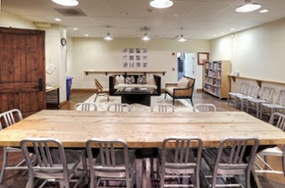
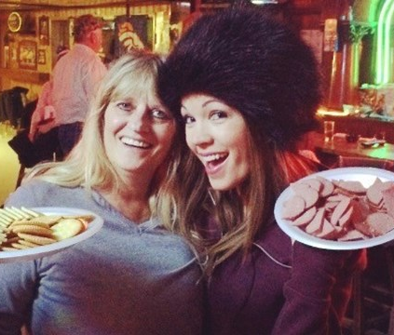
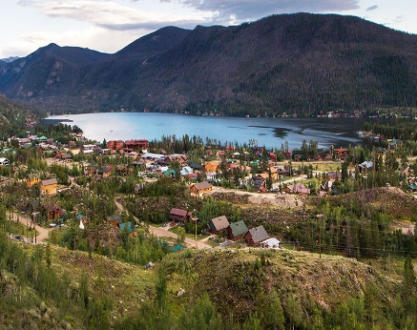
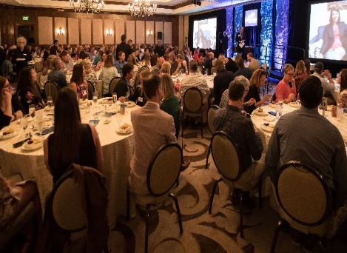
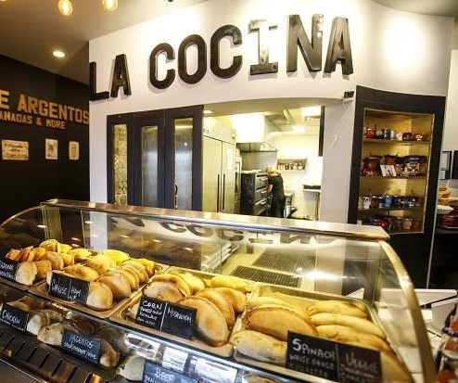
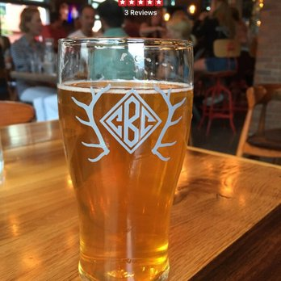
Promoting a positive Image of the Region
Vail Centre opens second co-work space
in Edwards to support
entrepreneurs and small businesses
Success Stories Bulletin - archives
NWCCOG eNews
Northwestcoloradoregion.org
Video!
The Town of Walden
provides "The Most Unexpected
Wild West Adventure"
Town of Grand Lake seeks
Creative District Designation
Town of Silverthorne
Business Grant Program
Awards over $24,000
to four local businesses
Summit Chamber/
Kaiser Permanente
Business Excellence
Award Winners
City of Steamboat Springs receives Certified Creative District Status
Capitol Creek Brewery
expanding to Aspen with
Assistance from the
Northwest Loan Fund

Slide 8
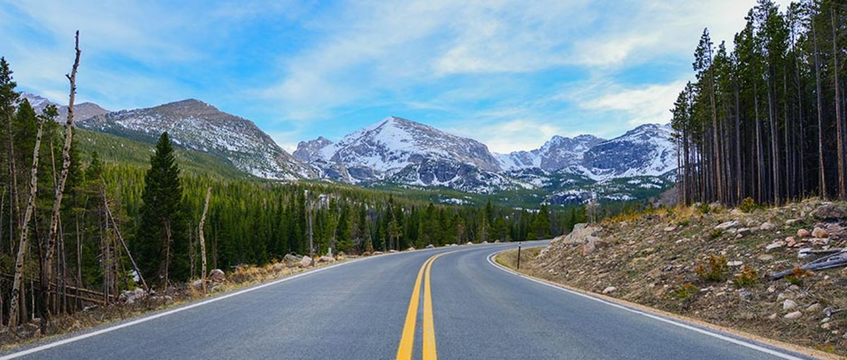
Comprehensive Economic Development Strategy
The strategic blueprint, known as a Comprehensive Economic Development Strategy (CEDS), is a strategy-driven plan for regional economic development. A CEDS is the result of a “regionally-owned” planning process designed to guide the economic prosperity and resiliency of an area or region. It provides a coordinating mechanism for individuals, organizations, local governments, and private industry to engage in a meaningful conversation and debate about the economic direction of their region.

Slide 9
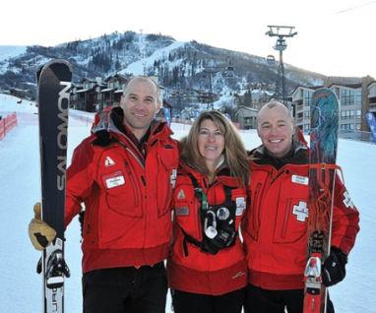
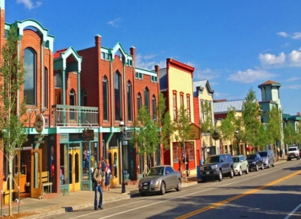
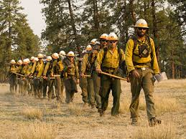
Strategic Direction/Action Plan
WORKFORCE
GOAL: Develop a healthy, productive, quality workforce that meets the demand for the business community
Objectives:
Build capacity in our region to have community infrastructure to support workforce: affordable housing, broadband, transportation, childcare, healthcare, education
Develop career pathways that help to retain a qualified workforce.
Foster an environment that supports the health and well-being of our workforce.
BUSINESS
GOAL: Cultivate a diversified, stable, balanced, sustainable economy
Objectives:
Create and maintain communities and a business climate attractive to entrepreneurs; Create an entrepreneurial ecosystem that encourages growth of new industries, new businesses
Encourage creation of higher-paying, year-round, career-focused jobs
Provide access to capital for existing businesses as well as new start-ups
Support, strengthen, build capacity in our region’s key industries and existing businesses
Build capacity of our towns and counties to meet their economic development goals
COMMUNITY
GOAL: Continue to help steward a unique community character and high quality of life attractive to year-round residents as well as visitors
Objectives:
Protect our unique community character
Protect the natural environment
Assist our communities to have thriving main street/downtown areas with full storefronts
RESILIENCY
GOAL: Foster a regional economy that is resilient to economic downturns/shocks and natural disasters in the long-term
Objectives:
Build capacity of our towns and counties to be resilient in the face of natural disasters, economic downturns
Bolster the long-term economic durability of the region so as not to be dependent on one single employer or one dominate industry
Establishing Information networks among the various stakeholders in the region to encourage active and regular communications between the public, private, education, and non-profit sectors to collaborate on existing and potential future challenges.
Promote a positive vision for the region

Slide 10
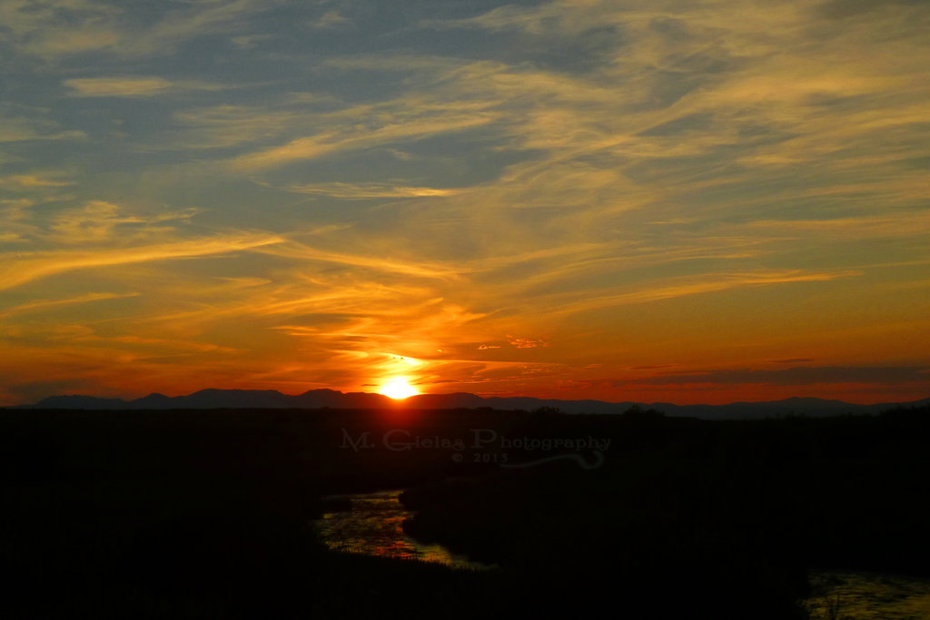
What Have We Accomplished in 2018?
2018 Economic Summit
Workforce Housing Report – coming soon!
Regional Broadband 5-Year Report
Building Entrepreneurial Ecosystem
Startup Colorado Events
Promotion of Events
Partnerships
Expand GEI into Jackson County
Continue Partnership with Grand County on EDA-Funded Initiative
Partner with Workforce Regions – Rural Resort and Northwest – Workforce 2020
Resources Bulletins: 12; Success Stories Bulletins: 7

Slide 11
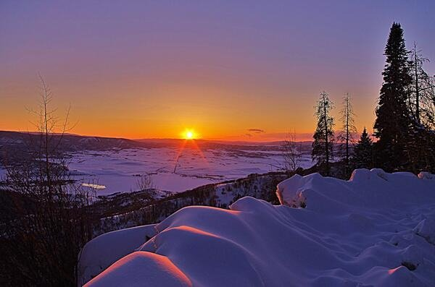
What Have We Accomplished in 2018?
Economic Development Successes in the Region:
Workforce Housing – many projects underway; STR regs; dedicated funding source in Summit County 5A
Regional Broadband Effort – Project THOR
Northwest Loan Fund – 2 loans in 2018 - $300,000
Investment in Community Infrastructure: Broadband, Workforce Housing Projects, Transportation
Investment in Creative Industries: Grand Lake, Steamboat, Breckenridge, Dillon, Silverthorne
Eagle County Tax Revenues to Mental Health Services
Building an Entrepreneurial Ecosystem
Co-Work Spaces
Startup Weekend
Expanded GEI into Jackson County
COILSx
Co-hosted Startup Colorado Workshops
Hosted OEDIT outreach workshops
SBDC
Vail Centre
Grand Enterprise Initiative – expands to Jackson County

Slide 12
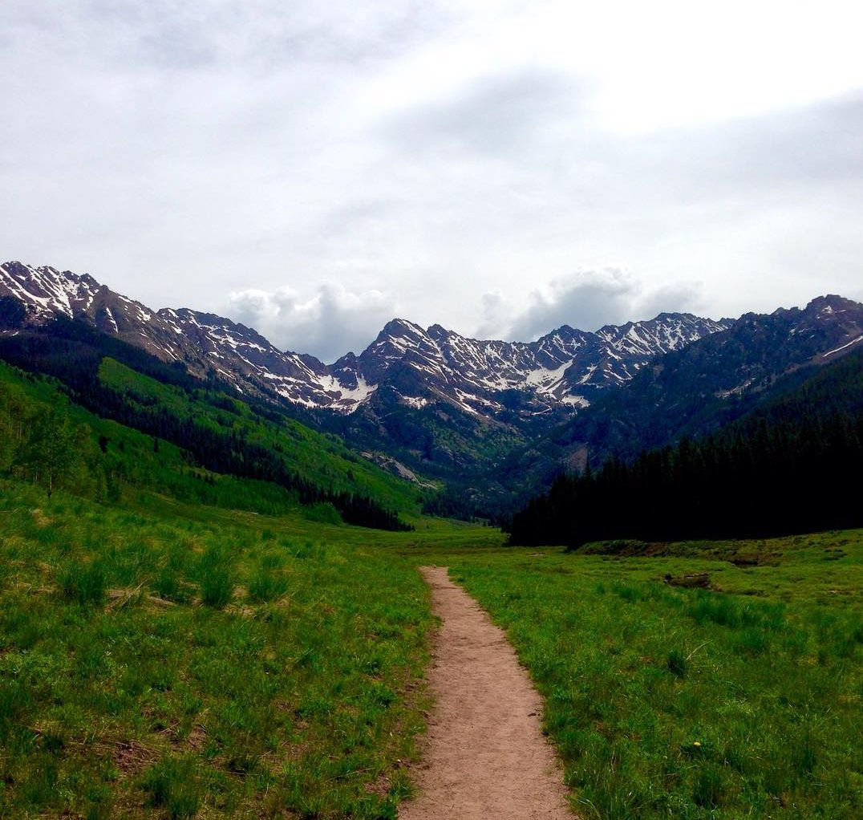
Looking Ahead to 2019
2019 Regional Economic Development Summit
Thursday, May 2, 2019 at the Silverthorne Pavilion
New, improved EDD website
Enhanced sections for resources for businesses, entrepreneurs
Census 2020: Outreach & Education
Count Me In / Vision 2020 – Outreach & Education on how the upcoming election/ballot initiatives affect our communities (public investments)
Continue to promote the region
Success Stories Bulletins
EDD website – highlight the region’s assets
Video!
Continue to build entrepreneurial ecosystem
Continue to build partnerships with champions of entrepreneurship
Continue to support efforts and events at local and state level
Continue to provide resources
Resources Bulletins
EDD website – data clearinghouse
Quarterly economic updates
Monthly workforce date
Data and info upon request

Slide 13
Looking Ahead to 2019
Other Projects, Initiatives, Activities?

Slide 14
Priority Area: WORKFORCE
Objective: Build capacity in our region to have community infrastructure to support both the current workforce and to attract future human capital/talent
ACTION | STAKEHOLDERS | RESOURCES | TIMEFRAME (2017-2021) | PRIORITY | PROGRESS
HOUSING: Inventory of workforce housing options in the region on website: links to housing authorities; sites listing rental housing; helpful tips to those looking for housing, etc. | TOWN GOVT COUNTY GOVT HOUSING BUSINESS | NWCCOGEDD HOUSING DCI | 2017 | H | Created Inventory of workforce housing options in the region on website; work underway on “Regional Workforce Housing Report” to be available Jan. 2018
BROADBAND: Carry out action items in Regional Broadband Strategic Plan | TOWN GOVT COUNTY GOVT BUSINESS CHAMBERS COWORK SPACES CMC K12 | NWCCOG TOWN GOVT COUNTY GOVT DCI EDA USDA RD | 2017-2022 | H | See list of completed projects
COMMUNITY INFRASTRUCTURE: Support efforts to provide needs of the workforce including healthcare; childcare; education/training; transportation | TOWN GOVT COUNTY GOVT BUSINESS EDUCATION COLORADO WORKFORCE SYSTEM | EDA USDA DOLA OEDIT CDLE | ONGOING | H
TRANSPORTATION: Support efforts to develop and improve multi-modal transportation systems including public transit, improvements to I-70; improvements and expanded service at airports (idea: sponsor a “bike sharing program” workshop; | TOWN GOVT COUNTY GOVT TOURISM INDUSTRY BUSINESS | CDOT I70 COALITION AIRPORTS EAA NWCCOG/RTCC | ONGOING | M

Slide 15
Priority Area: WORKFORCE
Objective: Encourage development of higher-paying, year-round, career-focused jobs
ACTION | STAKEHOLDERS | RESOURCES | TIMEFRAME (2017-2021) | PRIORITY H/M/L | PROGRESS
Create regional entrepreneurial ecosystem by learning about accelerator/incubator best practices throughout the state (OEDIT Blueprint 2.0 Initiative Program) | TOWN GOVT COUNTY GOVT BUSINESS COWORK SPACES COLORADO WORKFORCE SYSTEM | NWCCOGEDD OEDIT | 2017 | H | Completed Field trip to Mountain Ventures Summit in Telluride Feb 2017. 2 Follow-up meetings: 3/15/17; EDD board update on 5/25/17
Pursue funding under EDA’s Regional Innovation Strategies grant program for project that supports the development of an entrepreneurial ecosystem | TOWN GOVT COUNTY GOVT BUSINESS CHAMBERS COWORK SPACES CMC K12 | NWCCOG TOWN GOVT COUNTY GOVT DCI EDA USDA RD | 2017 | M | Submitted EDA RIS grant application on 6/22/17 for creation of “Mountain Outdoor Recreation Innovation Alliance”
Host a day-long workshop sharing best practices in innovation strategies; accelerator/incubator models; co-working spaces models; ideas for entrepreneurship and innovation | TOWN GOV County Govt Business Education | NWCCOGEDD EDA CENTER FOR RURAL ENTREPRENEURSHIP OEDIT USDA CHAMBERS | 2017 | M | Accomplished at regional economic summit in 2018

Slide 16
Priority Area: WORKFORCE
Objective: Establish partnerships to identify business’ workforce needs in terms of skills, training, and education
ACTION | STAKEHOLDERS | RESOURCES | TIMEFRAME (2017-2021) | PRIORITY H/M/L | PROGRESS
Create an ecosystem of businesses and business partners in our key industries as well as emerging industries to identify needs and develop programs to meet those needs. This may include developing industry sector partnerships in both key industries (tourism & outdoor recreation; health & wellness; infrastructure & engineering) as well as emerging industries (tech industry; creative industries) | TOWN GOVT COUNTY GOVT BUSINESS COLORADO WORKFORCE SYSTEM | NWCCOGEDD BUSINESS CMC K12 CWFC CDLE CHAMBERS | 2017-2019 | H | Strategy change: our region is not developing industry sector partnership as they are traditionally know; continue to work with partners on projects that help support the region’s key and emerging industries (i.e. Colorado Creative Districts; co-work spaces; entrepreneurial groups, chambers of commerce, etc. )
Provide training and education through partnerships | BUSINESS COLORADO WORKFORCE SYSTEM | CMC K12 CHAMBERS SBA SBDC CDLE | Ongoing | H | Promote trainings and workshops offered by partner organizations through resources bulletins

Slide 17
Priority Area: WORKFORCE
Objective: Foster an environment that supports the health and well-being of our workforce.
ACTION | STAKEHOLDERS | RESOURCES | TIMEFRAME (2017-2021) | PRIORITY H/M/L | PROGRESS
Continue WorkWell Collaborative | TOWN GOVT COUNTY GOVT BUSINESS WORKFORCE COLORADO WORKFORCE SYSTEM | NWCCOGEDD EAGLE COUNTY PH HEALTH LINKS CHAMBERS CDPHE RRR WDB | 2017-2018 | M | Year 2 of the grant from Colorado Department of Public Health and Environment has been completed. To date, the following are the results of the program: Impact on NWCCOG Region Employers: 77 employers participating in Health Links 36 employers renewed certification or converted from kick-start to certified $25 K distributed in kick start funding 11,390 total employees potentially reached with worksite wellness programming through Health Links

Slide 18
Priority Area: BUSINESS COMMUNITY
Objective: Create and maintain communities and a business climate attractive to entrepreneurs; Create an entrepreneurial ecosystem that encourages growth of new industries, new businesses
ACTION | STAKEHOLDERS | RESOURCES | TIMEFRAME 2017-2021 | PRIORITY H/M/L | PROGRESS
Develop and support resources for small businesses | BUSINESS | SBA EDA CHAMBERS CMC CDLE COWORK SPACES | ONGOING | H | 20 resources bulletins sent out Several updates made to website including economic and demographic data 4 quarterly economic updates created/distributed
Follow up on what is learned from OEDIT Blueprint 2.0 technical assistance: accelerator/incubator best practices | BUSINESS | OEDIT CENT FOR RURAL ENTRE | 2017 | H | Presented overview of Mountain Ventures Summit on 3/15/17 and 5/25/17
Pursue funding through EDA’s Regional Innovation Strategies grant program to create regional entrepreneurial ecosystem | BUSINESS | EDA TOWN GOVT COUNTY GOVT | 2017 | M | Submitted grant application for EDA RIS grant program on 6/22/17
Pursue funding to develop Kitchen Business Incubator Program | BUSINESS | USDARD DOLA |  | M
Pursue development of industry sector partnerships in emerging industries such as the Tech industry; creative industries | BUSINESS | COWORK SPACES BUSINESS CHAMBERS CDLE | ONGOING | M | Strategy change: no longer pursuing industry sector partnerships in the traditional sense; still provide key industry support
Pursue development of “Technology Innovation Center” | BUSINESS EDUCATION TOWN GOVT COUNTY GOVT | NWCCOG BROADBAND PROGRAM |  | M
Support and be a partner with Co-Working Spaces in the Region | COWORK SPACES BUSINESS | COWORK SPACES | ONGOING | H | Sponsor of Startup Weekend Breckenridge in Nov. 2017 (hosted by Elevate Cospace)

Slide 19
Priority Area: BUSINESS COMMUNITY
Objective: Support, strengthen and build capacity in our region’s key industries and existing businesses
ACTION | STAKEHOLDERS | RESOURCES | TIMEFRAME 2017-2021 | PRIORITY H/M/L | PROGRESS
Pursue development of industry sector partnerships in the region’s key industries such as Tourism and Outdoor Recreation; Construction; Health & Wellness; Technology & Information Continue existing sector partnerships (Health & Wellness) | BUSINESS | NWCOG EDD BUSINESS CHAMBERS OEDIT CWDC | Ongoing | H | Change of strategy: no longer pursuing development of industry sector partnerships in our region

Slide 20
Priority Area: BUSINESS COMMUNITY
Objective: Provide access to capital for existing businesses as well as new startups
ACTION | STAKEHOLDERS | RESOURCES | TIMEFRAME 2017-2021 | PRIORITY H/M/L | PROGRESS
Promote the Northwest Loan Fund | BUSINESS | NWCCOGEDD NLF | ONGOING | H | NLF Activity in 2017: 2 loans made: (1) $90,000; (2) $95,000
Develop and promote other funding sources for businesses – this may include applying for additional funding from USDARD – RMAP program | BUSINESS | USDARD OTHER FUNDING SOURCES BANKS | ONGOING | H | Promote other funding sources in Resources Bulletins

Slide 21
Priority Area: BUSINESS COMMUNITY
Objective: Build capacity of our towns and counties to meet their economic development goals; serve as a resource to our business community
ACTION | STAKEHOLDERS | RESOURCES | TIMEFRAME 2017-2021 | PRIORITY LEVEL | PROGRESS
EDD Resources Bulletin | TOWN GOVT COUNT GOVT BUSINESS | NWCCOG EDD | Ongoing | H | # Bulletins sent out: 20 Average open rate: 31%
Enhance and maintain NWCCOG Regional Economic Development Website | TOWN GOVT COUNTY GOVT BUSINESS | NWCCOGEDD | Ongoing | H | Updates to website include: creation of success stories page; creation of funding opportunities page; archive of all resources bulletins; creation of projects page to include information on EDA Economic Adjustment Grant for Grand and Clear Creek Counties
Provide economic data on website and via quarterly updates | TOWN GOVT COUNTY GOVT BUSINESS | NWCCOGEDD | Ongoing | H | # Quarterly economic updates: 4 Updates to data center on website: all town/county profiles updated using most recent data from statsamerica.org # of direct inquires responded to re: data: 34
Outreach on grant opportunities such as brownfields grants; USDA grants; etc. | TOWN GOVT COUNTY GOVT NONPROFITS EDUCATION | NWCCOGEDD | ONGOING | H | 20 resources bulletins sent out; funding opportunities page created to acrive this information

Slide 22
Priority Area: COMMUNITY CHARACTER
Objective: Protect our unique community character
Action | Stakeholders | Resources | Timeframe | Priority Level | PROGRESS
Build capacity in our towns and counties to protect assets and community amenities | TOWN GOVT COUNTY GOVT | NWCCOG EDD FUNDING AGENCIES | ONGOING | H | Provide information on funding opportunities and other technical assistance available through funding opportunities

Slide 23
Priority Area: COMMUNITY CHARACTER
Objective: Consider the impacts of activities on the natural environment
Action | Stakeholders | Resources | Timeframe | Priority Level | PROGRESS
Support efforts to protect the natural environment | TOWN GOVT COUNT GOVT | NWCCOGEDD FUNDING AGENCIES | ONGOING | M
Outreach on grant opportunities through resources bulletins, website, workshops, etc. | TOWN GOVT COUNTY GOVT | NWCCOGEDD | ONGOING | H | # resources bulletins sent out: 20
Develop relationships with our natural resource partners (in order to understand their “pain points” and capacity) | USFS BLM CDW NPS CO Parks | NWCCOG USFS BLM CDW NPS CO PARKS | ONGOING | M
Build the capacity of our communities to be resilient for ups and downs in the economic cycle | TOWN GOVT COUNT GOVT | NWCCOG EDD | ONGOING | H | Completion of EDA/EAA grant for Grand and Clear Creek County: Economic Resurgency and Resiliency Plan

Slide 24
Priority Area: COMMUNITY CHARACTER
Objective: Assist our communities to have thriving main street/downtown areas with full storefronts
Action | Stakeholders | Resources | Timeframe | Priority Level | PROGRESS
Partner with organizations to bring technical assistance to communities to assist with main street/downtown projects | TOWN GOVT COUNTY GOVT BUSINESS | NWCCOGEDD DCI DOLA | ONGOING | M | Promote programs of Downtown Colorado, Inc. and oter like organizations thorugh resources bulletins
Support the development of the creative industries sector | TOWN GOVT COUNTY GOVT | CCI DOLA | ONGOING | M | Promote programs of Colorado Creative Industries and other like organizations through resources bulletins

Slide 25
Priority Area: ECONOMIC RESILIENCY
Objective: Build capacity of our towns and counties to be resilient in the face of natural disasters, economic downturns
Action | Stakeholders | Resources | Timeframe 2017-2021 | Priority H/M/L | PROGRESS
Collaborate with NWAHEMR on Regional Emergency Management Plan; work with emergency managers in the region to address the risks identified through hazard mitigation planning | 10 counties in the NWAHEMR | NWCCOGEDD NWAHEMR | ONGOING | H | NWCCOG will be hosting a disaster preparedness workshop for elected officials in 2018
Establish information networks among the various stakeholders in the region to encourage active and regular communications between the public, private, education and non-profit sectors to collaborate on existing and potential future challenges. One method is to convene the EDD Working Group and have economic resiliency/disaster preparedness as a discussion topic | Town Govt County Govt Business Non-Profit CMC/K12 | NWCCOGEDD | Ongoing | H | NWCCOG is considering re-convening the working group in 2018 around economic development focused topics
Partner to bring educational workshops on disaster preparedness | TOWN GOVT COUNTY GOVT BUSINESSS | SBA DOLA EDA | ONGOING | H | NWCCOG will be hosting a disaster preparedness workshop in 2018

Slide 26
Priority Area: ECONOMIC RESILIENCY
Objectives: Bolster the long-term economic durability of the region so as not to be dependent on one single employer or one dominant industry
Action | Stakeholders | Resources | Timeframe | Priority | PROGRESS
EDA Economic Adjustment Assistance Grant - carry out scope of work – economic resiliency plan for Grand and Clear Creek Counties | Grand County Clear Creek County | EDA Climax Molybdenum Grand County Clear Creek County | 2017-2018 | H | NWCCOG was the grant writer and has served as project manager/fiscal agent for the project. A detailed economic data packet has been constructed for both the counties. This data outlines the economic concentrations and associated economic opportunities in both the counties. The teams have conducted extensive interviews (greater than 85) with the stakeholders in both the counties. The stakeholder list includes: government officials, business leaders, local residents, entrepreneurs, non-profit leaders, and more The team has developed a draft of what a 3 horizon economic development plan can look like for the county. This three horizon map allows the team to evaluate a diversified portfolio of strategies that have different investment requirements and are able to drive benefits at different time windows. Both counties have started establishing strong leadership teams locally. The purpose of this leadership team is to provide overall programmatic guidance and will be an important part of the long-term program continuity efforts. The grant closed on November 25th. Final report for the project has been submitted to the EDA. For Grand County, Action Teams were formed in the following five priority areas: 1.Anchor Institution Collaboration 2.Housing Solutions 3.Wood Cluster Stabilization 4.Tourism Cluster Diversification and Small Business Development 5.Industry Cluster Diversification Detailed action plans are now available on the NWCCOG EDD website on the “projects” page: http://northwestcoloradoregion.org/About-NWCCOG/Projects.aspx

Slide 27
Priority Area: ECONOMIC RESILIENCY
Objectives: Develop relationships with our dominant/key industries in order to understand their business model and plan for future changes/shocks/downturns in their business
Action | Stakeholders | Resources | Timeframe 2017-2021 | Priority H/M/L | PROGRESS
Develop industry sector partnerships with our key industries Continue existing sector partnerships (Health & Wellness) | Business Chambers Key industries: ski industry; outdoor recreation industry; construction industry | Businesses in key industries EDA OEDIT CDLE | Ongoing | M | Change in strategy: no longer focusing on building sector partnerships as its proven to be not the most successful model for our rural region; continue to provide key industry support

Slide 28
Priority Area: ECONOMIC RESILIENCY
Objectives: Promote a positive vision for the region; provide positive messaging about the region’s assets and opportunities
Action | Stakeholders | Resources | Timeframe 2017-2021 | Priority H/M/L | PROGRESS
Create and maintain regional marketing website | Town Govt County Govt Business Chambers | NWCCOGEDD | Ongoing | H | Created website as a regional promotion tool: Northwestcoloradoregion.org; continue to maintain and enhance the website
Include success stories from the region in EDD resources bulletins, NWCCOG e-News and on website | Town Govt County Govt Business Chambers CLDE | NWCCOGEDD NWCCOG | Ongoing | H | Success Stories Bulletins Archived on website
Support efforts of our region’s communities to develop the creative sector in their community | Town Govt County Govt Business Chambers | CCI DOLA OEDIT EDA | Ongoing | M | Highlight stories of creative industry sector in newsletters and success stories bulletins

