Slide 1
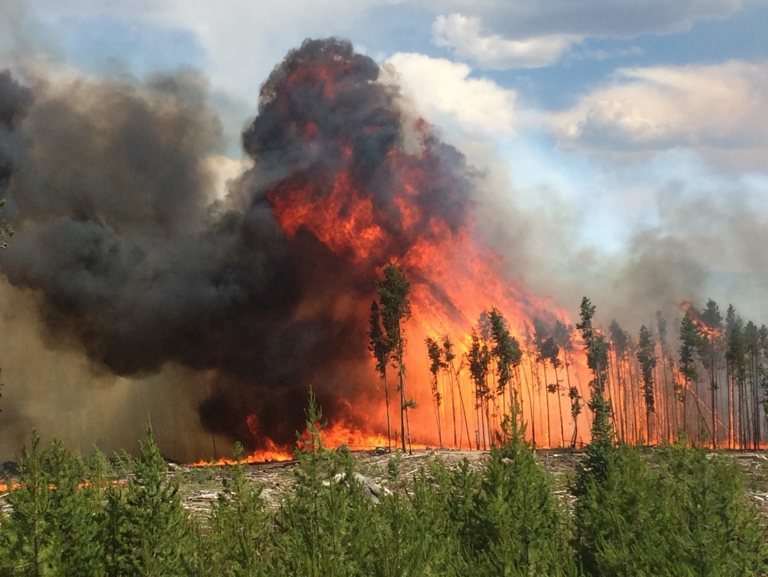
Sugarloaf & Golf Course fires

Slide 2
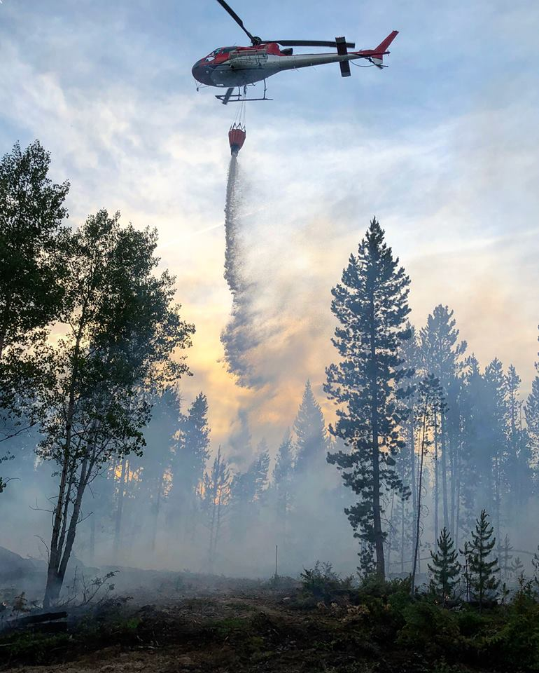
Overview
On June 28th, Grand County saw two fires begin on opposite ends of the county within 12-hours of each other. The Sugarloaf fire was on Forest Service land while the Golf Course fire was on county land. Both were heavily fueled by the Pine Beetle Kill infestation.
There were no injuries to residents or first responders, and no structures were damaged on either of these events.
On June 26th at the weekly Board of County Commissioners meeting, a unanimous vote was made to enact Stage 1 Fire Restrictions beginning on June 28th at 4pm.

Slide 3
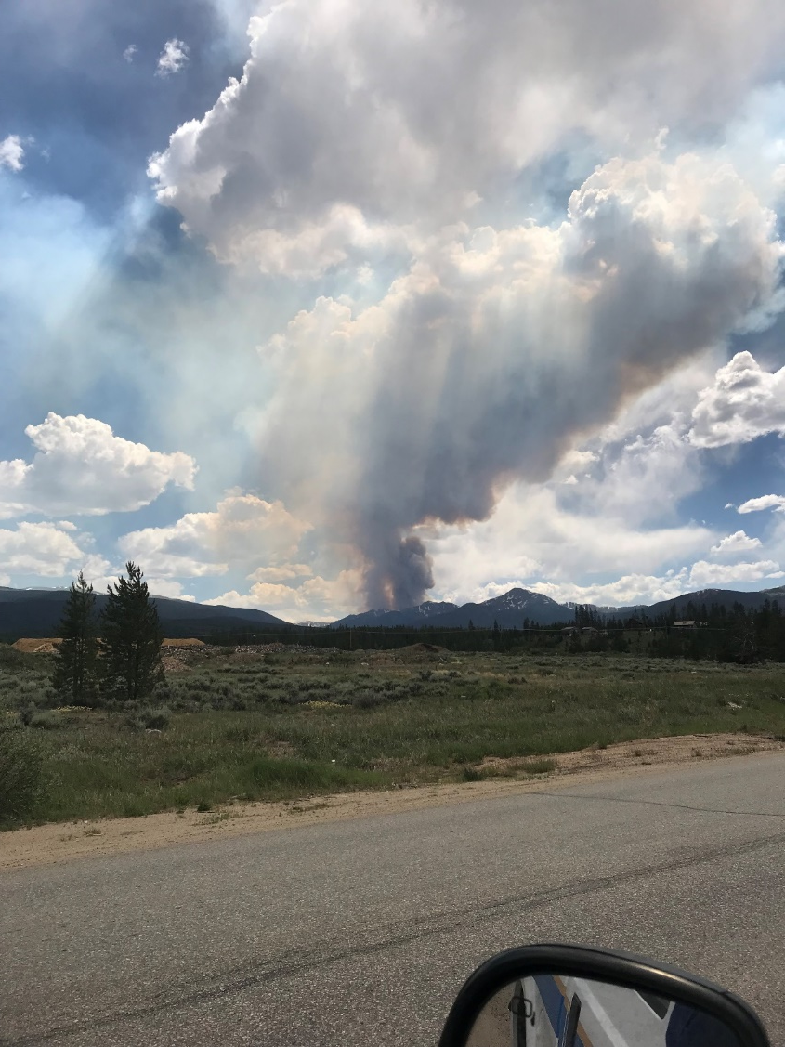
Sugarloaf Fire
Started: Thursday June 28, approx. 12:00 am
Cause of fire: Lightning strike
Location: 13 miles SW of Fraser
Size: 1280 acres
Current status: Active
Personnel assigned: 10
Resources assigned: 2 type-6 engines
Containment: 35%

Slide 4
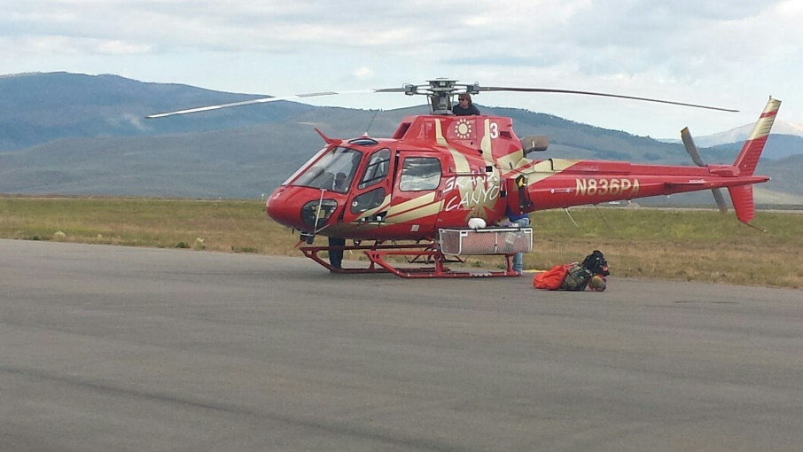
Sugarloaf Fire
History of the fire:
Grand County dispatch was notified of visible smoke SE of the Henderson Mill on the morning of June 28th.
Crews from Hot Sulphur Springs Fire District along with deputies from Grand County Sheriff’s Office responded and were able to control growth of the fire to a very small size.
Forest Service took control of the fire late morning and decided to let the fire burn as it was in a remote area impacted by the pine beetle infestation
Smoke plume from the growth of the fire was noticeable from Grand County as well as Summit County.

Slide 5
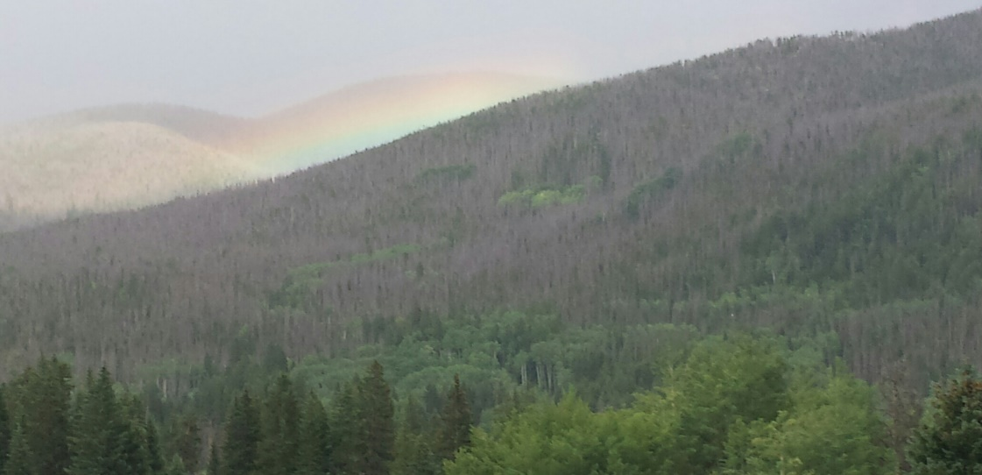
Sugarloaf Fire
History of the fire:
The sudden growth of the fire (and smoke plume) caused multiple reports across both counties of fires in the area, which also caused confusion as the Golf Course fire began.
Coordinator meeting was set up for Friday at 2pm at Granby directed by the Forest Service to keep all stakeholders aware of the response. These meetings continued until the middle of July when the fire’s growth began to slow and the fire’s activity was better controlled.
The Sugar Loaf fire received considerable attention due to the smoke plume viewed from Summit County as well as the smoke in the area.

Slide 6
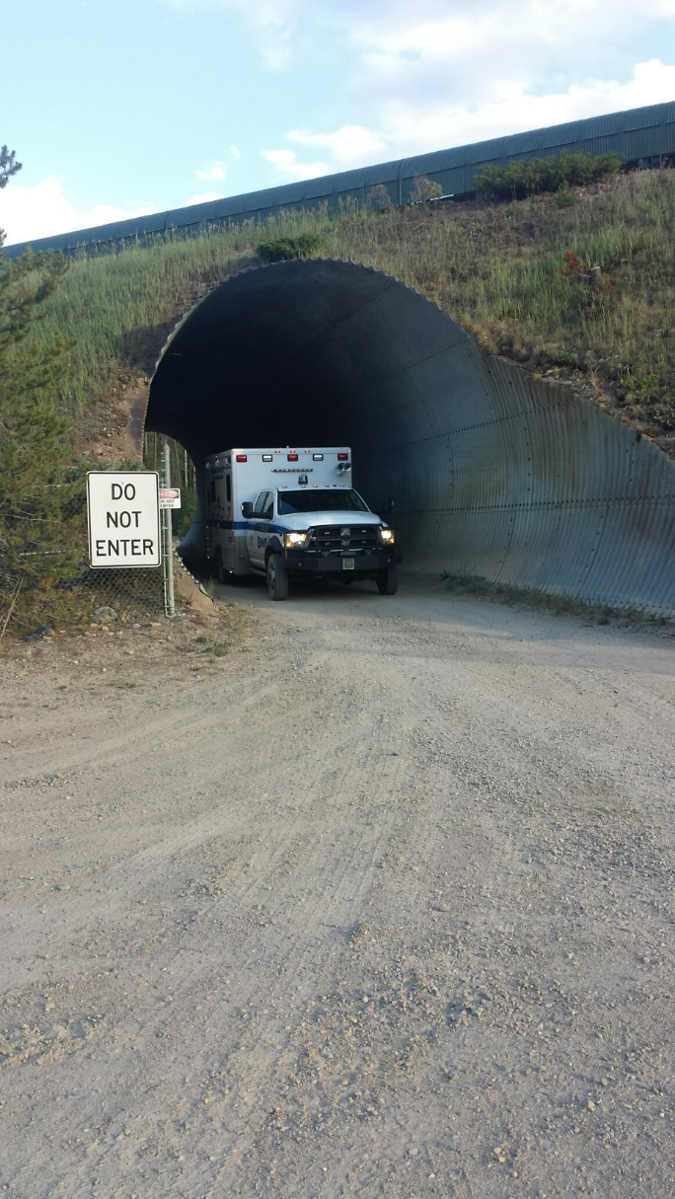
Sugarloaf Fire
Grand County EMS was asked to provide an ALS standby ambulance close to the staging area for 2 weeks to provide medical support in the event that a firefighter was injured.
GCEMS crews reported to the Incident Command Post at East Grand High School each morning at 7am and reported back at 8pm.
U.S.F.S. crews were extremely supportive of the presence of GCEMS.
No injuries were reported during their deployment.

Slide 7
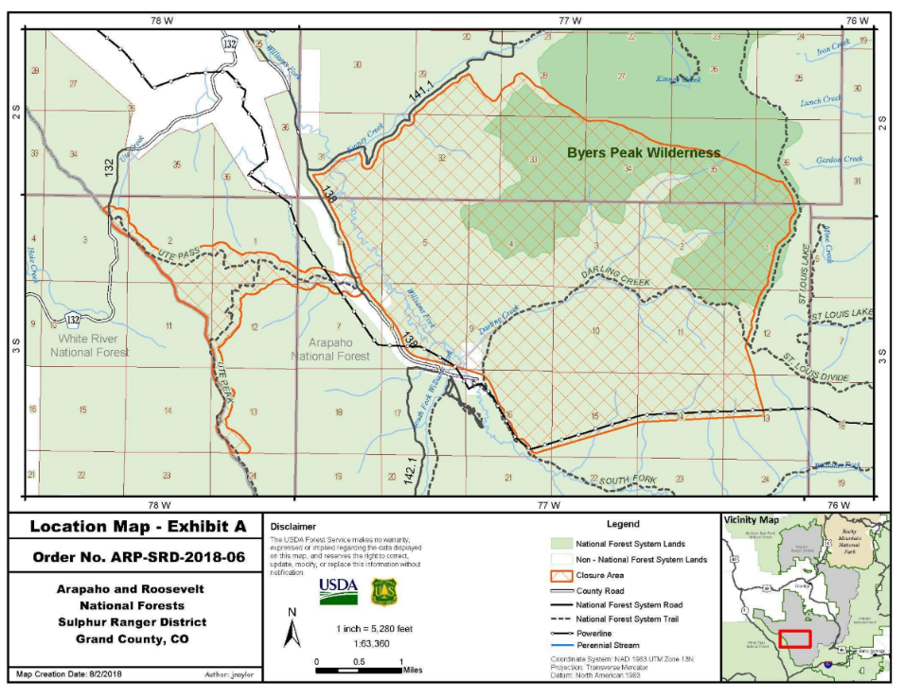
Sugarloaf Fire
The fire is still currently active and at 35% containment. There is minimal growth and minimal resources currently attached. No Grand County resources are actively engaging the fire at this time.

Slide 8
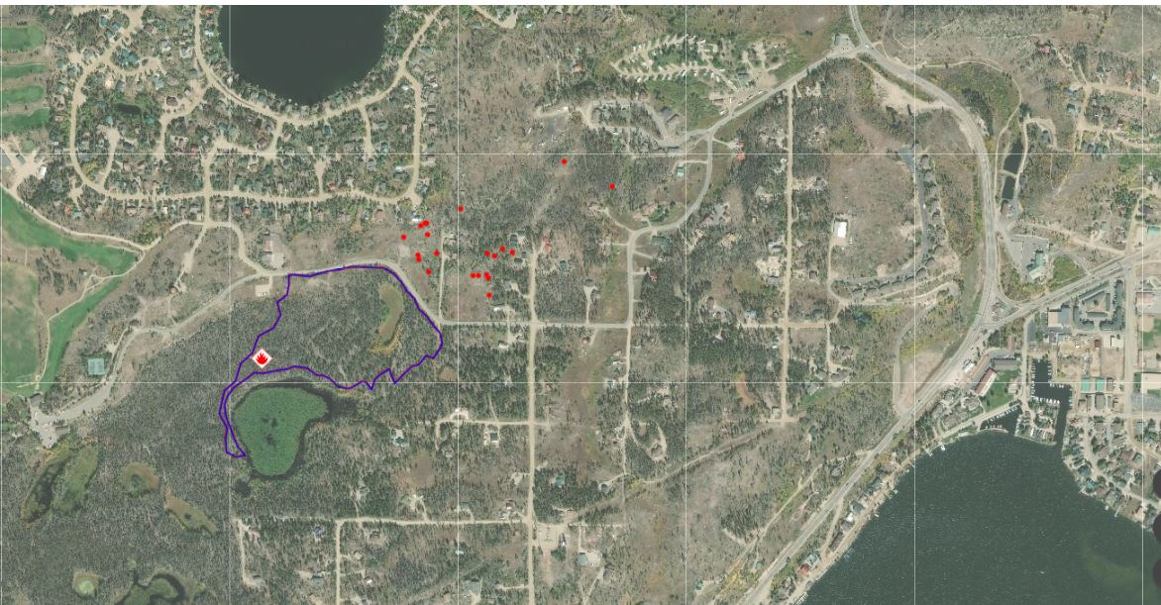
Golf Course Fire
Started: Thursday June 28, approx. 2:30pm
Cause of fire: Under investigation
Location: East of GL Golf Course
Size: 18.5 acres
Current status: Extinguished
Personnel assigned: 150+
Resources assigned: Heavy tankers, helicopters, hot shot crews, all types fire engines, dozers, loaders
Containment: 100%

Slide 9
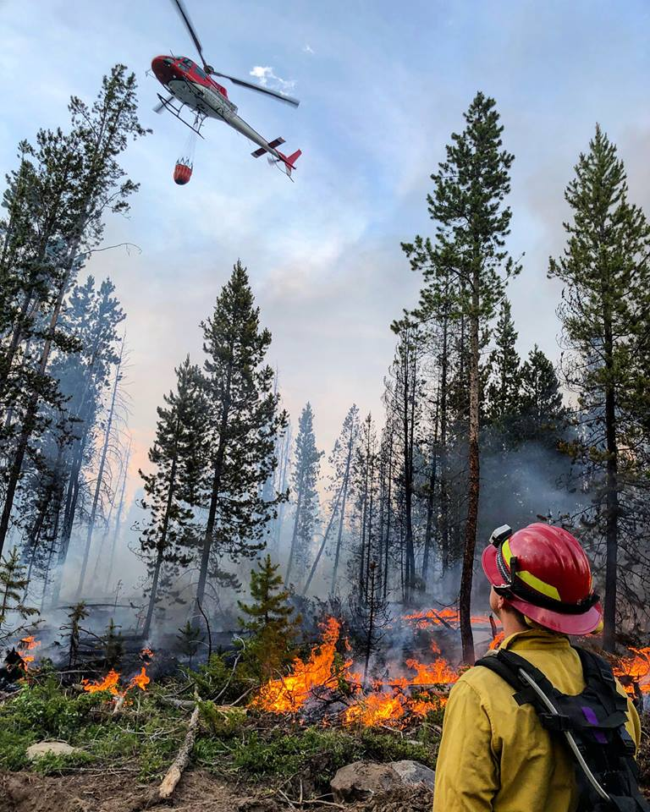
Golf Course Fire
History of the fire:
At approx. 2:30pm on June 28th, Grand County dispatch received calls of a fire burning in the area of County Road 48 and the golf course as other calls were being received of smoke in the county.
Grand Lake Fire District crews responded to the wildland fire within minutes of the initial call and began fighting the fire.
Area mutual aid was requested with Grand Fire, East Grand Fire, Hot Sulphur Springs Fire and Kremmling Fire all responding with varying crews.
Grand County EMS, Grand County OEM, Grand County Sheriff’s Office, The Rocky Mountain National Park and U.S.F.S all responded immediately to provide support.

Slide 10
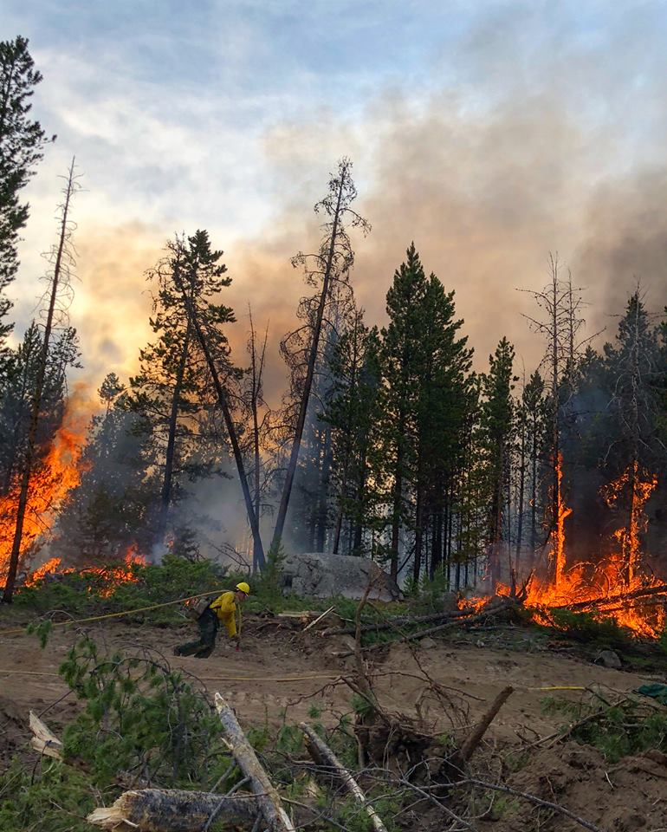
Golf Course Fire
History of the fire:
The newly organized Mountain Area Mutual Aid response was initiated to provide additional resources within a shortened period of time from the NW region.
Crews from across the NW region, state, SD and WY responded to assist with the fire efforts and would ultimately grow to over 150 personnel that battled it.
At 3:55pm a pre-evacuation notification was sent out through CodeRed warning the residents of the need to be prepared should the fire grow.
At 4:23pm the residents in the impacted were notified of a mandatory evacuation and that the evacuation point would be the Grand Lake Center.

Slide 11
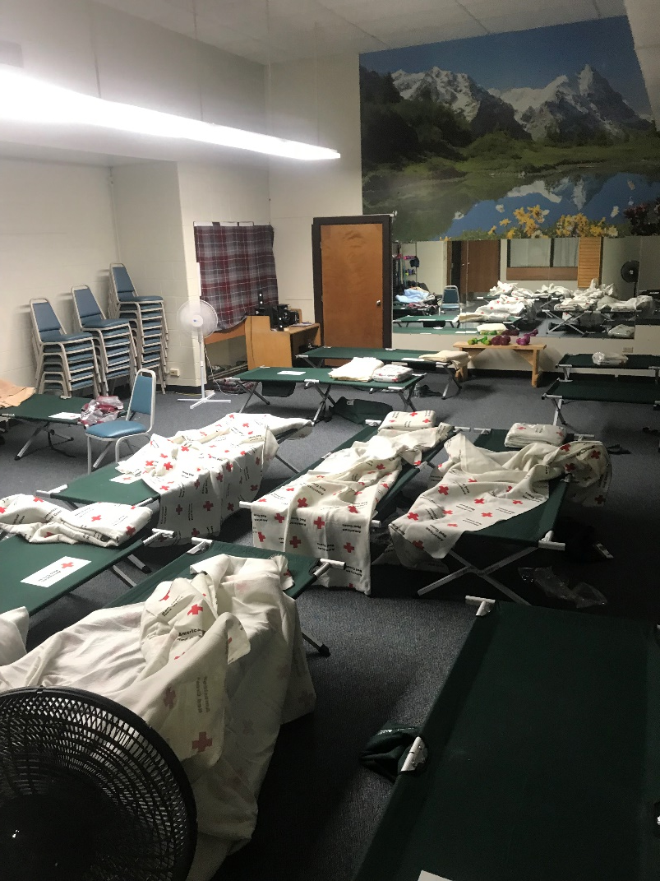
Golf Course Fire
History of the fire:
Incident Commanders did cut off power and gas to some of the impacted area to minimize potential fires
OEM was able to coordinate with the American Red Cross the use of the GL Center to provide shelter for any impacted resident. A total of 30 people stayed over night, either within the facility or camping outside.
The ARC kept the shelter open during the day on Friday and was able to demobilize in the evening of the 29th
OEM coordinated the feeding of the firefighters and worked with ARC on the feeding of those that sought shelter

Slide 12
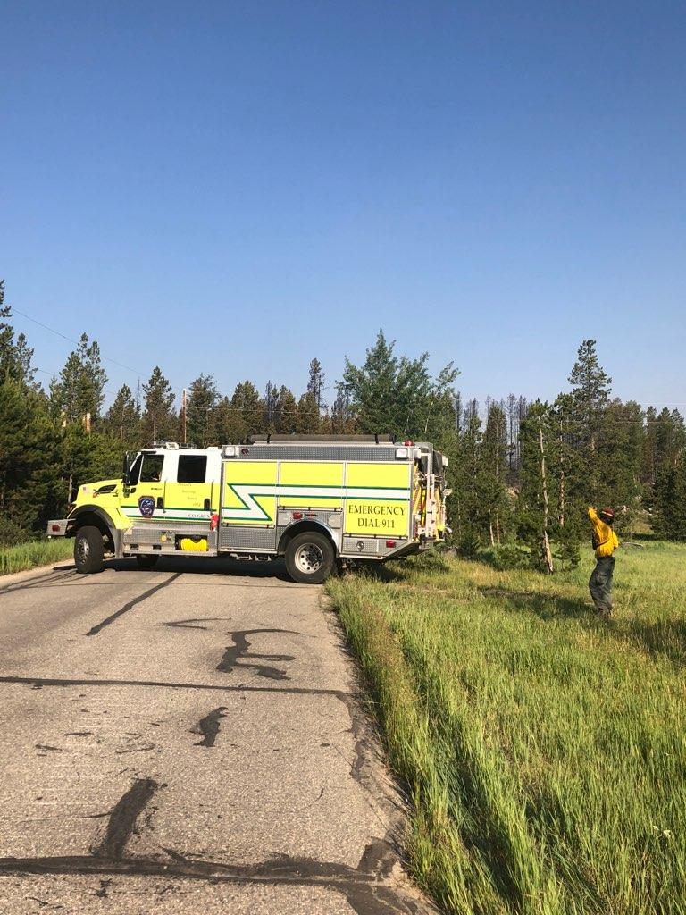
Golf Course Fire
History of the fire:
By Thursday night, crews had a good handle on the fire but needed to watch out for hot spots that were crossing the fire break of CR 48.
By Friday AM, it was believed that the fire would be adequately controlled enough by the end of the day to allow residents back home barring any major change in the wind.
Mutual Aid crews began to be released by 3:30 as the fire activity was slowing down.

Slide 13
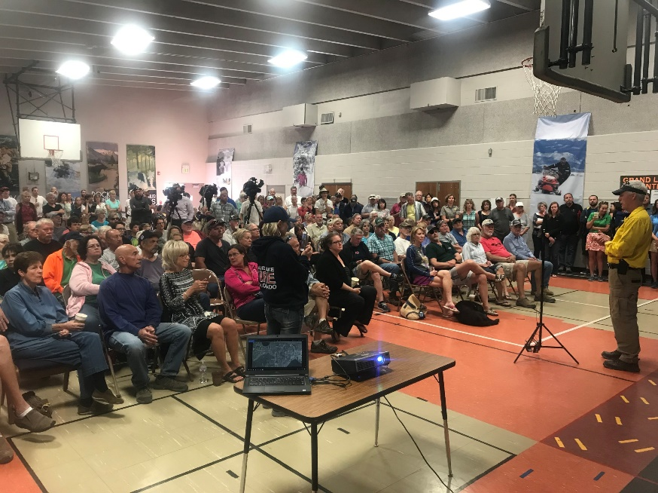
Golf Course Fire
History of the fire:
Due to the nature of the fire and to make sure that citizens were kept informed in a timely and professional manner, a community briefing was held at 7pm on Thursday where over 150 people attended.
A total of four community briefings were held between Thursday and Friday evening that allowed the incident commanders to provide information to the public and answer questions. Each briefing was recorded and shown on Facebook Live via OEM’s Facebook page.
At 7pm on Friday June 29th, the final CodeRed notification was sent out informing residents that the evacuation order had been lifted following the final briefing.
At the recent Responder and Public After Action Report meeting, everyone was thankful for the quick determination to hold these briefings as well as the ability to interact with the command staff.

Slide 14
Golf Course Fire
Grand County’s Sherrif’s Office used the brand new thermal-capable Unmanned Aerial Vehicle (drone) to assist firefighters with detecting hot spots that were not initially visible by those on the ground. Some of these spots were between 200-300 degrees and still undetectable due to the terrain and them not producing smoke initially.

Slide 15
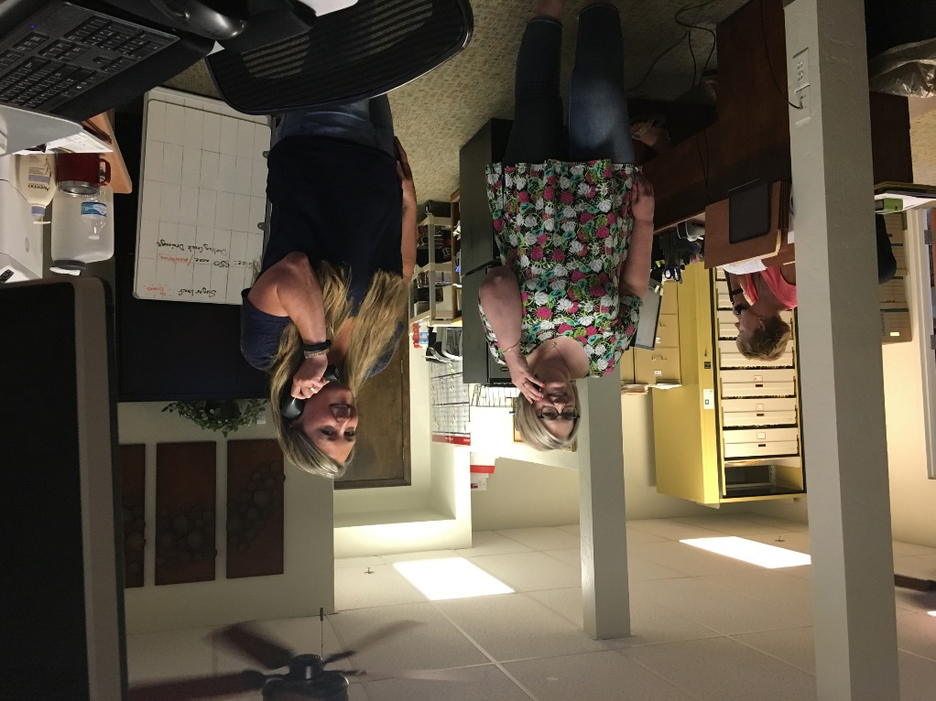
Golf Course Fire
Additional information:
A local hotline was established at the Grand County Admin building to answer questions from residents.
Social media was heavily used to provide information to the public at set times to ‘control’ the expectation of when residents could get any updates unless major issues arose.
Over 100,000 likes, views and or shares of posts and videos occurred over a three day period
www.gcemergency.com was used to provide additional updates

Slide 16
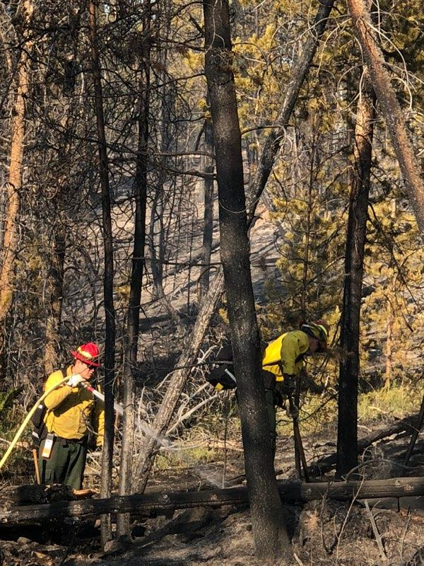
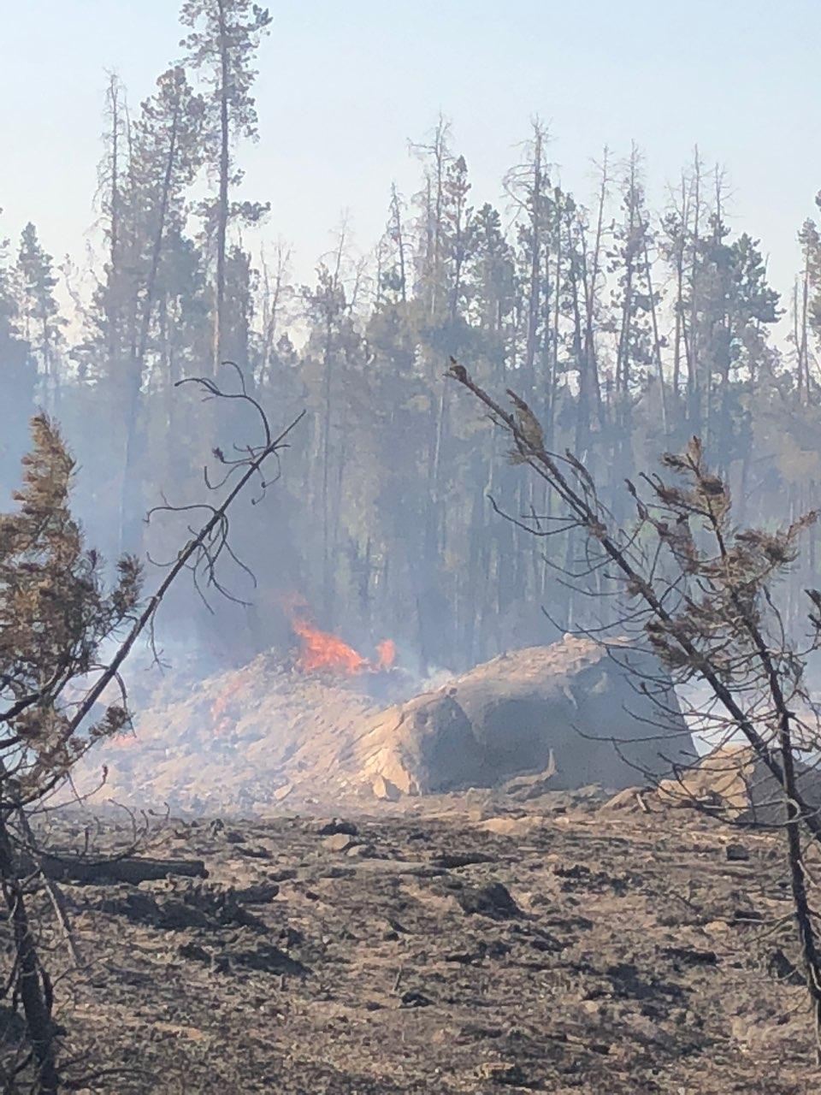
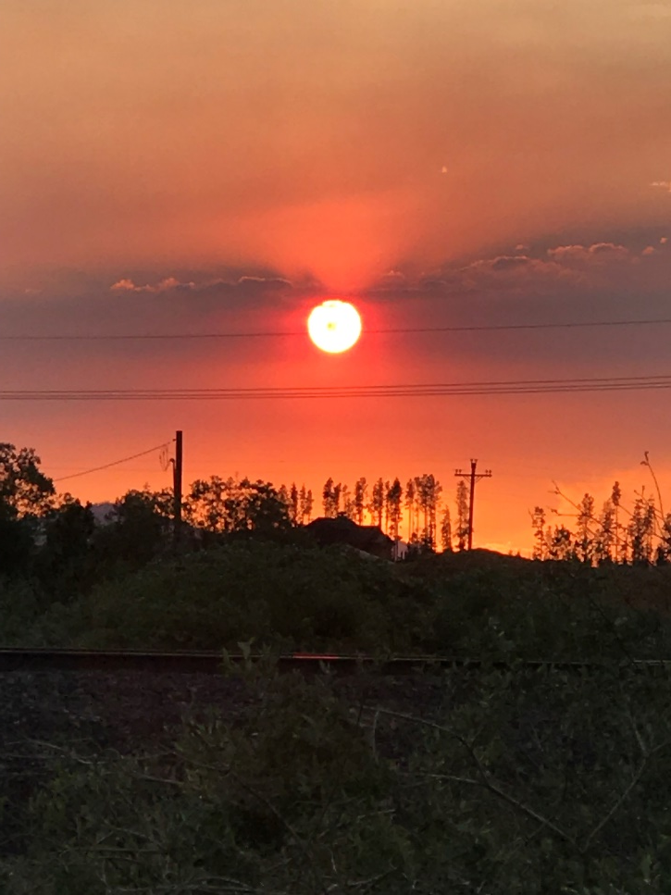
Thank You

