Slide 1
2017 Ten County Survey of Elected Officials Emergency Awareness
Tuesday, August 08, 2017

Slide 2
58
Total Responses
Date Created: Tuesday, April 11, 2017
Complete Responses: 58

Slide 3
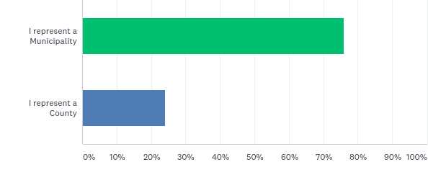
Q1: As an elected official, do you represent a municipality or a county?
Answered: 58 Skipped: 0

Slide 4
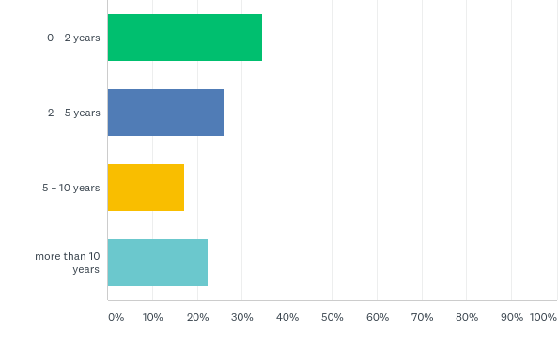
Q2: How long have you served in elected office including previous positions?
Answered: 58 Skipped: 0

Slide 5
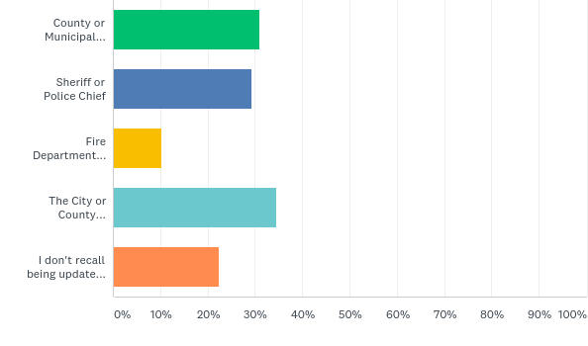
Q3: If your council or board receives periodic updates about Emergency Management planning, who provides those updates?
Answered: 58 Skipped: 0

Slide 6
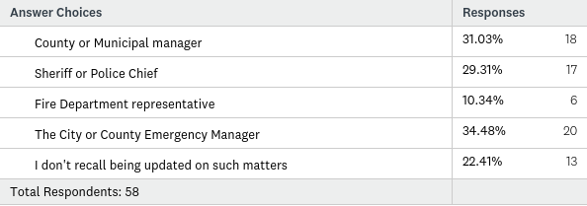
Q3: If your council or board receives periodic updates about Emergency Management planning, who provides those updates?
Answered: 58 Skipped: 0

Slide 7
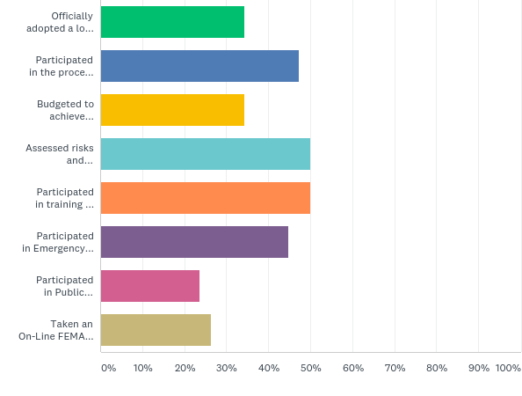
Q4: Have you participated in any of the following Pre-Disaster Hazard Mitigation Plan process elements? (check all that apply)
Answered: 38 Skipped: 20

Slide 8
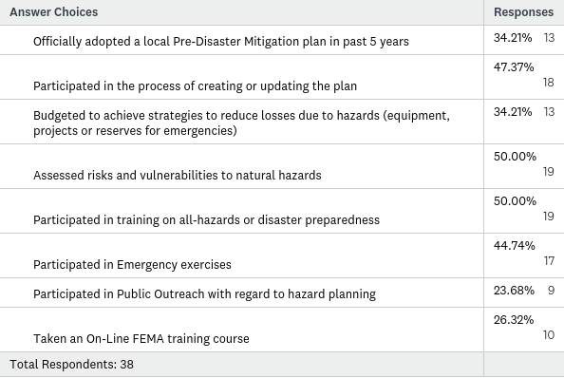
Q4: Have you participated in any of the following Pre-Disaster Hazard Mitigation Plan process elements? (check all that apply)
Answered: 38 Skipped: 20

Slide 9
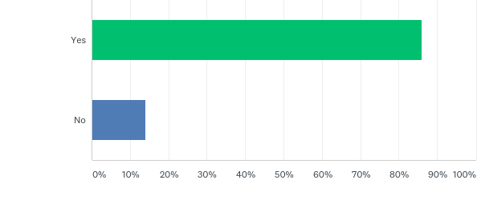
Q5: Do you know where your local Emergency Operations Center is located?
Answered: 57 Skipped: 1

Slide 10
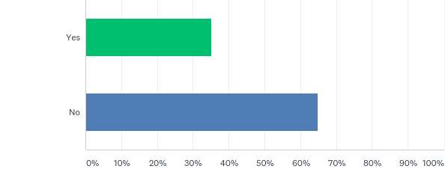
Q6: Do you have an identified functional role in case of an emergency?
Answered: 57 Skipped: 1

Slide 11
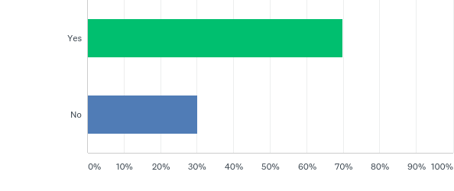
Q7: Does your jurisdiction have a Continuity of Operations (COOP) plan delegating specific emergency authority and outlining the emergency functions for the organization and assignment of responsibilities for all departments during an emergency?
Answered: 53 Skipped: 5

Slide 12
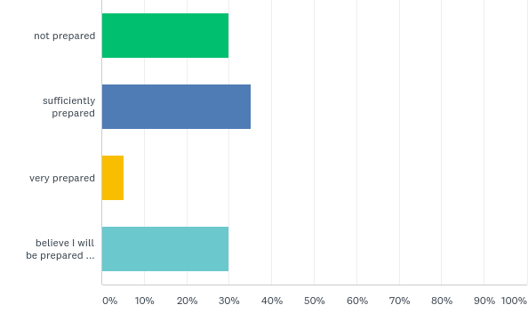
Q8: Rate your understanding of your own role as an elected official when it comes to Pre-Disaster preparedness?
Answered: 57 Skipped: 1

Slide 13
Q8: Rate your understanding of your own role as an elected official when it comes to Pre-Disaster preparedness?
Answered: 57 Skipped: 1

Slide 14
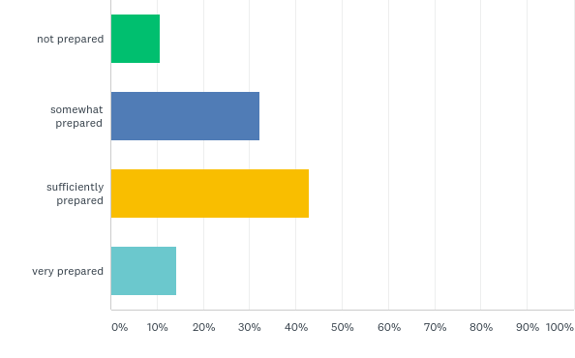
Q9: Rank your community’s overall preparedness
Answered: 56 Skipped: 2

Slide 15
Q9: Rank your community’s overall preparedness
Answered: 56 Skipped: 2

Slide 16
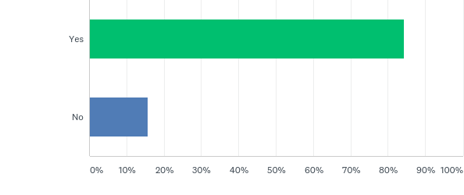
Q11: Would you like to know more about your roles and responsibilities as an elected official with regard to natural hazard and disaster preparedness?
Answered: 57 Skipped: 1

