Slide 1
NWCCOG
Workforce Development Update

Slide 3
Our Vision
A working economy that
elevates all of Colorado.

Slide 4
Workforce Center Services: Job Seekers
In-demand occupation data and profiles
Personalized information on training and skill boosting opportunities to increase your marketability
Job preparation, job search, career guidance and more
Resource area with computers, scanner, fax, etc.
Additional support and information for those applying for or receiving unemployment insurance
Resume review/writing help and mock interviewing support
Federally-funded training for in-demand occupations for eligible candidates
Local expertise on labor market, hiring trends, and related workforce issues (housing, transportation, etc)

Slide 5
Workforce Center Services: Business
Economic modeling and labor market reports and data
Insight into local talent market, competitive employer advantage, and workforce supply
On-the-job training, work-based and contextualized learning facilitation and support
Job-matching and personal referrals
On site hiring events
Assessments and candidate screening services (Prove-It, Work Keys, IBM Kinexa, etc)
Information on tax credits, federal bonding, apprenticeship programs, and other federal hiring resources
Access to free job advertising Colorado-wide for candidates looking for work in your field
Business education and information offerings on a range of subjects

Slide 6
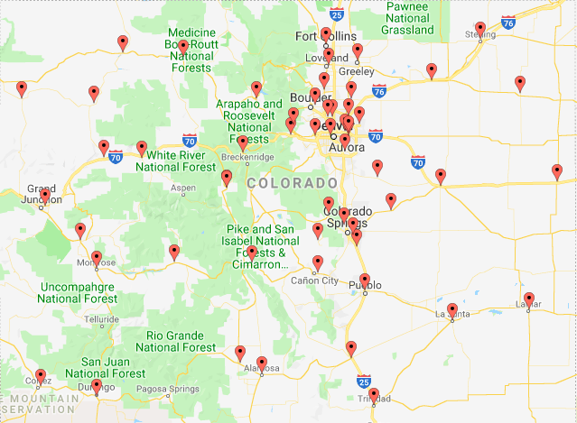
Workforce Center Locations

Slide 7
NWCCOG Area Locations
Granby /Grand & Jackson Counties(christina.oxley@state.co.us)
Steamboat Springs/Routt County (christina.oxley@state.co.us)
Frisco/Summit County (mark.hoblitzell@state.co.us)
Edwards/Eagle County (mark.hoblitzell@state.co.us)
Glenwood Springs/Garfield & Pitkin Counties (carolyn.tucker@state.co.us)

Slide 8
2019 Workforce Changes
Create new regional positions specific to business services and economic development
Replace quarterly sub-area board meetings with local area roundtables
Develop annual Workforce Development Symposium for 10-county+ region (Summer 2020)
Provide annual updates on workforce development activities and data to County Commissioner Boards
Disseminate workforce analytics, trends & insights on a monthly basis

Slide 9
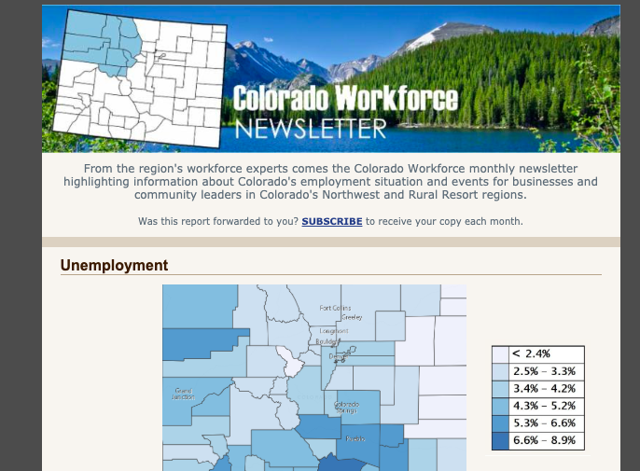

Slide 10
Workforce: Hot Topics
Equal Pay for Equal Work Act Passes
Forbids discrimination between genders on the basis of pay and includes a newly created right for employees who have suffered such discrimination to sue their employer
The law also requires that companies post all job openings internally
List a salary range for the position
Forbids employers from asking about salary history
Permits employees who have been discriminated against to recover back pay for a period of up to three years, and further awards additional damages equal to the amount of back pay owed unless the employer can demonstrate that they acted in good faith.
Bans employers from asking about a criminal history at the time of initial application
Takes effect January 2021

Slide 11
Workforce: Hot Topics
Local Government Minimum Wage Bill Passes
Applies to all workers engaged in 4+ hours of work a week at an employer within the geographic boundary established
May be established at a city, town or county level; contiguous counties & municipalities within counties
Rate for adult employees & emancipated minors
Annual increases capped at $1.75/year

