Slide 1
2017 NWCCOG Member Survey
Monday, May 01, 2017

Slide 2
29
Total Responses
Date Created: Wednesday, April 05, 2017
Complete Responses: 29

Slide 3
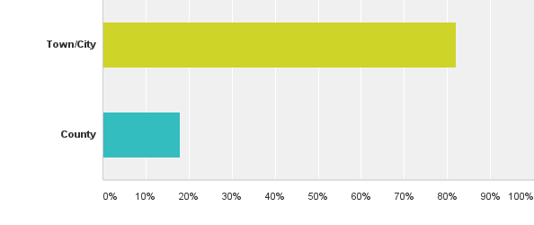
Q1: What municipality and county do you represent?
Answered: 28 Skipped: 1

Slide 4
Q1: What municipality and county do you represent?
Answered: 28 Skipped: 1

Slide 5
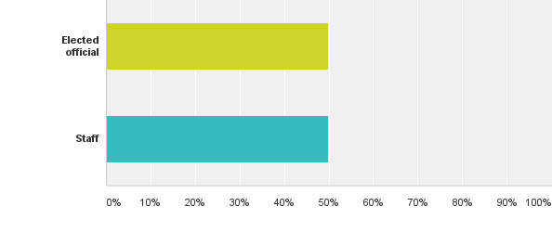
Q2: Are you an elected official or staff?
Answered: 28 Skipped: 1

Slide 6
Q2: Are you an elected official or staff?
Answered: 28 Skipped: 1

Slide 7
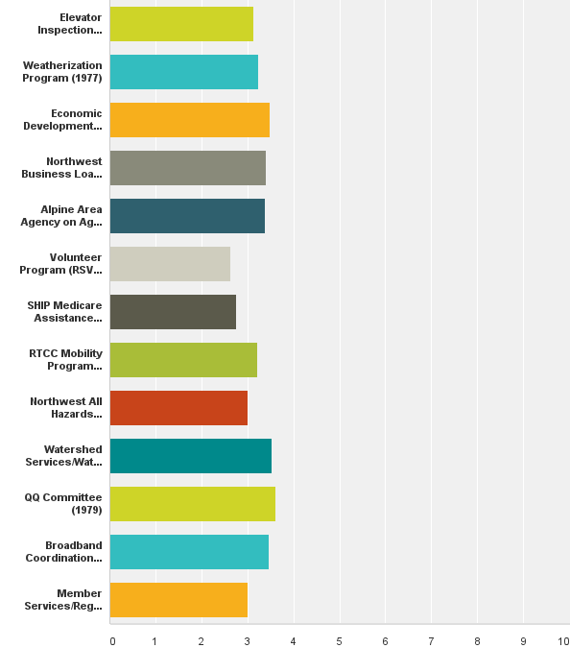
Q3: Rate the value of each of the following NWCCOG programs to the region:
Answered: 29 Skipped: 0

Slide 8
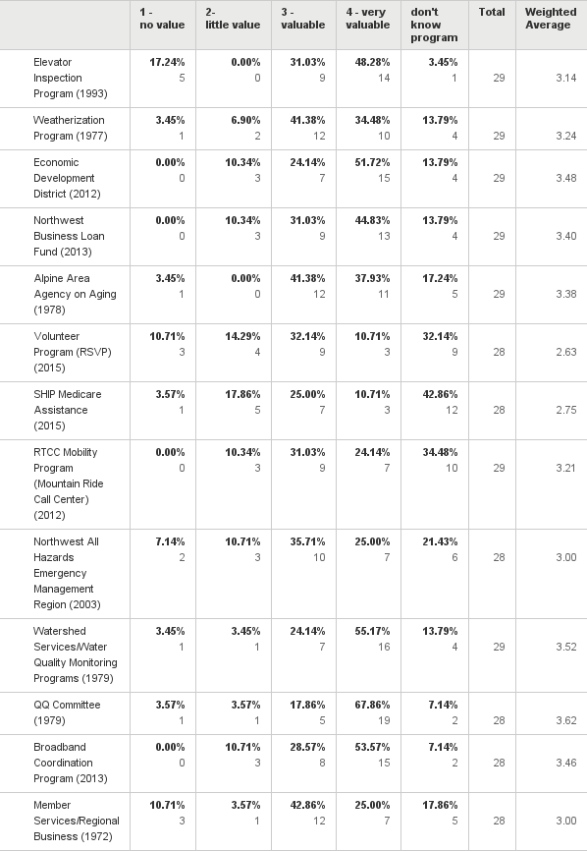
Q3: Rate the value of each of the following NWCCOG programs to the region:
Answered: 29 Skipped: 0

Slide 9
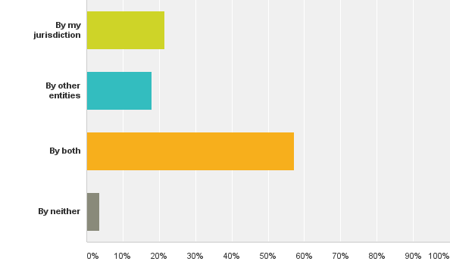
Q4: The Economic Development District is relatively new to NWCCOG. Is your jurisdiction actively involved in economic development or is this handled by others in your area?
Answered: 28 Skipped: 1

Slide 10
Q4: The Economic Development District is relatively new to NWCCOG. Is your jurisdiction actively involved in economic development or is this handled by others in your area?
Answered: 28 Skipped: 1

Slide 11
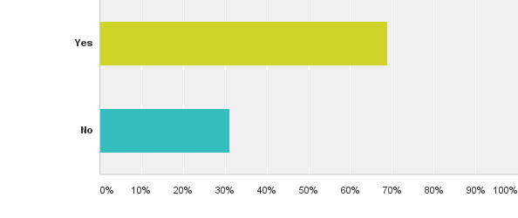
Q7: Is your jurisdiction active or planning to be active in broadband efforts in coming years?
Answered: 29 Skipped: 0

Slide 12
Q7: Is your jurisdiction active or planning to be active in broadband efforts in coming years?
Answered: 29 Skipped: 0

Slide 13
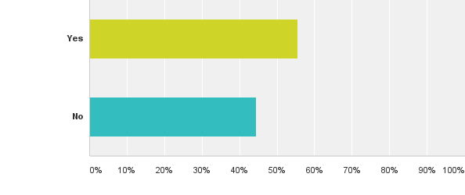
Q8: Broadband is a relatively new program at NWCCOG. Has the NWCCOG Broadband Program been of use to you?
Answered: 27 Skipped: 2

Slide 14
Q8: Broadband is a relatively new program at NWCCOG. Has the NWCCOG Broadband Program been of use to you?
Answered: 27 Skipped: 2

Slide 15
Q9: The NWCCOG Weatherization Program provides direct services to income qualifying homes. If federal funding for the program goes away, should NWCCOG consider providing non-income based Weatherization services for a fee?
Answered: 28 Skipped: 1

Slide 16
Q9: The NWCCOG Weatherization Program provides direct services to income qualifying homes. If federal funding for the program goes away, should NWCCOG consider providing non-income based Weatherization services for a fee?
Answered: 28 Skipped: 1

Slide 17
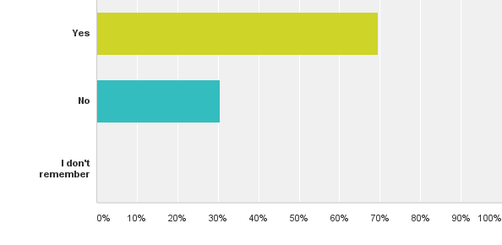
Q11: Many elected officials learn on the job by doing. When you were elected to your position on the council/board/commission, was there an organized on-boarding process by that entity to provide resources for your success in that role?
Answered: 23 Skipped: 6

Slide 18
Q11: Many elected officials learn on the job by doing. When you were elected to your position on the council/board/commission, was there an organized on-boarding process by that entity to provide resources for your success in that role?
Answered: 23 Skipped: 6

Slide 19
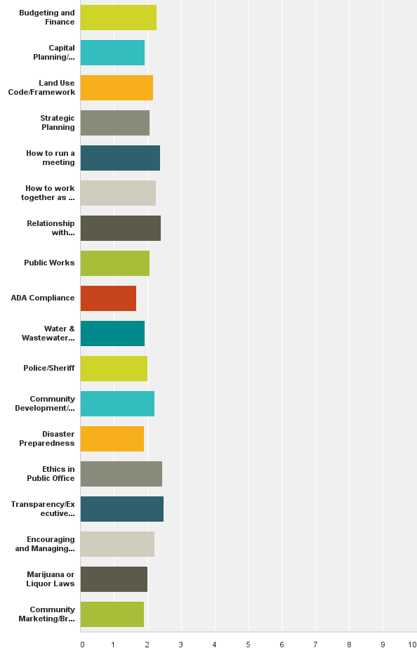
Q13: NWCCOG has considered playing a greater role in professional development training for elected officials. As an elected official (or staff working with your council/board/commission), rate how prepared or trained you feel with regard to the following topics:
Answered: 29 Skipped: 0

Slide 20
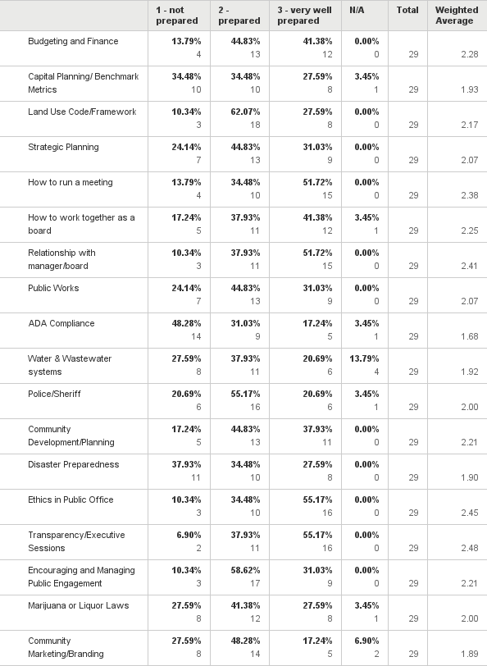
Q13: NWCCOG has considered playing a greater role in professional development training for elected officials. As an elected official (or staff working with your council/board/commission), rate how prepared or trained you feel with regard to the following topics:
Answered: 29 Skipped: 0

Slide 21
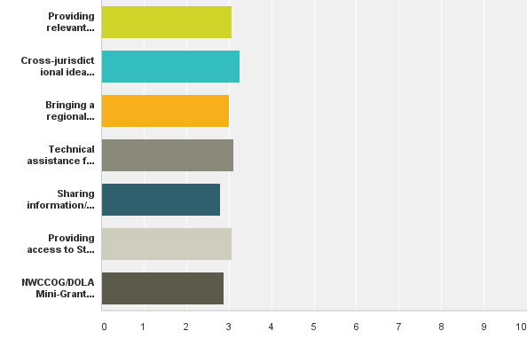
Q14: NWCCOG Regional Business/Member Services has been very adaptive to meeting emerging member needs over the years. Which of the following past, present, and possible roles do you place the most value on for the future? Of the Member Service roles NWCCOG currently provides, rate the importance of this role in the future:
Answered: 28 Skipped: 1

Slide 22
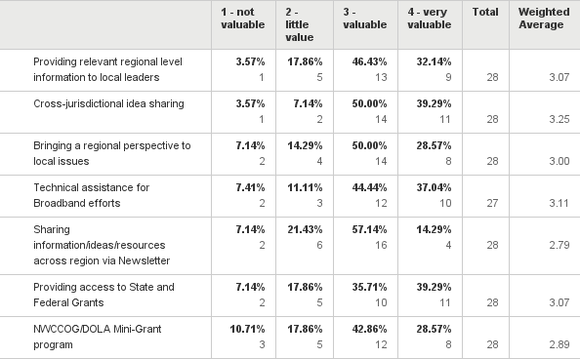
Q14: NWCCOG Regional Business/Member Services has been very adaptive to meeting emerging member needs over the years. Which of the following past, present, and possible roles do you place the most value on for the future? Of the Member Service roles NWCCOG currently provides, rate the importance of this role in the future:
Answered: 28 Skipped: 1

Slide 23
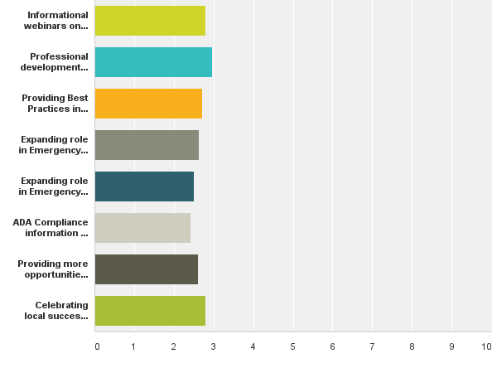
Q15: Of the Member Service roles NWCCOG has considered providing, rate the importance of this role in the future:
Answered: 28 Skipped: 1

Slide 24
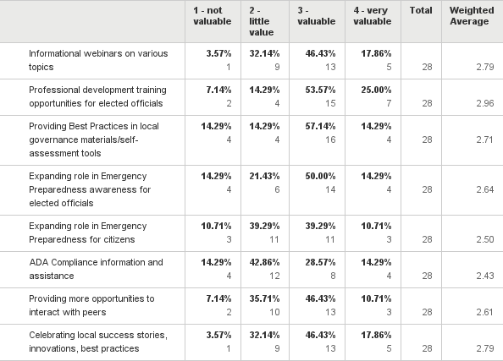
Q15: Of the Member Service roles NWCCOG has considered providing, rate the importance of this role in the future:
Answered: 28 Skipped: 1

Slide 25
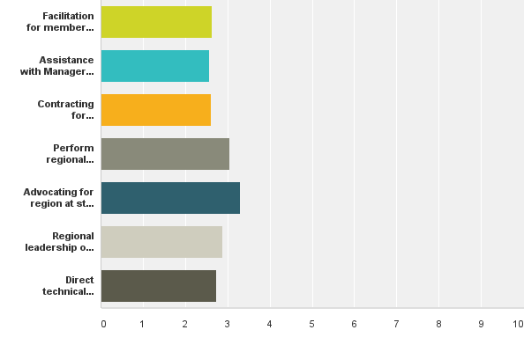
Q16: Of the Member Service roles NWCCOG has provided in the past, rate the importance of this role in the future:
Answered: 27 Skipped: 2

Slide 26
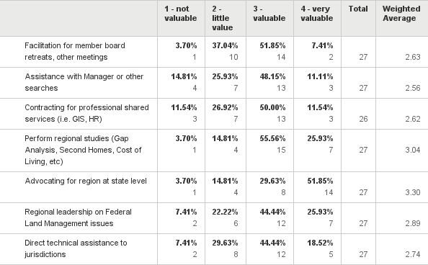
Q16: Of the Member Service roles NWCCOG has provided in the past, rate the importance of this role in the future:
Answered: 27 Skipped: 2

Slide 27
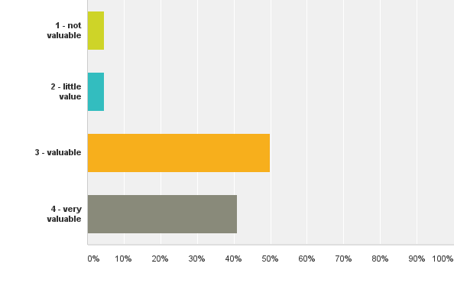
Q22: Rate NWCCOG's membership as a value proposition for the cost of the dues:
Answered: 22 Skipped: 7

Slide 28
Q22: Rate NWCCOG's membership as a value proposition for the cost of the dues:
Answered: 22 Skipped: 7

