Slide 1
2019 NWCCOG Member Survey
Tuesday, May 14, 2019

Slide 2
32
Total Responses
Date Created: Monday, March 18, 2019
Complete Responses: 27

Slide 3
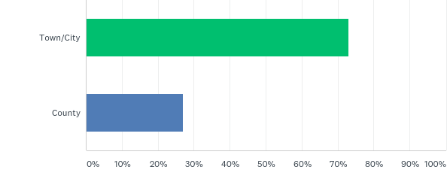
Q1: Do you represent a municipality or county?
Answered: 26 Skipped: 6

Slide 4
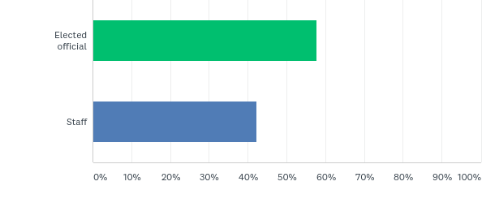
Q2: Are you an elected official or staff?
Answered: 26 Skipped: 6

Slide 5
Q3: Rate your perceived value of each of the following NWCCOG programs to the region:
Answered: 27 Skipped: 5

Slide 6
Answered: 27 Skipped: 5

Slide 7
Q4: Is your jurisdiction active or planning to be active in broadband efforts in coming years?
Answered: 26 Skipped: 6

Slide 8
Q5: NWCCOG is interested in development opportunities for elected officials. Rate how prepared or trained you believe others on your council or board are with regard to the following topics:
Answered: 27 Skipped: 5

Slide 9
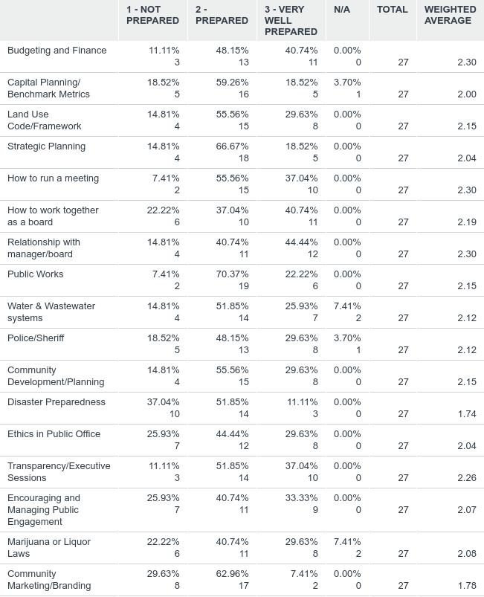
Answered: 27 Skipped: 5

Slide 10
Answered: 27 Skipped: 5

Slide 11
Q6: NWCCOG Regional Business/Member Services has been very adaptive to meeting emerging member needs over the years. Which of the following past, present, and potential roles do you place the most value on for the future?
Answered: 27 Skipped: 5

Slide 12
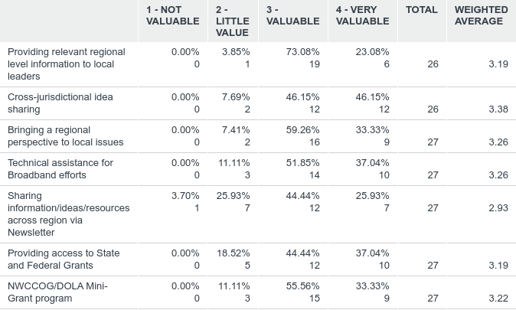
Answered: 27 Skipped: 5

Slide 13
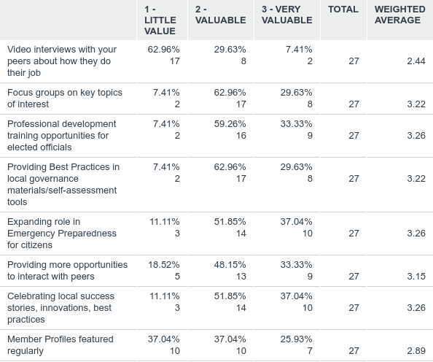
Q7: Of the Member Service roles NWCCOG has considered providing, rate the importance of this role in the future:
Answered: 27 Skipped: 5

Slide 14
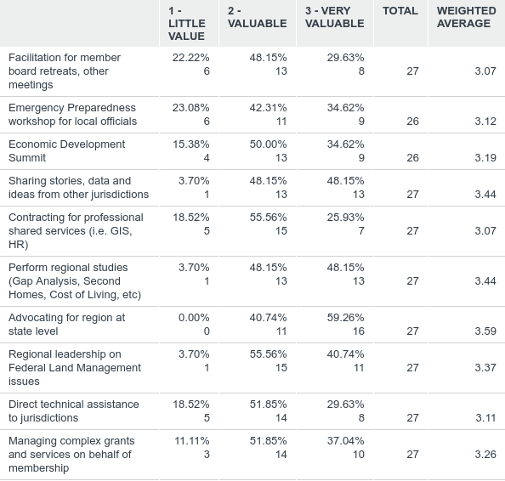
Q8: Of the Member Service roles NWCCOG has provided in the past, rate the importance of this role in the future:
Answered: 27 Skipped: 5

Slide 15
Q12: Rate NWCCOG's membership as a value proposition for the cost of the dues:
Answered: 21 Skipped: 11
2019
2017

Slide 16
Jon’s Takeaways
* Survey link sent to 68 members. Thirty two opened it, and 27 completed the survey (40% completion rate).
QQ, Broadband and AAAA are our most highly valued programs, everything we do has value to someone
We still have a challenge with many programs, including our most highly valued getting “don’t know the program” answers
82% of our jurisdictions are “planning to be active in broadband efforts” in coming years
Changed elected official training question from “what do you need” to “how prepared do you think others on your council” are?
With similar results– Disaster Preparedness still low, just about any topic worth some effort
Member Services– most valued for “cross jurisdiction idea sharing”, “information sharing”, “managing grants”, “sharing local success stories”
Newsletter has 50% valued and split 25%/25% with highly valued and not so much
NWCCOG is still a 90% valued, highly valued proposition for our members
In the comments, the inconsistency of video conferencing came up

