Slide 1
2021 NWCCOG Member Survey
Wednesday, April 07, 2021

Slide 2
22
Total Responses
Date Created: Wednesday, March 10, 2021
Complete Responses: 22

Slide 3
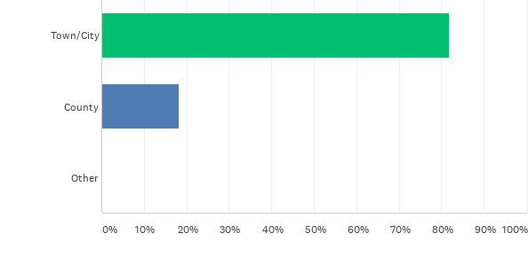
Q1: Do you represent a municipality or county?
Answered: 22 Skipped: 0

Slide 4
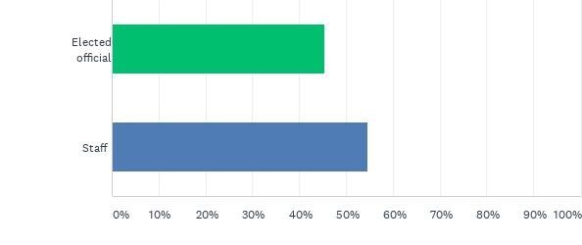
Q2: Are you an elected official or staff?
Answered: 22 Skipped: 0

Slide 5
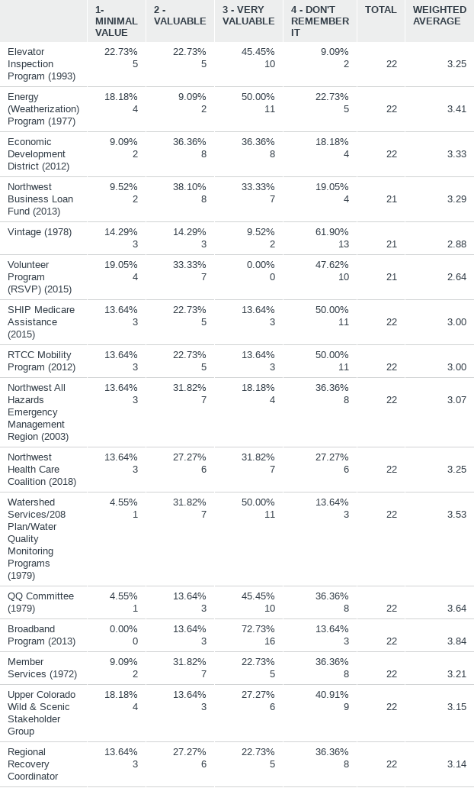
Q3: Rate your perceived value of each of the following NWCCOG programs to the region:
Answered: 22 Skipped: 0

Slide 7
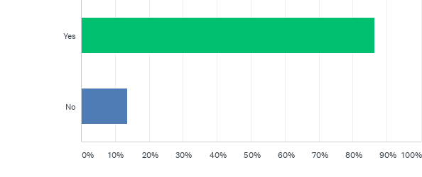
Q5: Is your jurisdiction active or planning to be active in broadband efforts in coming years?
Answered: 22 Skipped: 0

Slide 8
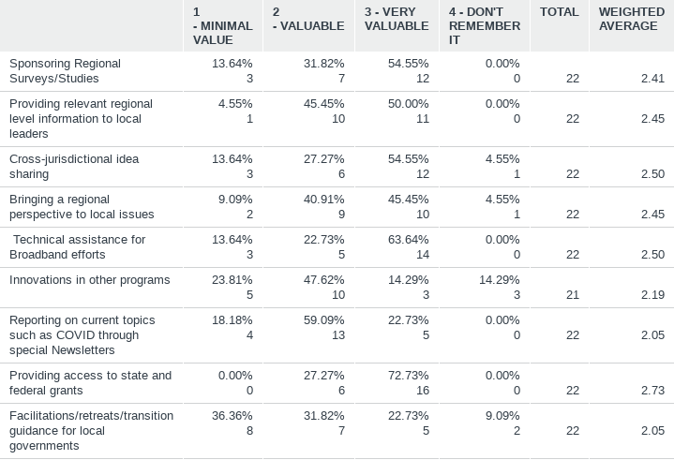

Q6: Which of the following NWCCOG roles have been most of use to you in the past two years or so?
Answered: 22 Skipped: 0

Slide 9
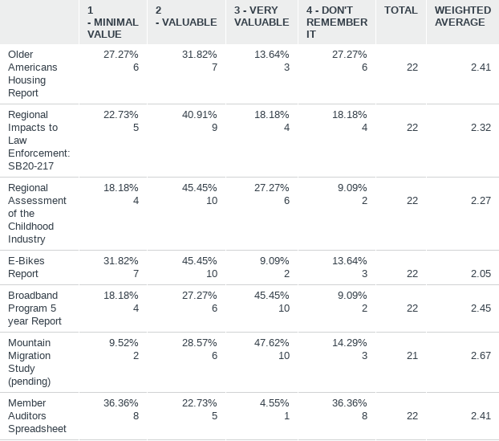
Q7: Which of the recent NWCCOG regional studies were useful to you and your peers?
Answered: 22 Skipped: 0

Slide 10
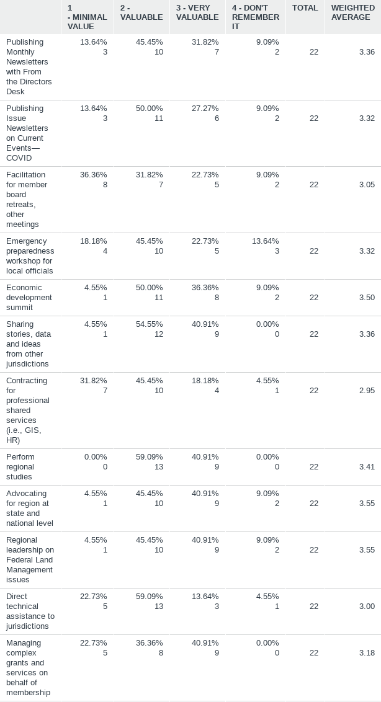
Q8: Of the Member Service roles NWCCOG has provided in the past, rate the anticipated importance of these role into the future:
Answered: 22 Skipped: 0

Slide 12
Q9: NWCCOG is considering compiling a study of regional organizational lessons learned from the COVID crisis, would such an effort be of interest?
Answered: 22 Skipped: 0

Slide 13
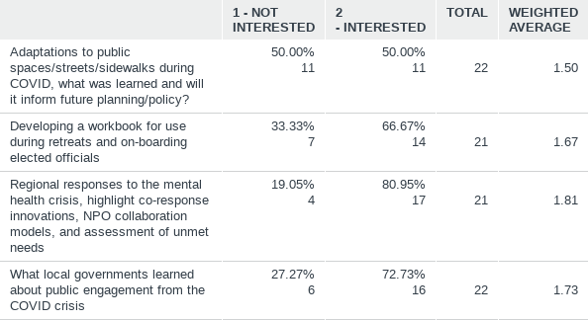




Q10: NWCCOG is considering the following for further research for a possible report, please note whether this would be of interest or not
Answered: 22 Skipped: 0

Slide 14
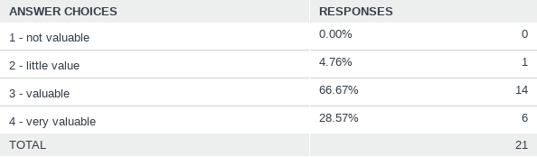

Q13: Rate NWCCOG's membership as a value proposition for the cost of the dues:
Answered: 21 Skipped: 1

