Slide 1
NWCOGG EDD Board Meeting
03/25/2021

Slide 2
Discussion points:
Introductions
EDA Overview and Mission
Investment Priorities
Programs
Application Process
American Rescue Plan
Contact Information
Q & A

Slide 3
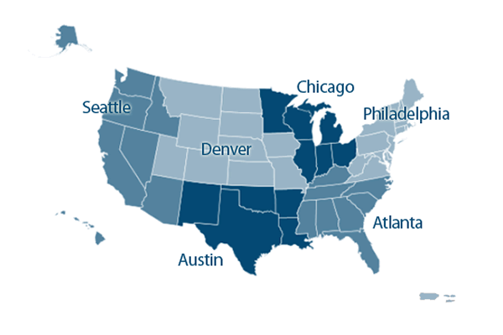
EDA Overview
U.S. Department of Commerce
Six Regional Offices
Mission
To lead the federal economic development agenda by promoting innovation and competitiveness, preparing American regions for growth and success in the worldwide economy.
Notes:
Only federal government agency focused exclusively on economic development
Guided by the basic principle that sustainable economic development should be locally driven
Programs are designed to allow for innovation and changing economic needs and leverage existing regional assets
Denver Regional Office

Slide 4
Investment Priorities
Recovery & Resilience
Economic resiliency and recovery from disaster events
Critical Infrastructure
Physical infrastructure necessary for a prosperous economy
Workforce Development & Manufacturing
Skills-training facilities that address the hiring needs of the business community and projects that support job creation in manufacturing
Exports & Foreign Direct Investment
Support the growth in US exports and increased foreign direct investment and the return of jobs to the US
Opportunity Zones
Projects in designated Opportunity Zone Census Tracts
Notes:
Recovery & Resilience: Projects that assist with economic resilience (including business continuity and preparedness) and long-term recovery from natural disasters and economic shocks to ensure U.S. communities are globally competitive.
Critical Infrastructure: Projects that establish the fundamental building blocks of a prosperous and innovation-centric economy and a secure platform for American business, including physical (e.g., broadband, energy, roads, water, sewer) and other economic infrastructure.
Workforce Development & Manufacturing: Projects that support the planning and implementation of infrastructure for skills-training centers and related facilities that address the hiring needs of the business community -- particularly in the manufacturing sector -- with a specific emphasis on the expansion of apprenticeships and work-and-learn training models. Also includes projects that encourage job creation and business expansion in manufacturing, including infrastructure-related efforts that focus on advanced manufacturing of innovative, high-value products and enhancing manufacturing supply chains.
Exports & FDI: Primarily infrastructure projects that enhance community assets (e.g., port facilities) to support growth in U.S. exports and increased foreign direct investment—and ultimately the return of jobs to the United States.
Opportunity Zones: Planning and implementation projects aimed at attracting private investment – including from Opportunity Funds – to grow businesses and create jobs in Census tracts that have been designated as Opportunity Zones. This includes targeted projects located within an Opportunity Zone; projects that, while not located within an Opportunity Zone, have a clear intent of benefitting nearby Opportunity Zone(s); and regional projects that encompass an area containing at least one Opportunity Zone with a clear intent of benefitting that Opportunity Zone. Opportunity Zones are designed to spur economic development by providing tax benefits to investors.

Slide 5
Programs
Planning
Public Works
Economic Adjustment
Build to Scale
Trade Adjustment Assistance for Firms
University Centers
Research and National Technical Assistance
Local Technical Assistance
Economic Development Integration
Notes:
Number of programs through which we carry out our mission. Focus more on Planning, Public Works, and Economic Adjustment
EDI:
Increase Access Support local and regional capacity to successfully identify and apply for any relevant economic development resources- federal and non-federal, public and private- that best support their economic development priorities and objectives.
Enhance Collaboration Facilitate coordination among interagency, inter-governmental, and cross-sector partners to promote strategic investments that support local priorities and contribute to sustainable and equitable economic growth.
Reduce Administrative Burdens EDA’s EDI team regularly works with federal interagency partners to help identify and leverage opportunities to align administrative requirements commonly triggered through the provision of federal program assistance (e.g., strategic planning, environmental reviews, grant reporting).

Slide 6
Planning
Provides essential support to district organizations, Native American organizations, states, sub-state planning regions, urban counties, cities and other eligible recipients to assist in planning.
Partnership Planning investments facilitate the development, implementation, revision, or replacement of Comprehensive Economic Development Strategies (CEDS), which articulate and prioritize the strategic economic goals of recipients’ respective regions.
Notes:
EDA/HUD MOU:
Reduced burden - Leverage Resources, Minimize Duplication, Coordinated Approach, and Comprehensive Impact
This may include the development of plans for various federal agencies as a prerequisite to accessing program funds. The administrative burden associated with meeting the similar strategic planning requirements for various federal programs results in a cumulative increase in costs borne by grantees and local jurisdictions. While these include investments of time and money, they also represent opportunity costs that are incurred when these resources are invested in many separate planning processes when they could be used to leverage opportunities for dynamic collaboration among local and regional stakeholders and partners.

Slide 7
Public Works
Helps distressed communities revitalize, expand, and upgrade their physical infrastructure.
Economic Adjustment Assistance
Provides a wide range of technical, planning, and public works and infrastructure assistance in regions experiencing adverse economic changes that may occur suddenly or over time.
Attract new industry
Encourage business expansion
Diversify local economies
Generate or retain long-term, private-sector jobs

Slide 8
Application Process
Eligible Organizations
District Organization
Indian Tribe or a consortium of Indian Tribes
State, county, city, or other political subdivision of a State, including a special purpose unit of a State or local government engaged in economic or infrastructure development activities, or a consortium of political subdivisions with local government support
Institution of higher education or a consortium of institutions of higher education
Public or private non-profit organization or association acting in cooperation with officials of a political subdivision of a State

Slide 9
Application Process
Distress Criteria
Unemployment rate that is at least 1 percentage point greater than the national average; or
Per capita income that is 80% or less of the national average
Special Need:
Located in an Opportunity Zone
Loss of a major employer essential to the regional economy
Community affected by a downturn in the coal economy
Presidentially Declared Disaster under the Robert T. Stafford Act
Military Base closure
NW Counties Distress Report
Notes:
All counties in NWCOGG although not traditionally distressed are eligible underneath the COVID national declaration as long as the project has a nexus to responding to the economic impacts of COVID-19
Grand County is also eligible underneath the FEMA Colorado Wildfire Disaster Declaration

Slide 10
Application Process*
Rolling application deadline (no specific deadlines)
Applications are reviewed every month
Applicants are encouraged to work with their regional economic development district to put together the EDA application
EDA’s Economic Development Representatives can advise on projects and provide technical assistance throughout the application process
Match rates begin at 1:1 (exceptions for different rates depending on per capita poverty levels, unemployment rates, and natural disasters)
*Disclaimer: Some exceptions may apply (e.g., University Centers, Build-2-Scale, Research and National Technical Assistance, etc.)

Slide 11
CARES Colorado Statewide Awards
Restart and Reimagine the Colorado Tourism Industry
Colorado Tourism Office (OEDIT)
Colorado COVID-19 Resiliency Roadmap
DOLA/OEDIT/Community Builders to work with 16 regional community teams
www.coresiliency.com/covid19-recovery-roadmaps
Colorado Statewide Revolving Loan Fund - $8 Million
Administered by Colorado Lending Source & Region 9

Slide 12
American Rescue Plan
$3 Billion allocated towards EDA
Double the amount of CARES Act
25% of this towards tourism related projects…TBD
Details have yet to be announced

Slide 13
Colorado State Contacts
Economic Development Representative
Trent Thompson
303-844-5452
tthompson@eda.gov
Deputy Economic Development Representative
Jamie Hackbarth
720-653-4365
jhackbarth@eda.gov

