Slide 1
Essential Pillars
For the Post-2026 Colorado River Guidelines
NWCCOG QQ
Anne Castle
June 18, 2025

Slide 2
Timeline for new guidelines
Draft EIS
Will contain complete modeling of all alternatives and impacts on various resources
Originally promised in Dec 2024, now Dec 2025
Comment period – through Mar/Apr 2026
State legislation/approval may be required
Final EIS will incorporate comments on draft
Record of Decision – May/June 2026

Slide 3
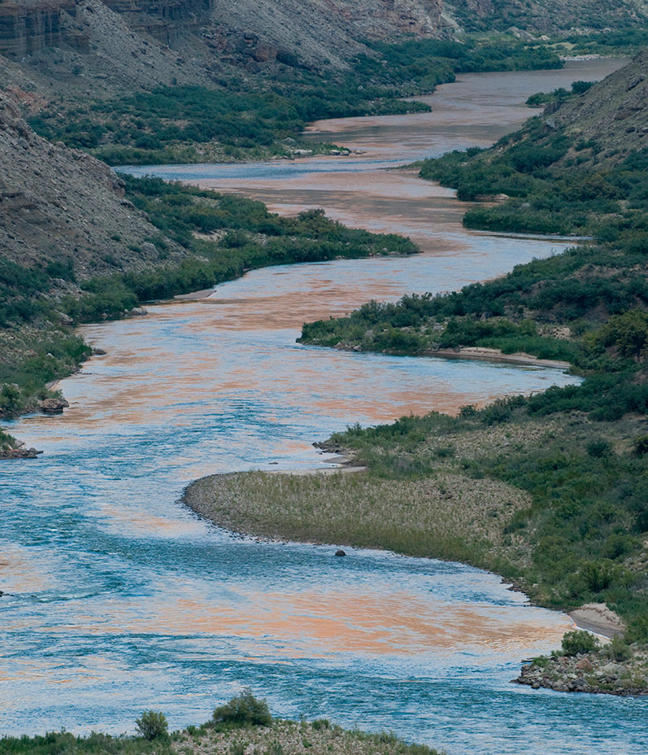
Alternatives proposed
Lower Basin states
Upper Basin states
Env NGO Coalition
19 Tribes
Schmidt, Fleck, Kuhn
Gila River Indian Comm.
National Park Service/ Fish & Wildlife Service
Web tool submissions

Slide 4
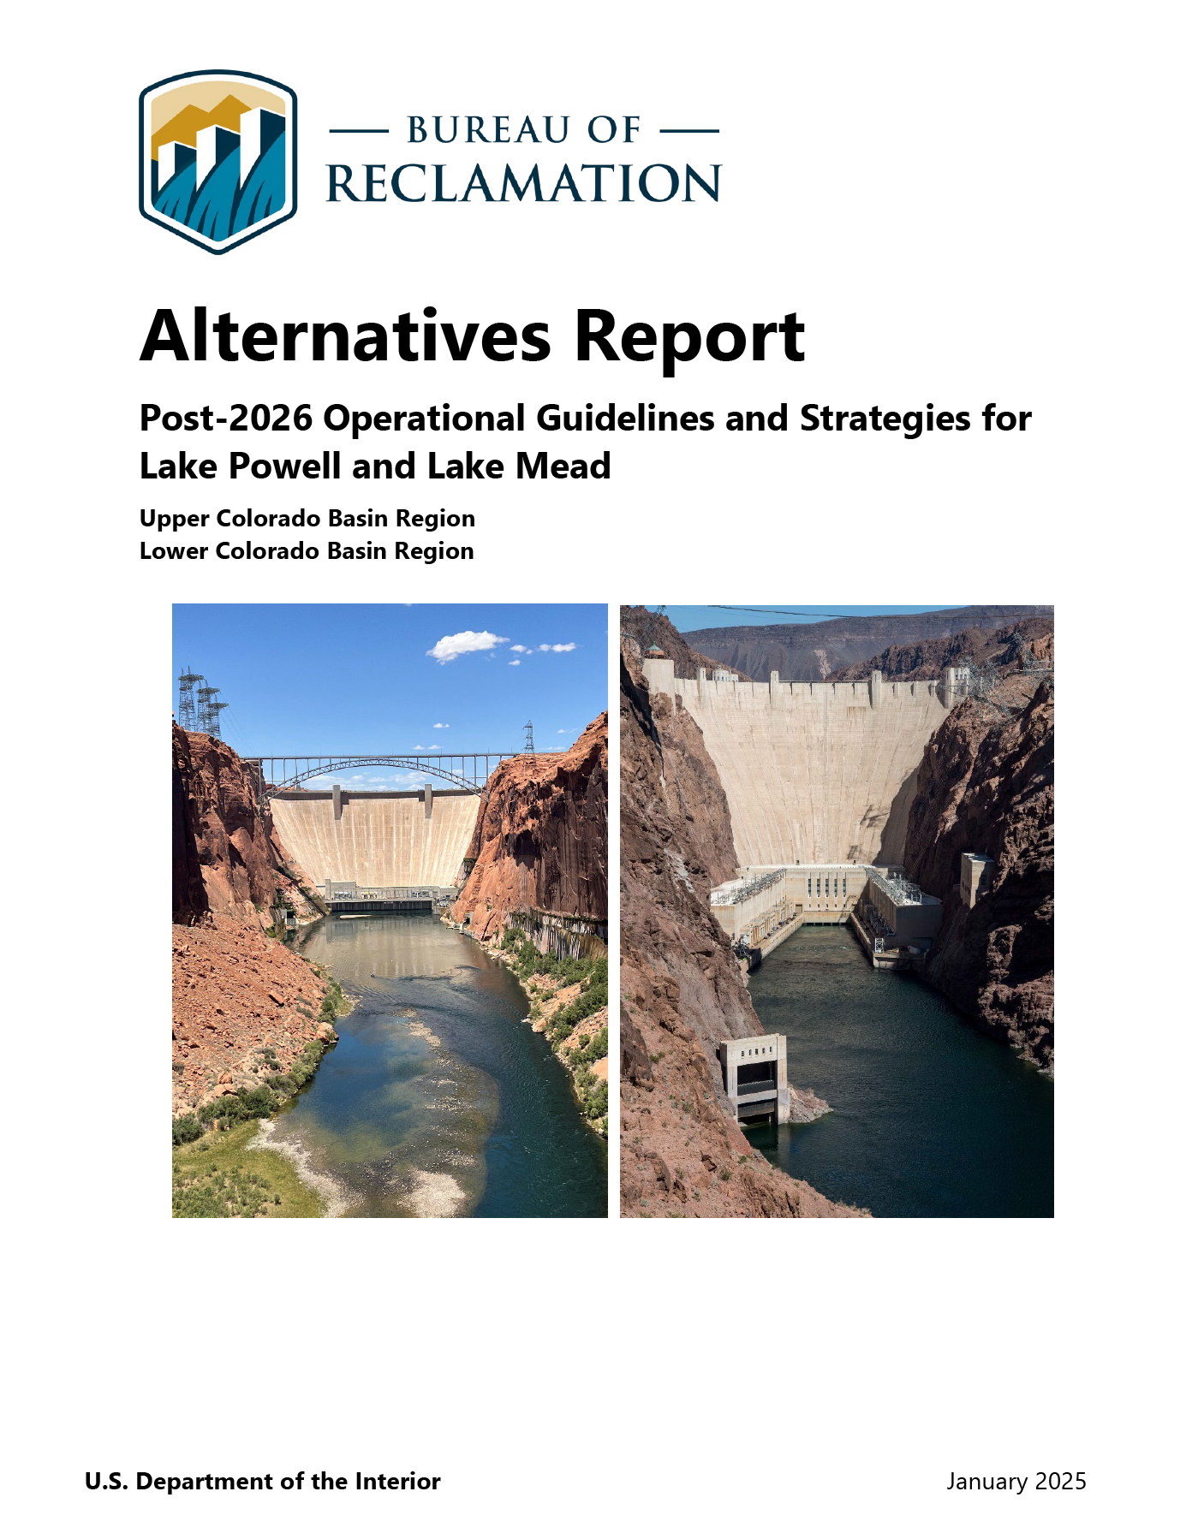
Current status
Reclamation published alternatives report in Jan 2025
4 action alternatives
Neither LB nor UB alternative adopted in full
3 alternatives require Congressional authority
Analysis underway
States negotiating
Hope for consensus dimming

Slide 5
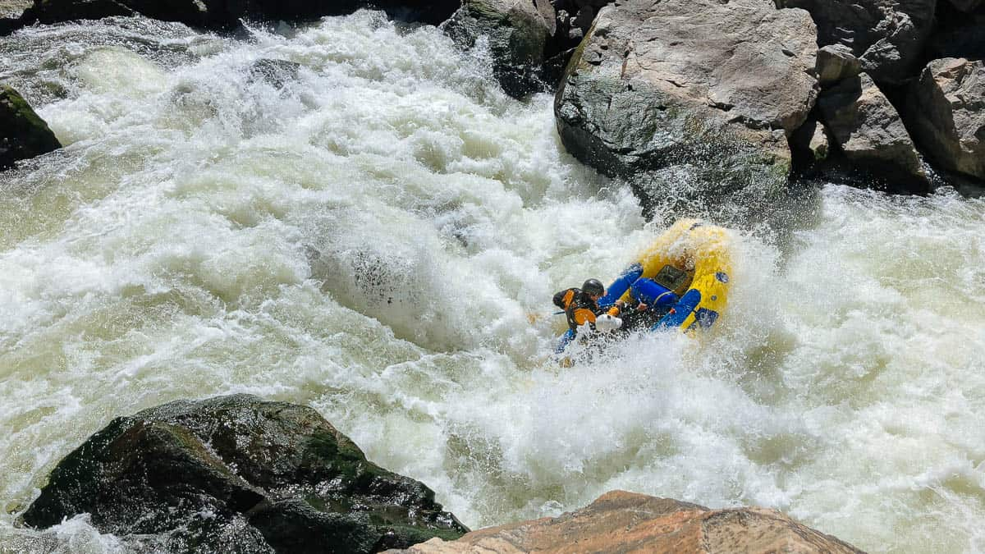
Hurdles to consensus
Volume of cuts needed
Lower Basin letter to Secretary of Interior
Freezing/rescission of federal drought funding
Political pressures work against compromise

Slide 6
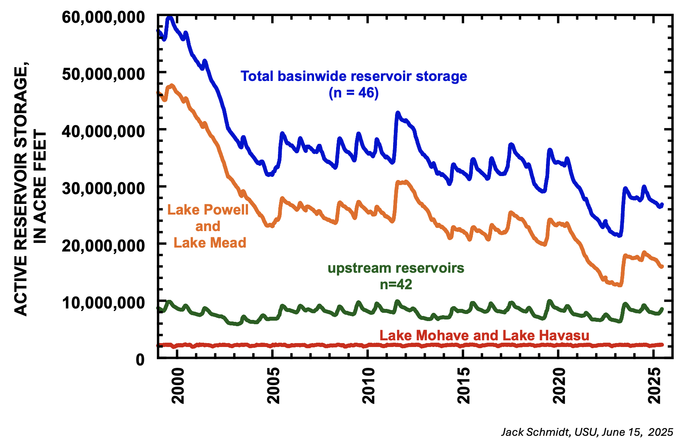
hydrology
Projected inflow to Lake Powell (April-July) – 45%!
Water year precipitation – 92%
Reservoir conditions
Lake Powell – 34% capacity
Lake Mead – 31% capacity

Slide 7
7 essential Pillars
Negotiations stalled
“Conclave” problem
New kids and empty desks at Interior
Back to basics

Slide 8
1
Enforceable Reductions in both Upper and Lower Basin
Math problem
Fairness – no one basin, state, or sector of the economy can solve this problem alone
Political viability
Shared pain critical to avoiding litigation

Slide 9
2
Reductions in Water Use Cannot Be Predicated on Federal Compensation
Unreliability of federal funding
Can’t provide long term funding for not using water that doesn’t exist
Some funding may be available and must be utilized wisely
Doesn’t preclude funding for Tribes

Slide 10
3
Conservation Pools in Lake Powell and
Lake Mead
ICS in Lake Mead was and is essential to preventing the “use it or lose it” syndrome
Lake Powell pool can help ensure Compact compliance and offset extreme cuts in LB
Saved water must have a history of consumptive use (but see Tribes)

Slide 11
4
Tribal Nations Must Have Full Access to Water Management Opportunities
At least same as other water users
Advocate for their water needs
Provide input on proposed flow regimes
Conservation and compensation
Compensated forbearance for undeveloped water addressed through Federal trust responsibility

Slide 12
5
Storage Recovery as Part of Operating Rules
Reservoirs provide highly desirable flexibility
But not when they’re always on the brink
Rules for diversion and use must include storage preservation
Explore access to dead pool

Slide 13
6
Flexibility to Achieve Environmental Objectives
Strict annual release requirements can thwart efforts in Grand Canyon and other highly important ecosystems
Flexibility in releases can mitigate injury without jeopardizing water deliveries

Slide 14
7
Absolute Protection of Domestic Water Deliveries for Public Health and Safety

Slide 15
Reactions to 7 pillars
Generally favorable
Dismissed as “talking heads” or not understanding Upper Basin realities
Questions whether state law changes would be required
Some discussion now of extension of existing rules

Slide 16
Creating a Sustainable Colorado river
This is the focus of the 7 Pillars
Authors are independent experts with no affiliations or obligations to constituencies
Primary goals
Avoiding litigation
Fairness throughout the system
Ensuring stability for future generations

