Slide 1
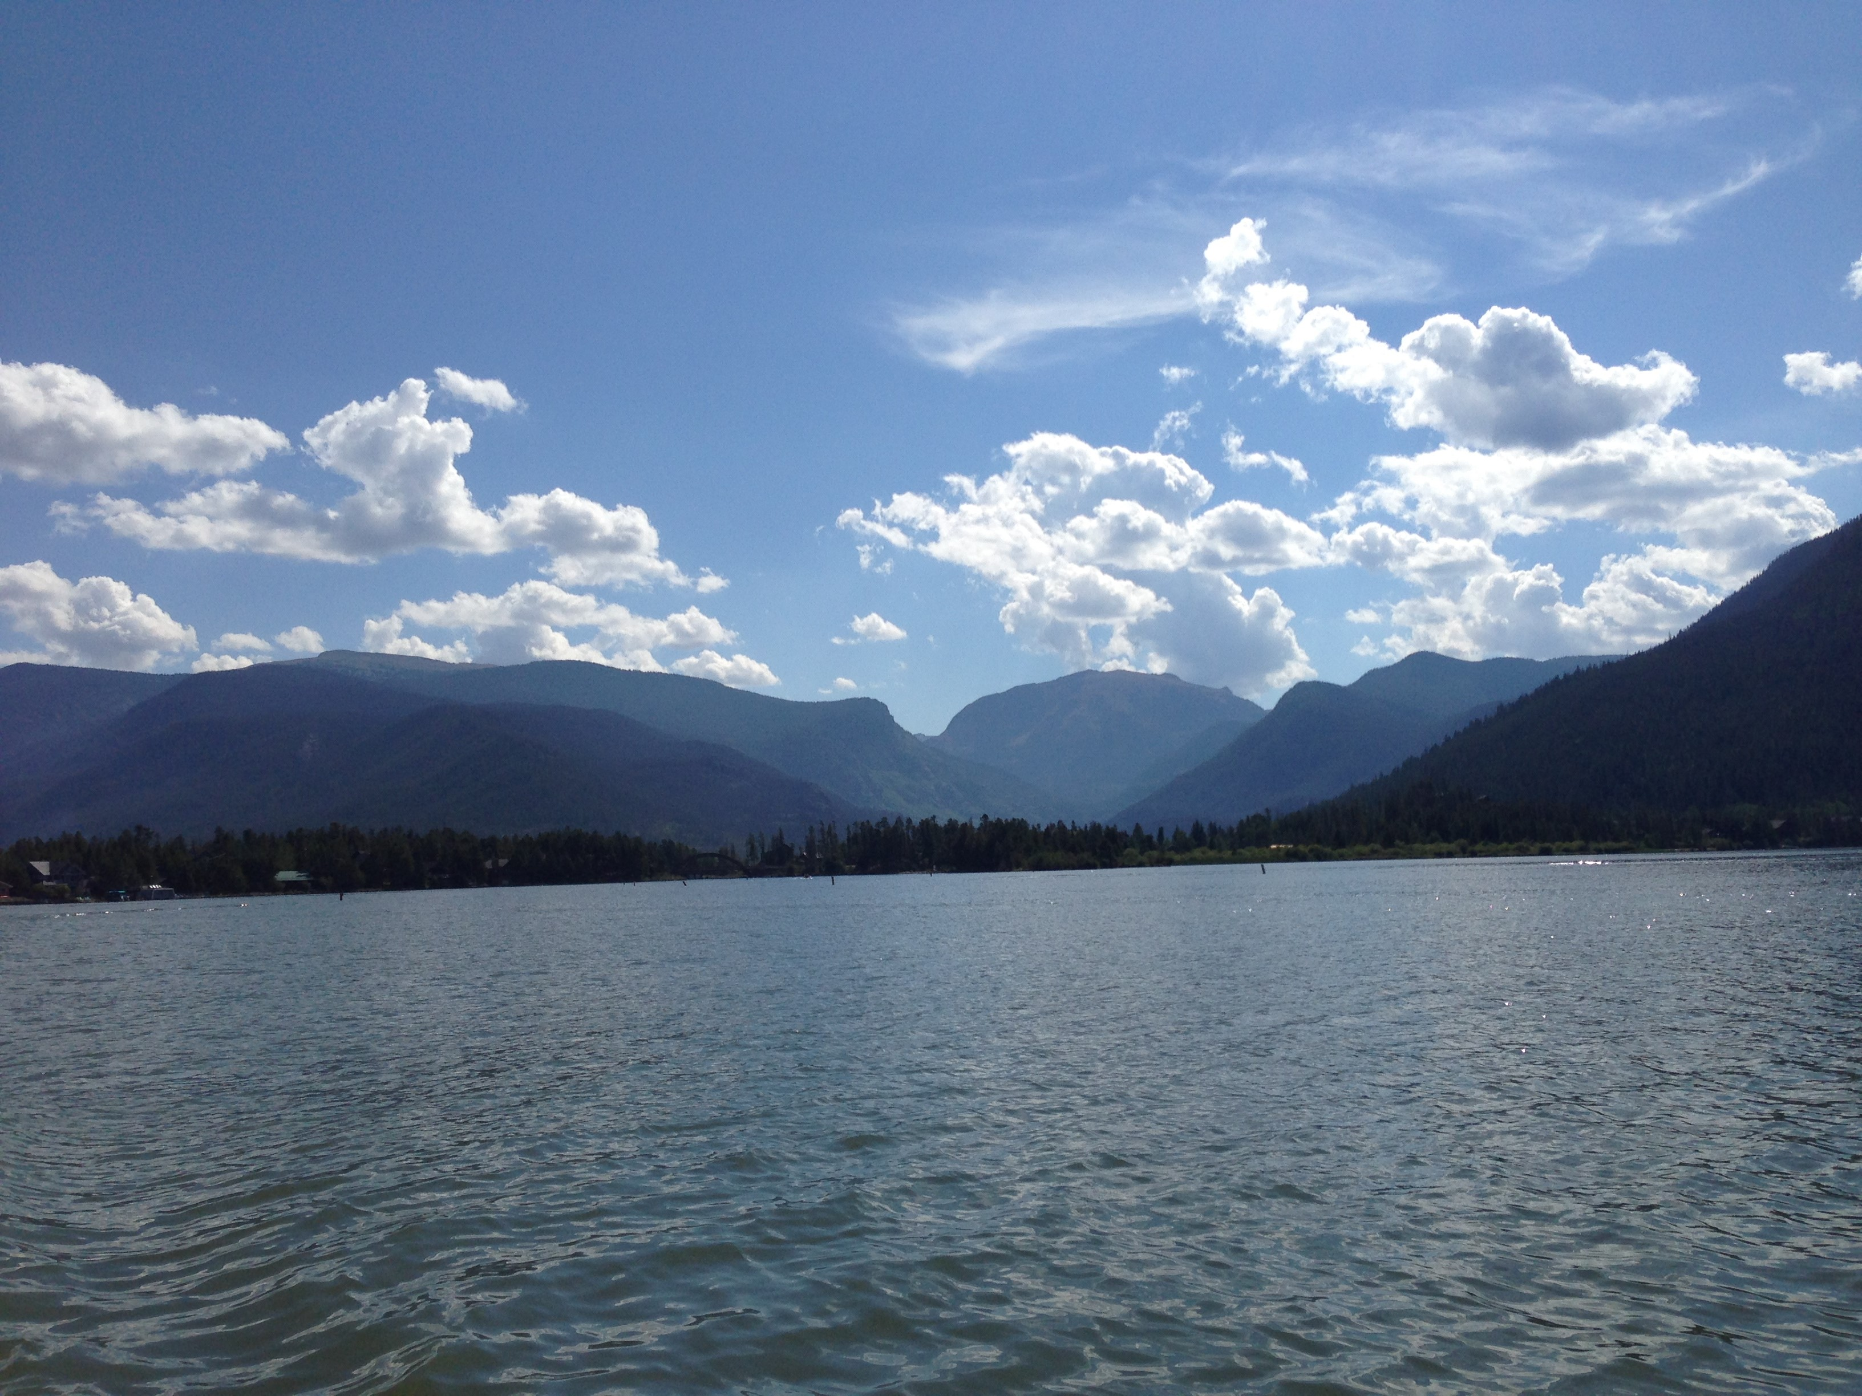
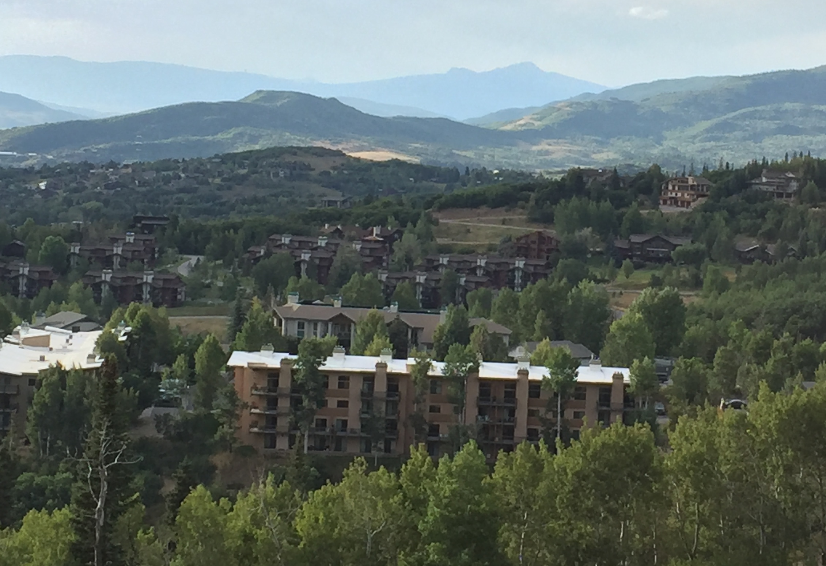
208 Planning in the NWCCOG Region
QQ Meeting
June 13, 2024

Slide 2
§ 208 of the Clean Water Act
PURPOSE of § 208 is to encourage and facilitate “the development and implementation of areawide waste treatment management plans” or 208 Plans. 33 U.S.C. § 1288(a).
Once a plan is developed:
  No construction grants for publicly owned treatment works shall be made unless such works conform to the 208 Plan. 33 U.S.C. § 1288(c).
  No 402 permit shall be issued for any point source which is in conflict with a 208 Plan. 33 U.S.C. § 1288(d).

Slide 3
§ 208 of the Clean Water Act, continued
CWA directs state governors to identify:
  1) Regional planning areas “which as a result of urban-industrial concentrations or other factors, have substantial water quality problems,” and 33 U.S.C. § 1288(a)(1)
  2) Agencies capable of development § 208 Plans for such areas.
    NWCCOG is the 208 Agencies for Planning Region 12.
    There are 4 other active “designated planning agencies:”
      North Front Range Water Quality Planning Association (Weld and Larimer Counties), the Pikes Peak Area Council of Governments (El Paso, Park, and Teller Counties), and the Pueblo Area Council of Governments (within Pueblo County).
Notes:
Section 402 of the CWA establishes a permit system for discharges of pollutants in waters of the United Statutes through a point source under the National Pollution Discharge Elimination System (“NPDES”) permit program. 33 U.S.C. § 1342.

Slide 4
EPA Regulations, 9 Elements of § 208 Plan 40 CFR § 130.6(c).
TMDLs
  Total Maximum Daily Load. “Identification of both point and nonpoint sources of pollutants, pollutant reduction targets, and load reductions necessary to reduce the source(s) of the pollutant.”
Effluent Limitations
Municipal & Industrial Waste Treatment
Nonpoint Source Management & Control
  Plan should “set forth procedures and methods (including land use requirements) to control to the extent feasible such sources.
Management Agencies
Implementation Measures
  “Including financing, the time needed to carry out the plan, and the economic, social and environmental impact of carrying out the plan.”
Dredge & Fill Program
Basin Plan (largely outdated)
Groundwater
Notes:
Section 402 of the CWA establishes a permit system for discharges of pollutants in waters of the United Statutes through a point source under the National Pollution Discharge Elimination System (“NPDES”) permit program. 33 U.S.C. § 1342.

Slide 5
208 in the Colorado Water Quality Control Act (CWQCA)
Implements CWA in CO, so similarly requires consistency with 208 Plan to issue grant $ or issue 402 Permits- in Colorado, Colorado Discharge Permit System (“CDPS”) permits. C.R.S. § 25-8-503(2).
Along with 208 Plan, the CWQCA also requires the Division to consider “long-range comprehensive plan for the area as it affects water quality” before approving of the site location and the design for new or enlarged domestic wastewater treatment works. C.R.S. § 25-8-702(2)(a).

Slide 6
208 in Water Quality Control Commission (WQCC) Regulations
WQCD must consider consistency with 208 Plan for:
1. Colorado Discharge Permit System (“CDPS”) permits (under 402 of CWA). C.R.S. § 25-8-503(2); 5 C.C.R. 1002-61.8(1)(c).
2. As part of antidegradation review for facility/ utility plans, site location applications, and 401 certifications. 5 C.C.R. 1002-21.16(B)
Division should give “substantial weight to any applicability determinations by local governments or land use planning authorities.” 5 C.C.R. 1002-31.8(3)(d)
Site location & Design Reviews
4. Grantmaking to publicly owned treatment works
site location decisions (Reg 22) | Interceptor sewer sites
WWTP applications | Lift stations
Increase or decrease design capacity

Slide 7
Local Implementation of 208 Planning
Local regulations address variety of water quality impacts such as:
Local regulations include, for example:
See also the NWCCOG Model Water Quality Protection Standards.
Runoff from urban development (construction and site planning) | Out of basin flow reductions (transmountain diversions)
Runoff from roadways | In basin flow reductions
1041 | Impervious Surface Limits
Watershed Protection | Waterbody Buffers/ Setback
Overlay Districts | Zoning/ Subdivision (siting + standards)
Notes:
Discuss that 1041 authority has been particularly important for addressing hydrologic modifications/ TMDs.
Because 1041 applies to home rule municipalities who are most likely to construct projects. Also good case law on denial of a project thanks to Eagle Co.

Slide 8
Local Implementation of 208 Planning, continued
Recommendation: Include consistency with the 208 Plan in development review.
County 1041 Regulations are best examples.
  Pitkin County 1041 standard for approval requires that “the Project is consistent with relevant provisions of applicable land use and water quality plans.”
  Pitkin County 1041 Application must include “description of provisions of the applicable regional water quality management plan that applies to the Project and assessment of whether the Project would comply with those provisions.”
Notes:
NWCCOG may assist members in water quality review of development proposals.
Some codes have consistency with 208 Plan as a standard.
Others use NWCCOG as a referral agency.

Slide 9
NWCCOG 208 Plan
NWCCOG is the designated Regional Water Quality Planning agency for Region 12.
    Region 12= Eagle, Grand, Pitkin, Routt, Summit Counties
The 2012 208 Plan is currently being updated.
QQ members will have opportunity to review the full draft.
QUESTIONS? DISCUSSION?

