Slide 1
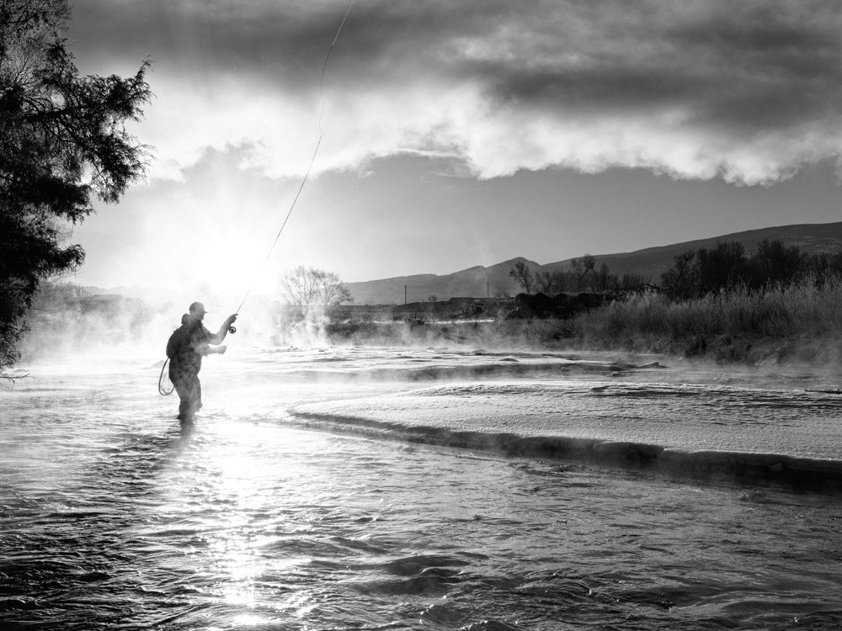
NWCCOG Economic Update
November 15, 2024
Presented to NWCCOG
Presented by Jessica Harvey
Harvey Economics
jcharvey@harveyeconomics.com
Notes:
HE is updating and expanding the 2012 Economic Study concerning the relationship that the headwater counties of Northwest Colorado have with water.
We want to understand how economic activity has changed and how water resources have changed in the past decade and going forward.
Presentation/discussion here will cover our intro, study objectives, plan of study, key research questions which we hope will lead to discussion here:
To what extent are changes in water resources driving changes in economic or social conditions, or inversely, how are economic and social conditions driving changes in water resources?
Given the relationship between the two how do you see economic activity and water resources changing in the future?
We are specifically focusing on water intensive sectors like water-based recreation, tourism, agriculture, industry and growth.

Slide 2
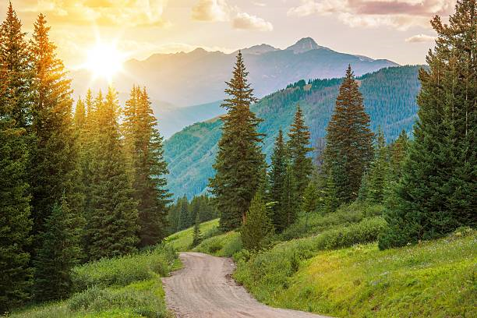
2012 Study Overview
Water and Its Relationship to the Economies of the Headwaters Counties, Coley/Forrest, Inc. (Jean Townsend, 2012)
2012 Study identified:
Unique economic characteristics of the six Headwaters Counties;
Eagle, Grand, Gunnison, Pitkin, Routt and Summit County
Water links to primary components of Headwaters Counties’ economies--tourism, agriculture, and mineral resources;
Link between water in the Headwaters Counties’ economies and effects of transmountain diversion projects, and;
Currently compromised condition of water resources in the Headwaters Counties and ways that water users, advocacy organizations and regulators have worked together to manage these resources.
Notes:
2012 Report establishes connection between water supply, local economies of the headwaters counties and the State
Report outline:
Economies of the headwaters counties
Tourism
Agriculture
Mineral and resource development
Water and the economies of the headwaters Counties
Water policies and problem-solving successes
Hydrology and transmountain diversions
Overall, this report documented water’s importance to this region

Slide 3
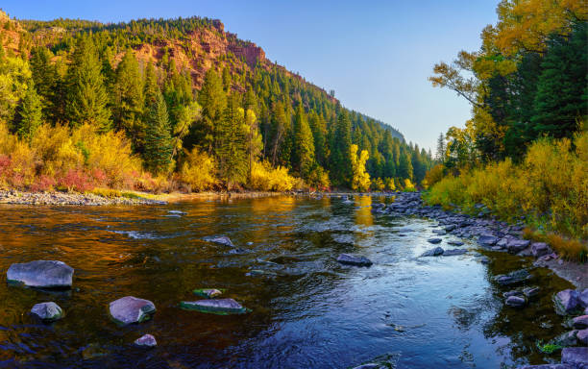
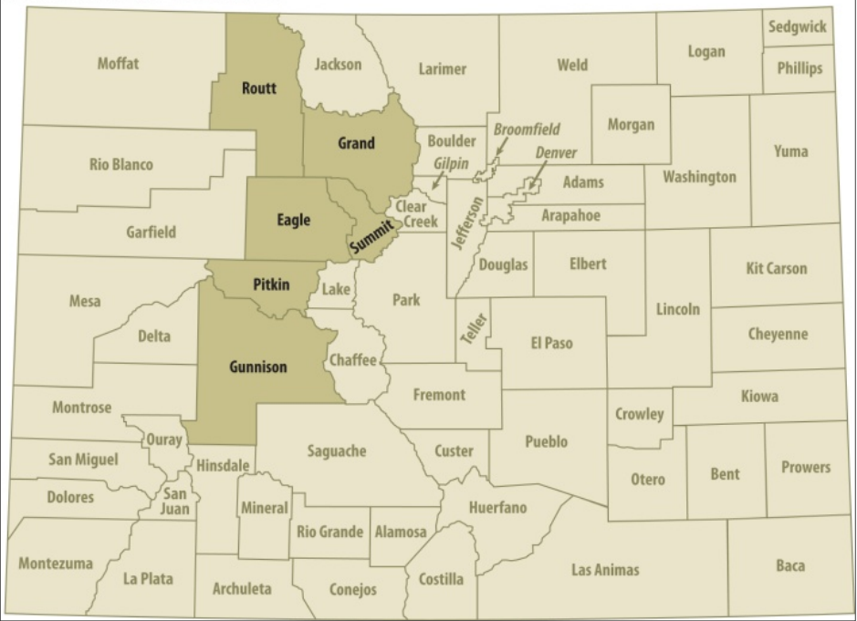
Colorado’s Headwaters Counties
Notes:
Just confirming this is our study area. Rest of the State someone else’s problem!
We will study each county separately because that is how data is collected and jurisdictions governed.

Slide 4
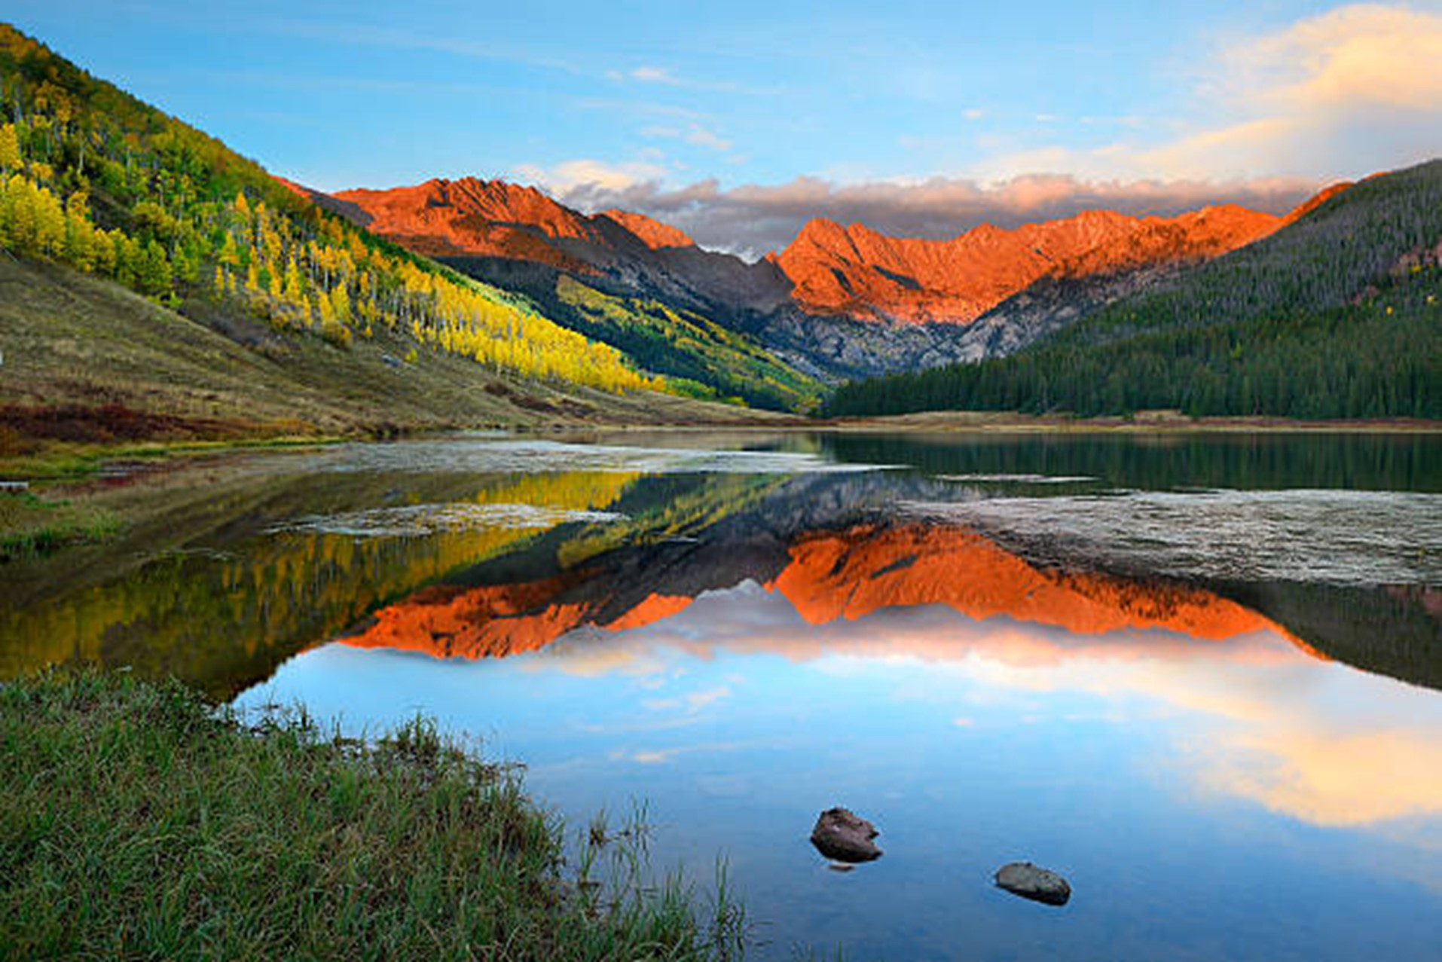
Objectives of the NWCCOG Economic Update
How has economic activity in Headwaters Counties changed in the past decade?
How are changes in water resources driving changes in economic conditions?
How are changes in economic or social conditions driving changes in water resources?
How will economic activity and water resources change in the future?
Study Focus: Water-Based Recreation, Tourism, Agriculture, Industry and Growth under Climate Change
Notes:
Plan to update but expand upon the 2012 study
World has changed a lot in 12 years:
Population grown
Rec and tourism grown
Mineral industry shrunk
Water leaving the HWC
Future? Climate Change might be the elephant in the room
Past and future effects on water then everything else
Effect on econ sectors
Econ and demog. conditions

Slide 5
Harvey Economics’ Update Study Plan
Secondary Research and Data Collection by County
Primary Research and Data Collection by County
Data Analysis and Conclusions
Notes:
Secondary Data Collection (BRIEF, GIVE ONLY A FEW EXAMPLES)
Collect economic, demographic and hydrologic data from outside sources including but not limited to:
BEA (Bureau of Economics Analysis)
DOLA (Department of Local Affairs)
Colorado Energy & Carbon Management Commission (Formally COGCC)
Colorado Geological Survey
Colorado Water Plan
USDA Census of Agriculture
CROA Report
Dean Runyan Associates Economic Impact of Travel in Colorado
Southwick Associates Economic Contributions of Water-Related Outdoor Recreation in Colorado
Colorado State Parks
ADD CLIMATE CHANGE RESOURCES
Primary Data Collection KEY PART AND WILL HONE IN ON THIS SHORTLY
Stakeholder Interviews by county
WHAT DOES IT ALL MEAN?

Slide 6
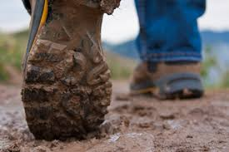
Boots on the Ground
Notes:
Huge part of this study will the be the stakeholder outreach/individual interviews
Importance of boots on the ground information
Need to hear from community members from different economic sectors
When you have boots on the ground you get the actual story
You will get individual perspectives from stakeholders in each given community
How do water resources actually impact individuals in each county
Learn individual experiences from stakeholders from water based economic sectors
Many people in the state are interested in this inextricable relationship between water and the economy

Slide 7
Stakeholder Engagement Plan
Headwaters County Plan: Eagle, Grand, Gunnison, Pitkin, Routt, and Summit Counties
Four to Six Interviews per County
Goal: Interview a wide variety of Stakeholders in each County
(Government, Recreation, Water and Sanitation Districts, County Commissioners, Hydrologists, etc.)
Notes:
Here is the Engagement Plan…
Started this process in Eagle County yesterday
Will visit each county and do 4-6 in person interviews along with other meetings virtually
HE to provide each interviewee with an economic and hydrologic snapshot of the given county before meeting to get the juices flowing

Slide 8
Economic Snapshot
HE will provide a brief economic snapshot for each Headwaters county.
Snapshot will include:
Overview of Demographic and Economic Conditions;
Water-based Recreation Activities;
Tourism;
Agriculture: Current and Historical Uses and Drivers of Aquatic Change and Degradation;
Mineral Extraction; and
Potential Future Water Demand Scenarios.
Notes:
Series of data on each water-based sector.
Briefly ID topics to spark discussion with interviewees

Slide 9
Hydrologic Snapshot
HE will provide a brief hydrologic snapshot for each Headwaters county.
Snapshot will include:
The main river stretches in each given county;
Current and historical uses and drivers of aquatic change and degradation;
What is happening of note with regards to stream flows, precipitation, and water temperature in the given county in the prominent watersheds; and
Potential future Climate Change scenarios for those watersheds.
Notes:
Primary discussion likely center around past and future changes in hydrology.
We are getting help on streamflow changes from Lotic Hydrological
Using recent study findings from Climate Change in Colorado to prompt discussion of economic effects from climate change effects on Headwater Counties, including Snowpack, Run-off Timing, Streamflow and Evapotranspiration.

Slide 10
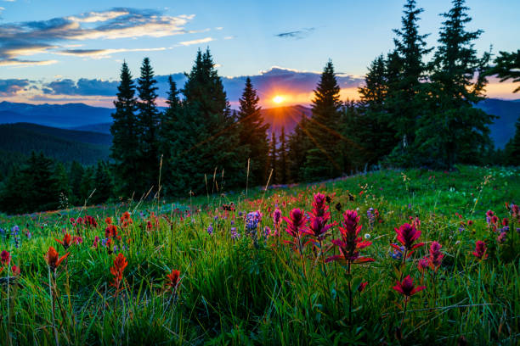
Indications of Climate Change
Climate Change Variable
Spring Snowpack
Runoff Timing
Stream Flow
Summer Soil Moisture
Evaporative Demand
2000 – 2023 Compared to 1951 – 2000
Lower 3% - 23%
Earlier
Lower 3% - 19%
Declines
Increase 5%
Projected Change by 2050 from 1971 – 2000
Lower 5% - 30%
Earlier
Lower 5% - 30%
Declines
Increase 8% - 17%
Level of Confidence
Medium
High
Medium
High
High
Source: Climate Change in Colorado, 2024
Notes:
Briefly highlight past and future changes in this table
All indications point to increasing pressure on hydrologic resources in the Headwaters.
Uncertainty is a big question: More confidence in temperature changes than in precip.

Slide 11
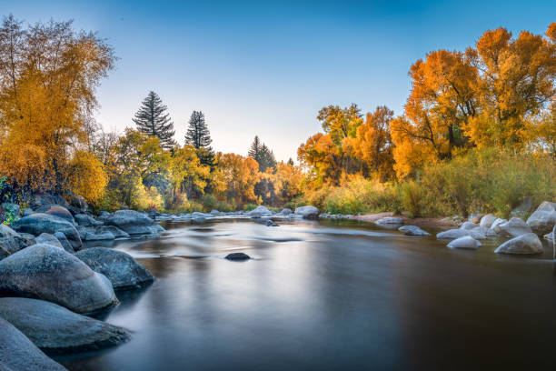
Sample Interview Questions
What will be the key drivers to changes in economic activity (for each water intense sector) in the future?
How have the local conversations surrounding water (availability, quality, temperature, management) changed in the last 10 years?
How do water challenges in other areas of Colorado (i.e., adjacent counties, Front Range) affect your county?
Notes:
Read and seek discussion.
How would you guys react right now to these questions?

Slide 12
THANK YOU
720.889.2755
HE@HarveyEconomics.com
HarveyEconomics.com
Notes:
If anything occurs to you about this study, insights, questions, people to contact, please let us know.

Slide 13
Sample Interview Questions
What will be the key drivers to changes in economic activity (for each water intense sector) in the future?
How has the local conversation surrounding water (availability, quality, temperature, management) changed in the last 10 years?
What are the major concerns surrounding water in your County (i.e., availability, water management, quality, etc.)?
What role do you see water playing in the local economy/different industries (i.e., agriculture, recreation, economic development, etc.) in your County, now and in the future?
What impacts or changes have you seen in the County because of current water challenges/issues (i.e., impacts to development, tourism, recreation, environment, etc.)?
How do water challenges in other areas of Colorado (i.e., adjacent counties, the Front Range) affect your County?

