Slide 1
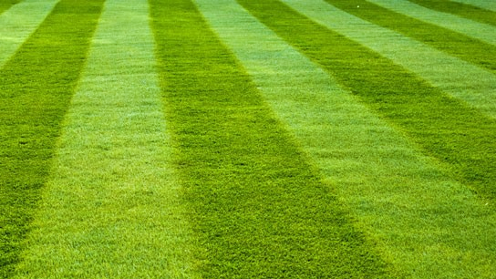
Got Nonfunctional Turf? What to Know About Implementing
SB24-005
Laura Belanger
Senior Policy Advisor, WRA
NWCCOG - June 18, 2025

Slide 2
SB24-005: The Basics
Intent is to conserve water resources by reducing the amount of nonnative cool-season, high-water use grasses used in landscaping.
Prohibits nonfunctional turf, non-functional artificial turf*, and invasive species
Only applies to new development and redevelopment.
Focuses on CII, HOA common spaces, rights of way, parking lots, medians, and similar
Municipalities and counties must develop or amend their landscape codes to comply by January 1, 2026
*HB1113 change

Slide 3
HB25-1113: The Basics
Expands and modifies SB24-005 requirements
SB5 prohibited all artificial turf. HB1113 changed to prohibit only nonfunctional artificial turf by original SB5 January 1, 2026 implementation date.
by January 1, 2028, adds multifamily residential properties with more than 12 units to properties SB5 requirements apply to.
Requires local governing entities to regulate turf on all residential properties by January 1, 2028, leaving it up to local entities to determine how.

Slide 4
Development and Properties Regulated by SB5
New Development &
Some Redevelopment
Properties
New Development: new construction requiring building or landscaping permit, plan check, or design review.
Redevelopment: construction that: requires building or landscaping permit, plan check, or design review; and disturbs more than 50% of total landscape area (SB5 only impacts disturbed area).
Does not require turf removal
Commercial, institutional, or industrial property;
Common interest community property;
Street right-of-way, parking lot, median, transportation corridor, similar.
Does not apply to residential properties*
*HB1113 does

Slide 5
What’s Prohibited Under SB24-005
Invasive plants (i.e., noxious weeds)
Nonfunctional turf & nonfunctional artificial turf*: turf/artificial turf that receives little, if any, use, primarily serves an aesthetic purpose, and could be replaced with landscaping that adheres to water-wise landscaping principles without adversely impacting quality of life or landscape functionality
*HB1113 defined nonfunctional and functional artificial turf.

Slide 6
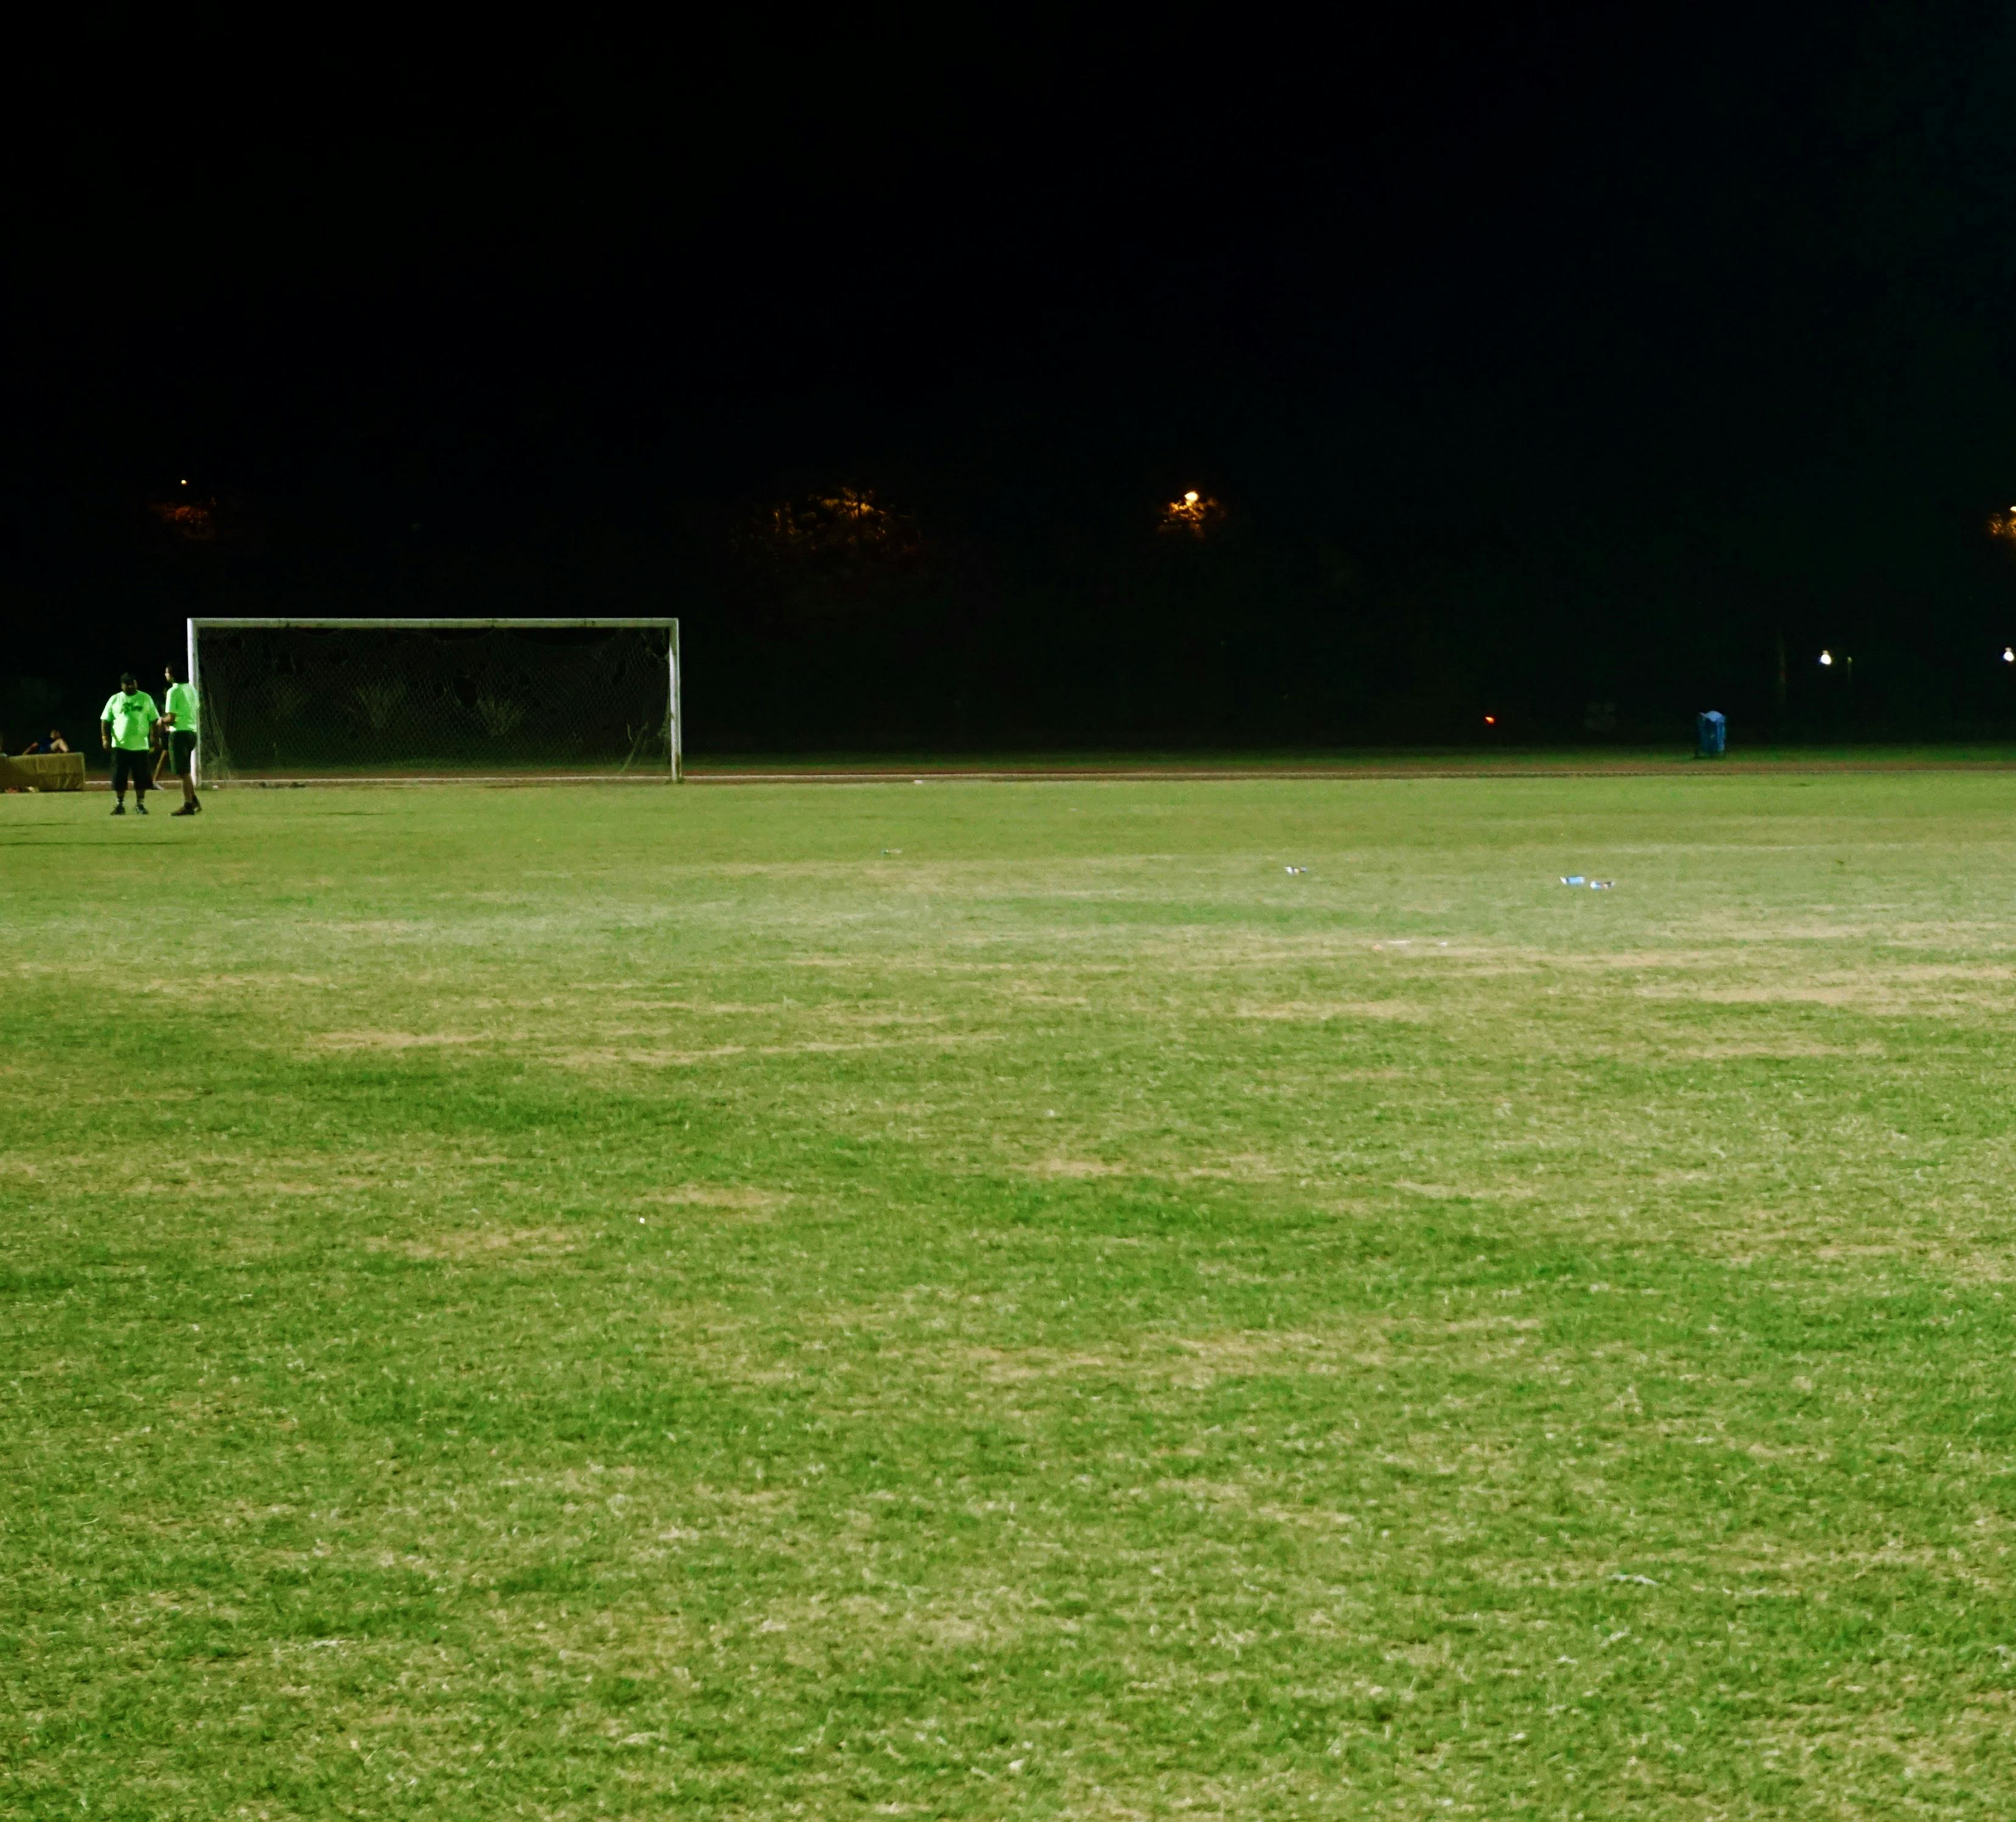
What’s Allowed Under SB24-005
Functional Areas
Functional turf & functional artificial turf: turf that is located in a recreational use area or other space that is regularly used for civic, community, or recreational purposes, which may include playgrounds; sports fields; picnic grounds; amphitheaters; portions of parks; and the playing areas of golf courses, such as driving ranges, chipping and putting greens, tee boxes, greens, fairways, and roughs
Anywhere
Any grass sod or seed that is a “native plant or has been hybridized for arid conditions”
Landscaping that adheres to “water-wise landscaping principles without adversely impacting quality of life or landscape functionality”
Notes:
property w
A 6 MULTIFAMILY RESIDENTIAL HOUSING PREMISES PROPERTY THAT INCLUDES 7 MORE THAN TWELVE DWELLING UNITS.ithin a common interest community that is owned and maintained by a unit owners' association, such as entryways, parks, and other common elements

Slide 7
SB5 Implementation Assistance Project
 | Dec | Jan | Feb | Mar | Apr | May | Jun | Jul | Aug | Sep | Oct | Nov | Dec
Technical Advisory Committee
Community Survey
Develop Resources
Share with and Educate Communities
Notes:
WRA to flush these slides out
March – May: Developing resources
June – December: Education on resources
Today’s meeting: Overview
April 22nd meeting – Resource review
June 17th meeting – Educational plan meeting

Slide 8
What Did We Hear? Resource Needs
SB5 Fact Sheet
Definitions library
Examples of “compliant” codes
Strategies for plan review and enforcement
Resources for what landscape material is allowed
Educational materials for developers

Slide 9
Priority Resources - available this month
Updated SB5 Fact Sheet (reflects relevant HB1113 changes)
Key Considerations Guide
Compliant Code Matrix
Grasses and Plants Guide
Currently evaluating additional resource needs

Slide 10
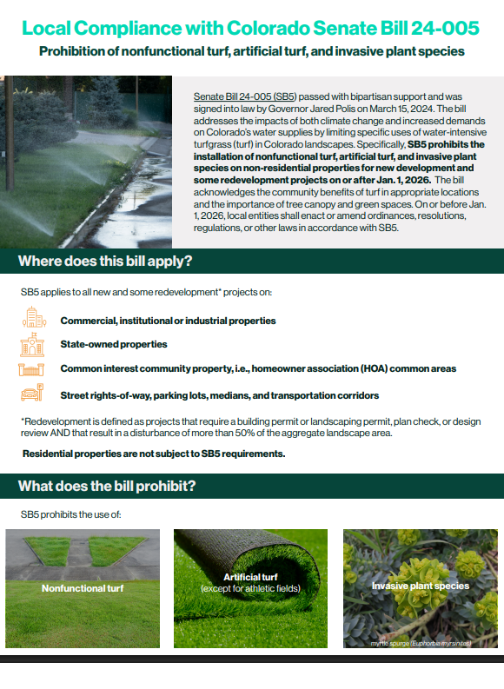
SB5 Fact Sheet
High level overview of SB5 including key information:
Timeline
Applicability
Prohibitions
Key Definitions
FAQs
Developing updated version to reflect HB1113 artificial turf changes

Slide 11
Resources Created and In Development
Key Considerations Guide
High level guide for updating regulations and processes per SB5
Consolidated definitions of key terms as defined by SB5
Clarifies bill intent
Special considerations for implementing code updates
Template for communication with developers
Compilation of supporting, existing resources (e.g., example landscape plans, plant lists)
Notes:
Abbye
Question for Abbye – will we include resources for developers in the resource guide

Slide 12
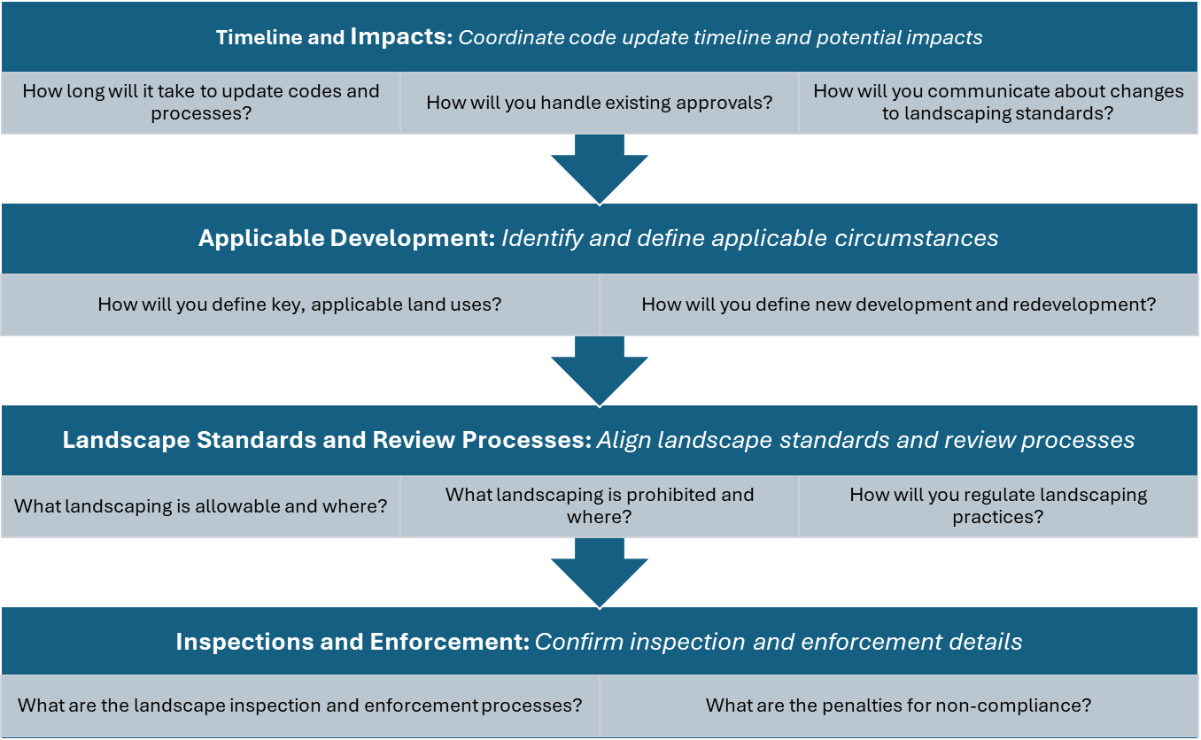
Key Considerations Guide

Slide 13
Compliant Code Matrix Overview
Turf and nonfunctional definitions
Language regarding nonfunctional turf on CII properties, HOA common areas, and transportation corridors
Artificial turf definitions and limitation language
Applicability language
No invasive species language
Notes:
This is emerging, not all communities are perfectly compliant, includes examples of communities that have some compliant language, not all communities use the exact definitions from the bill (e.g., non-functional turf defined as “turf for aesthetic purpose” in aurora.

Slide 14
City of Aurora
City of Edgewater
No turf in medians, curbside landscapes, and golf courses
Turf is only allowed in active or programmed recreation areas on commercial, multi-family, schools, common areas, and parks properties
Active or programmed recreation area means an area with a primary function of sport field but can also accommodate secondary functions including but not limited to nonorganized sporting events, cultural activities and organized social gatherings
No turf in front or side yards; shall not exceed the lesser of 45% or up to 500 sq ft in backyards
(Sec. 138-191 Use of turf and ornamental water features)
No turf in rights-of-way, medians, and parking lots.
Turf is only allowed in active or programmed recreation areas on commercial, industrial, institutional properties.
No turf in areas less than 8ft wide or on slopes greater than 25%.
Turf limited to 25% of total landscaped area on residential properties.
Artificial turf is prohibited.
(Ch. 16-34 Water efficient landscaping requirements)
Notes:
Some examples of what compliant code language looks like in current community landscape codes

Slide 15
Grasses and Plants Guide Overview
Guide for SB5 applicable properties
Focuses on grasses allowed and not allowed in nonfunctional areas (discusses hybrids)
Links to existing resources on waterwise plants for nonfunctional areas
Provides additional guidance for prohibiting invasive species, i.e., noxious plants
Outlines implementation considerations

Slide 16
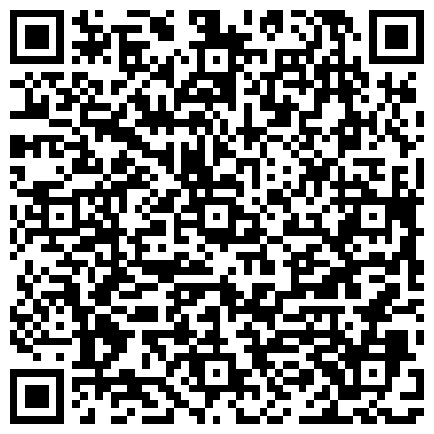
Interested in implementation resources? Scan the QR Code or click on “SB5 Compliance” on WRA’s Community Landscape Transformation Hub
Photo Courtesy of Resource Central

Slide 17
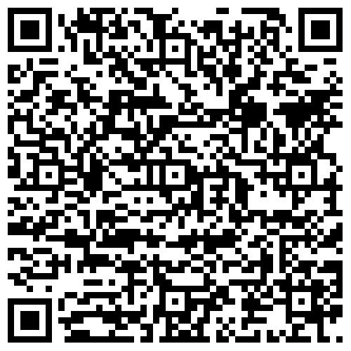
Additional Resources
WRA’s Guide to Designing Conservation-Oriented Tap Fees
Sonoran’s Growing Water Smart Technical Assistance & WaterNow Alliance’s Project Accelerator Program
DOLA Template Land Development Code
SMWSA Model Regional Landscape & Irrigation Ordinance
Community codes (Broomfield, Aurora, Castle Rock, Edgewater)
Download the report
Notes:
Conservation-oriented tap fees are another tool that communities can use to reduce their outdoor water demand by incentivizing developers to reduce their lot size, increase density, or to use water wise landscaping in exchange for lower system development charges.
WRA originally published a guide to developing conservation-oriented tap fees in 2015 and we’re in the process of updating this guide with our partners at Raftelis Financial Consultants to include new and revised case studies from Colorado and other Western states
The updated guide will be published this coming winter.

Slide 18
Questions?
laura.belanger@westernresources.org

