Slide 1
Project THOR 2.0
The network matures

Slide 2
Program Principles
Biased to Action
Move quickly and innovate
Meet regional and local community needs
Close the broadband gap

Slide 3
Leading the way
Innovator
Local Broadband Leadership
New Partnerships
Increased speeds
Connecting more people

Slide 4
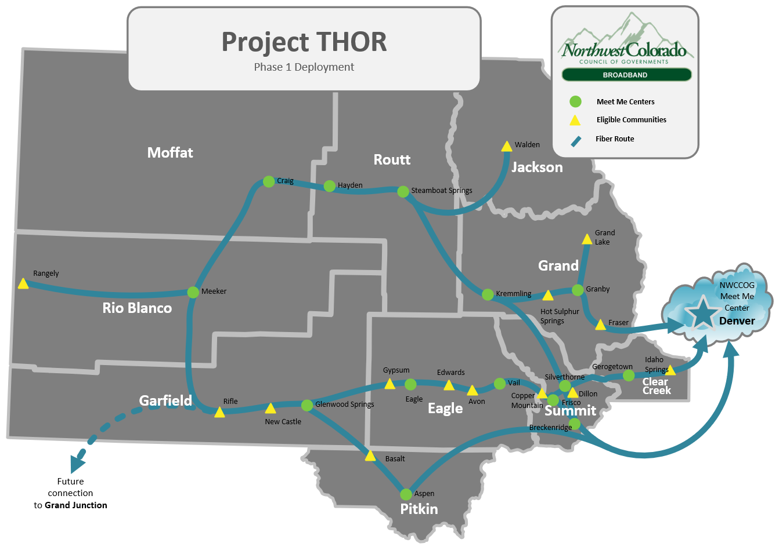
Project THOR Network
9 Counties, 16 rural towns and cities
Average costs per month between $8K and $6K per month depending upon available bandwidth
Monthly MMC network costs between $ 8K and 6K per month depending upon available bandwidth
Average service levels 100G to 10G
Peak daily traffic has increased from 5G to 28G
Notes:
Contracted with mammoth networks to operate and administer THOR network with ongoing nwccog oversight on behalf of participants

Slide 5
What Project THOR Fixed
More access in more places
Broke lock that inflexible national ISPs had on our communities
Flexibility allows communities the ability to roll with changing needs
Bandwidth costs reduced $1.10/M down to $0.36/M due to aggregation
Resilience helps reduce outages
Ability to provide access and bandwidth to support multiple smaller last mile ISPs

Slide 6
New Opportunities through DOLA Grant
DOLA Grant
Upgrades Project THOR
Creates integrated “West Slope Network”
Covers fiber lease where both networks ride CDOT fiber together
All NWCCOG markets upgraded to dedicated 100G/100G
Cost savings

Slide 7
Current Network

Slide 8
Legend
Project THOR 2.0 – DOLA Funded Middle Mile
200G – 400G DWDM Core
10G Shelf Interconnect
Mammoth 200G
100G Shelf Interconnect
Lumen 100G OWS
NWCCOG Hub Site
DWDM Frontage Road
Grand County Hub Site
100G Shared
Craig
Hayden
Steamboat
Strata 10G x 2 (Mammoth
100G Shared
Cheyenne WY PoP
November 2022
I-70 Express Path – EB Only today
100G Dedicated Wave GWS - DEN
100G Dedicated Wave NW Network- DEN
100G Dedicated Wave Roaring Fork Fiber – DEN
100G Dedicated Wave Vail – DEN
100G Dedicated Wave Frisco - DEN
100G Dedicated Wave SBS and Kremmling – DEN
100G Dedicated Wave Georgetown - DEN
I-70 Regional Path
200G Shared Wave - Bidirectional
Kremmling
100G Shared
Granby
100G Shared
Estes Park
100G Shared
May 2022
May 2022
Meeker
May 2022
Fraser/WP
100G Shared
100G Shared
May 2022
Grand Junction
100G Shared
Spring 2023
May 2022
Denver
100G Shared
Glenwood Springs
Eagle
Vail
Frisco
Georgetown
52 Km
59 Km
57 Km
53 Km
74 m
200G Shared
CDOT
200G Shared
200G Shared
Silverthorne
200G Shared
Idaho Springs
200G Shared
Dillon
20 Km
5164
April 2022
5164
6 Km
5164
47 Km
5164
5164
100G Shared – Lumen Path
5164
5164
5164
5164
Snowmass Village
Basalt
20 Km
5164
100G Shared
November 2022
10G
100G
Breckenridge
100G Shared
3948
June 2022
10G to 100G Shared
5164
Aspen

Slide 9
Program wins
Operating successfully for 3 years
Dug into operations
New network operator has lowered costs
New contracts at lower cost and better service
Maintained our reserves
DOLA Grant Provides
CDOT IRUs covered for next 7 years
Zayo IRU covered for 7 years
Network upgrades covered

Slide 10
Affects on Program Budget
New Long Term Budget
2022 transition from startup budget (based on 2018 assumptions)
Ensures long term program viability
Admin costs begin to be paid 2023
Contingency, R&M savings
Allows predictable budget planning for next 5 years

Slide 11
Project THOR 2.0 Budget

Slide 12
Questions

