Slide 1
AABC Integrated Clean Energy System
A DOLA Funded Collaboration between Holy Cross Energy, RFTA, the Aspen/Pitkin County Airport and Pitkin County

Slide 2
Project Overview
Vision Create a regionally resilient and 100% clean energy system that balances production, storage and distribution across four distinct public facilities, generates additional clean energy to the community and create a model for net-zero, resilient public facilities across the state.
Why Lake Christine Fire exposed significant vulnerabilities in our public infrastructure This project seeks to build resiliency for these core services, while simultaneously building a clean energy system for some of highest energy consumers in the County.
Who
Aspen Pitkin County Airport
RFTA Aspen Maintenance Facility
Pitkin County Public Works
(4) Holy Cross Energy electric system operations from Brush Creek Park n’ Ride to the Aspen Substation.
Notes:
The Lake Christine Fire exposed significant vulnerabilities in our public infrastructure in the event of a power failure and/or evacuation. This project seeks to build resiliency for these core services, while simultaneously building a clean energy system for some of highest energy consumers in the County.
CMC and the Aspen Sanitation are also in close proximity but were not selected due to the added complexity of additional public entities but provide future expansion opportunities

Slide 3
Feasibility Study (2019-2023)
Award
$200,000 - DOLA RNEW Program in 2019.
Goals
Make all four public facilities resilient and net-zero emissions by allowing optimized load distribution of renewable energy, provide a distribution point to the surrounding community for stored renewable energy, and significantly improve the resiliency of the regional grid and of the facilities themselves during catastrophic events.
Create structure with multiple public entities that serves as an example for replication
Completion of White Paper.
Site assessment of existing infrastructure and energy usage
Evaluation of potential conservation measures for each facility
Establish an “energy box” based on current energy load and energy load after conservation measures
Engineering analysis of integrated clean energy systems
Economic, ownership, and administrative framework for the integrated clean energy systems.

Slide 4
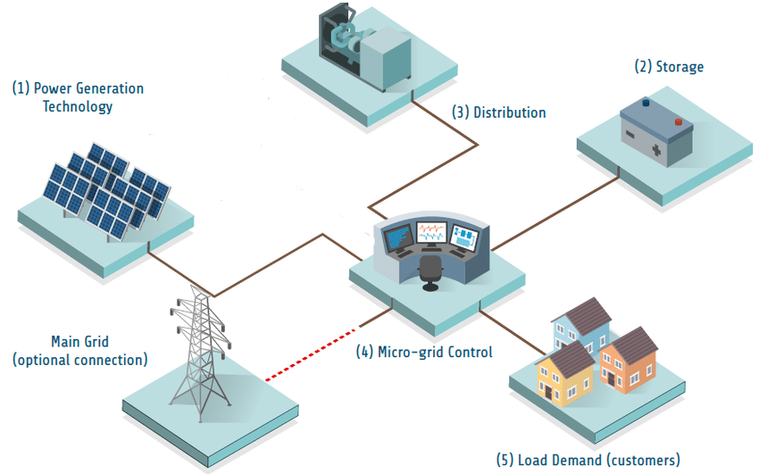
The Final Vision – Integrated Microgrid System
Integrate facilities in a micro-grid system that maximizes renewable energy use at the facilities and the surrounding community, and allows for optimized resiliency. Implement conservation measures and other technologies at later dates as funding opportunities become available and the redevelopment of facilities are complete.
Why?
Microgrid is both the easiest aspect to design and implement and have the greatest impacts on meeting climate and resiliency goals;
Microgrid is modularly expandable and allows for the surrounding community to directly benefit,;
Conservation measures and heating district required complete facility redevelopments

Slide 5
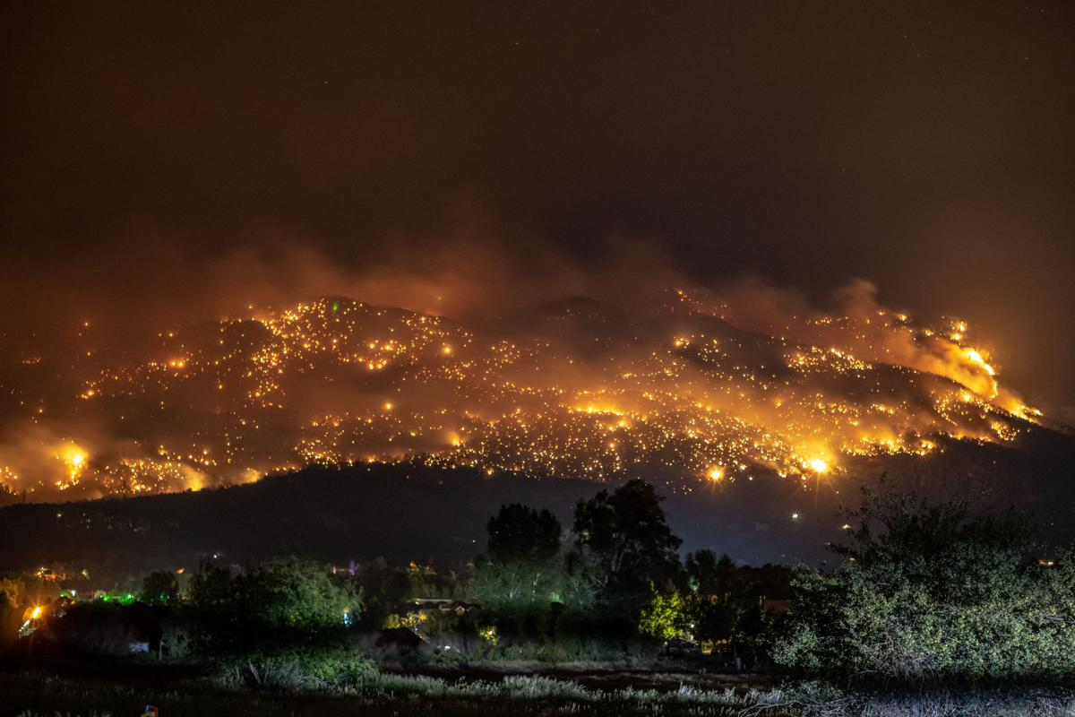
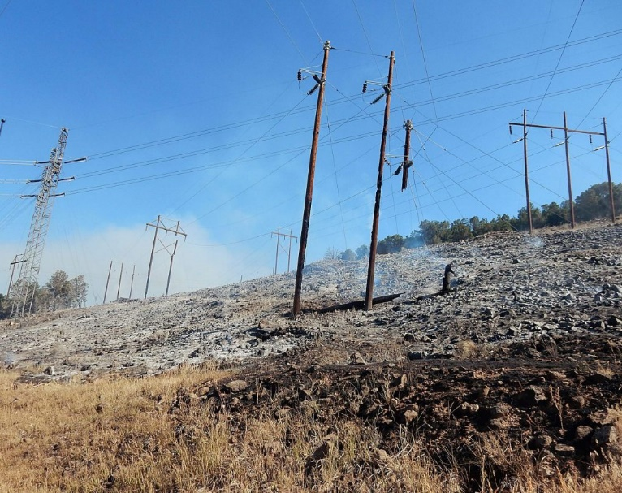
Resiliency Benefits of the Microgrid
A microgrid allows for continued operations of these facilities in the event that the regional grid fails. This could be a brief power outage , a black-sky day or a catastrophic event, each of which can cripple the regional grid.
Microgrid generates electricity via solar photovoltaics and then sores the energy in large-scale batteries.
These renewables and storage allow for the system to be disconnected from the regional grid with the ability to generate electricity for immediate use and to discharge the batteries when the renewables are inactive or unable to generate.
The Lake Christine Fire and Single-Point of Failure for the Regional Grid

Slide 6
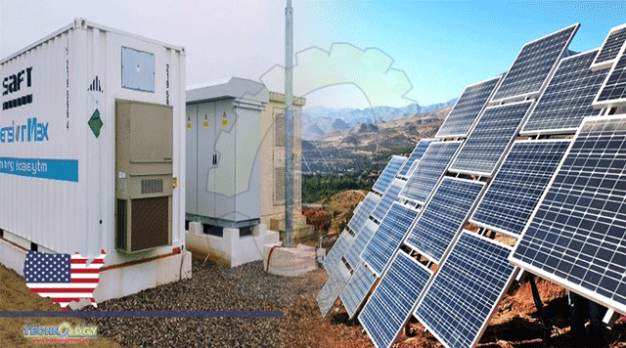
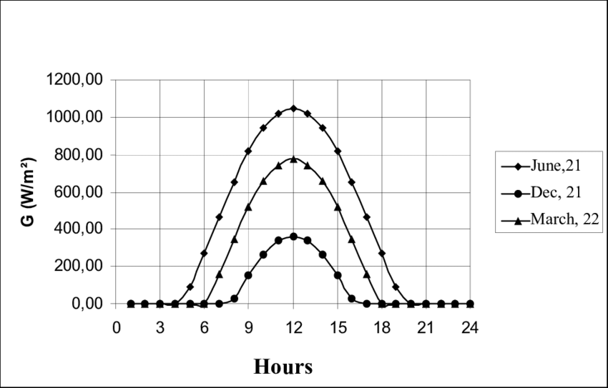
Climate Benefits of the Microgrid
By pairing solar generation with battery storage, it permits for the generated electricity from the day to be used during nighttime hours. Doing this:
Negates the need for Holy Cross to supply peak demand loads from Coal or Natural Gas Peaker plants;
Allows for facilities to be supplied with renewable electricity throughout the entire day;
Permits excess renewable generation to be distributed into the surrounding community when it is most needed, and;
Can be used as the hub for the spokes of community solar and battery systems, that, when discharged in concert, can provide renewable energy for the entire community.

Slide 7
What is Needed for a Microgrid at the AABC
CURRENT ENERGY DEMANDS
Current average daily electricity usage at the four public facilities is 8.2 MWh (megawatt hours)per day.
Average daily electrical usage estimated to increase to 11.7 MWh per day when new airport and fully electrified terminal completed. Energy demands will increase during peak periods ( July 4th or the Christmas week)

Slide 8
What is Needed for a Microgrid at the AABC
(1) RENEWABLE ENERGY GENERATION
5 MW Holy Cross Energy Solar array at Aspen Sanitation District will produce a daily average of 27.5 MWh.
Need 400 kW of additional solar generation. Proposed solar at RFTA AMF and Public Works will produce a daily average of 2.2 MWh.
With 5MW solar facility plus additional 400 kW proposed, enough renewable and clean energy should be available to power the facilities. Additional modifications, such as snowmelt at the Airport will require more electricity daily and will integrate future renewable energy generation.
(2) ENERGY STORAGE
Distributed energy storage among Airport, Public Works and RFTA AMF.
4.5 MW batteries to achieve 24 MWh of energy storage capacity across all facilities to achieve resiliency and net-zero goals for 90% of average daily load needs, excluding “Peak Week” events
(3) LOAD MANAGEMENT SOFTWARE
As these facilities are already connected on a shared distribution system, the final step is the implementation of a load management software managed by Holy Cross Energy. Load Management System will:
Balance the needs of each facility & ensure optimal operations of the system
Allow for the distribution of renewable energy during the hours when solar is not generating to permit net-zero emissions from operating the facilities.

Slide 9
Phase 1(a) Implementation (2022-2023)
DOLA RNEW – $1,700,000 + $1,655,000 cash match (from all partners) = $3,355,000
Due to the cost of implementation, broken the project into multiple phases. Phase 1(a) includes:
Design Integrated Microgrid to 35%. Ready for design build for any future funding opportunities
Design 100% for implementation of integrating the 5MW Solar Farm array and at least 1 MW battery
Future phases – dependent on future funding
Easily scalable
installation of 400 kW of additional solar
installation of remaining MW of battery storage
Load Management software

Slide 10
Future Implementation
INSTALLATION OF CONSERVATION MEASURES
Installation of conservation measures at the Airport AOC building, the RFTA AMF and Holy Cross offices. As the Public Works Campus and Airport terminal are scheduled to be redesigned and rebuilt in the next 10 years, no conservation measures will be implemented at them. Total costs of this phase are being determined and will be dependent on economic conditions and ongoing development of new technologies. They will cover the needed infrastructure to take the facilities to fully electric.
NEW FACILITY DEVELOPMENT
The last phase includes the construction of the new airport terminal and Public Works Campus, both of which will be fully electrified.
As part of this phase, the construction and installation of the heating district linking all facilities will be incorporated. As new facilities will be constructed, this is the optimal time for the construction of the necessary infrastructure for the heating district to operate.
Lastly, as part of this phase, an additional 2 MW of solar is proposed for installation on airport property. This additional solar will create a more robust and resilient source of electricity for the facilities and guarantee that they are powered by renewable electricity.

Slide 11
Outstanding Items
Ownership structure.
Identification of the ownership, management and capital maintenance of the infrastructure. Items are located by site based on available space. Ownership of infrastructure and fiscal responsibility are still outstanding. Currently, it is anticipated that the 4 involved entities will split the grant match evenly. It remains outstanding if this comprises full costs of implementation.
Administrative structure.
Agreement of how day-to-day operations and excess electricity discharge are managed
Black-day prioritization.
Perhaps the most complicated component of cooperation on this project is prioritizing critical services and operations in the event of a catastrophic failure of the regional grid. In this event, what services must run? What services would be nice to have but aren’t critical? And what services can be safely turned off? This will require extensive discussion and planning between the partners before a final agreement can be signed.

Slide 12
Questions?

Slide 13

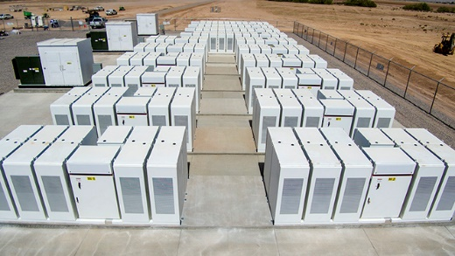
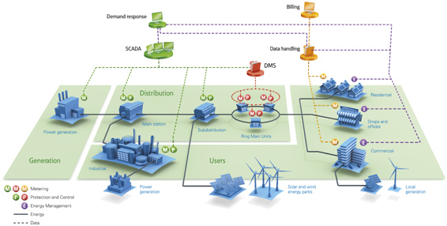
Just What is a Microgrid Anyways?
A micro-grid is an integrated electricity grid that combines electrical generation, storage, a distribution system, a load management network, and end demand users in an a single linked and interconnected system.
(1) The first key component of a micro-grid is electricity generation, preferably a clean and renewable source. This is essential so the microgrid can continue to generate electricity independent of the regional grid and allow for continuation of services.
(2) The next is electrical storage, often in batteries. This is necessary so that renewable electricity, which can’t generate when the sun is shining or the wind is still, can be stored during periods of generation decline. This allows for on-going electrical use regardless of what the weather or time of day.
(3) The final component is the distribution system and a load management software. Electricity generation and storage is not sufficient, it needs to be able to be transferred to where it is needed and when. This requires transmission line and transformers. However, each user on the grid will have different demands based on use an time of day, necessitating a management software to keep the whole micro-grid in balance and operating.

Slide 14
Clarifications – Micro-Grid
Infrastructure
Blue sky event – site infrastructure is owned and specific to the site. HCE work so that any extra capacity HCE can pay for Blue sky events
Black sky event – neighbors helping neighbors. HCE becomes the system integrator. Partner on operations, and commissioning to make sure all systems can work together.
HCE – Construction, engineering and meets guidelines to connect to grid. Not do it FOR, but do it WITH. Can it be a resource for Blue Sky (nice to have) but necessary partnership for BLACK sky.
Argument for the larger partnership. We can operate our sites, but need to operate at the community level. Interconnectedness of the critical infrastructure. We all rise together…or we all fail together…if not connected.
HCE is the network operator to a) help each site meet each individual needs and optimize and b) optimize for black sky events
IGA that commits to outcomes of this project
Microgrid, PV, batteries, networking piece to be managed by HCE.
Good faith efforts of electrification

