Slide 1
Welcome to the 2023 NWCCOG Regional Economic Development District Summit
May 4th
^{Silverthorne Pavilion, CO}

Slide 2
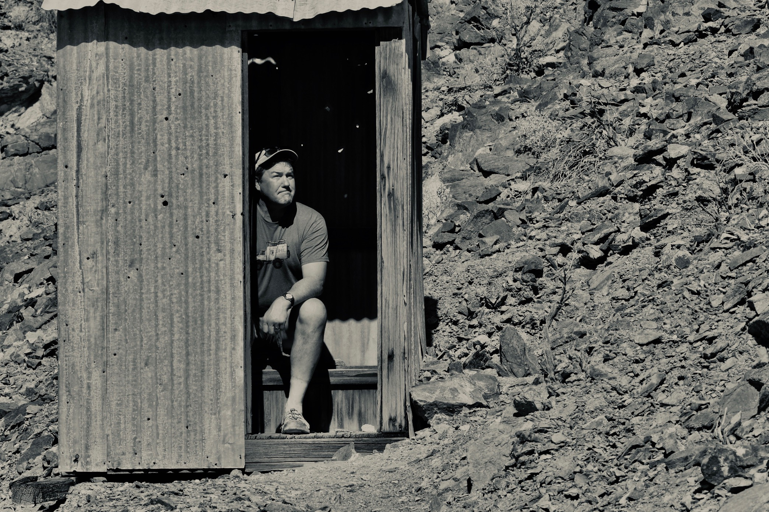
Emergency Exits Bathrooms Food Agenda
Logistics

Slide 3
9:00 a.m. Welcome - Jon Stavney, Executive Director, NWCCOG 9:10 a.m. Angela Belden Martinez, Regional Director, Denver Regional Office, U.S. Department of Commerce Economic Development Administration 9:20 a.m. Economic and Demographic Trends - Greg Totten, Economist, Colorado Demography Office 10:00 a.m. Audience Participation Interactive Session 10:20 a.m. Networking Break 10:30 a.m. Supporting our Workforce with Integrated Network Services - Brianne Snow, Executive Director, Family & Intercultural Resource Center 11:00 a.m. Our Transitioning Economy: Business Succession Planning & Support - Erin McCuskey, Regional Director, Northwest Colorado SBDC & Eagle County Economic Resiliency Manager 11:30 a.m. CHFA Workforce Housing Projects - Margie Joy, Colorado Housing & Finance Authority 11:45 p.m. Lunch Provided by Red Buffalo Coffee & Tea and Colorado Marketplace and Bakery 12:30 p.m. The Healthcare Industry in the Region – Moderator: Chris Romer, President & CEO, Vail Valley Partnership Panel: Will Cook, President & CEO, Vail Health, Jason Cleckler, CEO Middle Park Health, David Ressler, CEO, Aspen Valley Hospital 2:00 p.m. Networking Break 2:10 p.m. Introduction & Federal Funding Jonathan Godes, Regional Grants Navigator - 2:15 – 3:25 2023 Market Forces at Play and the Evolution of Marketing, Management and Mitigation - Ralf Garrison & Insight Collective Team 3:25 – 3:45 Follow-up from Interactive Morning Session 3:45 – 4:00 Closing Remarks and Raffle
A
g
e
n
d
a

Slide 4
Last Year: Elizabeth Garner, State Demographer 1. US peak births 2007, now 15-year-olds, declined since 2. It takes 25-26 years to bring worker on-line, debatable 3. Next Decade, expect slowdown of in-migration, down 70% 4. A job is not a job without a worker and a place to live

Slide 5
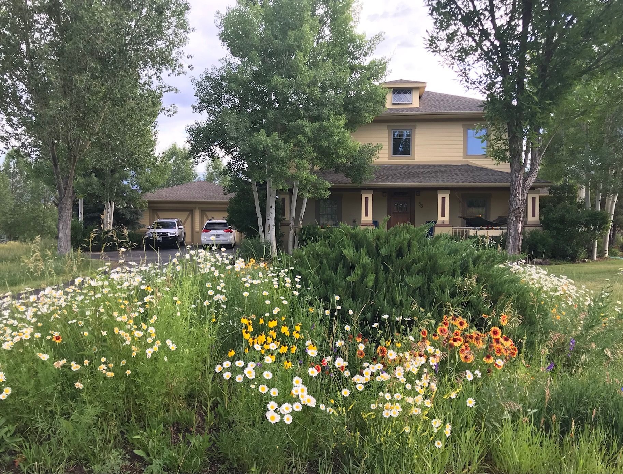
Workforce = Housing
Mountain Migration Report 2021
Bold Actions All over the Region
State’s Action – SB23 – 213
Still the Fountainhead of issues
Public Managers Interviewed Q1
THOUGHT: We are going to have to show
The state regional housing plans.

Slide 6
Small Employer Panels
Erin Young, Owner Red Buffalo Coffee and Tea
“People don’t do business with businesses they do business with people.”
Larry Moore, Co-Founder Eagle Climbing Gym,
“Embrace that your employees have other passions.”

Slide 7
Destination Management Is in Transition
* Eliza Voss Aspen Chamber Resort’s The Aspen Challenge
* Breckenridge, Shannon Haynes Harmony Q of L for residents and visitors
* Mia Vlaar reported on Vail’s Destination Stewardship Plan
* Insights Collective spoke on Forces at Play in Resort Communities

Slide 8
Destination Management Is in Transition
While Vail Town Council was poised to consider adopting its Stewardship Roadmap at its Tuesday, April 18, meeting, the discussion pivoted to the plan’s future and purpose.
Vail Town Manager Russ Forrest said that there were “some broader questions about the plan,” one of which was: “How will this plan be used moving forward?”
“This plan is not a land use plan, it’s not a vision plan, it’s not a strategic plan, but it is something that, given the significant public feedback that occurred throughout this and the significant work that staff has made … is valuable,” Forrest said. “We would like to receive some high-level direction on where to go next.

Slide 9
Destination Management Is in Transition
Last Year: “Those who are economically independent approach their community differently than those who are economically dependent on that community.” Ralf Garrison, Insights Collective
Today, IC is gathering input from you to begin of a proof-of-concept process toward a project for NWCCOG.

Slide 10
This Year: * Greg Trotten from CDO * New Interactive Session –Alpha-Omega * Supports for essential workers, at risk * Large Employer Panel - Not tourism * Insights Collective – What to do with Changes? Be sure Be sure to stay until raffle at the end

Slide 11
Reminder
Reports at https://www.nwccog.org/programs/member-services/reports/
Newsletters at: https://www.nwccog.org/about/communications/e-news/
Check our Services: WWW.NWCCOG.ORG

Slide 12
Interactive Session
Two Minute Burnout Checkup:
HBR Management Tip of the Week
0 – 10 Pain Scale, like for Doctor
Workload
Values (deeper connection to work)
Reward (financial, social, recognition)
Control or Autonomy
Fairness
Community https://hbr.org/2023/04/a-two-minute-burnout-checkup

Slide 13
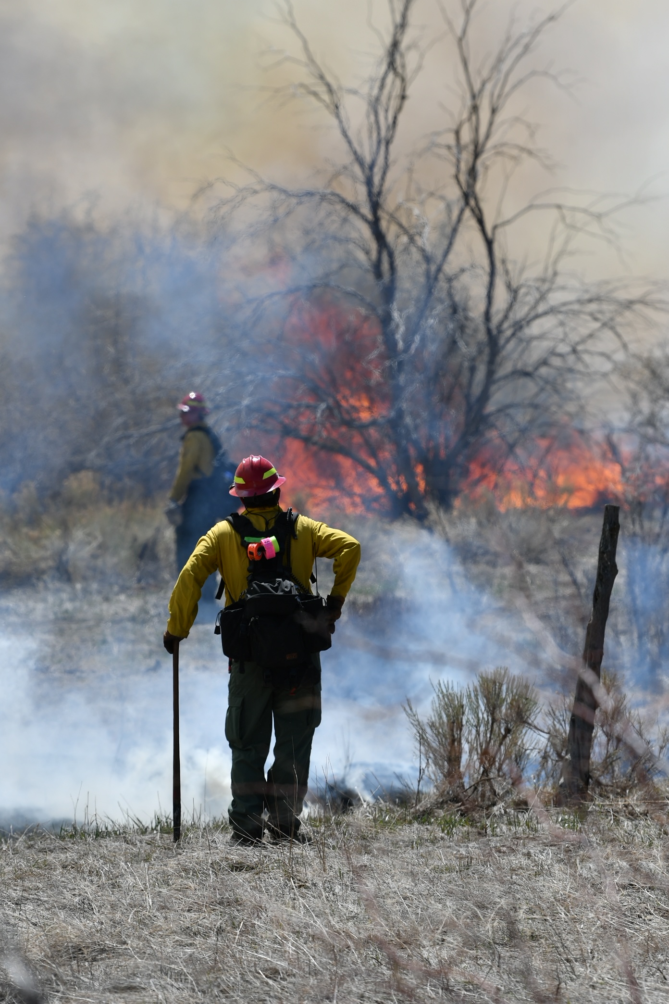
As leaders we know how to focus on the work, the process and the content. We must also focus on our people, and ourselves.

Slide 14
Interactive Session
LinkedIn: “Employees Do Not Leave Jobs, They Leave Managers.”
Indeed: Top 16 Reasons to Leave Job: insufficient challenge, salary, uninspired, undervalued, the manager, more growth or advancement, more feedback or structure, environment/culture…
https://www.indeed.com/career-advice/career-development/reasons-employees-leave
Gallup State of the Global Workplace Report 2022: trends
Engagement and wellbeing trends are stable but low
Employee stress is at an all time high, higher than during Pandemic
3.Globally hope has declined among workers
Gallup Estimates that “trillions are lost to low engagement worldwide”

Slide 15
Stand up: How Many of Us Are super excited about something an upcoming project at work? Are super excited about a trip or vacation planned for next 12 months? Are Cat people? Dog People? Are homeowners? Renters? Have raised kids here? Are raising K-12 kids here now? Like Crunchy peanut butter? Smooth peanut butter? Know a friend/family that lived here for 10 + years that recently moved away? Twenty years? Thirty years? Know someone who started a business in our region this year? Who sold or closed a business in our region this year?

Slide 16
Stand up: How Many of Us
Are morning people? Night owls? Know someone suffering from depression? Know someone how has died of substance abuse? Know friend of the family who has completed suicide?
Are struggling financially due to inflation? Are spending more now than during COVID? Are more optimistic about our economy than in recent years? Believe a recession is imminent in 2023?
Feel there is enough laughter in your day?
Supportive people around you at work?
Talk regularly about mental health with employees?

Slide 17
Discussion: What question was the toughest and why? What is a project or issue you would like help with? Stand Up if you have advice or want to mentor –business cards or sticky notes. What is a project or issue you are absolutely kicking butt on and want to share or mentor others on? Stand Up if you have advice or want to mentor –business cards or sticky notes. Will publish these sheets.

