Slide 1
NWCCOG Community Metrics Survey 2023
Preliminary Results 7/6/2023

Slide 2
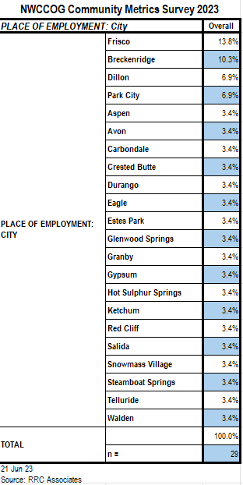
Place of Employment

Slide 3
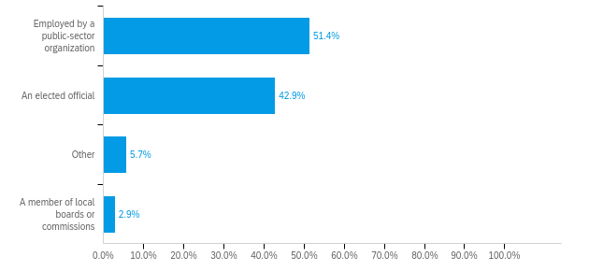
Role in the Community
Which of the following best describes your role in the community from a governance perspective? (Check all that apply)

Slide 4
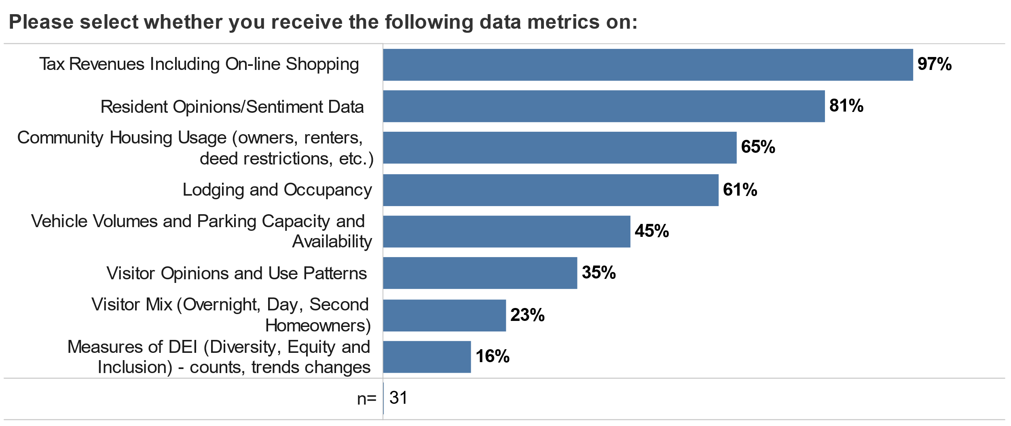
Metrics Received

Slide 5
Value of Metrics Received

Slide 6
Perceived Value of Metrics Not Received

Slide 7
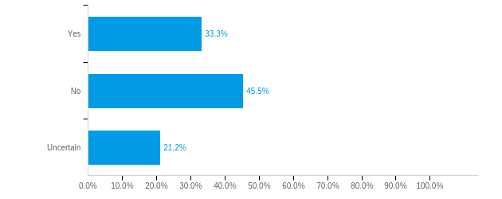
Quality of Life Metrics
Is your community using quality of life metrics (such as resident sentiment tracking, traffic counts, trailhead parking) that are not economic measures of success?

Slide 8
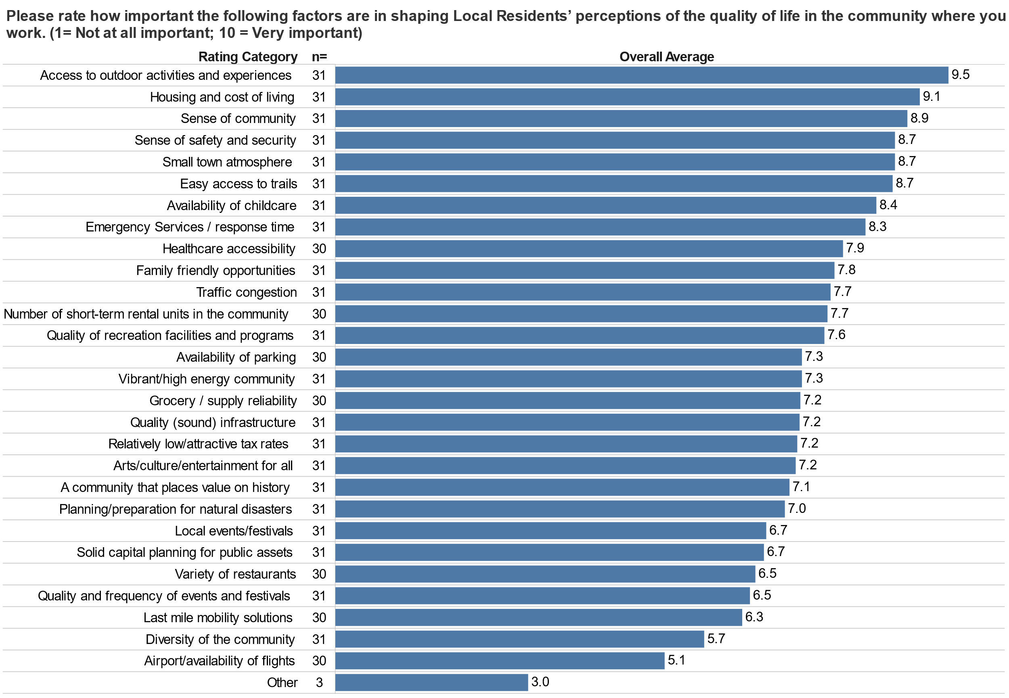
Importance to Local Residents’ Quality of Life

Slide 9
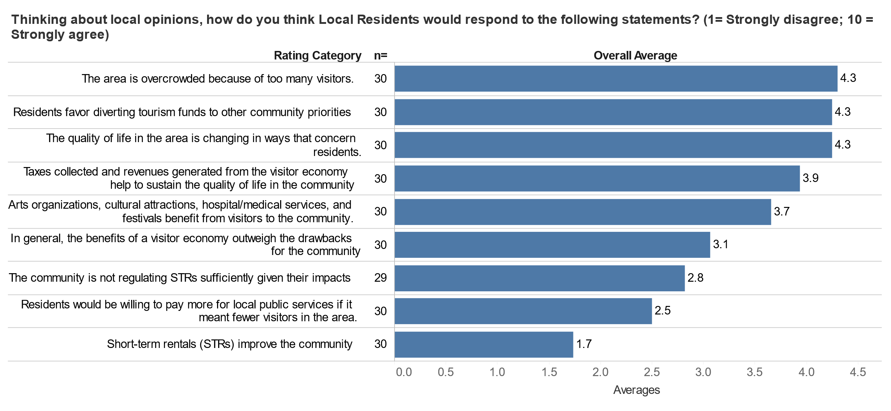
Local Residents’ Opinions

Slide 10
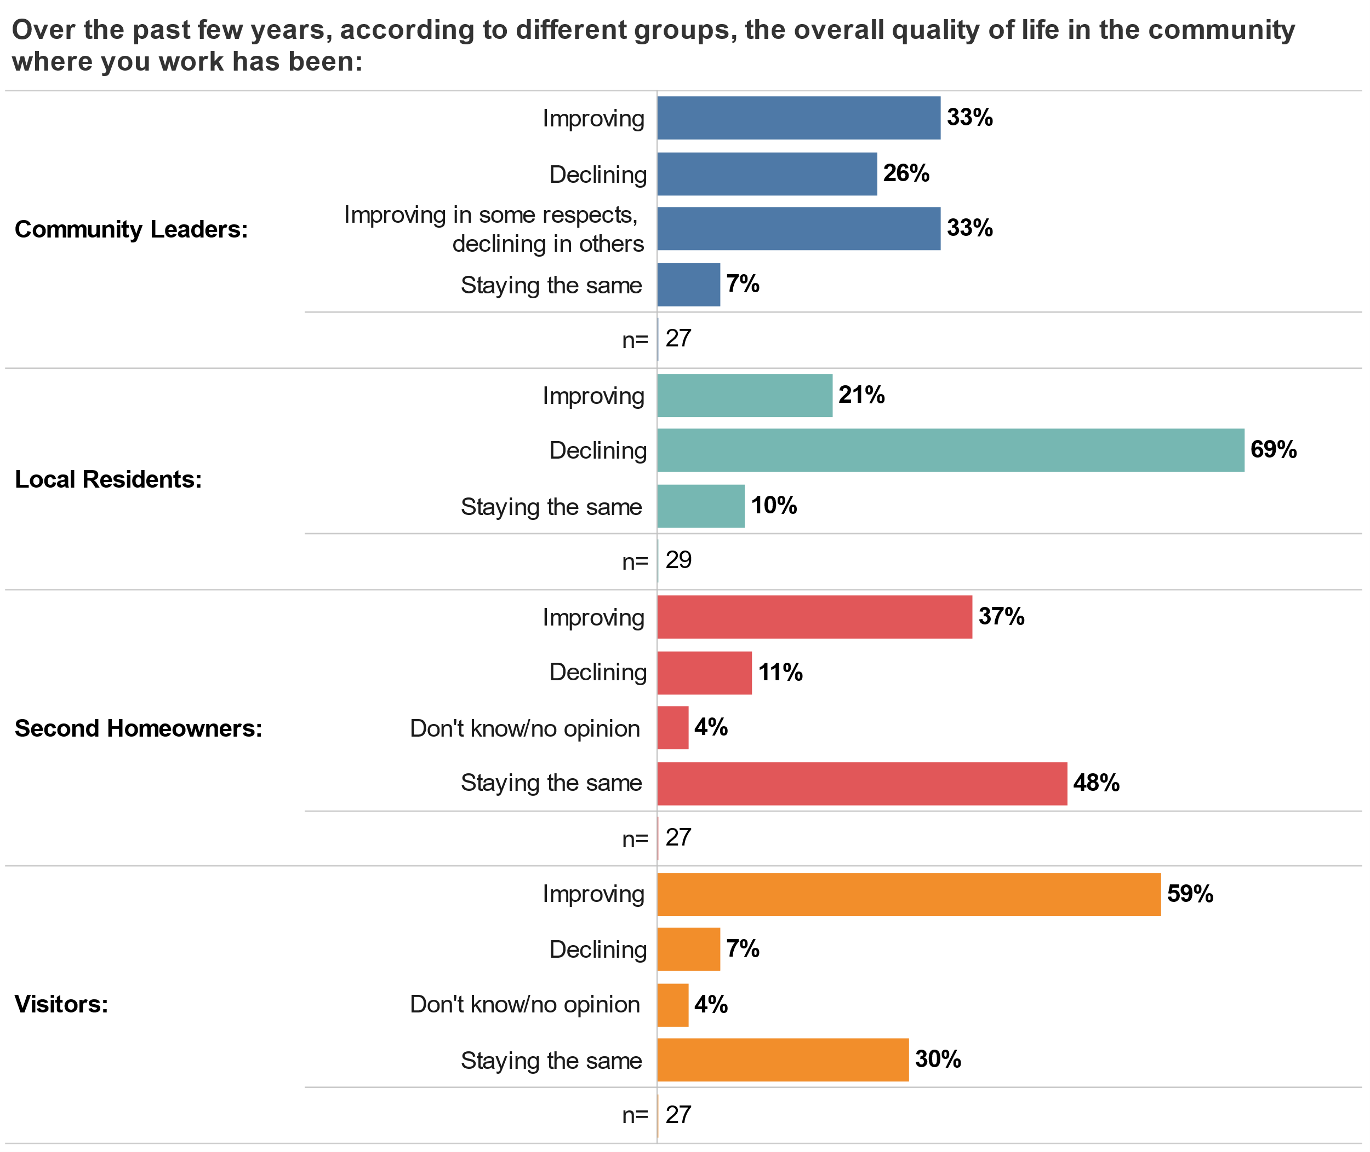
Quality of Life Over Time

Slide 11
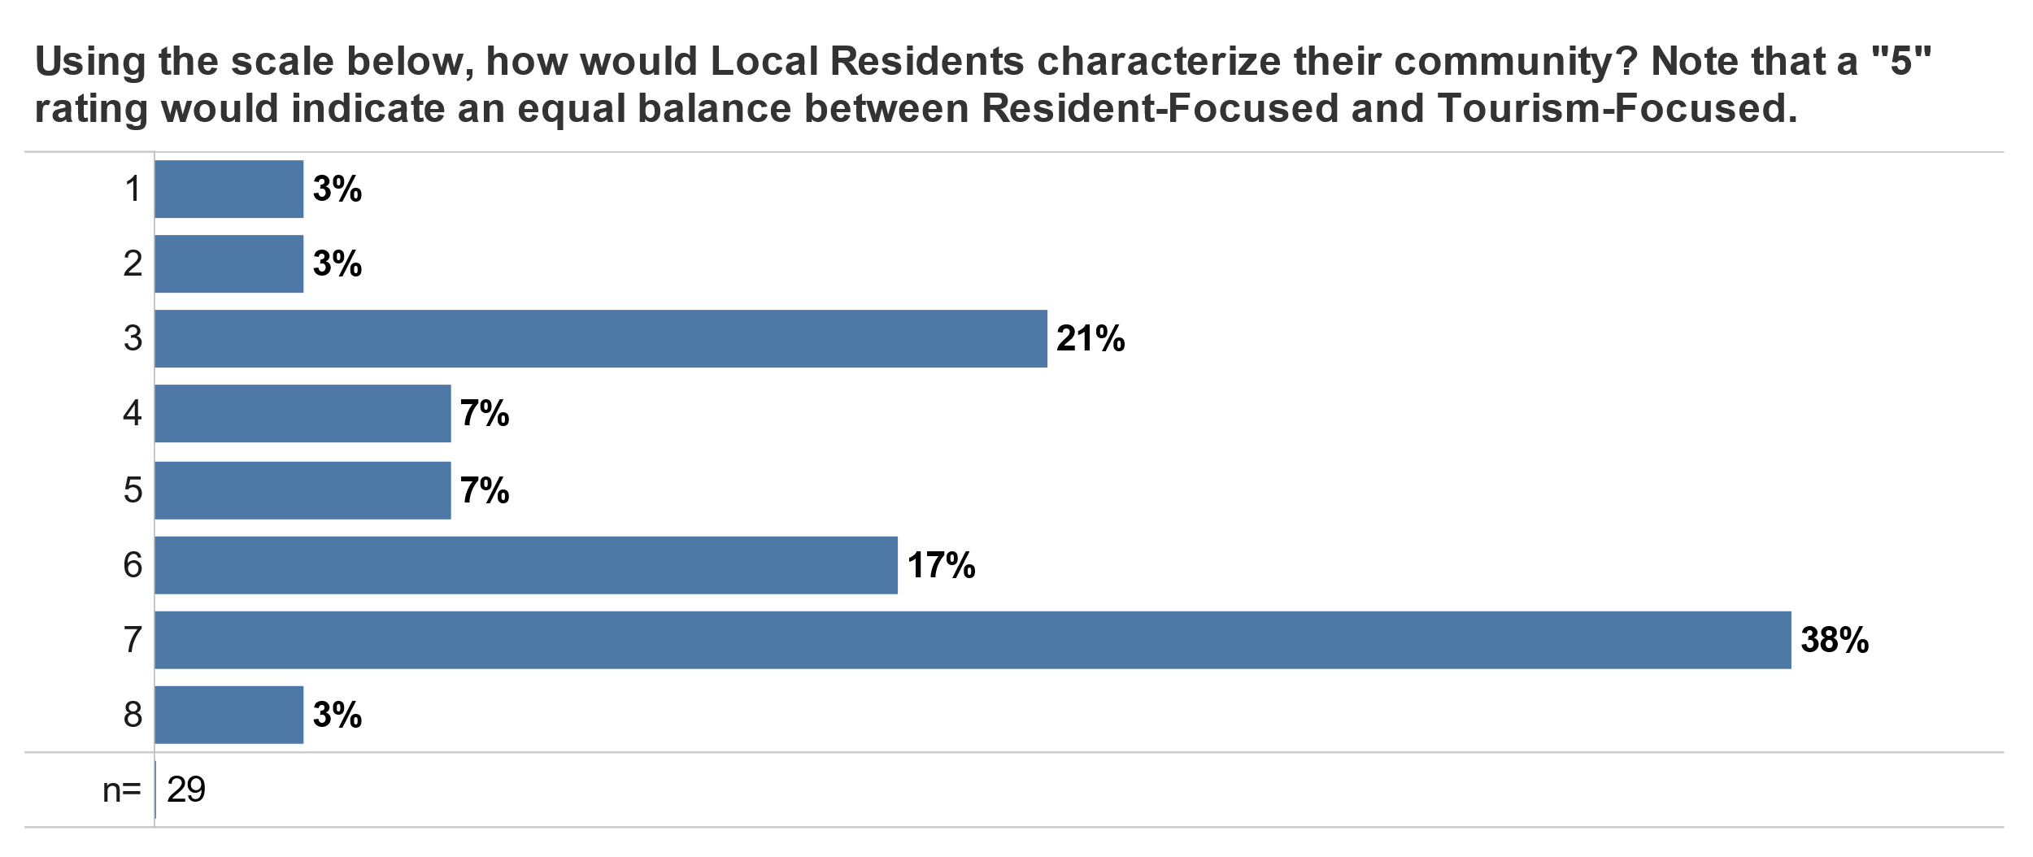
Resident-Focused vs. Tourism-Focused Community

