Slide 1


Advocacy Alert

Slide 2

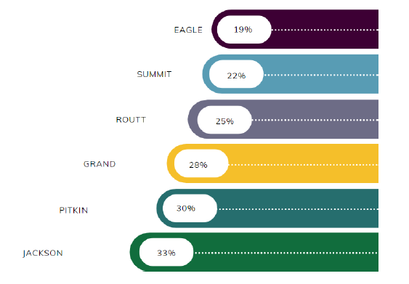


60+ Population of Total in 2021
State Demographers Office 2021 Final Population Estimates
Notes:
I'm sure all of you are very aware of the demographics in your counties.
This is your population of those 60 and older compared to your total population.

Slide 3
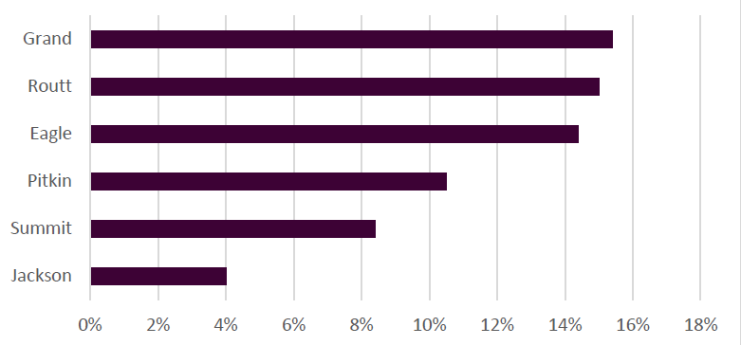
Estimated Percentage age change 75+ from 2024 to 2027
State Demographers Office

Slide 4

Activities of Daily Living (ADLs) & Instrumental Activities of Daily Living (IADLs)
Center for Disease Control
Notes:
It is quite common for aging adults to need assistance with a variety of activities. In fact, according to a 2014 Center for Disease Control (CDC) study, 10.6% of adults over 75 have limitations in ADLs, while 18.8% have limitations in IADLs.
Investment in these low-cost in-home services helps keep individuals in their homes and out of institutional care. The 2022 National Survey of OAA participants identified that 96 percent of participants identified this as a service that helped them live independently.

Slide 5


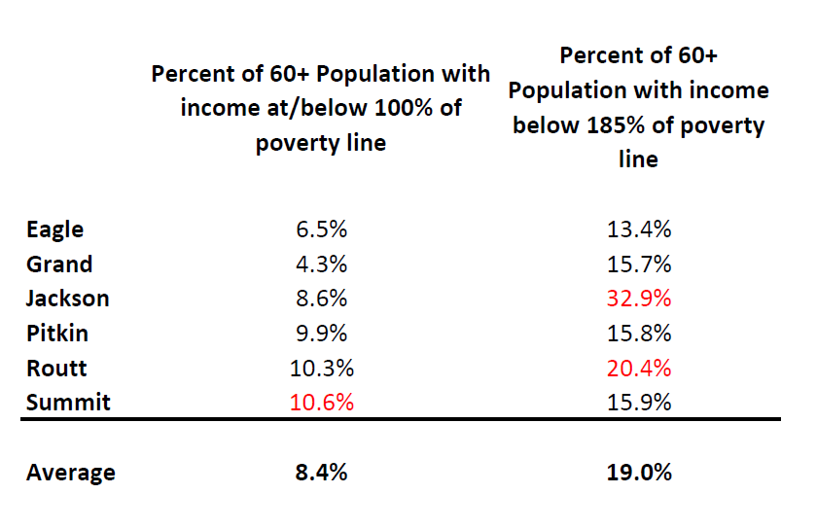

Percentage of population 60+ by Poverty Status
Colorado Demography Office

Slide 6

Your Community
Support
Meals
Transportation
Case Management
Medicare Counseling
Education
Caregiver Services
Dental
Emergency Funding
Bountiful Baskets
Information & Referral
Evidence Based Health Promotion
Homemaker Services
Chore Services
Financial Vouchers
Home Modifications
Hearing Aids
Elder Abuse Prevention
Legal Assistance
Long Term Care Ombudsman
Outreach
Caregiver Conference
Senior Law Day
Restaurant Vouchers
Notes:
This is what we're doing in your community, either directly or through local providers, like your senior center or council on aging.
It's supposed to be visually overwhelming because I want you to visually understand all the services and funding we're providing in your towns and county.
$886k in contracts in the community
SB290 money

Slide 7






89 Supporters, including counties, municipalities, statewide older adult advocacy organizations, councils of governments, individual AAAs, local service providers
Notes:
On August 1st and on October 4, the colorado association of area agencies on aging, drcog and these

Slide 8

Ask
Increase in General Fund support for
State Funding for Senior Services (CDHS)
1
2
3
$5M
Community Provider
Statutory Proposal
General Fund base increase
Classification as a community provider to be considered for annual inflationary increases
Review adequacy of funding every five years
Notes:
A General Fund “base” increase of $5 million to help address unmet need
Classification of the State Funding for Senior Services line item as a “community provider”, thereby ensuring that the line item will be considered for annual inflationary increases.
A statutory proposal to review the adequacy of funding for the line item every five years.

Slide 9







2019-2023
State Funding
Population Growth
Unit Rate Increase
Fallen 14.5% accounting for inflation
Average of 5% increase in 60+ population in Region 12
The cost of providing services has increased
Notes:
The AAAs have not had a budget increase in state General Fund since 2019.
Adjusting for inflation, state funding for Colorado’s AAAs has fallen 14.5% in real dollars over the last 4 years while the older adult population has grown 5%
For example, let's use transportation services. We pulled the actual cost of providing a one way ride through our providers for eagle, grand, jackson counties and we saw and between 2019-2023 we saw a 28% increase in the cost of providing the ride.
Percent Age Group Change from 2019-2023
Eagle 13.9%
Grand 9.8%
Jackson -1.6%
Pitkin -7.0%
Routt 13.9%
Summit 3.9%
Avg 5%

Slide 10
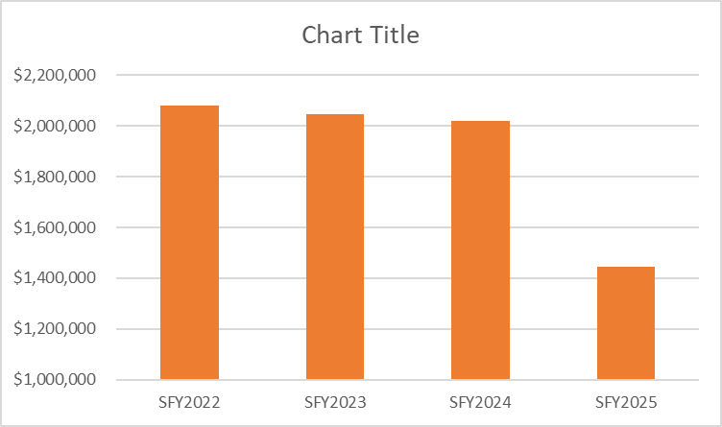
Total Vintage Funding Per SFY
Notes:
So with all those factors, we're looking at a 28% decrease next year (july 1) in our funding compared to this current year.

Slide 11

A Colorado well adapted for aging is one where all individuals can thrive –
a Colorado for all.
Notes:
To summarize all of this and why it's important as commissioners that you do care about aging as much as you care about child care and workforce housing and road and bridge and tourism and why you don't use the phrase silver tsunami and you see your aging population as a resource rich part of the fabric of your community, is this. This is straight out of the lifelong Colorado plan and it means that if we invest in a community that is good for older adults, everyone is going to benefit.

