Slide 1




Regional Statistical Analysis Project – Study Results
Presented to attendees of the NWCCOG Regional Economic Summit
Thursday, May 7, 2026
10:30 – 11:30 am
On screen:
Carl Ribaudo, President
Brian London, Managing Director
In the room:
Susan Rubin-Stewart, Treasurer-Secretary

Slide 2
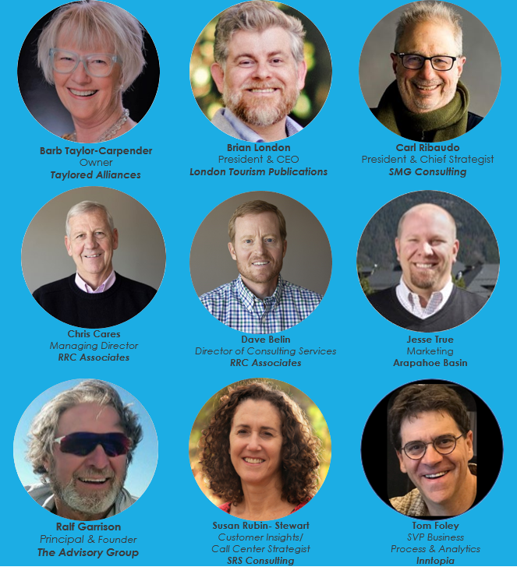
Insights Collective
The Travel Economy Think Tank
"None of us is as smart individually as all of us, together..."
Chris Cares
Managing Director |
RRC Associates
Ralf Garrison
Principal & Founder |
The Advisory Group
Brian London
President & CEO |
London Tourism Publications
Susan Rubin-Steward
Customer Insights/ Call Center Strategist |
SRS Consulting
Carl Ribaudo
President & Chief Strategist |
SMG Consulting
Jesse True
Marketing | Arapahoe Basin
Tom Foley
SVP Business Process & Analytics | Inntopia

Slide 3
Insights Collective
The Travel Economy Think Tank
About Us
Driven by a shared passion for travel and a commitment to the well-being of the tourism sector, our team of independent, professional subject matter experts draws on our diverse backgrounds and perspectives to foster innovation and collaboration that will benefit not only the industry, but also the communities and environments that it touches.
Our mission is to give back to an industry that has given us so much, and to help shape a brighter future for travel and tourism.

Slide 4



Agenda:
Project Overview & Methodology
Summary of Findings
Considerations & Observations
Project Sponsors:
Northwest Colorado Council of Governments (NWCCOG)
Colorado Association of Ski Towns (CAST)
Colorado Department of Local Affairs (DOLA)

Slide 5
Project Overview & Methodology
Background
A new initiative to better understand how rural municipalities are navigating today's unprecedented pace of change to ensure that rural voices help shape the next generation of policy and practice.
Foundational Assumptions
Significant uncertainty confronting local governments: sweeping shifts in federal programs and regulations, continued economic volatility from tariffs and AI-driven distribution, and widening funding gaps at the state level.
Initial Scope
Interviews with mayors, elected officials, or their designee from:
  Fast-Growth Residential Towns
  Agricultural/Resource-Based Communities; and
  Mountain Resort Towns
Survey of community leaders from a broad cross-section of rural Colorado
Notes:
Quick insight: foundational assumptions shifted after the interview phase, as the focus of local leaders was on local issues first, regional issues distant second, federal issues only when prompted and even then there was a sense of not needing to be distracted when so many local issues needed addressing first. From that we could surface some predictable results – housing, infrastructure, remote workers as potential solutions … we came into this not knowing what we would get, and this is what we got … on slides that follow.

Slide 6
Project Overview & Methodology (cont.)
Survey Design
  A structured interview guide and survey instrument was developed to capture both quantitative and qualitative perspectives on community conditions, quality of life, and long-term pressures shaping mountain communities.
Data Collection
  Survey responses were collected from participating stakeholders across communities, generating a mix of fixed-response and open-ended input.
Qualitative Analysis
  Responses were reviewed using a thematic analysis approach to find recurring issues, shared concerns, and patterns across the dataset. Responses were assessed for both frequency and intensity to better understand the issues that appeared most often and where respondents expressed the greatest urgency.
Synthesis and Reporting
  Findings were synthesized into key themes and supporting observations. The findings informed the development of the final presentation and report materials, which are designed to support discussion, interpretation, and decision-making.
Notes:
We're going to be informing as part of the presentation today, and the big idea is that after the presentation there is a chance to socialize these findings with each other and to make it part of the broader summit conversation.

Slide 7











Project Overview & Methodology (cont.)
Conducted 8 interviews with mayors, elected officials, or their designee focused on:
  Governance and leadership structure
  Local, state, and federal challenges
  Budgeting and resource allocation
  Community engagement and public sentiment
  Intergovernmental support and partnerships
  Strategic planning and outlook
Received 100+ individual questionnaires from community leaders focused on:
  Pressing issues facing their community
  Description of those issues in greater detail
  Assessment of recent changes in quality of life
  Reasoning behind those beliefs
  Other context not otherwise captured in the survey
Notes:
Salida, Aspen, Basalt, Silverthorne, Crested Butte, Snowmass Village, Town of Avon
The analysis used a thematic review process to id repeated patters, shared concerns, and recurring points of emphasis.
Responses were reviewed for both frequency and intensity.

Slide 8














Notes:
Over 25 communities / organizations … represented, including those at the County, City, Chamber and Committee level …
Breckenridge Social Equity Advisory Committee, Vail Chamber,

Slide 9
Overall Perspective
The following reflects input from mayors, administrators, and community leaders across Northwest Colorado. While each community has its own context, a consistent pattern surfaced:
Leaders are managing multiple, overlapping pressures: housing, infrastructure, workforce, and fiscal constraints, within limited local capacity and a highly dynamic regional economy.

Slide 10
2. Summary of Findings
1:1 Interviews: Interviews with mayors, elected officials, or their designee
Community Leaders Survey – 2026: Survey of community leaders from a broad cross-section of rural Colorado

Slide 11
1:1 Interviews - Recurring Themes
Leadership is Stretched Thin
Simultaneous pressure on housing, infrastructure, workforce capacity, and fiscal resilience, while trying to maintain (and increase) public trust and regional collaboration.
Leadership is Aware of the Housing Gap
Acknowledgment that current workforce housing approaches are both necessary yet insufficient relative to demand
Leadership Values Intergovernmental Collaboration
Many issues are cross-jurisdictional (traffic, transit, wildfire readiness); differences in local politics, funding tools, and implementation pace still constrain outcomes

Slide 12
1:1 Interviews - Near-Term Opportunities
Dynamic Housing Efforts AND More Units
"There may be programs for one- or two-bedroom condos, but not enough options for families trying to stay and raise children"
Clear Priorities for Capital Spending
Many high-cost needs hitting at once. Communities are making tradeoffs, but not always in a way that is clearly communicated or prioritized
Regional Coordination Tied to Regional Implementation
Coordination often stops at the planning stage
Communications with Bilingual and Harder-to-Reach Groups
Hispanic populations, younger residents, working families, etc. Anyone not familiar with how the Planning and Zoning Board operates
Notes:
Remote worker status for government positions …

Slide 13
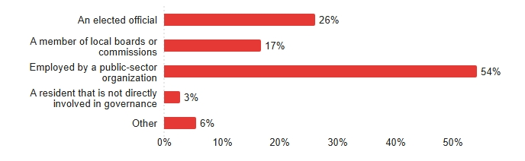
Which of the following best describes your role in the community from a governance perspective?
Community Leaders Survey – 2026

Slide 14
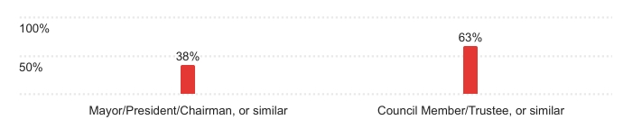
Which best describes your title?
Community Leaders Survey – 2026

Slide 15
...what are the three most pressing issues currently facing your community?
Community Leaders Survey – 2026
Housing and Affordability
  Drives every other challenge
  Total cost (beyond housing) of living in the community is unsustainable for working residents
Infrastructure Strain and Environmental Risk
  Water and wastewater infrastructure
  Cost of affording the systems required to support growth
  Environmental resilience as inseparable from economic resilience
Long-term Sustainability of Mountain-Town Economies
  Childcare (most consistently cited as the 'third issue')

Slide 16
Descriptions of a growing mismatch between what communities want, what they can afford, and what their systems are built to support
Community Leaders Survey – 2026
Capacity mismatch
Infrastructure was built for an earlier version of these communities. Communities have changed faster than the systems built to support them
Revenue structure
Overreliance on sales tax, shrinking grant access, limited appetite for new taxes
Wealth inequality
Responses pointing to the widening gap between local wages and outside wealth

Slide 17
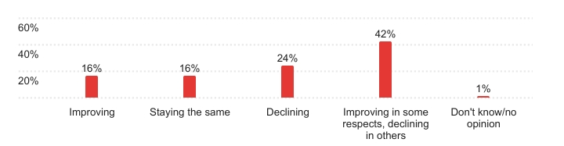
Over the past few years, would you say the overall quality of life in the community where you work has been:
*Respondents do not view quality of life as moving in a single direction

Slide 18
Quality-of-Life Reasoning – Main Themes
The community is improving physically but not necessarily becoming more livable
Quality of life is not being experienced equally
Tourism as an amplifier of existing pressures
Those indicating QOL as 'Declining' were much more likely to describe quality of life through the lens of personal strain, not community investment
  Less likely to acknowledge balance among new amenities, infrastructure, or services
  Frame housing as a dilution of community identity (not just a supply issue)
Notes:
Quick conversation started, Pitkin County is inviting the broader community to participate in the second phase of its 2026 Biennial Community Survey, offering an opportunity for the public to share feedback on county services and overall quality of life.

Slide 19
How much do you agree or disagree with the following statements (Scale: 1-5)
Community / Tourism Balance and Funding Insights
Taxes collected and revenues generated from the visitor economy help to sustain the quality of life in my community -– 4.22
In general, the benefits of a visitor economy outweigh the drawbacks for the community -– 3.58
Residents would be willing to pay more for local public services if it meant fewer visitors in the area -– 2.49
Residents favor further diverting funds from tourism to addressing other types of community needs -– 3.80
Residents favor further diverting funds from tourism to addressing other types of economic development/industries -- 3.47
Notes:
Tourism Revenue = Improved QOL
Perhaps, residents View of Community Investment is that they are already paying a 'fair share'

Slide 20
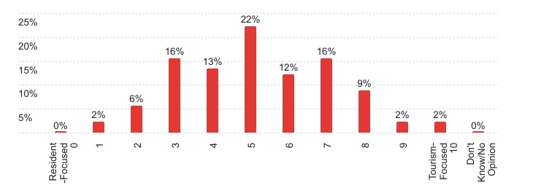
Using the scale below, where does your community currently sit … Resident-Focused / Tourism-Focused:

Slide 21
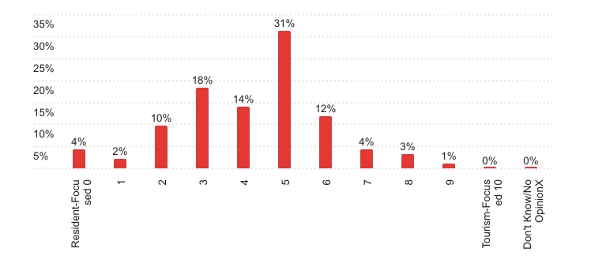
Using the scale below, where would you like the community to sit in the future … Resident-Focused / Tourism-Focused:
Perceived Balance Obtained When the Community Shifts Towards a Resident-Focused Future

Slide 22
3. Considerations and Observations
A Familiar Story
Several communities described a similar situation, a small staff managing housing programs, infrastructure planning, and daily operations, while also responding to increasing visitor demand and rising resident expectations.
In these cases, even when funding is available, the capacity to implement projects remains the limiting factor.

Slide 23
Key Finding: Capacity
This Is a Capacity Crisis, Not an Issue Crisis
Across Northwest Colorado, local leaders aren’t struggling to identify the issues, housing, infrastructure, and workforce; they’re struggling to implement solutions with limited staff, constrained budgets, and competing priorities.
In many communities, the same small team is managing housing initiatives, infrastructure planning, and day-to-day operations simultaneously.
What is Important:
Strategy must focus on what can actually be delivered, not just what is needed.

Slide 24
Key Finding: Housing Pressure
Housing and Infrastructure Are Outpacing Local Systems
In communities like Summit, Eagle, and Routt Counties, housing demand, by second homeowners, workforce migration, and tourism, continues to outpace local supply strategies.
At the same time, infrastructure systems, from roads to water to public safety, are under strain from both visitor volumes and population growth, often without corresponding increases in funding.
What is Important:
This creates continuous pressure on the workforce, service delivery, and community stability.

Slide 25
Key Finding: Regional Gaps
Regional Problems Are Being Solved Locally (and That’s the Gap)
While housing, transportation, and workforce challenges operate at a regional scale across Northwest Colorado, decision-making authority and funding mechanisms remain largely local.
This creates a disconnect where communities are aligned on the problem, but not always aligned, or equipped, to act collectively.
What is Important:
Progress depends on aligning action across jurisdictions, not just agreeing on the problem.

Slide 26
Implications
NWCCOG is not just any region; it has very specific structural dynamics:
Unlike many regions, Northwest Colorado communities are managing these challenges within a highly seasonal, tourism-driven economy, where demand fluctuates dramatically, and housing markets are heavily influenced by second-home ownership and short-term rentals.

Slide 27
Implication: Execution Capacity
The Limiting Factor is No Longer Strategy, It’s Execution Capacity
What it Means:
Across Northwest Colorado, communities are not lacking plans or ideas; they are constrained by the ability to implement them with existing staff, funding structures, and time.
The Impact:
Without addressing execution capacity, even well-funded or well-intended initiatives will continue to underperform or stall.

Slide 28
Implication: System-Level Risks
Housing and Infrastructure Are Becoming System-Level Risks
What it Means:
Housing shortages and infrastructure strain are no longer isolated issues; they are actively limiting workforce stability, economic activity, and community viability.
The Impact:
These pressures will continue to compound, particularly in a tourism-driven, seasonal economy with strong second-home demand.

Slide 29
Implication: Alignment and Execution
Regional Alignment Without Regional Execution Will Continue to Fall Short
What it Means:
There is broad agreement across communities on the nature of the challenges, but limited mechanisms to implement solutions at a regional scale.
The Impact:
Fragmented action leads to duplication, inefficiency, and slower progress across all jurisdictions.

Slide 30
To Sum it Up…
The insights from this work are clear.
Northwest Colorado communities are not struggling to understand their challenges; they are struggling to implement solutions at the pace and scale required.
Housing, infrastructure, and workforce pressures are increasing faster than local systems can respond, and while these challenges are regional in nature, the tools to address them remain largely local.
The opportunity moving forward is not to generate more plans, but to build the capacity, tools, and alignment necessary to act.

Slide 31
Thank you.
Regional Statistical Analysis Project – Study Results
Presented to attendees of the NWCCOG Regional Economic Summit
Thursday, May 7, 2026
10:30 – 11:30 am
On screen:
Carl Ribaudo, President
Brian London, Managing Director
In the room:
Susan Rubin-Stewart, Treasurer-Secretary

