Slide 1
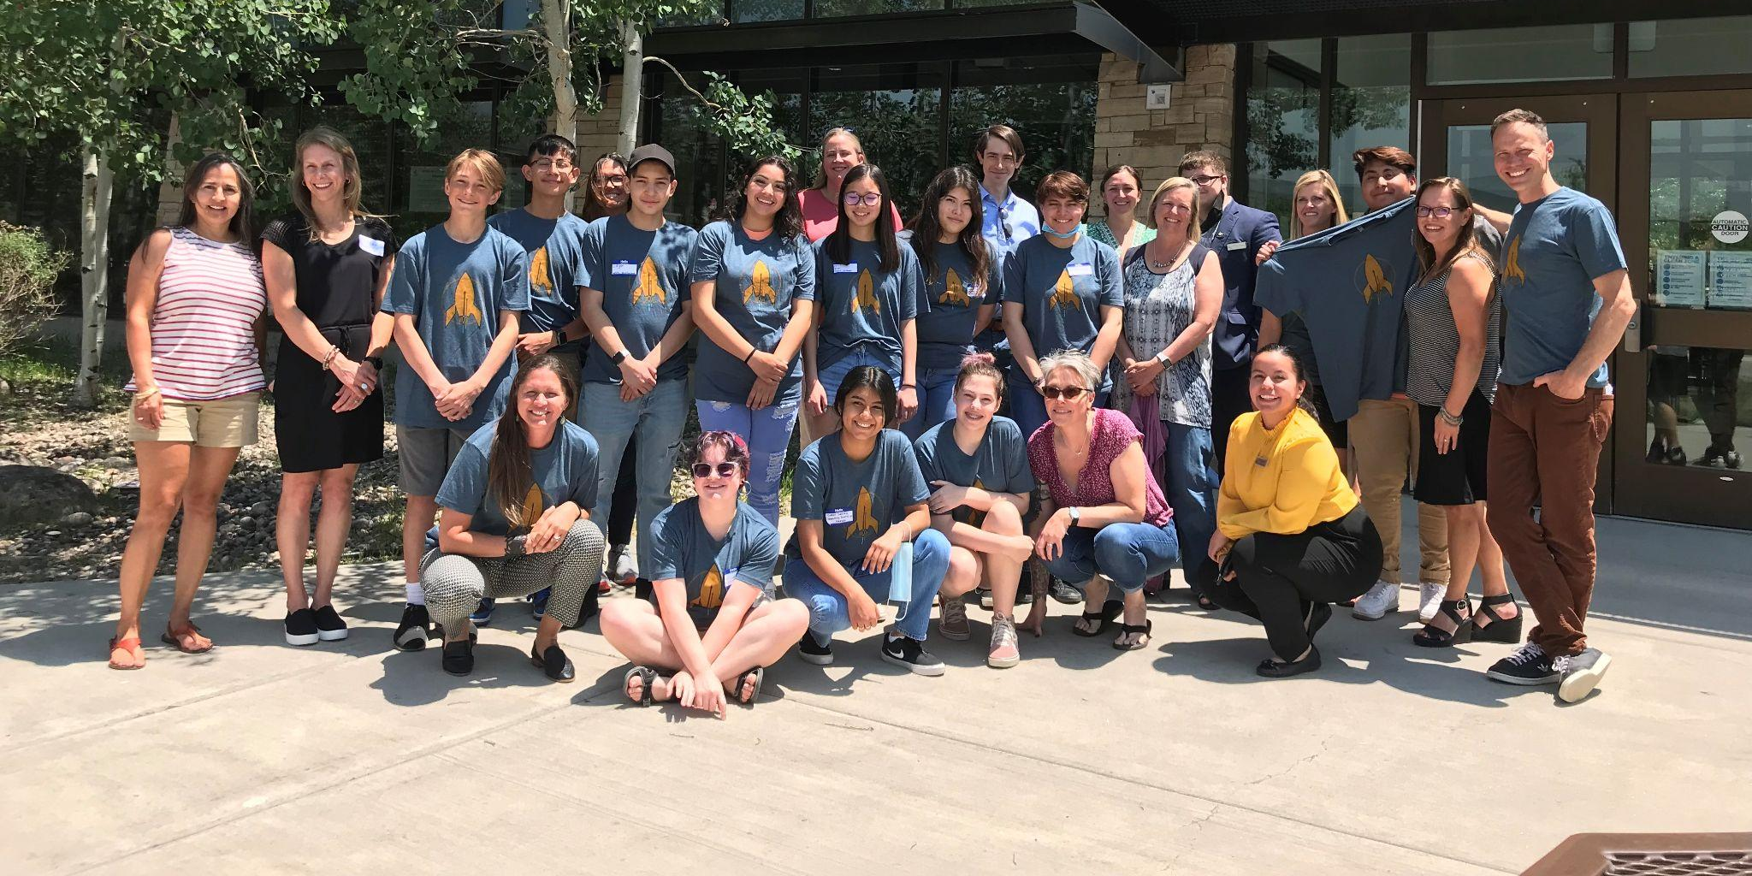


Wo
Eagle County Work-Based Learning Opportunities

Slide 2







Slide 3
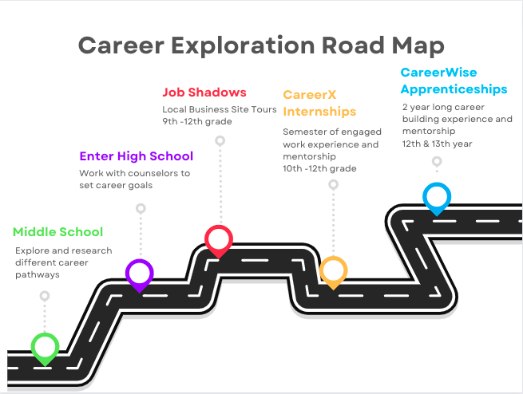
Notes:
Xello/ICAP discussion/introduction here.

Slide 4



Apprenticeship
Internships
Job Shadows

Slide 5
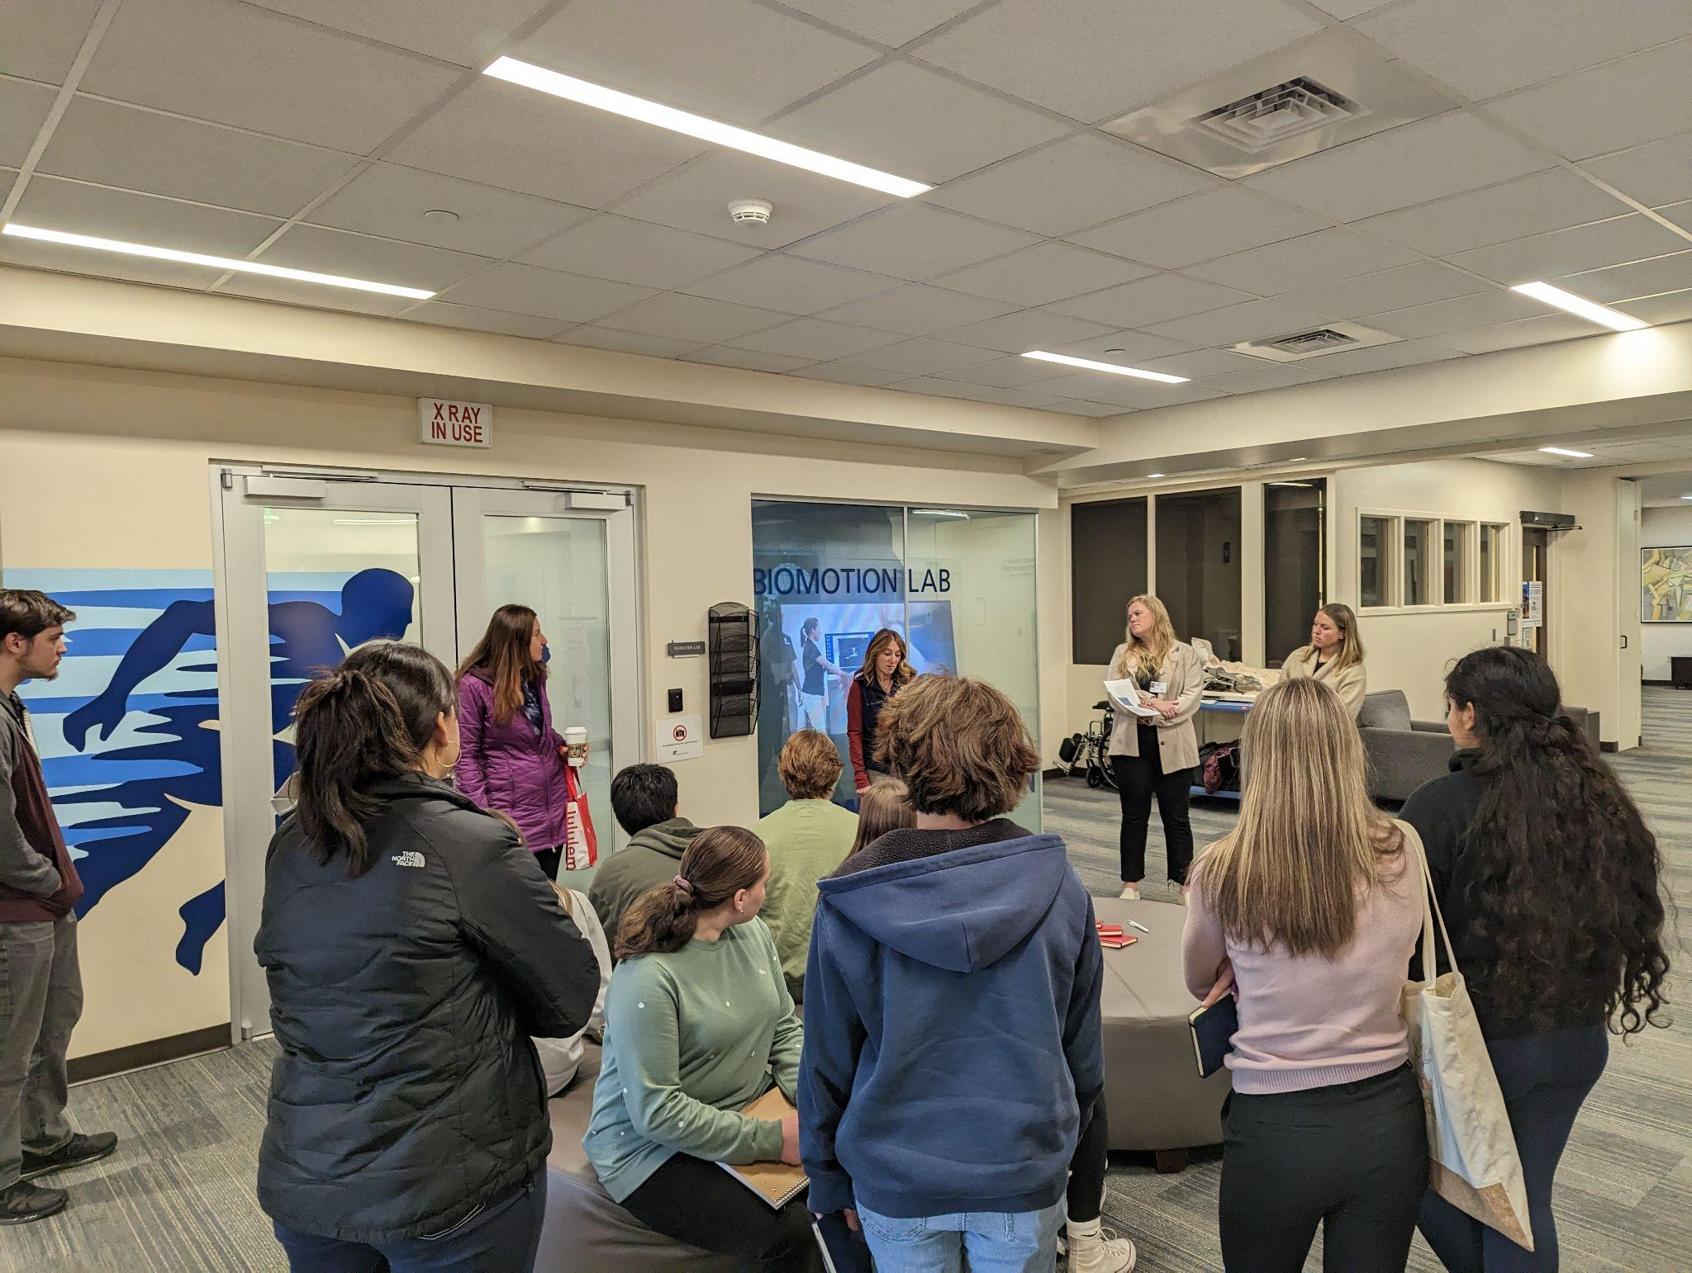


Job Shadows
Usually 2-4 hours
Site Visits or on Campus
Students visit a business that is of interest
Students get to ask questions (career path, education requirements, etc)
Site Tour/Debrief Conversation
One time occurence-perfect for freshmen/sophomores to start their career exploration
Provide guest speakers to chat with students

Slide 6
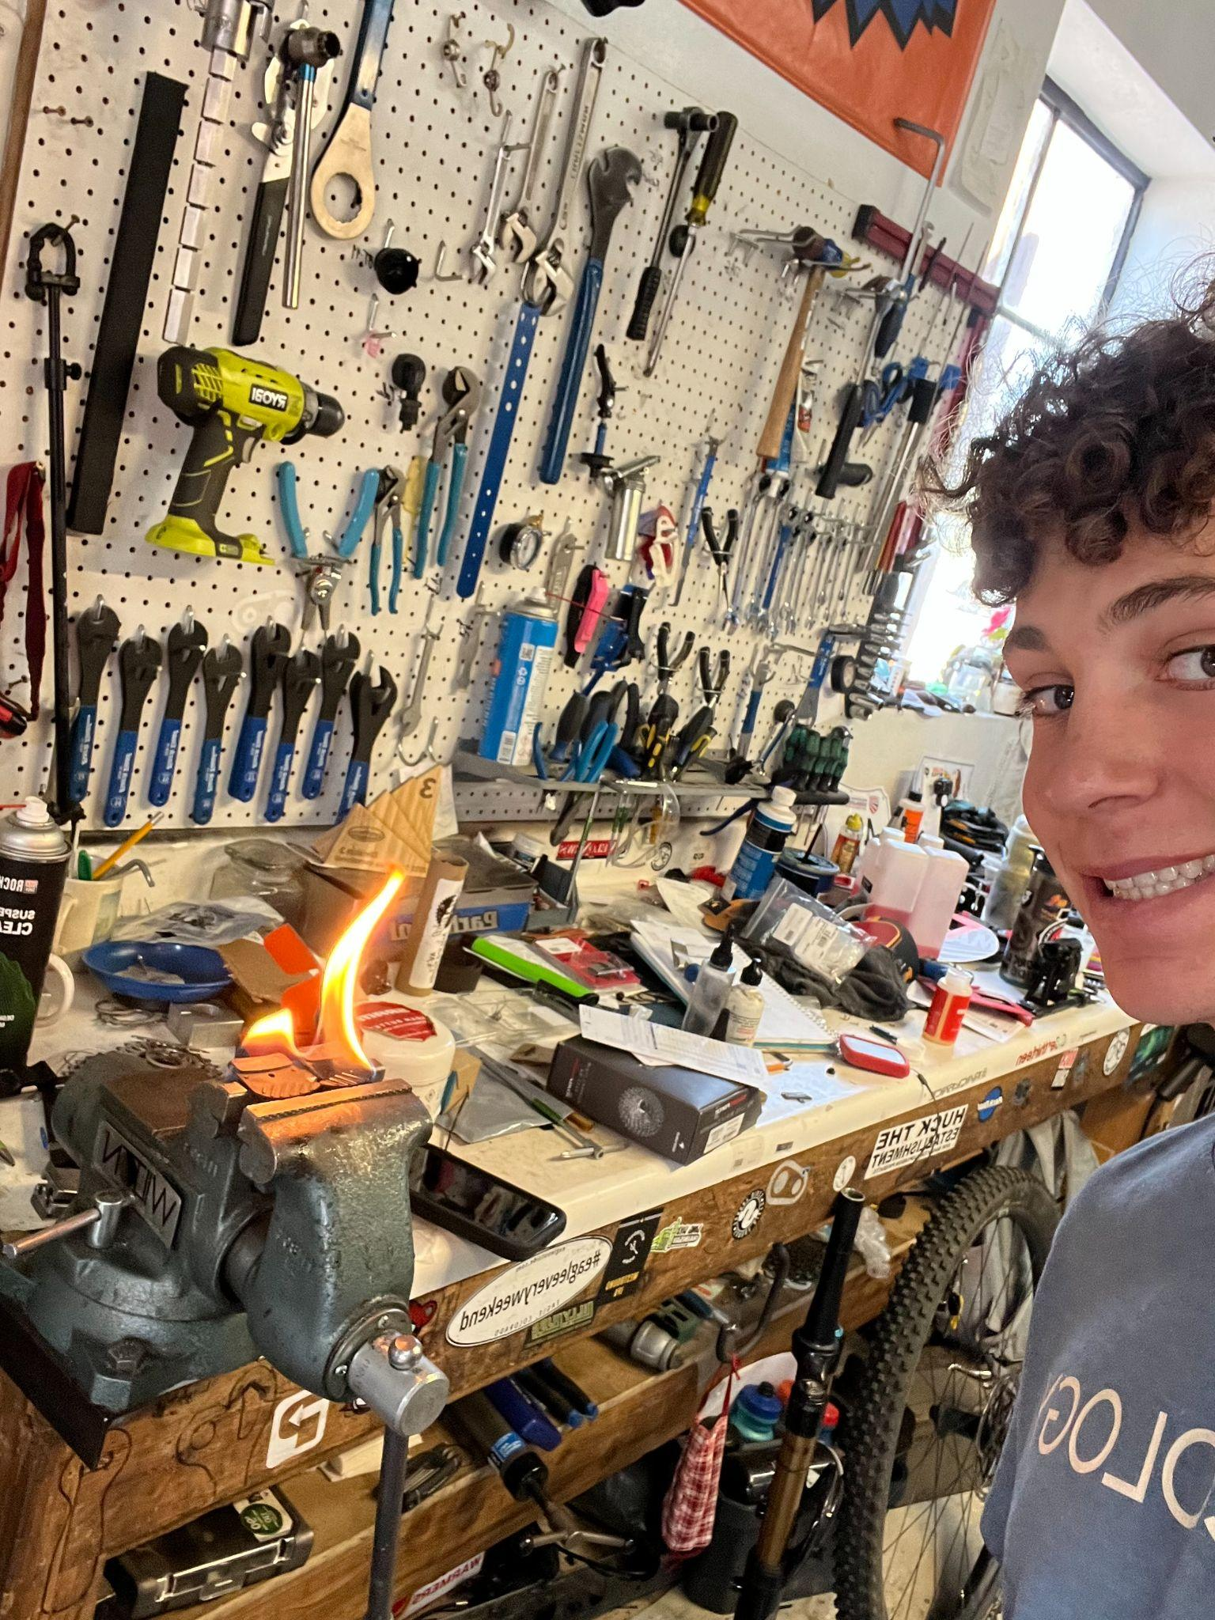
Internships
60 hours /.25 Credit
1 semester commitment
4-6 hours per week
Engage in meaningful career tasks/work
Mentorship by business partner
Can be paid or unpaid ( carry insurance)
We do not force place; Students choose area of interest
Education/Eagle County School District, Veterinary, Interior Design, Physical Therapy, Baking/Culinary, Excavating, Welding, Fashion Merchandising, Hospitality

Slide 7


MODERN YOUTH
APPRENTICESHIP

Slide 8
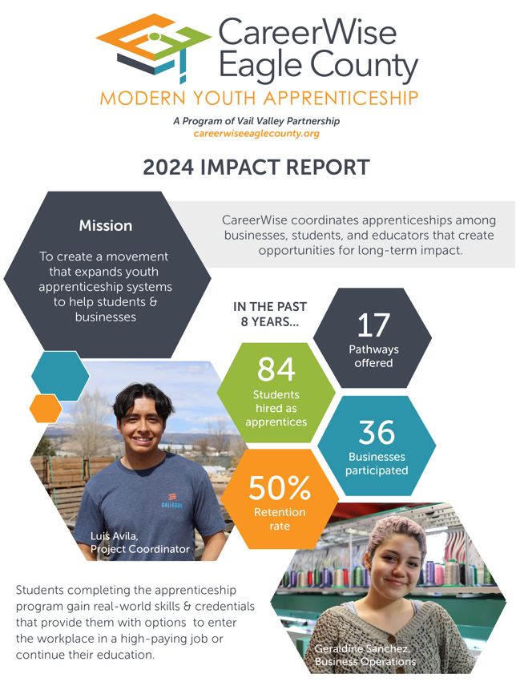
“Building a sustainable modern youth apprenticeship program that connects education with local businesses to develop a skilled and talented workforce pipeline that is equitable to all young professionals.”

Slide 9
CareerWise Apprenticeship Overview
2 year commitment
Apply Junior year
Begin Summer before Senior Year
Earn HS elective credit
Work 20 hrs - 40 hrs a week depending on year in program
Earn while you learn (Wages range $18 - $22 @ hour)
Mentorship by business partner
College Credit and Credentials paid for up to $2000 @ year
Upon completion possible Job offer or move on

Slide 10
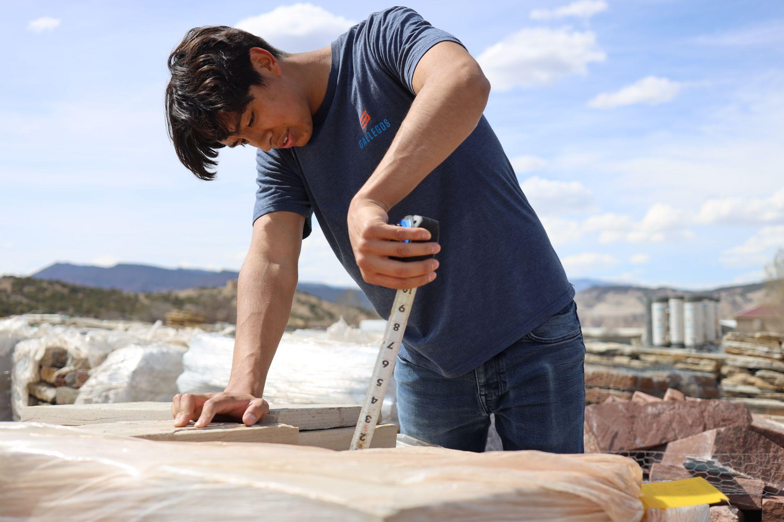
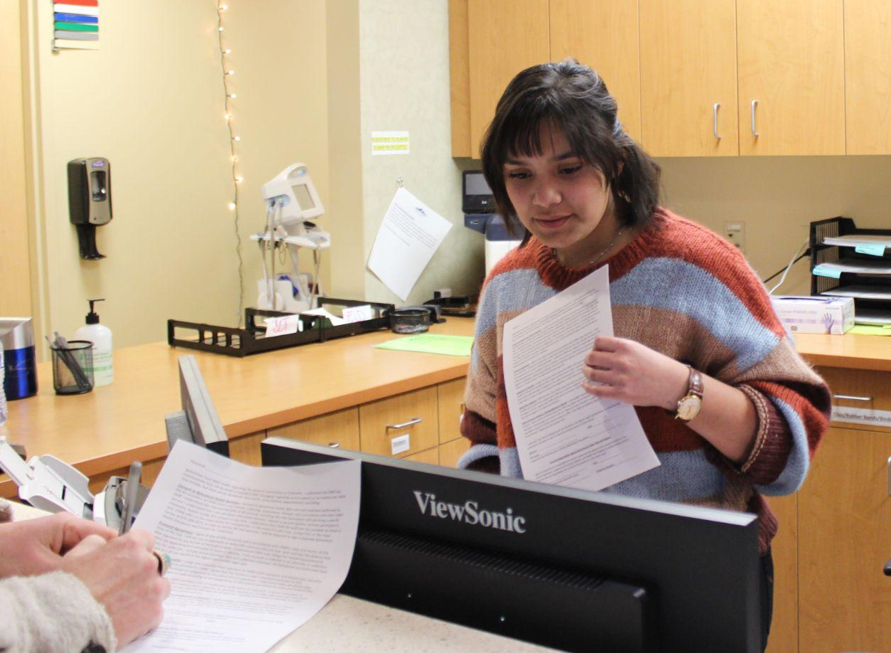
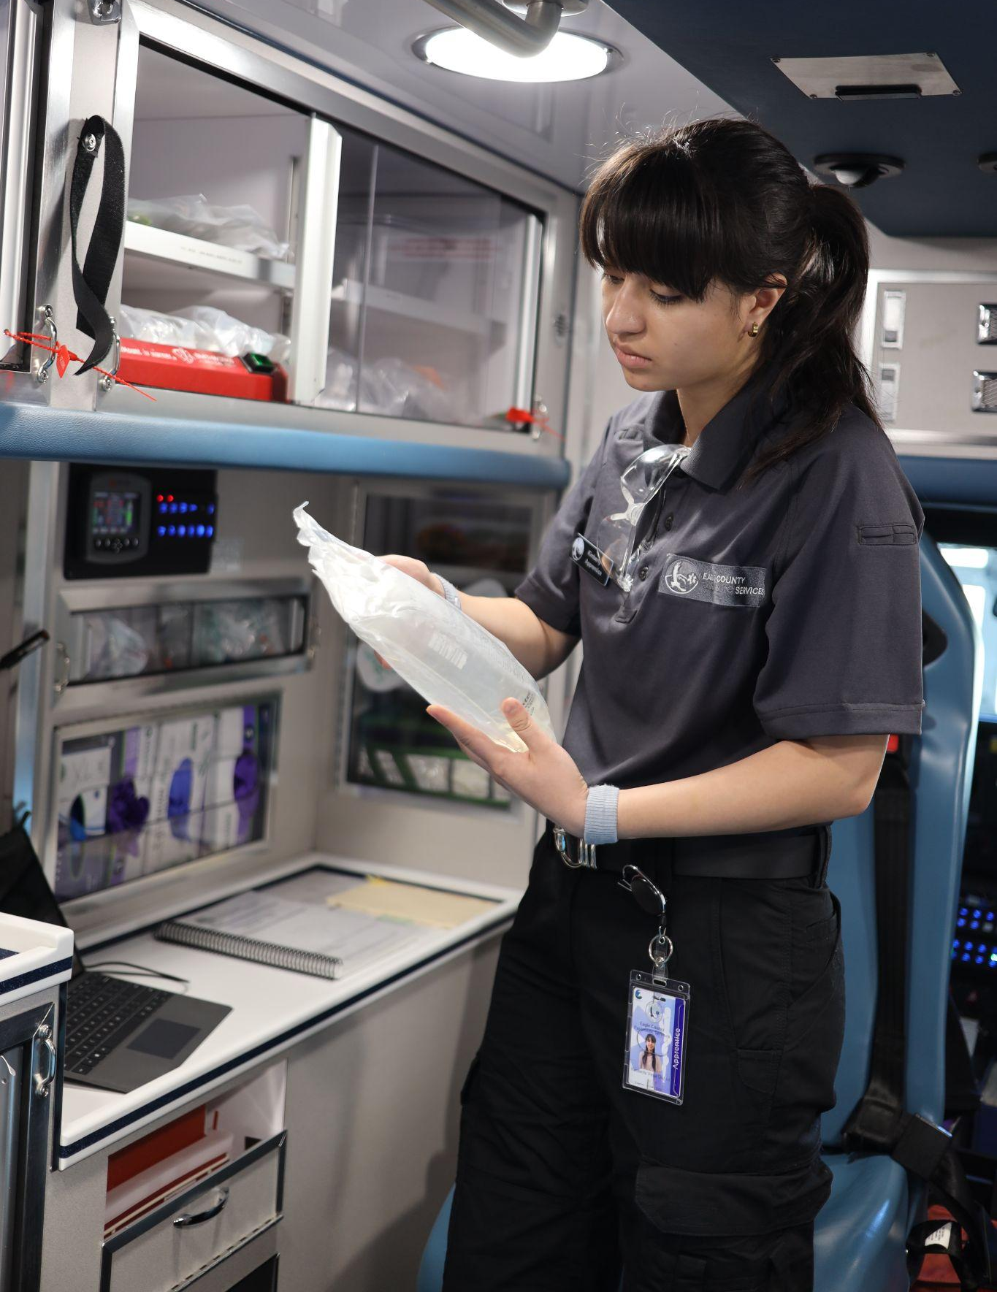
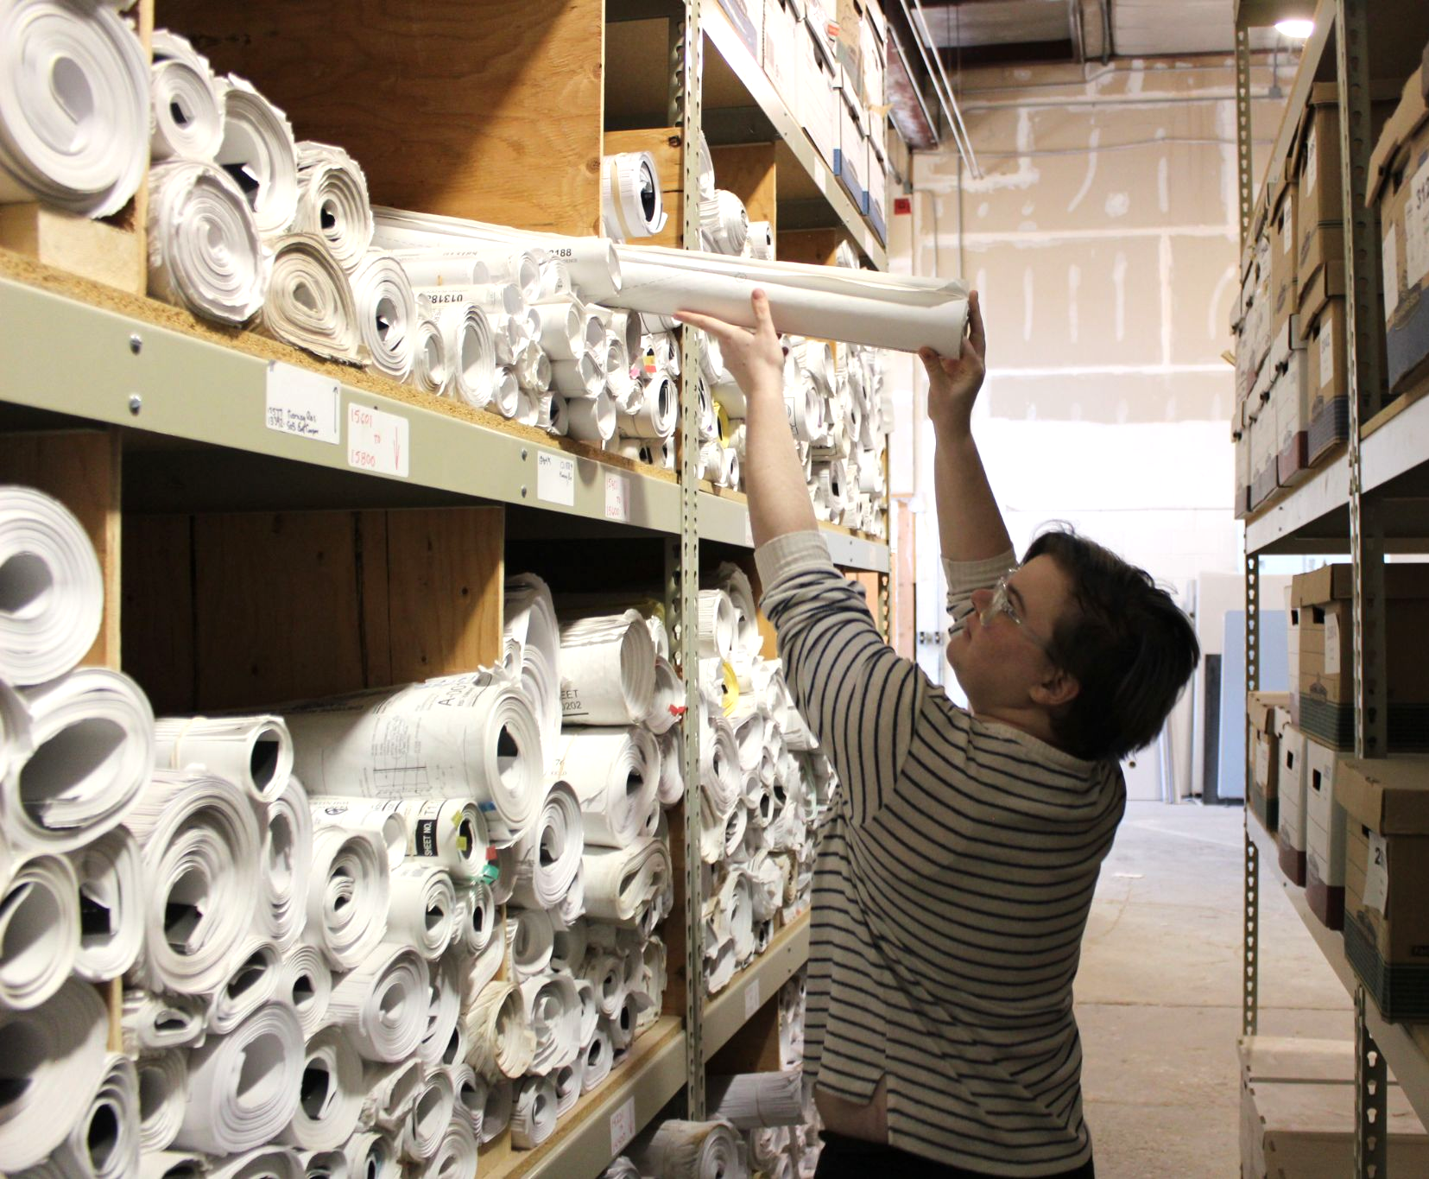
BENEFITS OF A YOUTH APPRENTICESHIP
Addresses organizational equity goals by building diverse young talent pipelines
Creates an employee pipeline that already has housing in our valley
Fosters an inclusive culture of mentorship
Minimizes recruiting costs and maximizes training
Accelerates business transformation enhanced by digital natives

Slide 11



WHY REGISTERED APPRENTICESHIP?
We’re changing the readiness narrative one size does not fit all… and it excludes those who need it most.
Notes:
stephanie

Slide 12






2 Year Apprenticeship Timeline
Summer 1
Year 1
Year 2
HS Classes
& Concurrent Enrollment
None
High
School
None
High School Graduation
Apprenticeship Completion:
Seek continued employment with your company, pursue higher education, or both!
24 - 40 Hours
per week **
20 -24 Hours
per week
30-40 Hours
per week
On-The-Job
Training
0-5 Higher Education
Courses
Courses
& Credentials
Bootcamp
None
On the Job Training:
Each apprentice will develop career-ready, in-demand competencies through their employer. These skills are designed to have currency in the job-market, and to set up apprentices for future success.
Higher Education:
Post-graduation, apprentices will be able to enroll in higher education courses aligned with their industry pathway.
Industry Credentials:
Apprentices are required to pursue an industry credential to develop practical knowledge and skills.
**
Apprentices are guaranteed and must be willing to commit the required number of hours, together employer and apprentice may decide to increase work hours

Slide 13
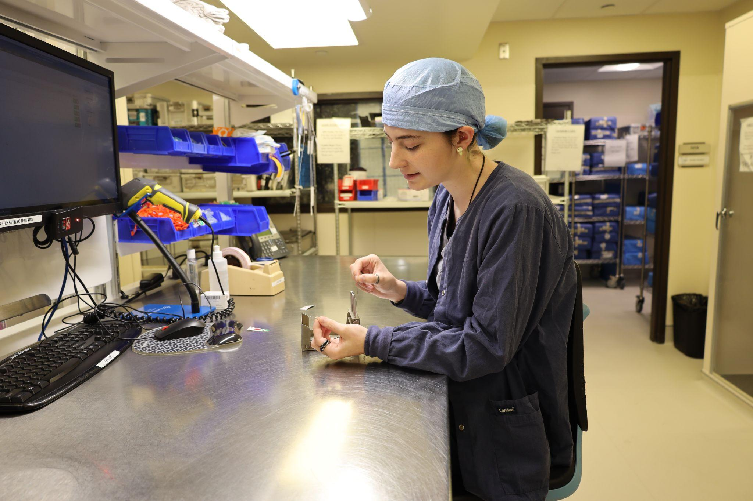
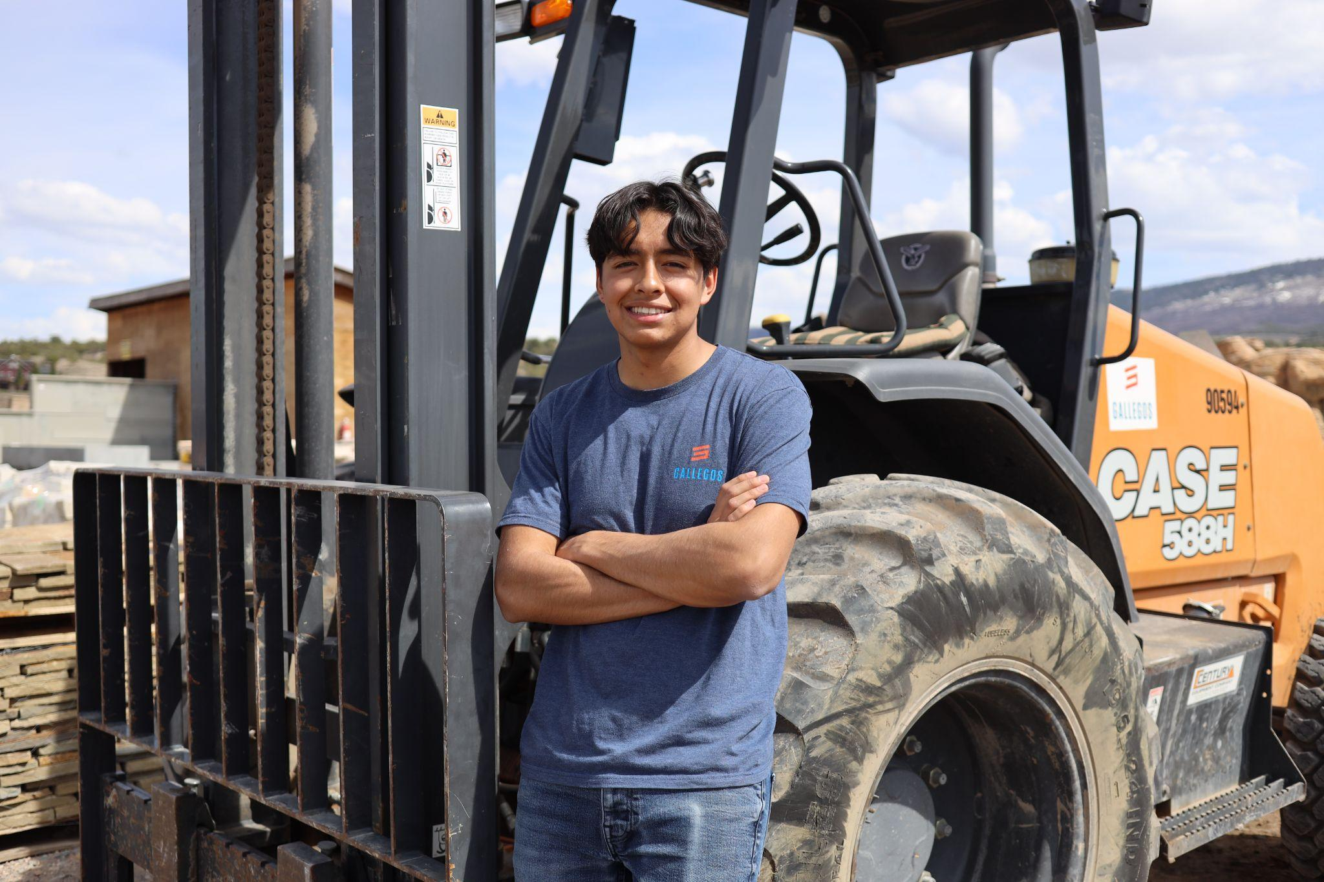

Luis Avila
Graduated Apprentice & full time employee
Gallegos Corp.
Bronte Nelson
2nd year
“This apprenticeship taught me how to communicate on a professional level and gave me confidence.”
Vail Health - Sterile Processing Technician

Slide 14
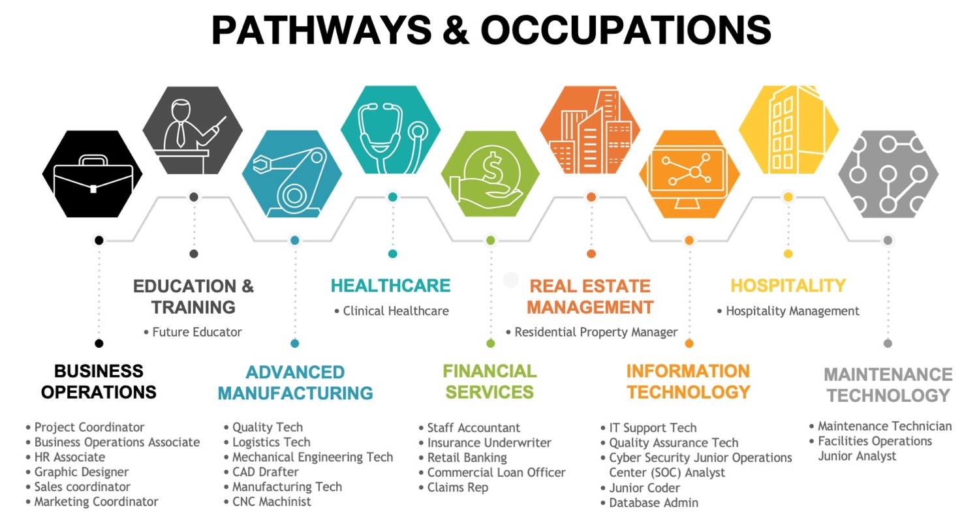

Slide 15
COST SUMMARY
  Employer determines wage scale and pays the apprentice hourly. Must show wage progression if performance standards / competencies are met.
APPRENTICE
WAGE
CAREERWISE SUPPORT
  To facilitate the program and support services, Vail Valley Partnership invoices $1000 per apprentice, after each completed apprenticeship year. (total $2,000)
TRAINING
COSTS
  Years 1-2: Employer pays for an industry relevant credential
  Year 2: Employer pays for up to $2000 in Community College instruction, mutually agreed upon. (CMC, $105 per credit hour)
‹#›

Slide 16
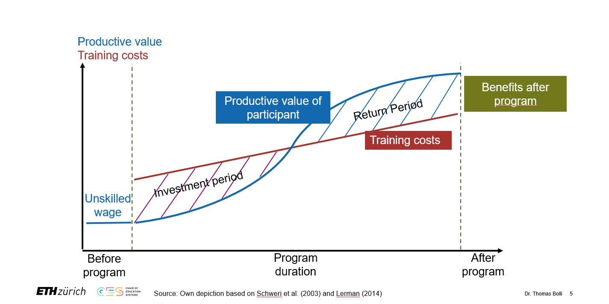
Visualizing Employer ROI

Slide 17
For questions or to schedule a meeting
please email
Erik Williams or Christy Beidel
erik@vailvalleypartnership.com cbeidel@vailvalleypartnership.com
Notes:
Tell them what we’ll tell them

