Slide 1

Colorado & NWCCOG’s Demographic Outlook
Kate Watkins, Ph.D.
State Demographer
NWCCOG Regional Economic Summit
May 7, 2026

Slide 2
People and the Economy
Jobs
People
Housing
“Jobs are people”
“Houses are where those people go to sleep”

Slide 3



Key Population Trends
US
CO
Lower fertility rates = Fewer births
Aging = More deaths
Slower population growth
Net migration a key population growth driver
Increasingly diverse

Slide 4
Global Trends

Slide 5

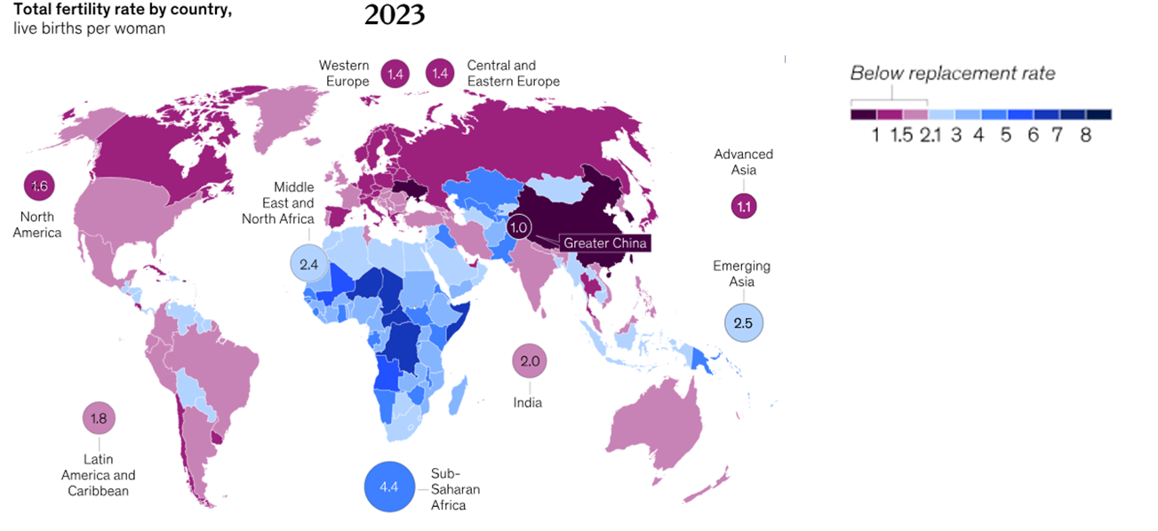
Fertility rates have fallen everywhere
Source: McKinsey Global Institute analysis of the United Nations World Population Prospects 2024. https://www.mckinsey.com/mgi/our-research/dependency-and-depopulation-confronting-the-consequences-of-a-new-demographic-reality

Slide 6
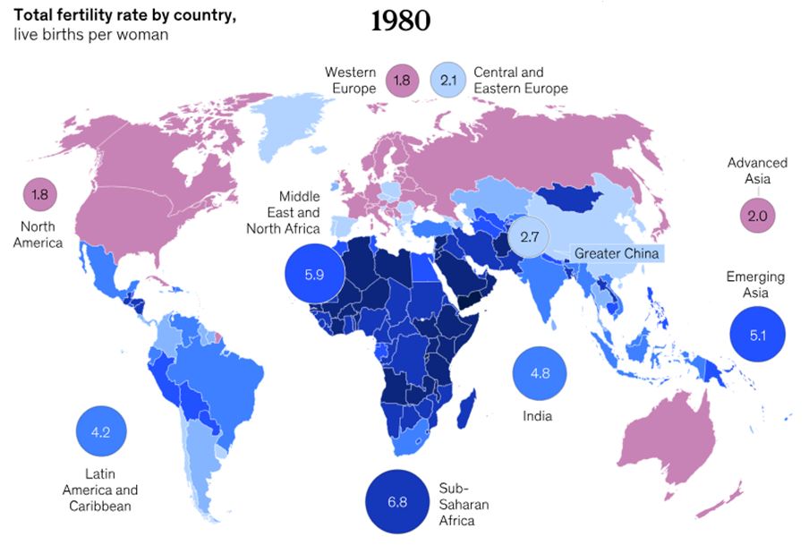

Global fertility rates, 1980
Source: McKinsey Global Institute analysis of the United Nations World Population Prospects 2024. https://www.mckinsey.com/mgi/our-research/dependency-and-depopulation-confronting-the-consequences-of-a-new-demographic-reality

Slide 7
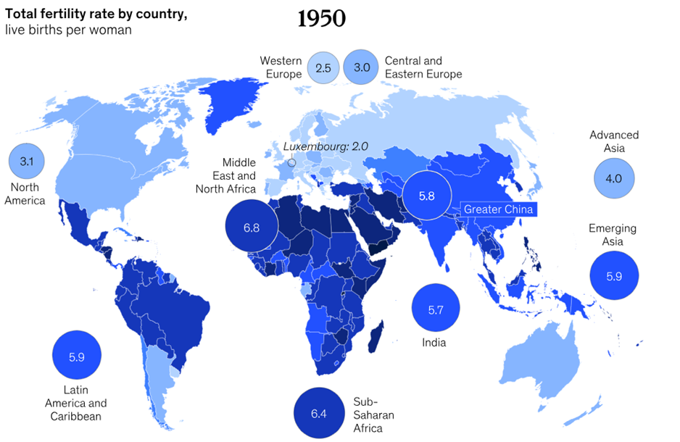
Global fertility rates, 1950
Source: McKinsey Global Institute analysis of the United Nations World Population Prospects 2024. https://www.mckinsey.com/mgi/our-research/dependency-and-depopulation-confronting-the-consequences-of-a-new-demographic-reality

Slide 8
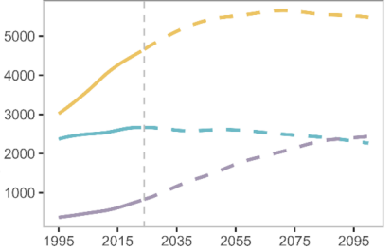
Global Population Slowing and Aging
World Population (Millions)
Strongest growth in the 65+ population
School-age population in decline
Near-term rise in the working-age population
Ages 20 to 64
Ages 0 to 19
Ages 65+
Source: United Nations World Population Prospects 2024. https://population.un.org/wpp/assets/Files/WPP2024_Summary-of-Results.pdf

Slide 9

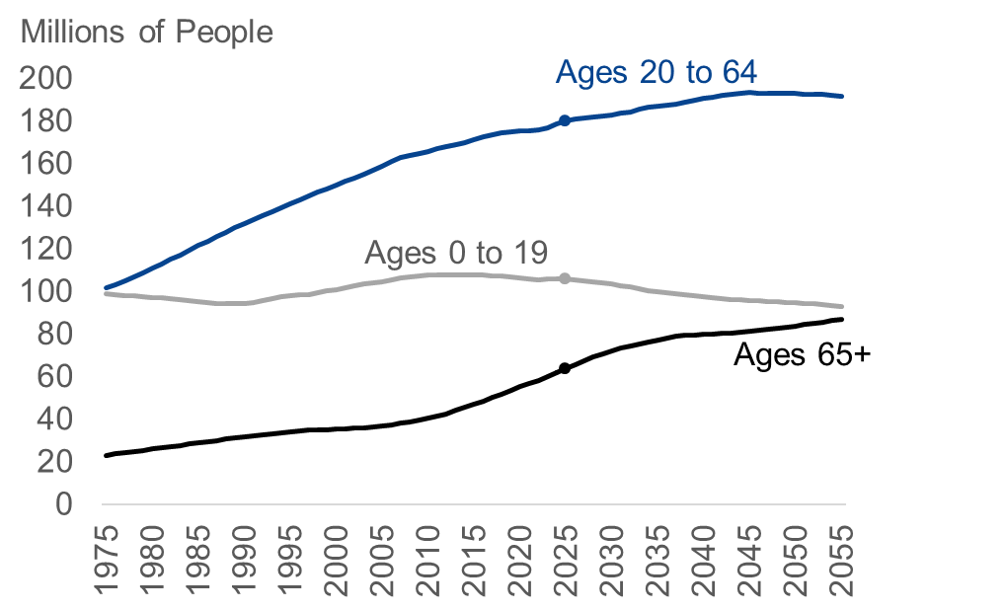
U.S. Population Slowing and Aging
Strongest growth in the 65+ population
School-age population in decline
Near-term rise in the working-age population
Source: U.S. Congressional Budget Office, An Update to the Demographic Outlook, 2025 to 2055. https://www.cbo.gov/publication/61390

Slide 10
Colorado Trends

Slide 11
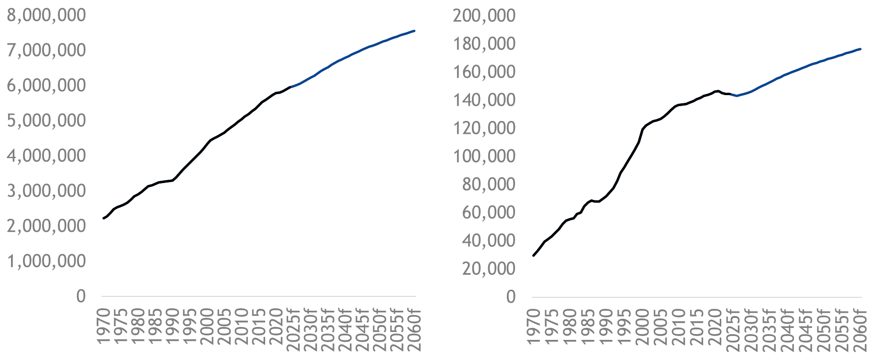
Population Levels
Colorado Population
NWCCOG + Routt County
Source: State Demography Office, vintage 2024 estimates and projections.

Slide 12
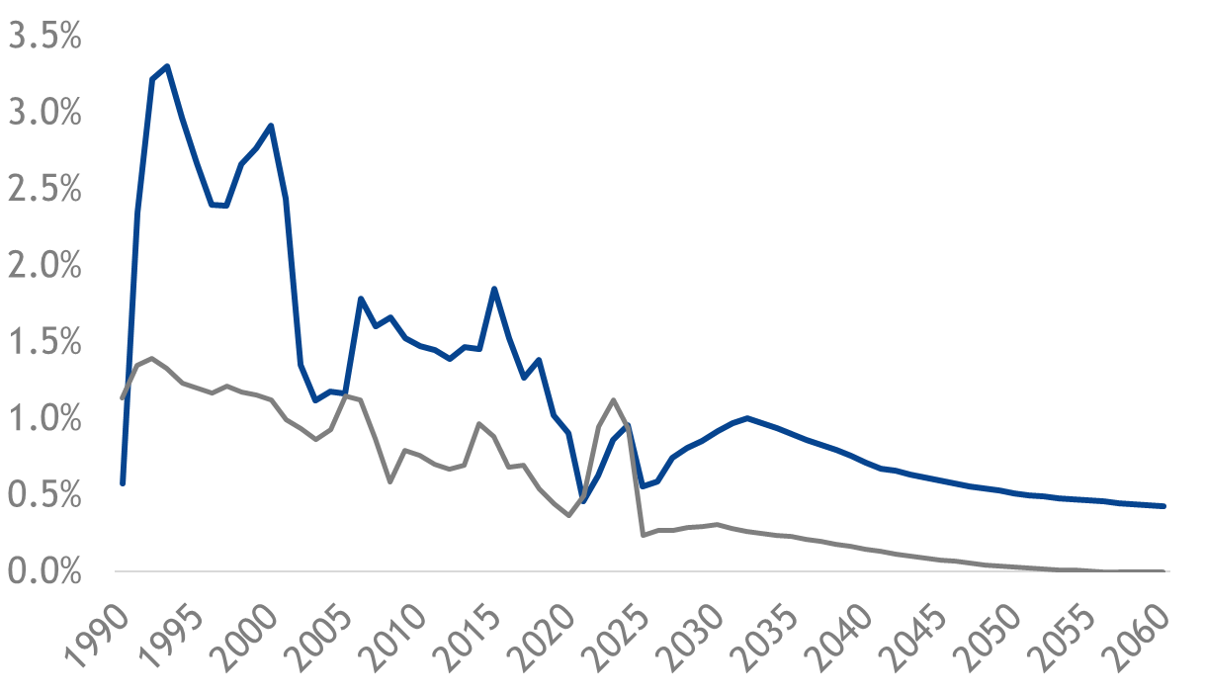
Population growth rates are slowing
Annual Population Percent Change
Slowing U.S. Population Growth
Some states are already shrinking
Slower U.S. growth will impact Colorado’s growth via net migration
Projections
Colorado
U.S.
0.4%
0.0%
Source: State Demography Office, vintage 2024 estimates and projections; U.S. Congressional Budget Office, An Update to the Demographic Outlook, 2025 to 2055.

Slide 13
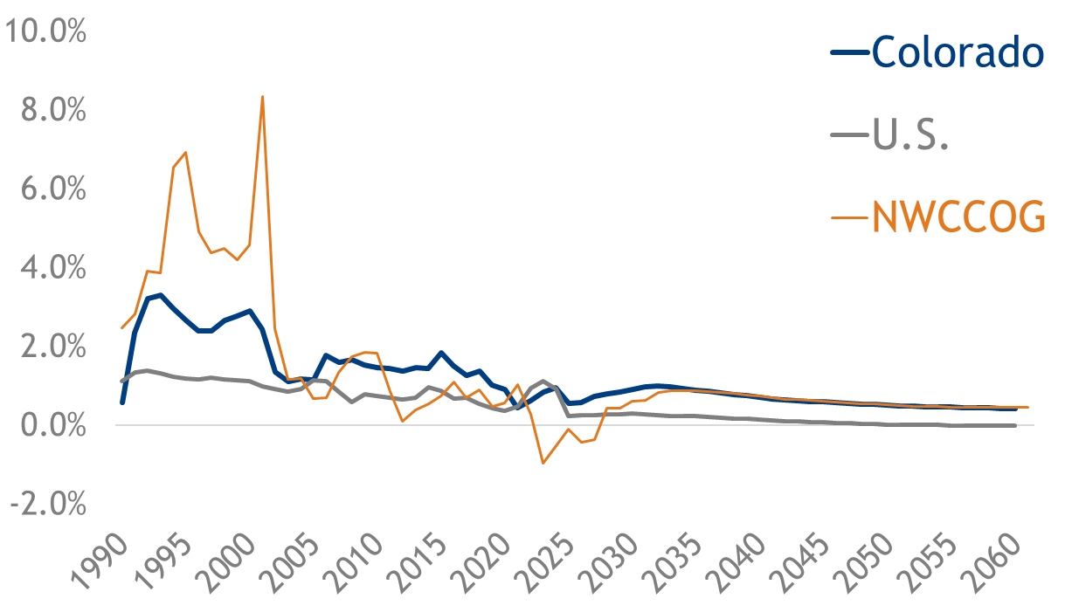
Population growth rates are slowing
Annual Population Percent Change
Source: State Demography Office, vintage 2024 estimates and projections; U.S. Congressional Budget Office, An Update to the Demographic Outlook, 2025 to 2055.

Slide 14

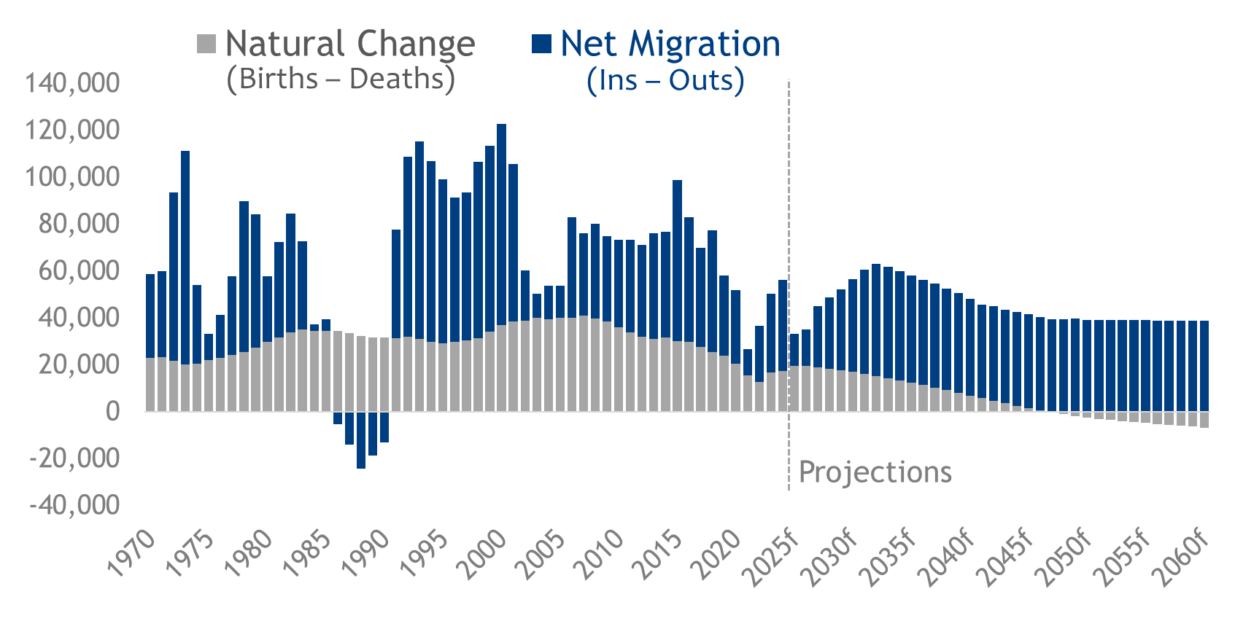
Colorado Components of Population Change
CO
Long-run net migration expectations based on long-run labor demand
Source: State Demography Office, vintage 2024 estimates and projections.

Slide 15
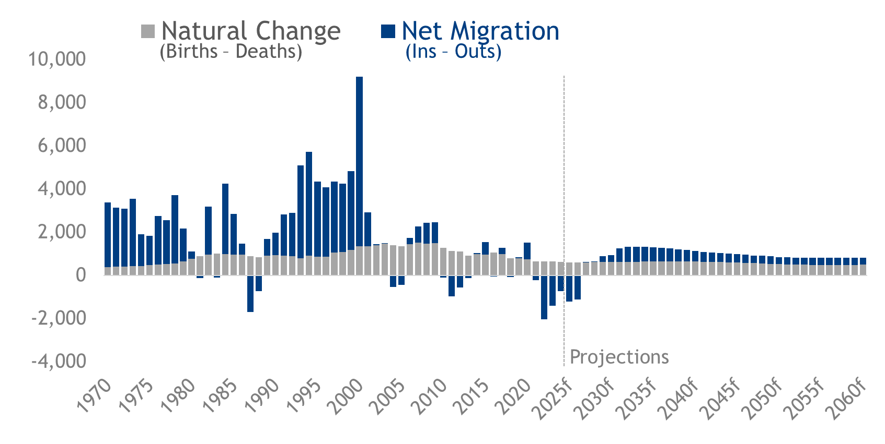
NWCCOG Components of Population Change
CO
Eagle, Grand, Jackson, Pitkin, Routt, and Summit Counties
Source: State Demography Office, vintage 2024 estimates and projections.

Slide 16
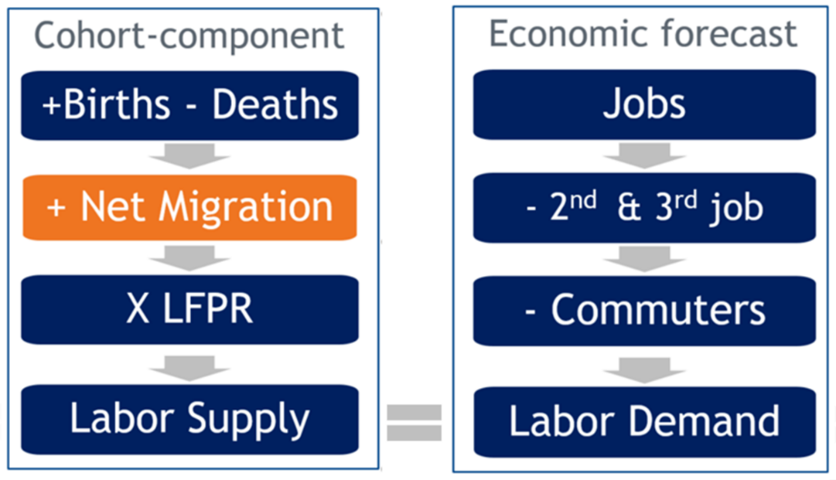
Colorado Population Forecast Methodology
U.S. growth is important
Jobs are people
Age matters
Job demand and expected retirements drive migration
Differences between supply and demand resolved by net migration

Slide 17
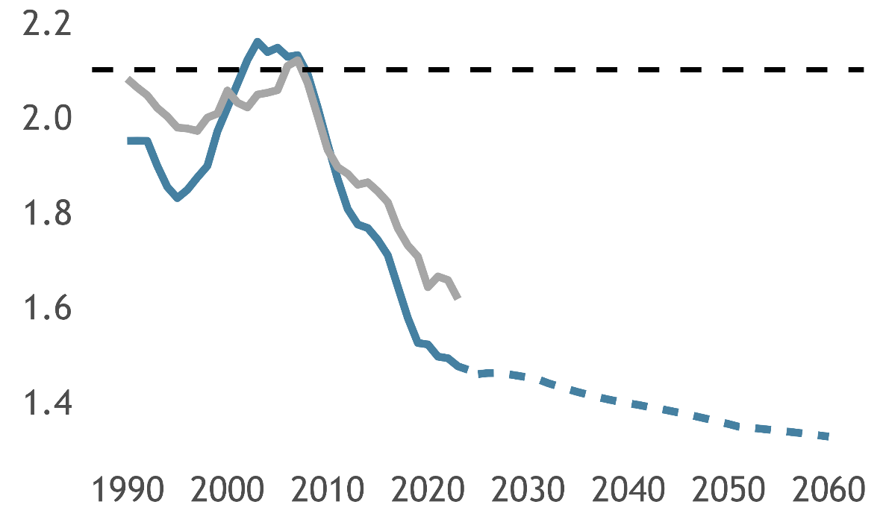
Fertility Rates Continue to Fall
Colorado Total Fertility Rate
Colorado and US increased in fertility in the 90’s
Dramatic fall off beginning in the mid-2000’s
Colorado has recently pulled away from US fertility
Replacement Rate
United States
Colorado
Source: State Demography Office, vintage 2024 estimates and projections.

Slide 18
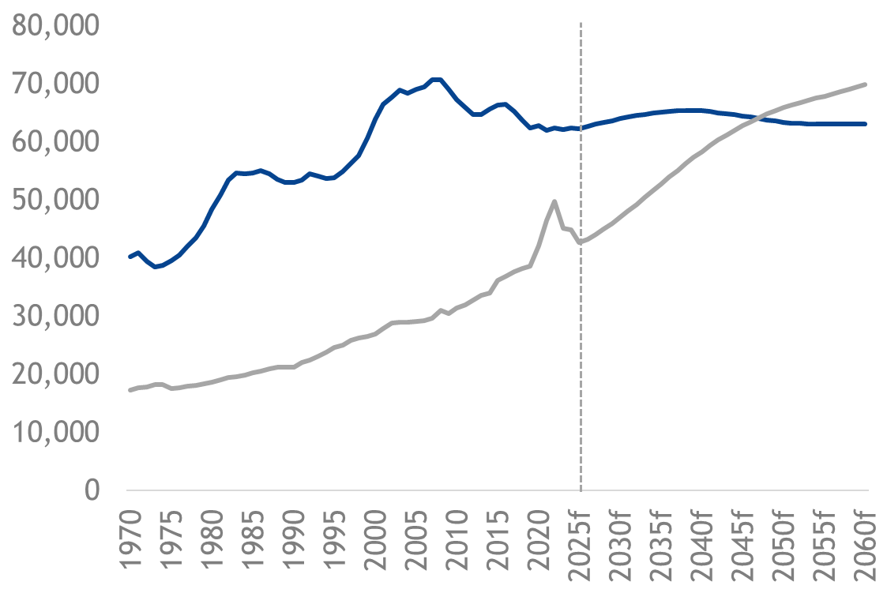
Colorado Natural Change
CO
Births and Deaths
Colorado deaths expected to exceed births beginning in 2048, compared to 2030 for the U.S.
Net migration supports slight increase in births in future years
Births
Deaths
Projections
Source: State Demography Office, vintage 2024 estimates and projections.

Slide 19
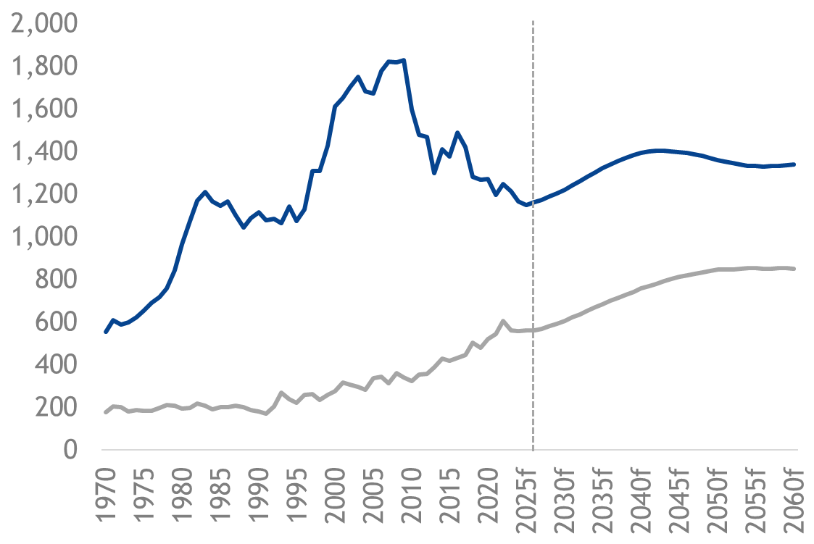
NWCCOG Natural Change
CO
Births and Deaths
Older adults tend to move out of the region before dying.
Births expected to rise with net migration of 20- and 30-year olds.
Births
Deaths
Projections
Source: State Demography Office, vintage 2024 estimates and projections.

Slide 20
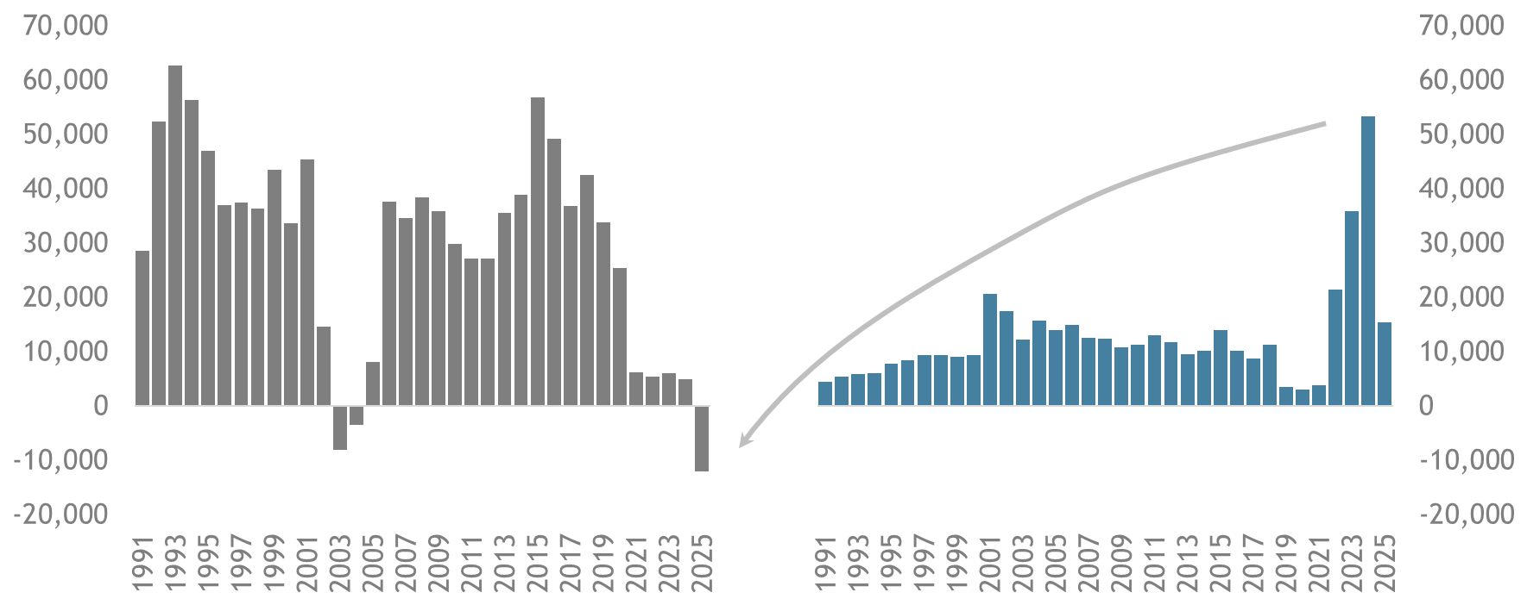
Colorado Net Migration
CO
Domestic
International
A portion of recent international migrants likely moved to other states in 2025, contributing to net negative domestic migration
+15,356
-12,100
Source: U.S. Census Bureau Population Estimates Program. Data for 2020 through 2025 are vintage 2025.

Slide 21
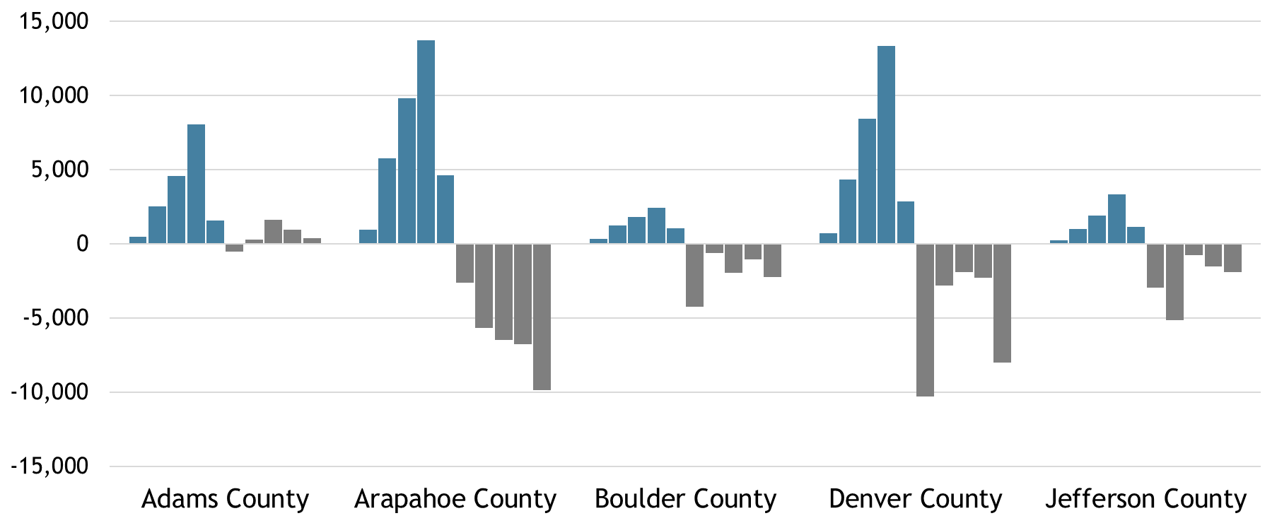
Denver Metro Net Migration
Counties with the strongest net international migration in 2024 and highest home prices show the greatest net negative domestic migration in 2025 (e.g., Arapahoe and Denver)
CO
International
2021-2025
Domestic
2021-2025
Source: U.S. Census Bureau Population Estimates Program, vintage 2025 estimates.

Slide 22
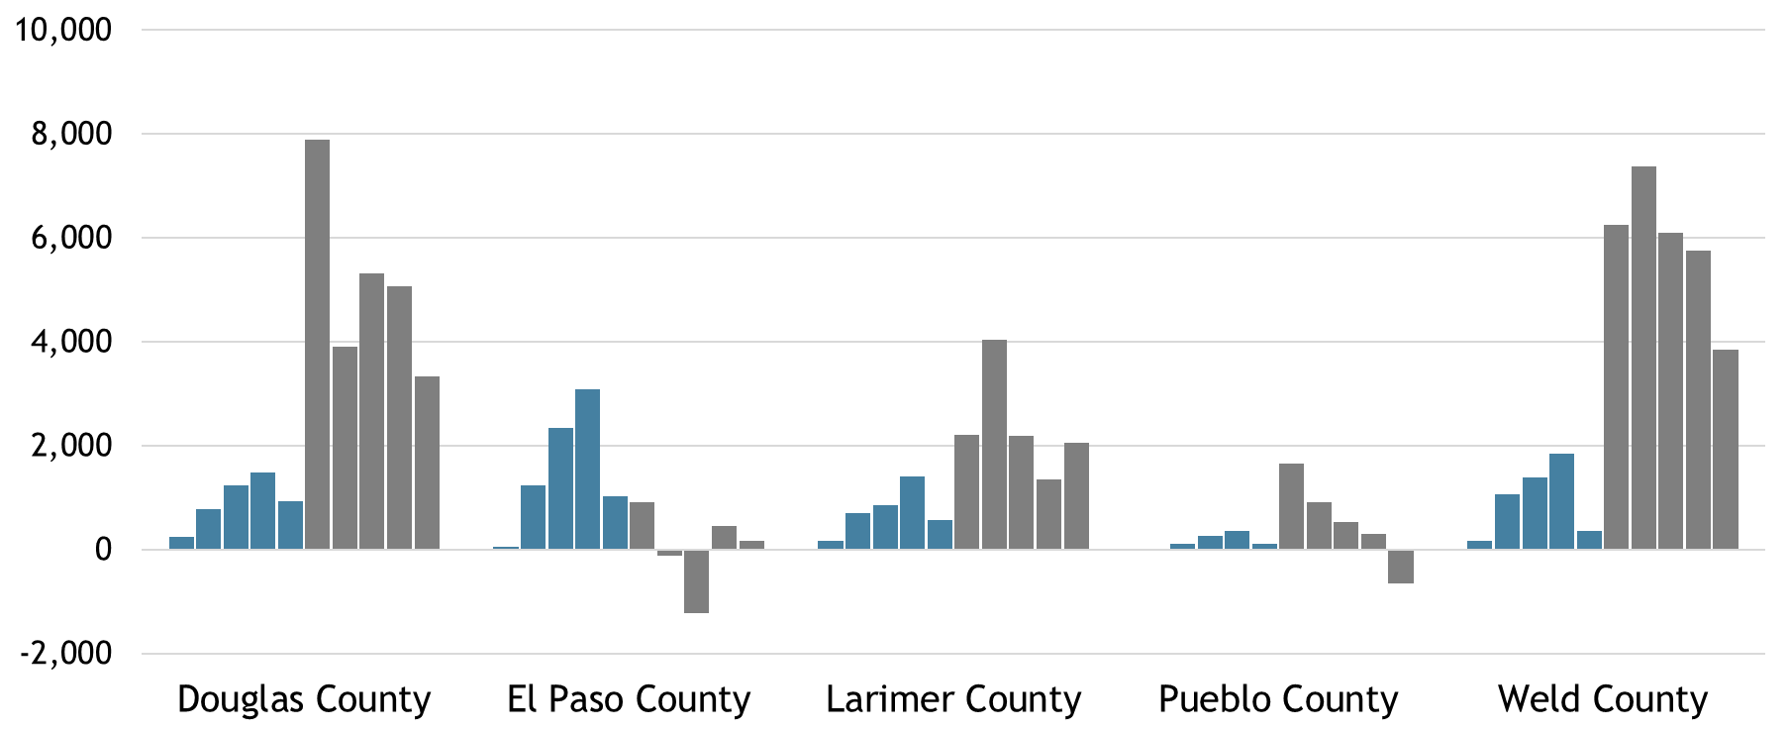
Other Front Range Net Migration
CO
Weld, Douglas, and Larimer counties have seen stronger residential construction activity in recent years, supporting positive net migration
International
2021-2025
Domestic
2021-2025
Source: U.S. Census Bureau Population Estimates Program, vintage 2025 estimates.

Slide 23
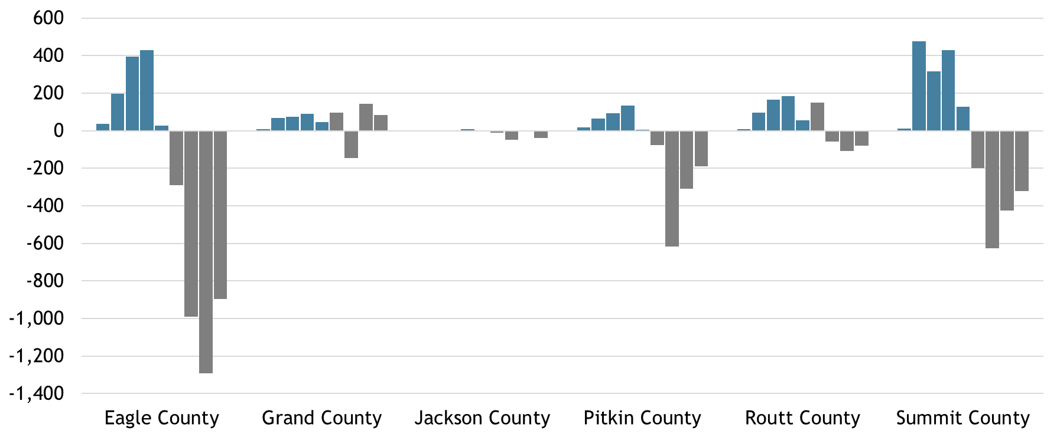
NWCCOG County Net Migration
CO
International
2021-2025
Domestic
2021-2025
Source: U.S. Census Bureau Population Estimates Program, vintage 2025 estimates.

Slide 24
People and the Economy
Jobs
People
Housing
“Jobs are people”
“Houses are where those people go to sleep”

Slide 25
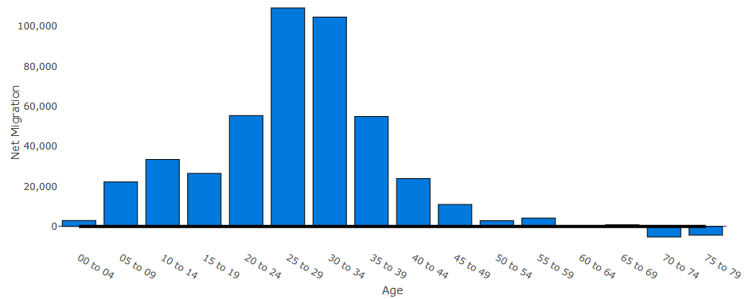
Colorado Net Migration by Age
CO
Net Migrants, 2010 to 2020
Source: State Demography Office analysis of U.S. Census Bureau 2020 and 2010 data. https://demography.dola.colorado.gov/assets/html/netmigcomp.html

Slide 26
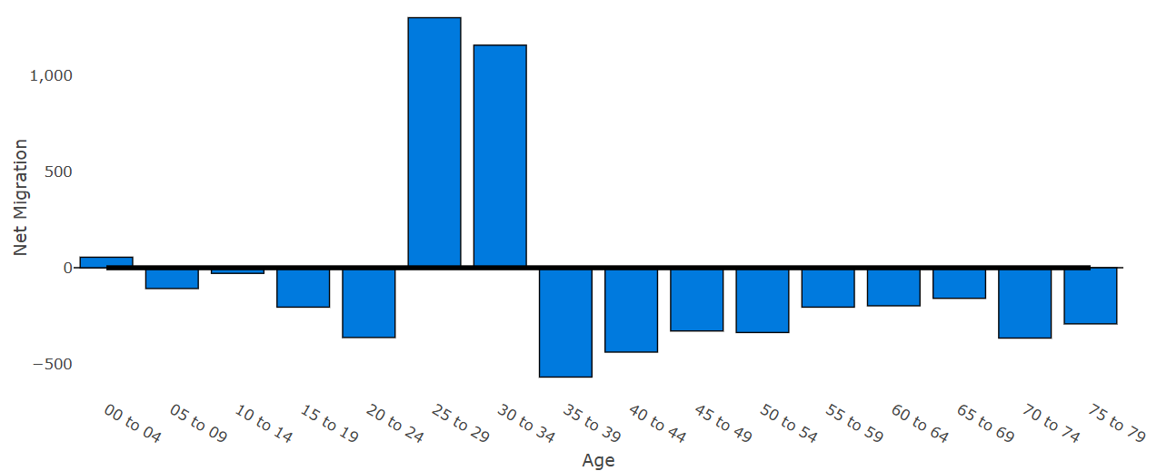
Eagle County Net Migration by Age
CO
Net Migrants, 2010 to 2020
Source: State Demography Office analysis of U.S. Census Bureau 2020 and 2010 data. https://demography.dola.colorado.gov/assets/html/netmigcomp.html

Slide 27
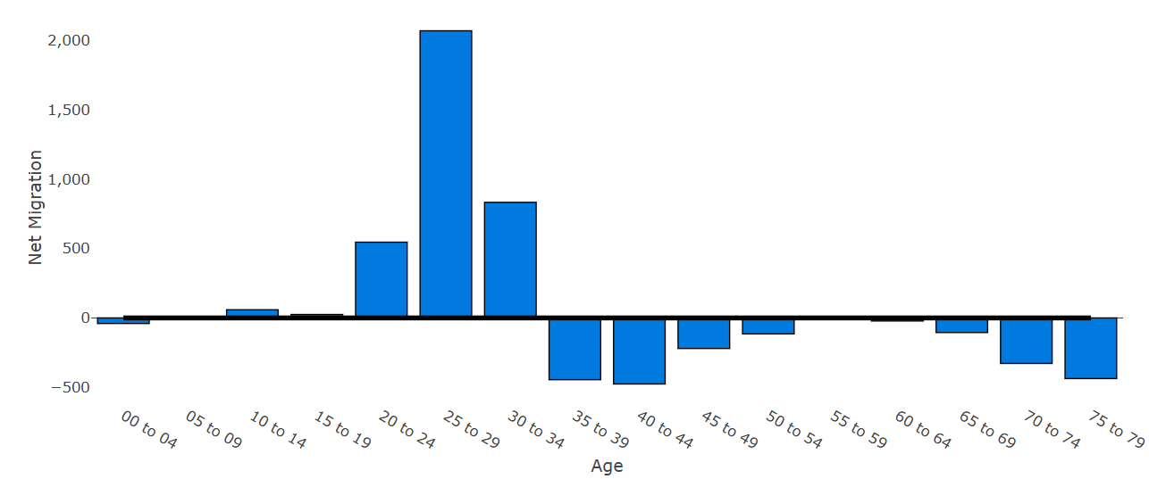
Summit County Net Migration by Age
CO
Net Migrants, 2010 to 2020
Source: State Demography Office analysis of U.S. Census Bureau 2020 and 2010 data. https://demography.dola.colorado.gov/assets/html/netmigcomp.html

Slide 28
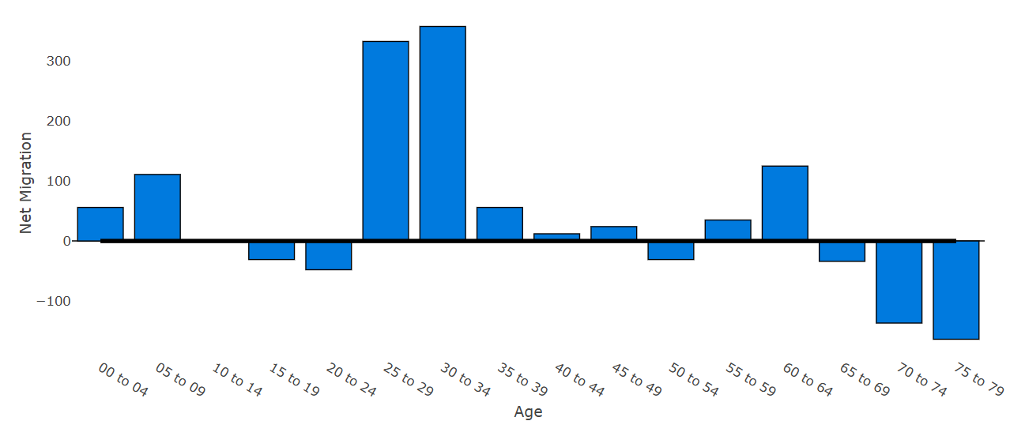
Grand County Net Migration by Age
CO
Net Migrants, 2010 to 2020
Source: State Demography Office analysis of U.S. Census Bureau 2020 and 2010 data. https://demography.dola.colorado.gov/assets/html/netmigcomp.html

Slide 29
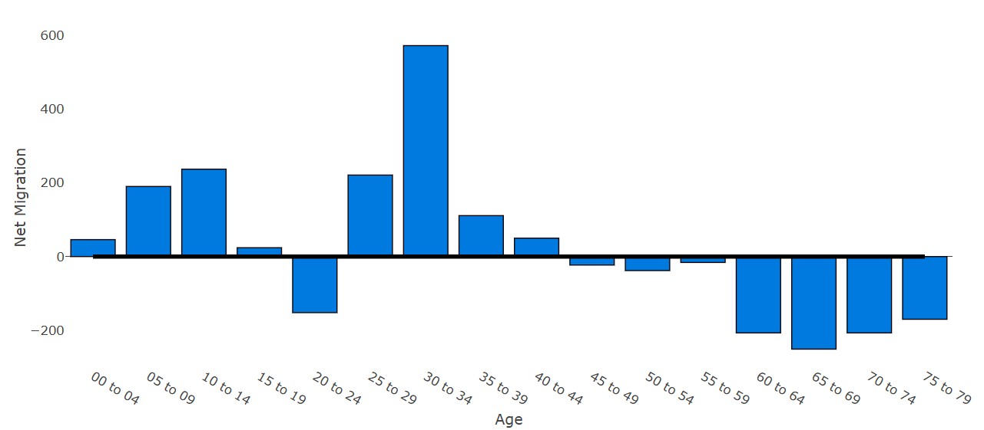
Routt County Net Migration by Age
CO
Net Migrants, 2010 to 2020
Source: State Demography Office analysis of U.S. Census Bureau 2020 and 2010 data. https://demography.dola.colorado.gov/assets/html/netmigcomp.html

Slide 30
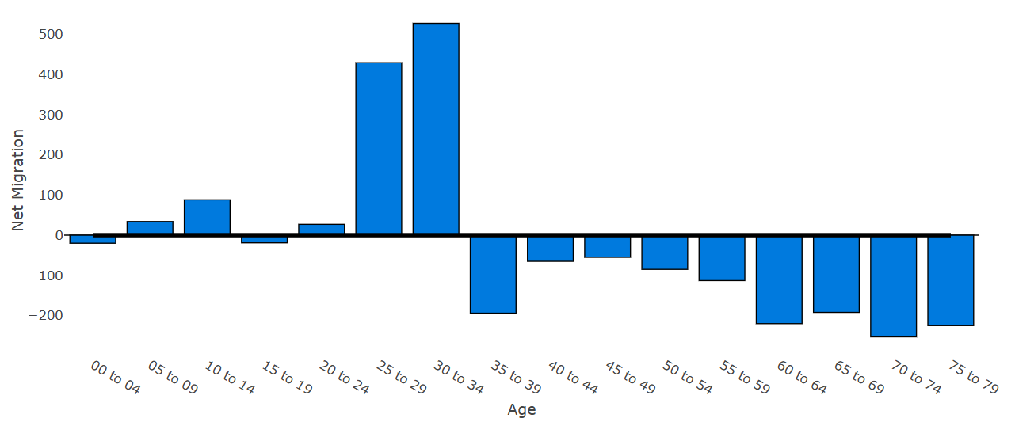
Pitkin County Net Migration by Age
CO
Net Migrants, 2010 to 2020
Source: State Demography Office analysis of U.S. Census Bureau 2020 and 2010 data. https://demography.dola.colorado.gov/assets/html/netmigcomp.html

Slide 31
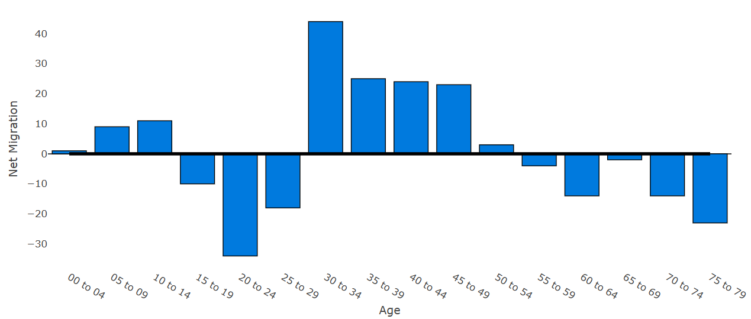
Jackson County Net Migration by Age
CO
Net Migrants, 2010 to 2020
Source: State Demography Office analysis of U.S. Census Bureau 2020 and 2010 data. https://demography.dola.colorado.gov/assets/html/netmigcomp.html

Slide 32
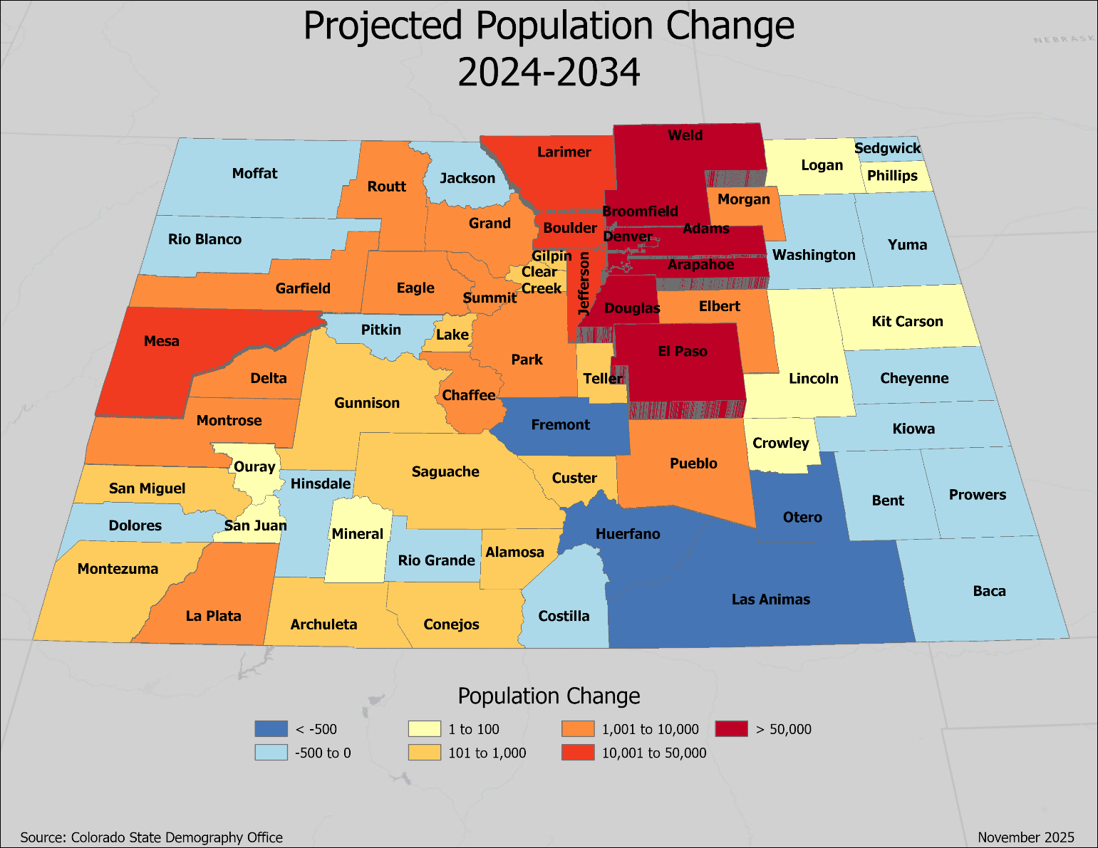
Ten-Year Population Growth Outlook
CO
Front range still leading growth
Growth heavily contingent upon net migration
Source: State Demography Office, vintage 2024 estimates and projections.

Slide 33
Race & Ethnicity

Slide 34
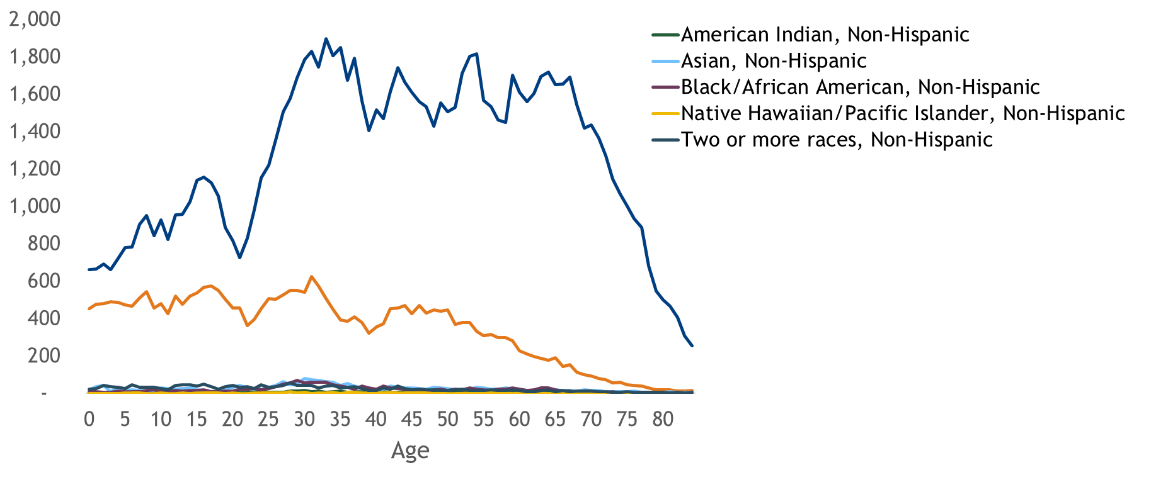
NWCCOG’s Population by Race and Ethnicity, 2024
CO
White, Non-Hispanic
Hispanic
Source: State Demography Office, vintage 2024 estimates.
https://demography.dola.colorado.gov/assets/html/racebyage.html

Slide 35
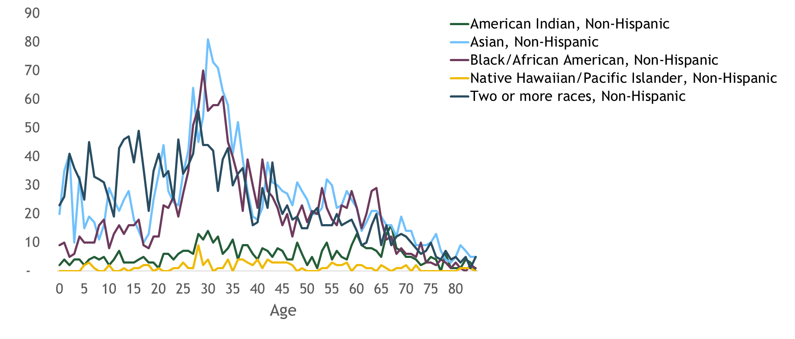
NWCC’s Population by Race and Ethnicity, 2024
CO
Source: State Demography Office, vintage 2024 estimates.
https://demography.dola.colorado.gov/assets/html/racebyage.html

Slide 36
Age Matters

Slide 37
Why Aging Matters
Lower labor force participation means more competition for talent
Shifts in demand for goods and services
Supply and demand for housing (near-term pressure)
Income sources and amounts evolve as we age
Downward pressure on federal, state, and local government tax revenue; upward pressure on government expenditures

Slide 38
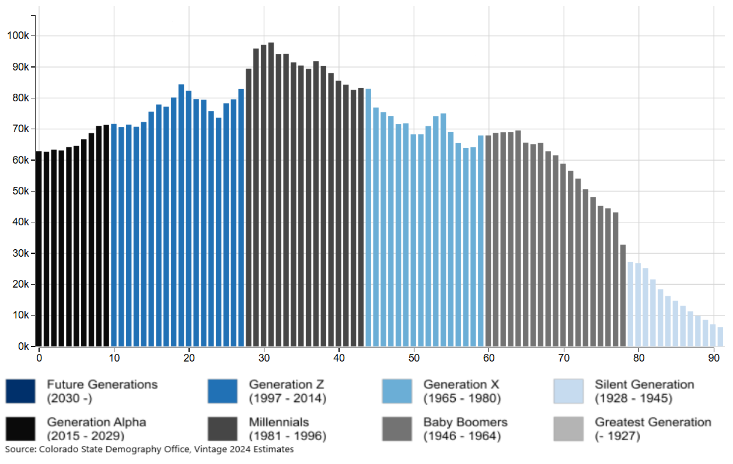

Colorado’s population by age and generation, 2024
CO
2024
View animated changes in populations over time: https://gis.dola.colorado.gov/Age-Animation-Bars/
Source: State Demography Office, vintage 2023 estimates and projections.

Slide 39
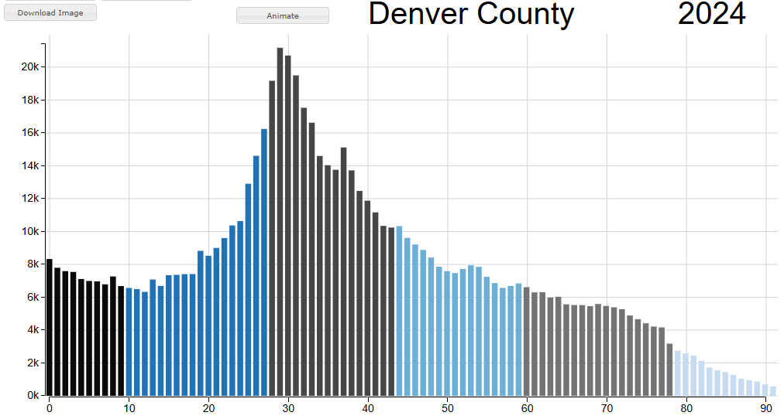
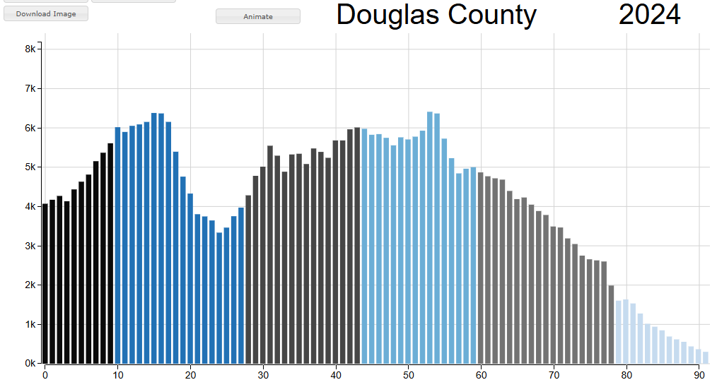
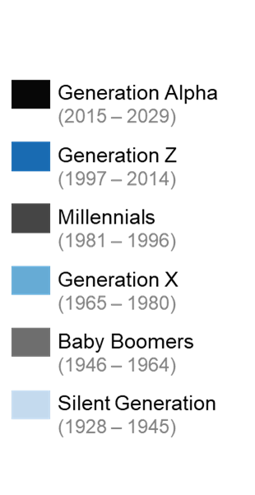
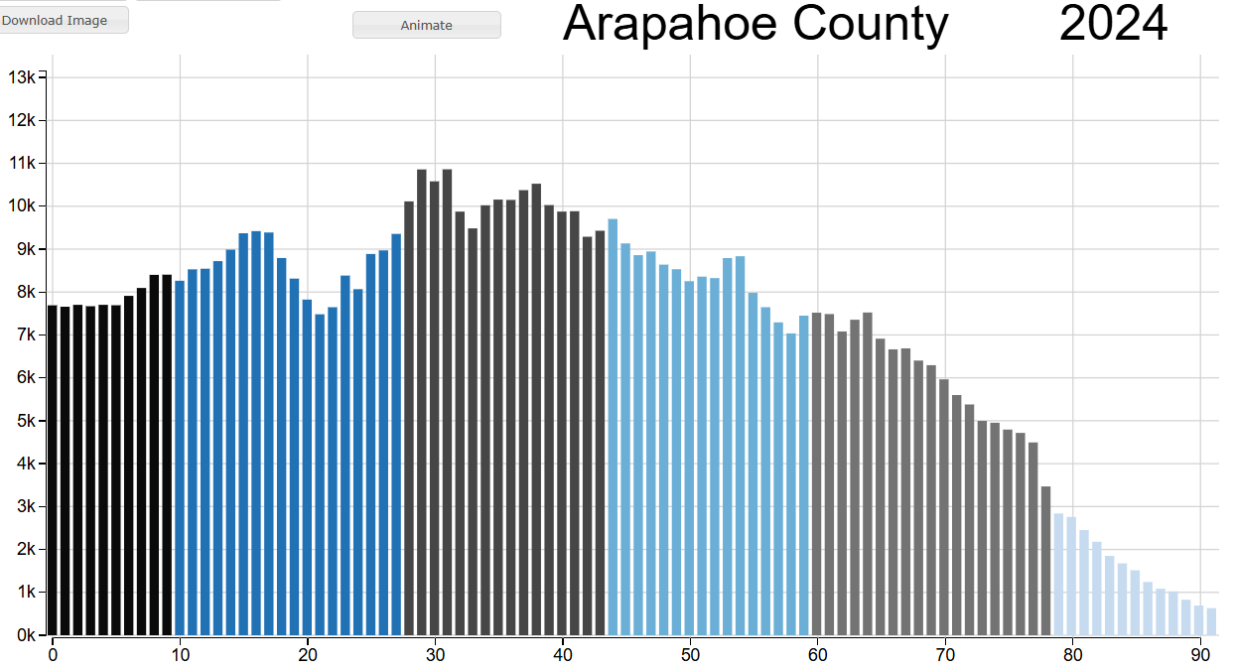
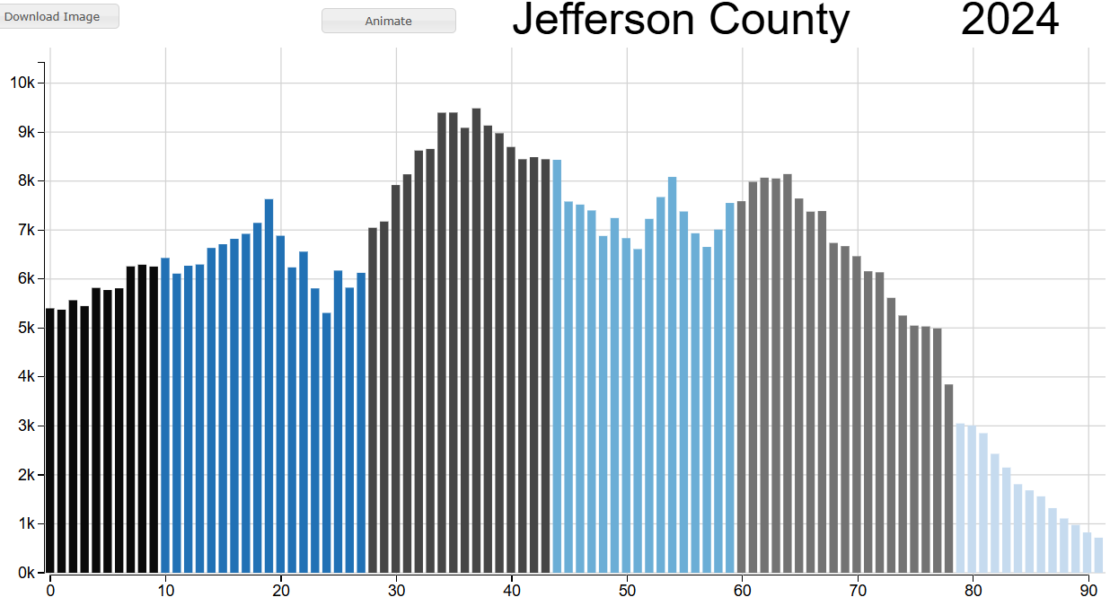
Every county has a unique age composition
CO
Source: State Demography Office, vintage 2024 estimates and projections.
Interactive visuals available at: https://gis.dola.colorado.gov/Age-Animation-Bars

Slide 40
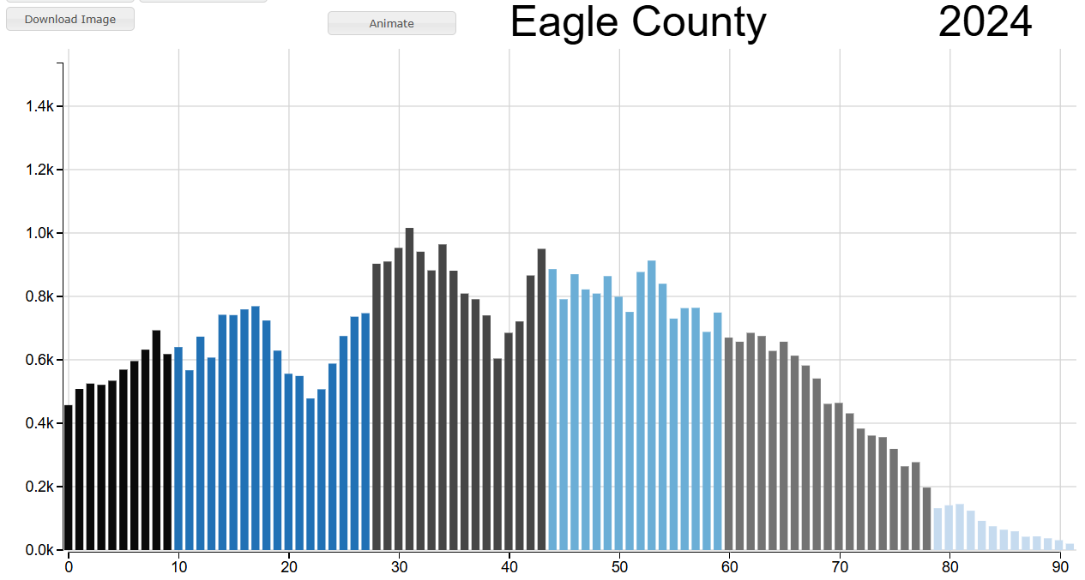
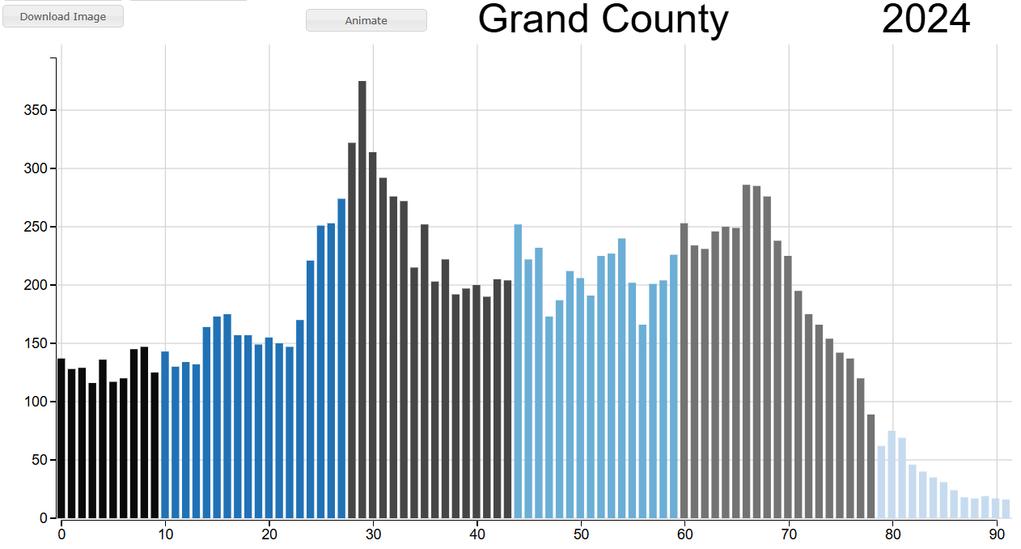
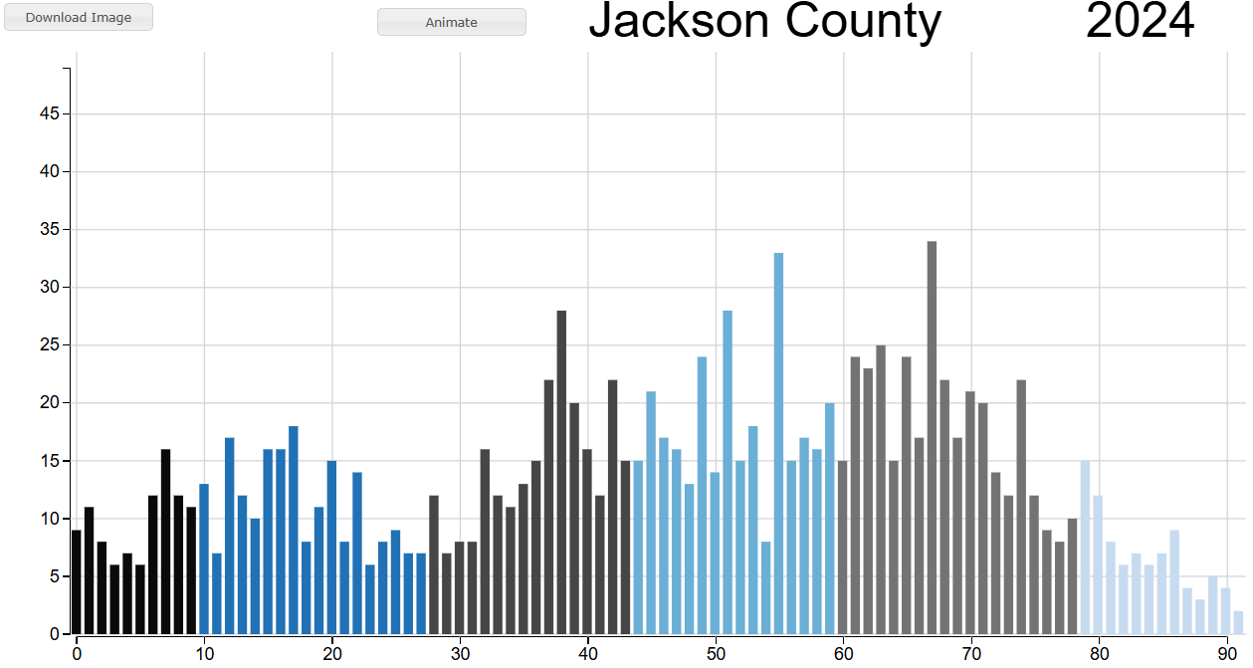
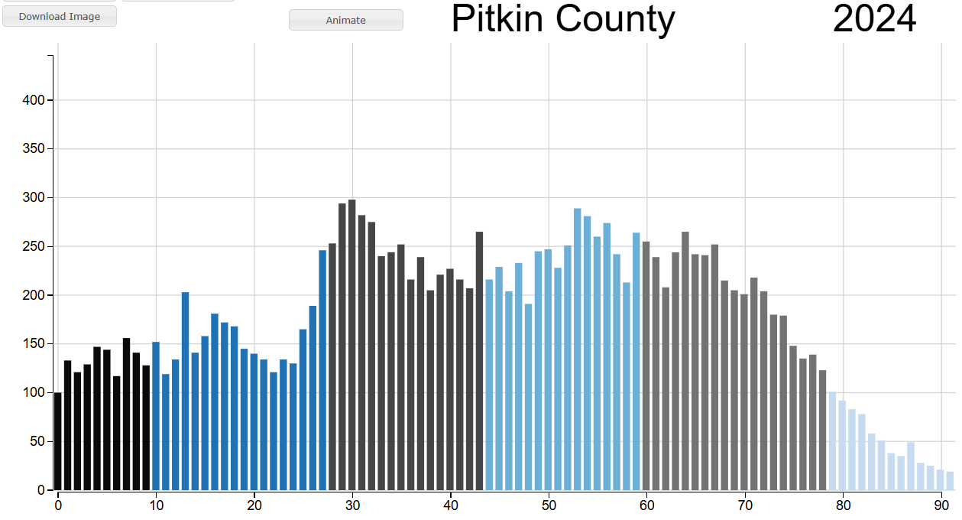
Every county has a unique age composition
CO
Source: State Demography Office, vintage 2024 estimates and projections.
Interactive visuals available at: https://gis.dola.colorado.gov/Age-Animation-Bars

Slide 41
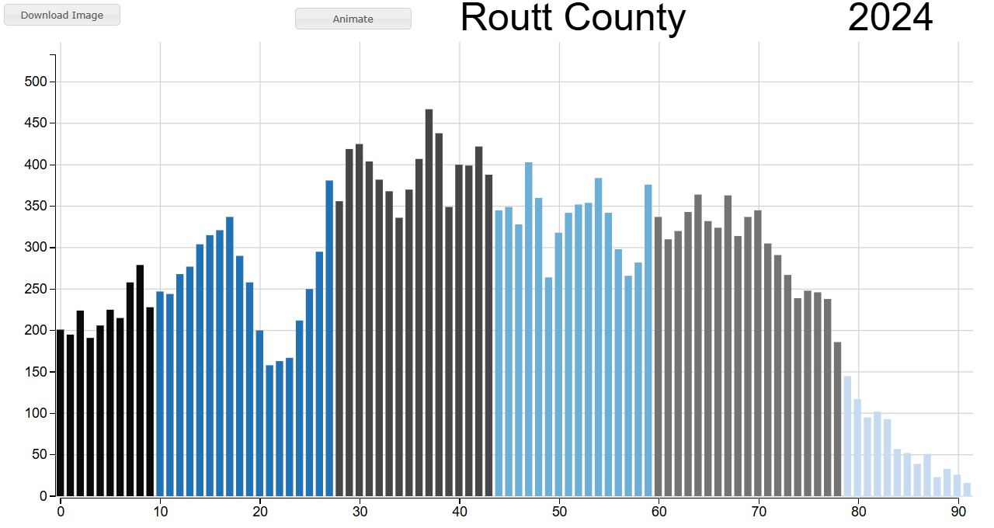
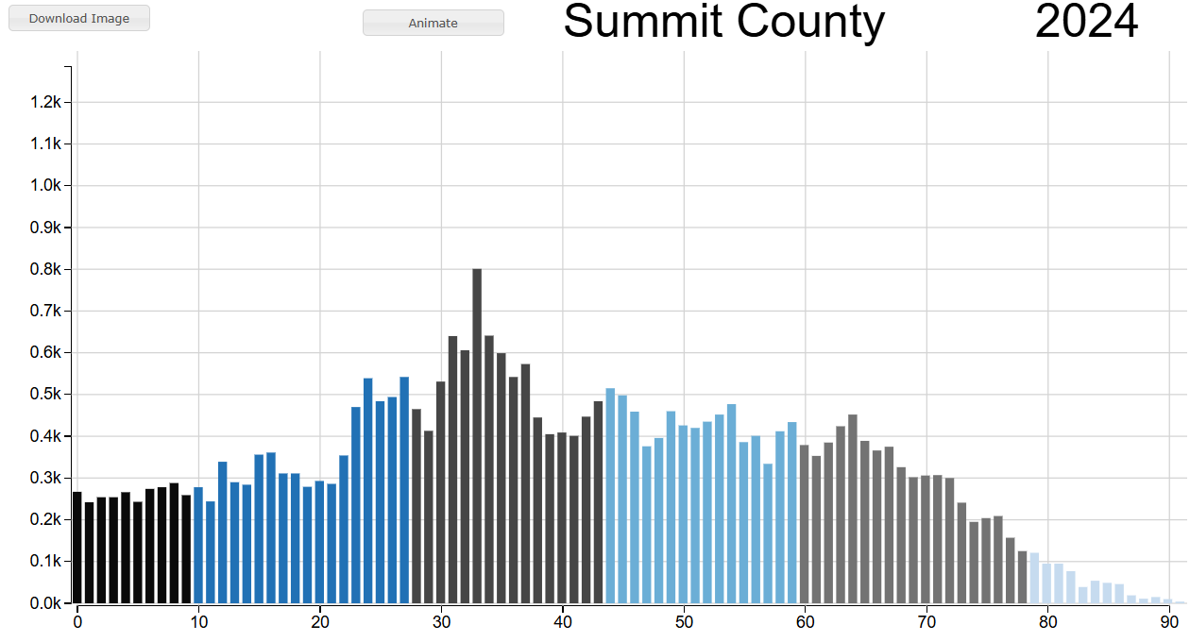
Every county has a unique age composition
CO
Source: State Demography Office, vintage 2024 estimates and projections.
Interactive visuals available at: https://gis.dola.colorado.gov/Age-Animation-Bars

Slide 42
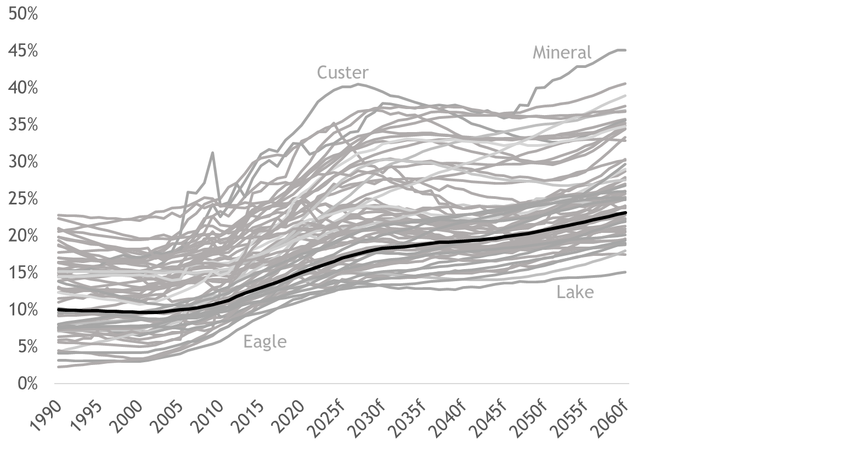
Share of the population age 65+
CO
Colorado
Colorado
16.5% as of 2024
23.1% by 2060
Source: State Demography Office, vintage 2024 estimates and projections.

Slide 43
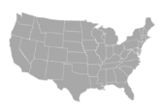
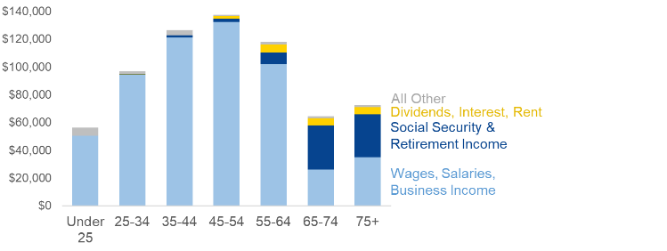
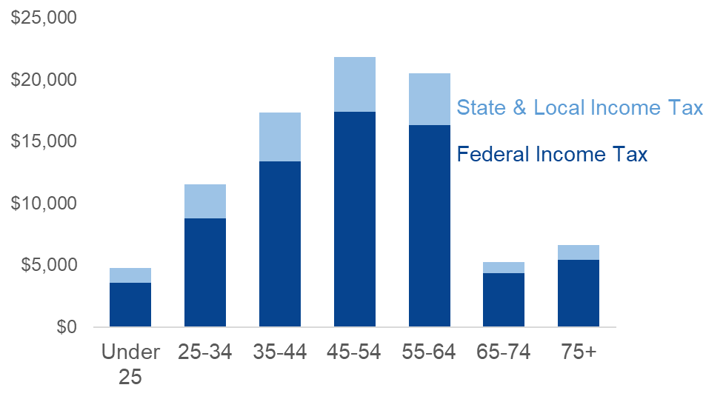
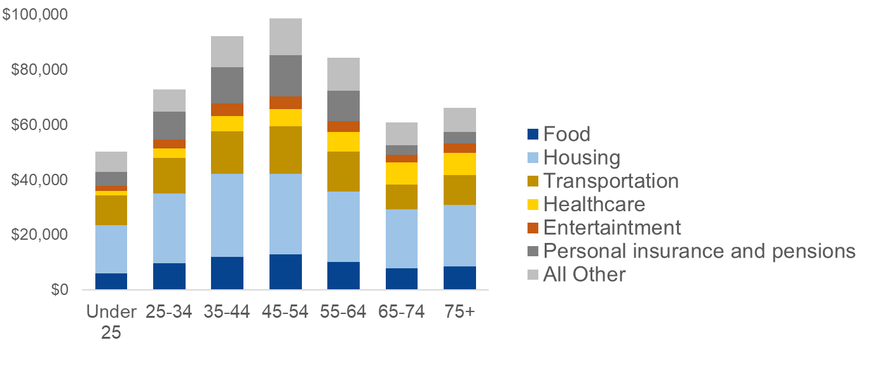
Income and spending rises and then falls with age
US
Average U.S. Income
Average U.S. Income Tax
Average U.S. Consumer Spending
Aging will…
Impact our labor markets
Impact our tax base
Shift consumer spending
Source: U.S. Bureau of Labor Statistics, 2023 Consumer Expenditure Survey.

Slide 44
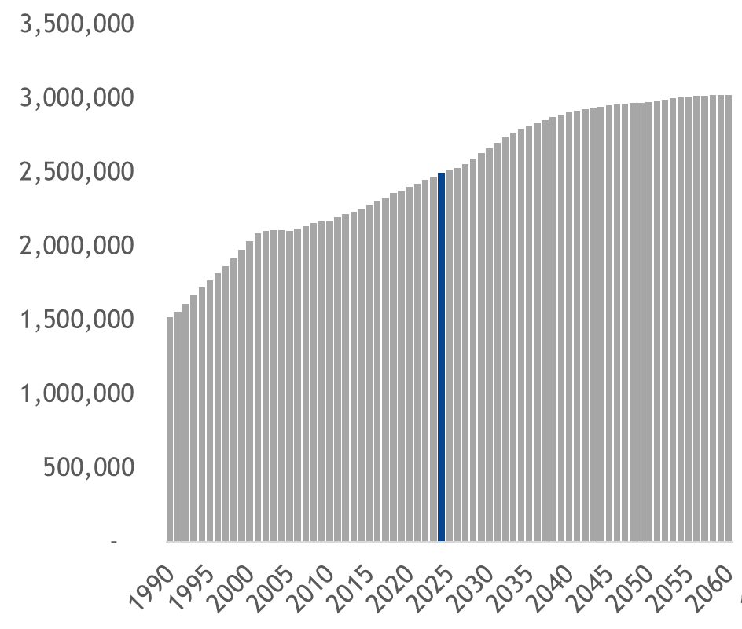
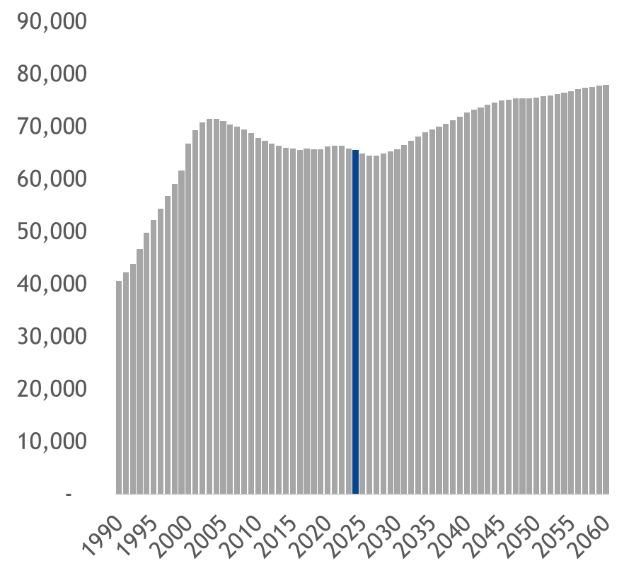
Most likely to work
Growth is highly dependent on net migration to Colorado
CO
Colorado Population Aged 25 to 54
NWCCOG + Routt
2024
2024
Source: State Demography Office, vintage 2024 estimates and projections. https://gis.dola.colorado.gov/AgeMap/

Slide 45
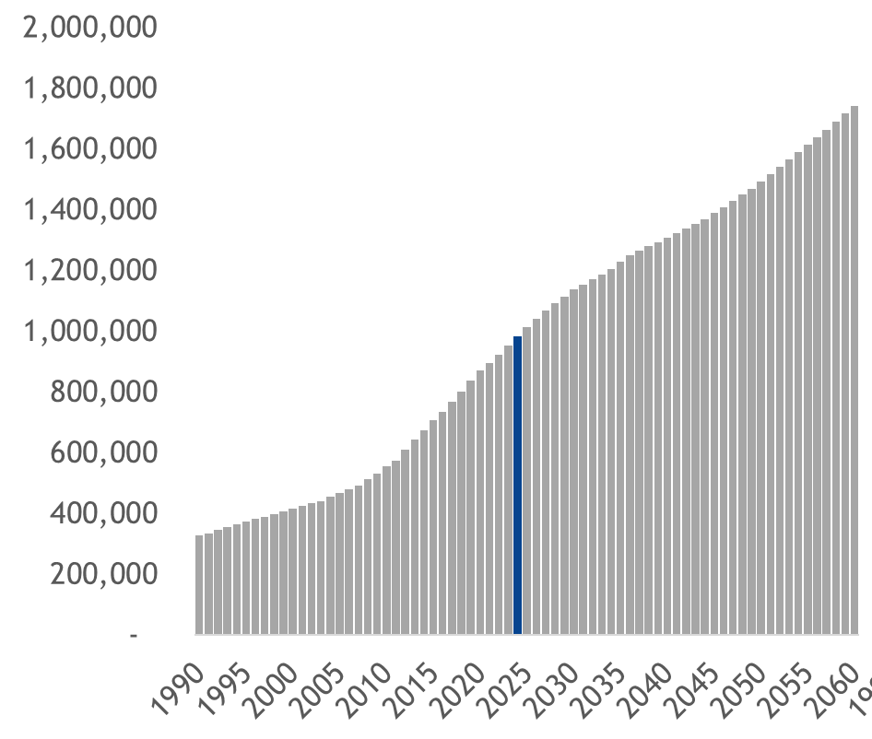
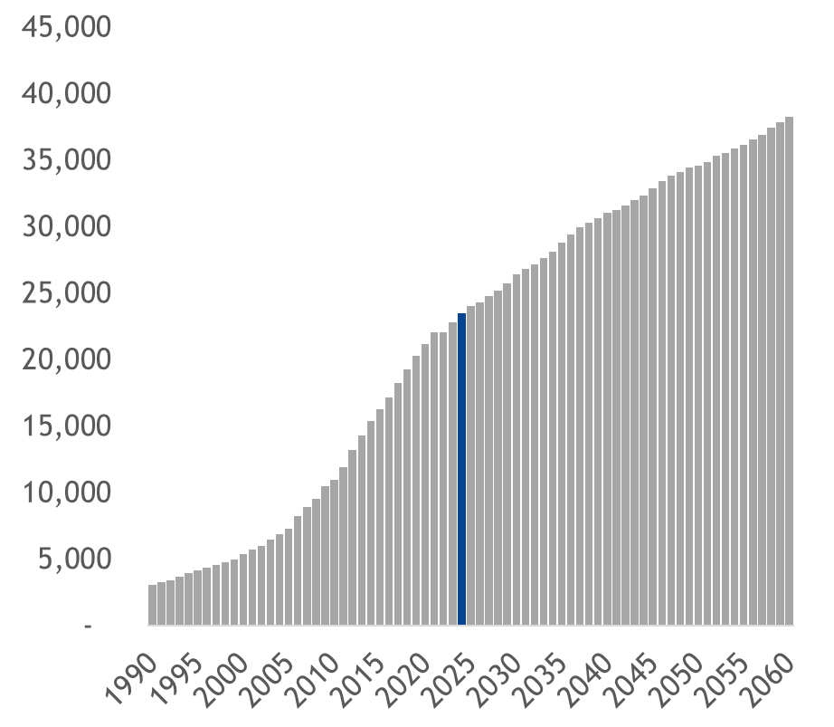
Growing older adult population
Largely reflects aging in place
Our population’s needs and wants will change with age
Colorado Population Aged 65+
NWCCOG + Routt
2024
2024
Source: State Demography Office, vintage 2024 estimates and projections. https://gis.dola.colorado.gov/AgeMap/

Slide 46
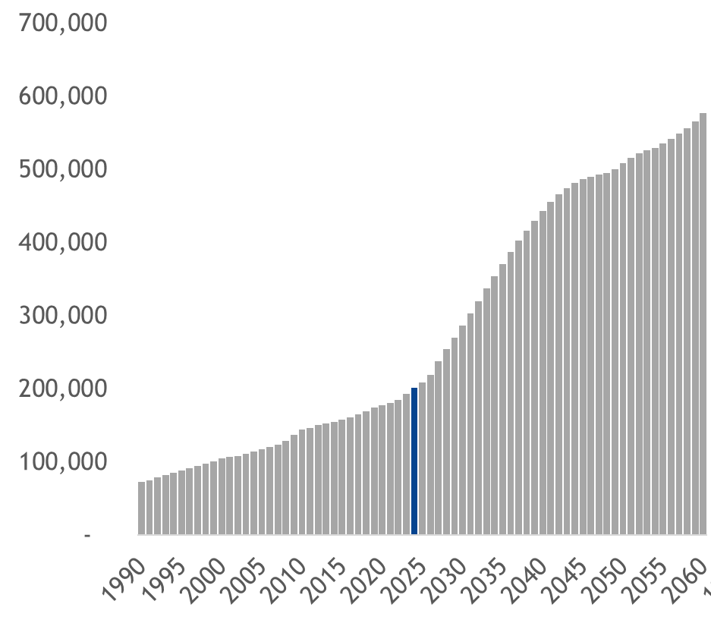

Significant growth expected among those 80+
Colorado Population Aged 80+
Those 80+ tend to experience greater health and assistance needs
NWCCOG + Routt
2024
2024
Source: State Demography Office, vintage 2024 estimates and projections. https://gis.dola.colorado.gov/AgeMap/

Slide 47


School Age Population
Rebound in births driven by net migration and easing of fertility decline
Colorado Population Aged 5 to 17
2024
NWCCOG + Routt
2024
Source: State Demography Office, vintage 2024 estimates and projections. https://gis.dola.colorado.gov/AgeMap/

Slide 48


Change in the school age population
CO
Change in the Population Aged 5 to 19, 2020 to 2030
Source: State Demography Office, vintage 2024 estimates and projections. https://gis.dola.colorado.gov/AgeMap/

Slide 49
Risks to the Forecast
National population growth - Immigration policy - Geopolitical events
Push/pull relative to other states, counties - Housing affordability - Competition for labor - Natural disasters, water availability
Economic activity - Net migration tied to the business cycle
Housing turnover: Will more Coloradan’s move out freeing up supply?
Remote/hybrid work: Less concentrated growth or return to work?
Automation & AI: Will AI impact labor markets?
Plan and invest with resiliency (many possible futures) in mind.

Slide 50

Relative housing affordability across the U.S.
Median Home Price, 2025Q2
Less than $150,000
$150,000 to $350,000
$350,000 to $550,000
$550,000 to $750,000
$750,000 to $1 million
$1 million and more
Source: National Association of Realtors calculations based on U.S. Census Bureau American Community Survey and Federal Housing Finance Agency data.
https://www.nar.realtor/research-and-statistics/housing-statistics/county-median-home-prices-and-monthly-mortgage-payment

Slide 51

Relative housing affordability across the U.S.
Percentage of Median Income Required to Purchase Median Priced Home, September 2025
Less than 25%
25% to 30%
30% to 40%
40% to 50%
50% to 60%
Greater than 60%
Source: Federal Reserve Bank of Atlanta Home Ownership Affordability Monitor.
https://www.atlantafed.org/research/data-and-tools/home-ownership-affordability-monito

Slide 52
Alternative Scenarios

Slide 53

Colorado What Ifs
CO
Total Colorado Population
Baseline Vintage 2024
Japan’s Fertility Rate
Low Net Migration
South Korea’s Fertility Rate
Zero Net Migration Scenario
Source: State Demography Office, vintage 2024 estimates and projections and alternative scenarios.

Slide 54
Low net migration scenario…
Annual Population Percent Change
…assumes U.S. growth rates instead of the baseline for Colorado
Projections
Colorado
U.S.
0.4%
0.0%
Source: State Demography Office, vintage 2024 estimates and projections; U.S. Congressional Budget Office, An Update to the Demographic Outlook, 2025 to 2055.

Slide 55

Colorado What Ifs: Those Most Likely to Work
CO
Colorado Population Aged 25 to 54
Baseline Vintage 2024
Japan’s Fertility Rate
South Korea’s Fertility Rate
Low Net Migration
Zero Net Migration Scenario
Source: State Demography Office, vintage 2024 estimates and projections and alternative scenarios.

Slide 56
Scenarios
CO
Baseline vintage 2024. The State Demography Office’s current projections as of October 2025.
Japan’s fertility rate. Colorado fertility decline resembling Japan’s (reduction to 1.2 births per woman over the next ~30 years). These rates are similar to Spain and Italy’s.
South Korea’s fertility rate. Colorado fertility decline resembling South Korea’s (reduction to about 0.7 births per woman over the next ~25 years). An unlikely scenario but helpful for a reference point.
Low net migration. Colorado’s total population growth rate matches the U.S. growth rate, as projected by the Congressional Budget Office.
Net zero migration. Everyone ages in place, no ins or outs. Very unlikely but helpful for a reference point.

Slide 57
Strategic Growth and Strategic Aging
How do we attract and retain talent?
How do we grow economies (or rethink growth) when our population or labor force shrinks? How do we strategically shrink?
How do we meet the needs and wants of our aging populations?
How can we better leverage the talents of our aging populations?
How might we better leverage technology?
There’s no better time than now to plan for what our changing demographics will bring.

Slide 58

Questions? Kate Watkins kate.m.watkins@state.co.us demography.dola.colorado.gov

