Slide 1


What is Northwest Colorado Council of Governments (NWCCOG)?
Who is Jon Stavney?
Regional Organization with Membership
Monthly Newsletter and Special Series: Seven Part Workforce Housing Series at https://www.nwccog.org/about/communications/e-news/
2023 Workforce Housing Report, and 2020 Older Adult Housing Needs Assessment
At https://www.nwccog.org/programs/member-services/reports/
How I got into this Conference:
I wrote a Newsletter: Devastation in CA, it could happen here.
Not a Housing wizard
Not an Insurance expert
Notes:
Mention Counties and Municipalities, some of the most sophisticated and longterm housing strategies.
I’m proud, from Aspen being a leader more that 30 years ago, people are retiring in workforce housing, to Summit County Comb Housing Authority going to the ballot for funding, to Vail Indeed, now replicated in Winter Park and Avon. Went to take photos for our 2023 Housing Report – took two entire rolls of film in Summit and Eagle counties

Slide 2

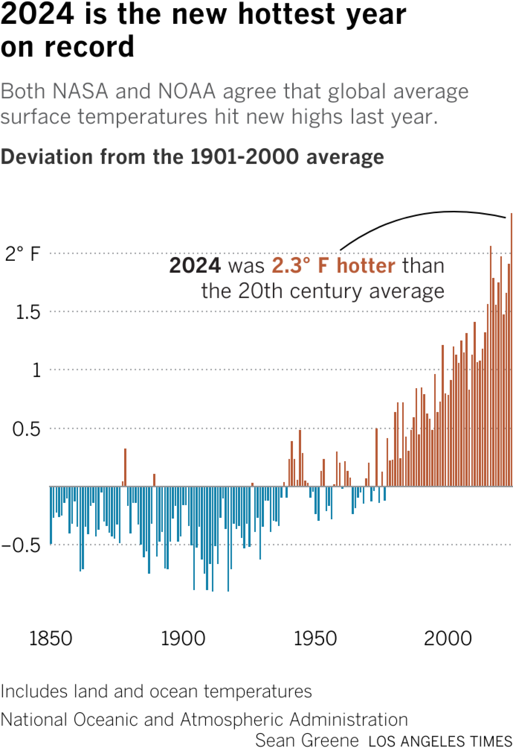
Cost Factors of
Homeownership
Beyond our Control
Climate Change in CO→ Fire & Ice & Rain & Flooding
  Past 10 years are hottest in 200 years of recordkeeping, 2024 World 1.55 C higher
  Drought Since 2000 is driest 22 yrs in at least 1,200 years in Colorado River Drainage/Plateu.
  Colorado’s 20 largest Wildfires all occurred since 2001
  Number of Wildfires in Colorado increased 2X – 3,400 (2020) to 7,300 (2023)
  Since 2017, 9 of 10 most costly wildfires occurred
  CO is 4th highest costs state in the nation for Hail events (400 in 2023)
  Hail event in Metro Denver 2017 alone cost $2.3B
Notes:
# wildfires – Colorado Sun 3/7/2025 Are wildfires becoming more frequent in Colorado?
Nine of 10 - Headwaters Economics
Drought, Scientific American, National Geo, Sports Illustrated and LA Times https://www.latimes.com/environment/story/2024-07-30/megadrought-ucla-research

Slide 3
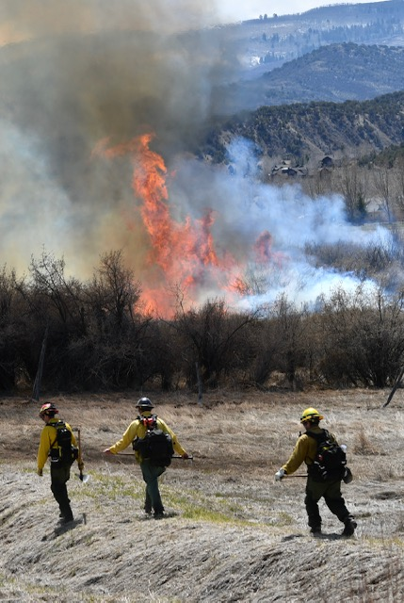
Other Cost Factors for Homeownership
Beyond their Control
Incidents occur: God, Nature… Not You.
Insurance Industry- Is it the Iron Bank?
  Policy Non-Renewals up 25% U.S.
  Colorado has 4th highest homeowner’s insurance in US
  $4,600/yr average (FL,TX,CA are higher)
  Jon’s $4,268(2022) to $11,878(2025) 178%!
  Colorado was UNPROFITABLE for Insurers 8 of past 11 years (NYT)… this is not good.
  HOA cost of coverage up 51% from 2019 to 2022.
April 20, 2021
For Our Future, Look to California…
Notes:
# wildfires – Colorado Sun 3/7/2025
Nine of 10 - Headwaters Economics

Slide 4
COST FACTORS within The Homeowners Purview
Consider Operational Costs.
Annually assess your Homeowners Insurance.
Can it cover increased value and local cost to build? DOI released report March 25th.
  Marshall Fire – 951 total loss homes.
  At rebuild cost $250/psf – 344 units underinsured
  so at this cost, 36% underinsured by average of $98,967.
  At $300psf, 523 or (55%) underinsured
  At $350psf, 639 or (67%)
Emergency Operations – Know that Local Capacity will be Exceeded. This is the Definition of Disaster. Don’t expect your house to be protected in a major incident. Create defensible spaces. Get inspected.
Prepare to be on your own 3-5 Days? Evacuation Plan? “Go-Bag Personal items and Document Box?”
Don’t Be a NIMBY. Make bumper stickers. Testify for tomorrow’s workers when affordable projects come up.

Slide 5
FACTORS within Community Purview
My Challenges to You
Enact wildland fire safety and fire hardened building standards – within reason
Move decisions from public process to administrative process. We have allowed spoiled, privileged wealthy people to block housing too long. Ezra Klein, Yoni Applebaum,
Go to your Voters!
Coordinate with Fire/Law on egress, water supply, planners and engineers understand fighter needs. Within Reason.
Don’t Fix in Anticipation: Town of Eagle’s “Parking Problem”
Earn a Good Reputation: assess your processes in detail. Stop fighting ADUs, encourage them
Multiple Strategies are needed to protect workers from market imbalance. Learn how to live with STRs, don’t “sin tax” every good idea that comes along
Notes:
Eagle County – serial passing of files system-went online. Set an internal goal for max days for Dev Review for within Zone District, max hours for building permit review and inspections. Err to speed—bureaucrats cost money, the private sector isn’t against you.
Deed Restrictions. Cooperate with other agencies to build housing in public lands

