Slide 1

Northwest Colorado Council of Governments
Regional Water Quality Management Plan
(“208 Plan”)
September 17, 2026

Slide 2
The goal of the 208 Plan is to maintain and enhance water quality in the NWCCOG Region. The plan includes:
NWCCOG Regional Water Quality Management
Policies and Implementation Measures
Attainment of Water Quality Standards and Use Classifications
Nonpoint Source Pollution Management and Control
Point Sources
Climate Change
Water Quality’s Relationship to the Region’s Economy and Environmental Justice

Slide 3
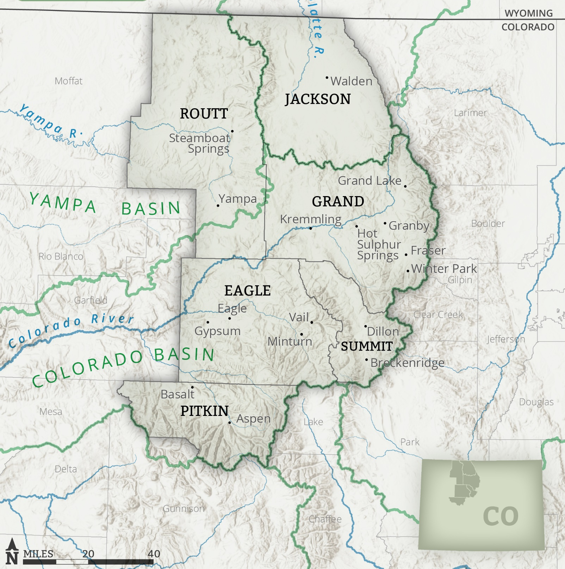
1. NWCCOG Regional Water Quality Management
NWCCOG is the Designated Planning Agency in 6 counties:
  Routt
  Jackson
  Grand
Counties and municipalities are management agencies
Domestic WWTFs are operating agencies
QQ provides legal, technical, and policy advice
Eagle
Summit
Pitkin

Slide 4
2. Policies and Implementation Measures
9 Policies: Used by NWCCOG to determine whether development applications are consistent with the 208 Plan
10 Implementation Measures: Support policies and used by NWCCOG, QQ, and local governments to guide water quality protection
Strategies, Projects, and Programs: provide detailed recommendations to protect and enhance water quality (see sections 4 and 5)
Policies
Implementation Measures
Strategies, Projects, and Programs to address pollution and water quality issues (sections 4 and 5)

Slide 5
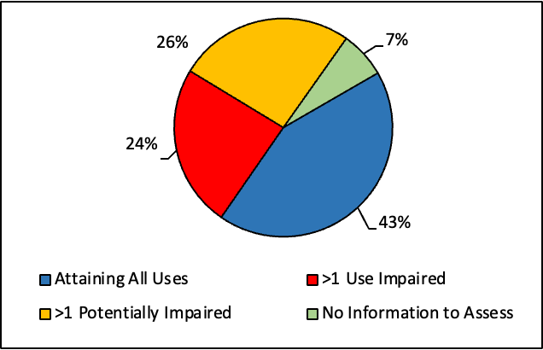
3. Attainment of State Water Quality Standards and Use Classifications
Attainment status of streams and rivers
How common are WQ Issues?
43% of streams meet water quality standards
24% of streams impaired for one or more uses
26% of streams potentially impaired (M&E List)

Slide 6
3 Continued. Which pollutants and where are they most common?
  Total arsenic
    Common throughout the Region
  Temperature
    Grand, Eagle, Routt, Summit, and Pitkin counties
  Dissolved oxygen
    Jackson county
  Dissolved iron
    Eagle and Jackson counties
  Dissolved zinc
    Summit, Eagle, Routt, and Grand counties

Slide 7
4. Nonpoint Source (NPS) Pollution Management and Control
Diffuse “nonpoint sources” of pollution such as runoff from urban development, agriculture, or abandoned mines are not regulated through a federal or state permit system, but are instead left to state, regional, and local governments to address, including through 208 planning.
In the NWCCOG Region, transmountain diversions have created substantial water quality problems because they remove significant amounts of water and alter the natural flow and timing in streams and rivers.

Slide 8
4 continued. Nonpoint Source (NPS) Pollution: TMDs setting the stage
TMDs remove about 21 percent of the water from the Blue River Watershed in Summit County.
TMDs remove about 40 percent of the water from the headwaters of the Roaring Fork Watershed in Pitkin County
TMDs remove about 60 percent of the water from the headwaters of the Colorado River in Grand County
The Plan also discusses future TMDs including:
  Windy Gap Firming Project
  Moffat Collection System
  Wild Horse Reservoir
  And others

Slide 9
4 continued. Nonpoint Source (NPS) Pollution: Issues in the Region
Several types of NPS pollution are directly related to development and land uses associated with increasing urbanization. Because the Region continues to grow, there is a need to prevent and reduce NPS pollution. NWCCOG members address these impacts through land use regulations. Primary sources include:
  Urban Development and Runoff
  Runoff from roadways
  Onsite wastewater treatment systems
Additional sources of NPS pollution
  Abandoned mine lands
  Agricultural grazing and irrigation
  Wildfire
  Silviculture
  Impacts from recreation
  In-basin water diversions
  Invasive species

Slide 10
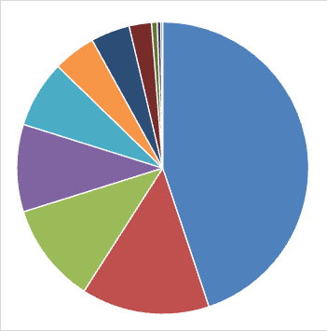
5. Point Sources the NWCCOG Region
Point source pollution originates from any confined and discrete discharge to a waterbody. This term does not include agricultural stormwater or irrigation return flows.
As of early 2026, there were approximately 500 permits in the NWCCOG Region. The five most common types of permits include:
Construction Stormwater (218)
Domestic Wastewater Treatment Facility (69)
Industrial Stormwater (54)
Sand and Gravel Industry (47)
Dewatering (36)

Slide 11
5 continued. Point Sources: Domestic WWTFs
Discharge permits issued by Water Quality Control Division include effluent limitations and other requirements that protect existing water quality, protect designated uses, and support attainment of applicable water quality standards. In the NWCCOG Region:
  21 domestic WWTFs discharge into waterbodies that attain all applicable water quality standards.
  35 domestic WWTFs discharge into waterbodies that are listed as impaired.
  10 domestic WWTFs discharge into waterbodies that may be impaired and appear on the M&E List

Slide 12
5 continued. Point Sources: Common Compliance Challenges at Domestic WWTFs
37 WWTFs discharge into segments that are impaired or potentially impaired for arsenic
17 WWTFs discharge into segments that are impaired for temperature
In 2030, the Water Quality Control Division plans to propose updated technology-based effluent limits for nutrients (total nitrogen and total phosphorus). These limits will account for technological and economic feasibility. Appropriate planning is required for WWTFs to meet these limits.

Slide 13
6. Climate Change
Predicted impacts of climate change in the NWCCOG Region include:
  increased air temperatures
  increased water temperatures
  decreased snowpack accumulation
  accelerated snowmelt runoff, and reduced peak flows
  increased water demand
  more frequent and prolonged drought
These factors are inextricably linked to one another and water quality.

Slide 14
7. Water Quality’s Relationship to the Region’s Economy and Environmental Justice
The economy of the NWCCOG Region is focused on recreation and tourism, with $5.5 million in visitor spending from 18 million visitors in 2024. The bulk of this economic activity is water-based, including snow sports, fishing, and boating. Water quality problems can quickly generate economic challenges.
Many communities in the NWCCOG Region are considered disadvantaged communities primarily because of the disparity between income levels and the cost of living. Residents spend a disproportionate amount of their income on housing.
The 208 Plan includes some recommendations to address housing affordability as it relates to water quality (e.g., wastewater utility rates, economic feasibility of WWTF upgrades).

Slide 15
How The State uses 208 Plans
Water Quality Control Division must consider consistency with 208 Plan for:
1. Colorado Discharge Permit System (“CDPS”) permits (under 402 of CWA). C.R.S. § 25-8-503(2); 5 C.C.R. 1002-61.8(1)(c).
2. As part of antidegradation review for facility/ utility plans, site location applications, and 401 certifications. 5 C.C.R. 1002-21.16(B)
  Division should give “substantial weight to any applicability determinations by local governments or land use planning authorities.” 5 C.C.R. 1002-31.8(3)(d)
Site location & Design Reviews (Reg. 22)
4. Grants or loans to publicly owned treatment works
Along with 208 Plan, the CWQCA also requires the Division to consider “long-range comprehensive plan for the area as it affects water quality” before approving of the site location and the design for new or enlarged domestic wastewater treatment works. C.R.S. § 25-8-702(2)(a).
WWTP applications | Interceptor sewer sites
Increase or decrease design capacity | Lift stations

Slide 16
  How Local Governments use the 208 Plan
Local regulations can address water quality impacts such as:
Runoff from urban development (construction and site planning)
Runoff from roadways
Increased pollutant concentrations, reduced flows, and habitat impacts attributed to transmountain diversions
Types of local regulations may include:
Municipal Watershed Protection Ordinances
Zoning Overlay Districts
Impervious surface limits
Waterbody setbacks or buffers
Regulations adopted pursuant to 1041 Powers
The NWCCOG Model Water Quality Protection Standards provides additional examples and explanation.
Notes:
Discuss that 1041 authority has been particularly important for addressing hydrologic modifications/ TMDs.
Because 1041 applies to home rule municipalities who are most likely to construct projects. Also good case law on denial of a project thanks to Eagle Co.
Ashley to summarize Grand County’s 1041 permit for the Henderson Mill Water Treatment Plant.

Slide 17
  How Local Governments use the 208 Plan, continued
Local governments should require consistency with the 208 Plan where development could cause water quality impacts.
  For example:
  Pitkin County 1041 standard for approval requires that “the Project is consistent with relevant provisions of applicable land use and water quality plans.”
  Pitkin County 1041 Application must include “description of provisions of the applicable regional water quality management plan that applies to the Project and assessment of whether the Project would comply with those provisions.”
  Routt County Unified Develop Code Section 3.1.L “Regional Water Quality Management Plan. All development shall demonstrate compliance with the Northwest Colorado Council of Governments’ (NWCCOG) Regional Water Quality Management Plan (“208 Plan”), the 208 Plan Policies and Implementation Actions, the NWCCOG Model Water Quality Protection Standards, and the Water Savings Guidance and Model Standards for the Colorado Headwaters (collectively “208 Plans and Policies”), which are incorporated herein by reference. The development’s compliance with the 208 Plans and Policies shall be reviewed by the NWCCOG Water Quality and Quantity program and the cost borne by the applicant.
  The Town of Dillon is working to develop a municipal watershed protection ordinance.
Notes:
NWCCOG may assist members in water quality review of development proposals.
Some codes have consistency with 208 Plan as a standard.
Others use NWCCOG as a referral agency.

Slide 18
  208 Plan Policies used for Consistency Reviews
Policy 1: Requires water quality protection and mitigation for development activities
Policy 2: No TMDs without prior approval of the local governments and conservancy districts affected by the project
Policy 3: Local Government land use regulations require consistency with 208 Plan
Policy 4: Developments shall use water smart land use and development practices.
Policy 5: Nonproliferation of wastewater treatment facilities (WWTF)
Policy 6: Private wastewater operation not allowed, unless no other practicable alternative
Policy 7: OWTS must comply with local regulations, not allowed unless connecting to or developing a consolidated system is not technically or legally practicable
Policy 8: Climate change must be considered in land use and water development permits
Policy 9: The use of pesticides, fertilizers, algaecides, hazardous substances, and road maintenance materials shall not degrade water quality
Adopted by QQ in November 2024, Adopted by NWCCOG in January 2025. Policies summarized as key words. Complete policies here.

Slide 19
  Additional Questions, Discussion, or Outreach Recommendations
Please contact me to discuss the 208 Plan, water quality issues or other topics. I enjoy learning from and supporting members to maintain and enhance water quality in the NWCCOG Region.
                Ashley Bembenek
                NWCCOG 208 Plan Administrator
                abembenek@nwccog.org
                (970) 251-0029

Slide 20
  Recommended Action
QQ recommends that NWCCOG take the following action:
    I MOVE THAT THE NWCCOG COUNCIL ADOPT THE REGIONAL WATER QUALITY MANAGEMENT PLAN AS NOTICED FOR THIS HEARING, along with any minor revisions that may be requested by the Water Quality Control Division and the US Environmental Protection Agency.

