Slide 1

AI Interactive Workshop
Building Regional Strategy LIVE
Notes:
info-mtrl@vetetnous.com

Slide 2
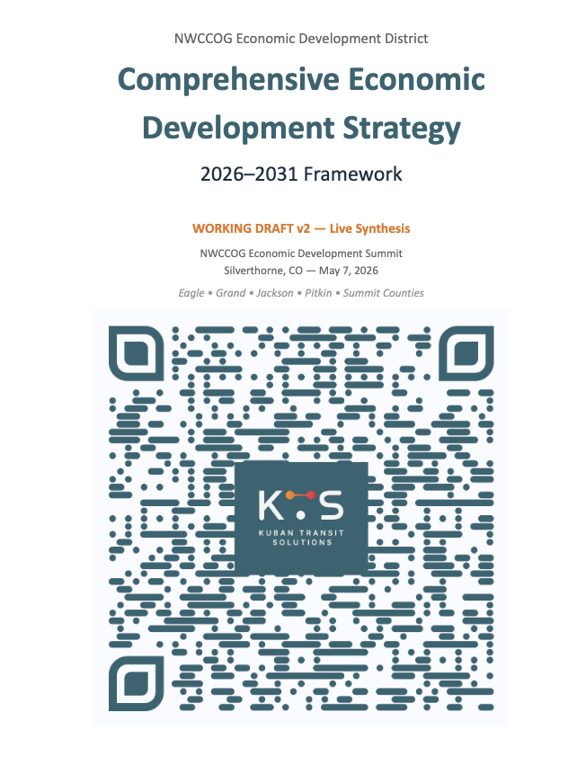
CEDS drafted this morning!
The impossible is now possible.

Slide 3


Slide 4

Whiteboard image with sticky notes

Slide 5

Whiteboard image with sticky notes

Slide 6
Three irreplaceable skills.
1. Clarity of Ideas |  | 2. Quality of Decisions |  | 3. Ability to Make it Happen

Slide 7

1. Clarity of Ideas
AI is an educator

Slide 8

One simple prompt:
Start by summarizing the NWCCOG CEDS 2021 strategy and the 4 pillars. Then discuss the latest big risks that are being discussed in NWCCOG and across the board of similar communities. This video then must educate us on how other peer regions are adopting economic strategies to adapt to these big risks, and evolving their strategies since COVID. Walk us through clear case studies of similar regions, approaches they've taken, and how that compares to the NWCCOG region itself. Educate us with the purpose of surfacing threats and solutions and shifts that other non-colorado places are seeing and implementing, and put it into the colorado specific context.

Slide 9


Slide 10
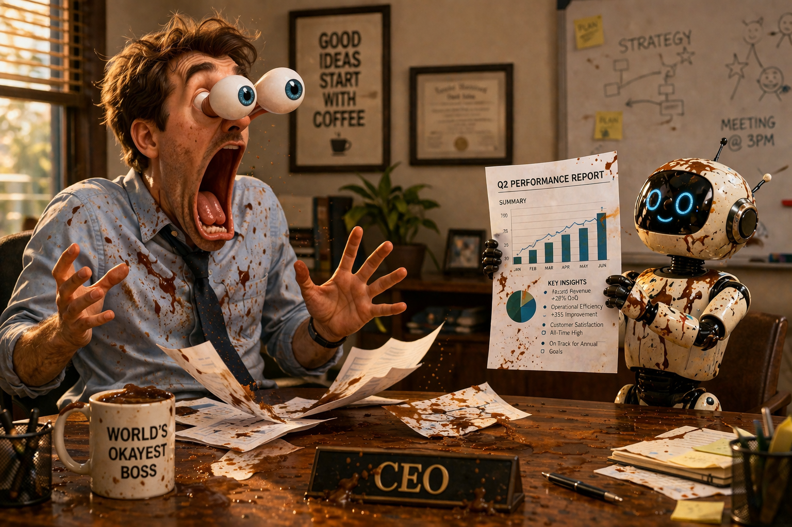
Whiteboard image with sticky notes

Slide 11

2. Quality of Decisions
AI is a thought-partner

Slide 12


Slide 13


Slide 14

3. Ability to Make it Happen
AI is an executor

Slide 15


Slide 16
AI makes you faster. Not better.

Slide 17
AI makes you faster. Not better.
YOU make you better.

Slide 18
Be irreplacable.
1. Clarity of Ideas |  | 2. Quality of Decisions |  | 3. Ability to Make it Happen

