Slide 1
Northwest Colorado Council of Governments
Audit Exit Presentation
Year ended December 31, 2025

Slide 2
Agenda
Audit scope and process
Audit opinions and communications
Financial statement highlights
Engagement finalization
Industry insights and emerging issues
Thought leadership and upcoming webinars

Slide 3




Audit Scope
Report on the organization’s financial statements
Internal control/
management letter
Required governance communications letter
Report on internal control over compliance with major program requirements (federal awards)
Notes:
Note we also prepared the 2027 indirect cost allocation plan, but provide no assurance over this document.

Slide 4




AUDIT OPINIONS
AUDIT RESULTS
Financial statement
No material weaknesses noted.
Significant deficiency
2025-001 Internal Controls over Financial Reporting
2025-002 Reporting of Grant Carry-Over Revenue and Expenditures
Federal awards
No material weaknesses or significant deficiencies noted.
Financial statement
Financial statement audit opinion is unmodified.
Federal awards
Federal awards audit
opinion is unmodified.

Slide 5

Management Letter Recommendations
Cash reconciliation
Journal Entry Review
Capital Asset Disposals

Slide 6
Governance Communications
Overall
No significant changes to accounting policies or new policies adopted
Difficulties
None
Estimates
Allowance for loan loss (NLF)
Other
Uncorrected misstatements
Corrected misstatements
Notes:
Corrected misstatements – note that our SOW calls out assistance with certain full to modified accrual entries

Slide 7
Total Revenue and Expenses

Slide 8
GASB Standards

Slide 9



GASB 103 Financial
Reporting Module
CLA can help by assisting with or evaluating financial statement disclosure updates
Text
Effective date
December 31, 2026
Impacts financial statement presentation
Updated disclosure guidance for:
MD&A consistency
Clearer definition of unusual or infrequent items
Presentation of proprietary fund statements
Major component unit information
Budgetary comparison information

Slide 10



GASB 104 – Disclosure of Certain Capital Assets
Text
Text
Effective date
June 30, 2026
CLA can help by
assisting with or evaluating financial statement disclosure updates
Will clarify how capital assets are disclosed in financials:
Capital assets held for sale and related pledged debt
Leased assets
Subscription assets
Right to Use PPP assets
Other intangible assets
©2026 CliftonLarsonAllen LLP
Notes:
103 & 104 Combined Impact
Practical Consideration: All entities with capital assets. May require some financial statement disclosure changes if not already segregated.
Impact and Procedures:
$3,000 if financial statement prepared by CLA;
$1,000 if prepare by client;

Slide 11

GASB Implementation Guide 2025-1
Text
Text
Effective date
June 30, 2026, except for Question 4.16, which is effective immediately
CLA can help by
assisting with or evaluating accounting and financial statement presentation and disclosure updates
Will provide explanatory guidance in the following areas:
Cash flow reporting
Subsidies
Lease Term and Modifications
Accounting Changes and Error Corrections
©2026 CliftonLarsonAllen LLP
Notes:
IG 2025-1
Practical Consideration: Primarily clarifies previously issued GASBs in the form of Q/A. Limited impact, but clients with component units should pay attention to Q 4.16, which may require them to coordinate with their component units. Q 4.16 effectively prohibits component units from implementing GASB 103 at a later date than the primary government.
Impact and Procedures:
Included in GASB 103 impact

Slide 12

GASB 105 Subsequent Events
CLA can help by assisting with or evaluating financial statement disclosure updates
Text
Text
Effective date
June 30, 2027
Clarifies subsequent event definition and establishes specific note disclosure requirements:
Subsequent event time frame
Recognized vs nonrecognized events
Disclosure of date through which subsequent events were evaluated
Specific disclosure requirements for nonrecognized events
©2026 CliftonLarsonAllen LLP
Notes:
105
Practical Application: Applies to all state and local governments.
Procedures and Impact:
2 hours/$1,000 if statement prepared by CLA; 1 hours/$500 for PBC financial statements
Evaluate client’s determination of the date through which subsequent events have been evaluated
Evaluate client’s determination of recognized and nonrecognized subsequent events
Evaluate/propose footnote modifications

Slide 13

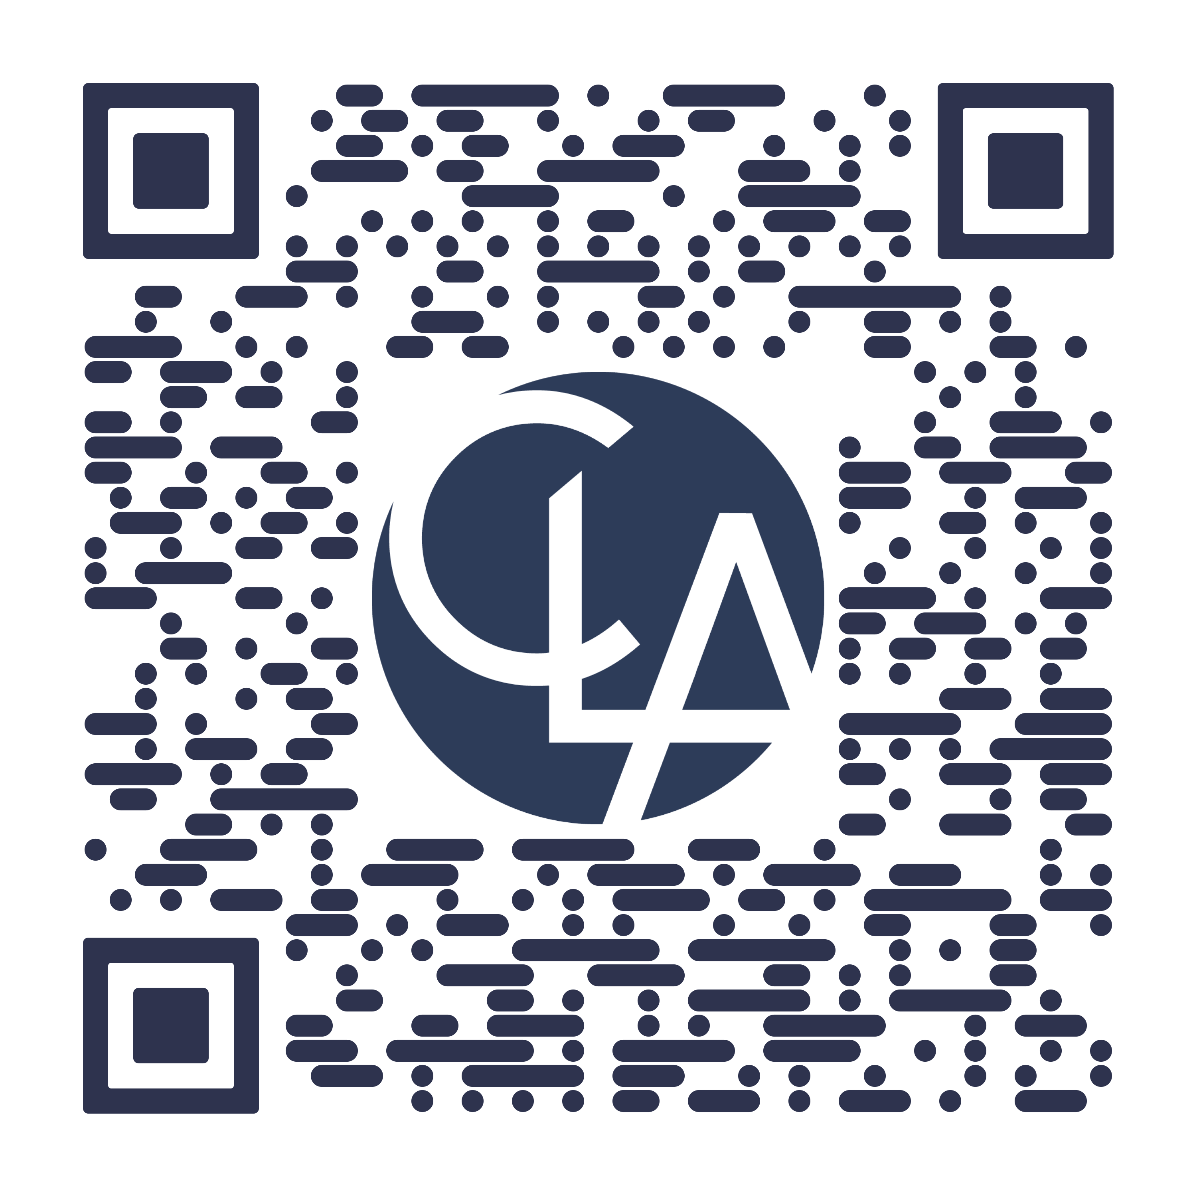
Insights
Stay informed and
prepare for what’s next.

Slide 14
CLA Cybersecurity Services Overview
CLA’s cybersecurity team provides a wide range of technical testing, assessment, and advisory services.
Technical Testing
Governance, Risk, and Compliance
Specialty Assessments
CLA provides technical testing services to our clients to assess the security of their network, infrastructure, cloud environment, applications, and physical facilities.
CLA conducts compliance, regulatory, and risk-based controls assessments. Our team has experience across a wide range of industries and control frameworks to utilize during an assessment.
CLA provides strategic security consulting services to our clients, including supporting M&A activities, building security analytics dashboards, and performing cyber readiness assessments.
Service overview
Penetration testing
Vulnerability assessments
Application security review
Physical security assessments
Breach/incident response
Social engineering testing
Cloud security assessments
Security maturity assessment
Control framework assessment
Governance documentation creation
Compliance attestation or validation
M&A tech/security assessments
Incident response tabletops
Ransomware readiness testing
Security analytics and board reporting
Cyber readiness assessment
CLA services
Size of the network
Depth of testing
Complexity of the environment
Selected framework
Number of documents and stakeholders
Size and complexity of the environment
Scoping considerations

Slide 15
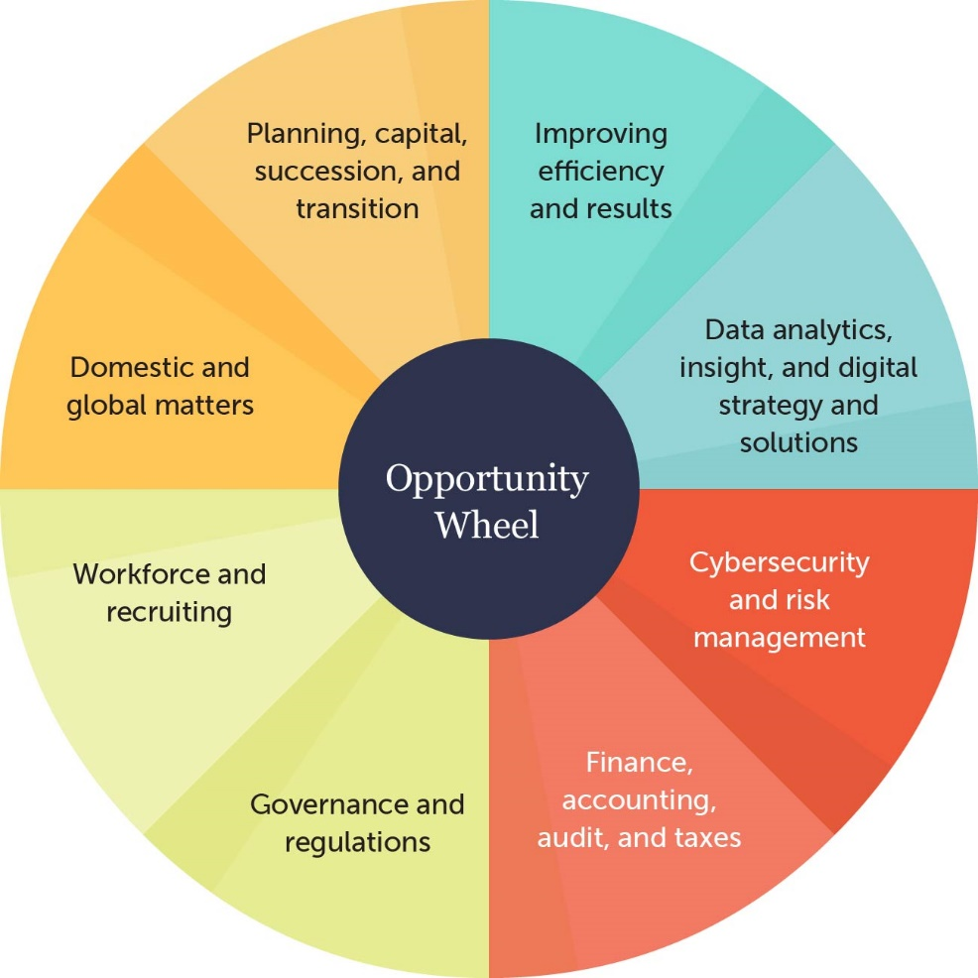
Find support at every turn
Benefit from guidance on all aspects of your business.

Slide 16

Questions and Feedback
We appreciate the opportunity to serve you
and welcome any feedback relative to our performance and to the engagement.

Slide 17
Sam Hellwege, CPA
Principal
303-439-6082
Sam.Hellwege@CLAconnect.com
Alli Ventre, CPA, CISA
Director
303-265-7894
alli.ventre@CLAconnect.com

